Slide 1

Internationally accepted
rights of child
Presented By,
Mr. Nirmal Raj E V
Assistant Professor
Department of Child Health Nursing, SNC

Slide 2
HAQ: Centre for Child Rights works through:
Children and Governance
Budget Tracking of Government Expenditure & Executive Decisions (Budget for Children)
Performance Monitoring – Status of India’s Children Reports
Monitoring & Analyzing Parliament Questions (Says a Child…)
Child Protection
Legal Support to Children
Counselling Support to Children
Monitoring Judicial Process
Training and Capacity Building for police, judicial officers & NGOs
Monitoring State Accountability

Slide 3
What is Budget for Children (BfC)?
Budget for children is not a separate budget.
It is an attempt to disaggregate from all government allocations, those made specifically for children.

Slide 4
WHO IS A CHILD?
ALL PERSONS UPTO THE AGE OF EIGHTEEN YEARS

Slide 5
BfC At Two Levels:
Union and State
Analysis at both levels is necessary to comprehensively gauge the Governments’ commitment to Child Rights
Policy making, planning and allocation of funds – at both levels
Flow of Funds – From Union to State
Tracking the budget flow—where does it go and how?

Slide 6
Questions Before Us
What were the resources being invested by the government for children?
What proportion of the allocation was actually spent?
How did it match the outcomes in terms of indicators for children? More importantly, are the resources being allocated and spent “adequate”?
What is the Performance of programmes at the implementation level vis-a-vis allocation?
For HAQ, budget analysis fitted perfectly into the work of watching over and monitoring state performance in all matters pertaining to the realisation of Child Rights.

Slide 7
Challenges before us at that time
Developing a methodology
Gaining acceptance for the concept
Using the findings

Slide 8
Budget for Children
A Study by HAQ: Centre For Child Rights
First phase: HAQ’s work on the Budget for Children (BfC) established the need for such analysis and set the initial direction for developing a methodology to do this more effectively

Slide 9
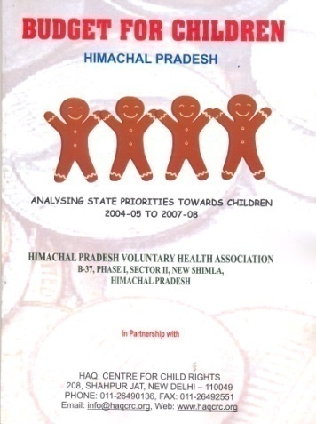
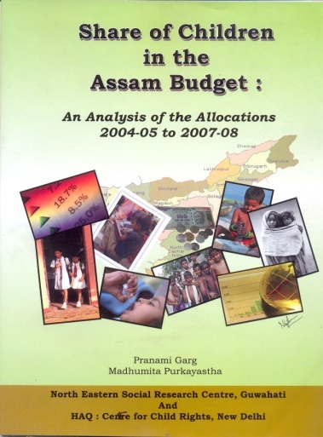
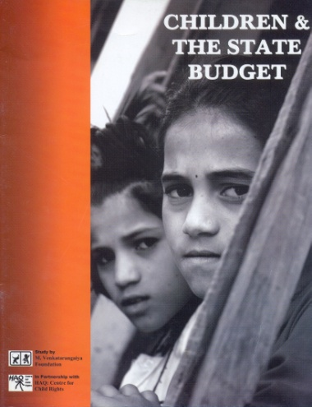
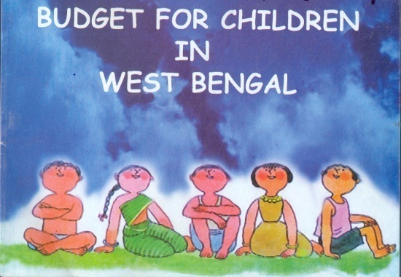
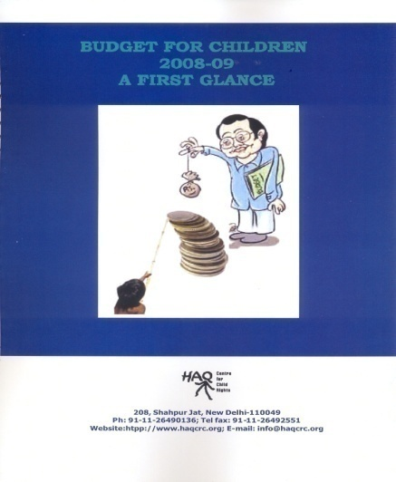
Since 2002…
Began BfC in the States- 6 states now
Union Budget through out….

Slide 10
For Our Analysis, We Refer To….
Government’s budget documents (Finance Bill as well as Detailed Demands for Grants)
Other government documents
  Reports of the Comptroller and Auditor General
  Appropriation Accounts (Report of the Accountant General) AND Performance Budget of Departments and Ministries
  Annual Reports
  Economic Survey
  Parliamentary Standing Committee Reports
Reports and studies that reflect on the implementation of programmes and the situation of children

Slide 11
Share of Children in the Budget: A Quick Peek
Of every Rs 100 allocated to the Union Budget, an average of Rs 4.45 has been allocated to children during 2004-05 to 2008-09. Of every Rs 100 within the budget for children, Rs 49.05 has been provided for education, Rs 17.14 for health, Rs 16.54 for development and 1.08 paise for protection.

Slide 12
What is Allocated and What is Finally Spent on Children?
The difference in the budget estimates (BE) and revised estimates RE) shows how the budget changes throughout the financial year
The actual expenditure (AE) is the sum that is finally spent—a reflection of the implementation of the programmes
On an average, 2.74 per cent of allocations remained unutilised… Governments almost always report only on allocations

Slide 13
Share of Children in Different Sectors in Union Budgets
Of all sectors, governments seem to be thinking only of education. Health and Protection always had the lowest share of budget and maximum under-spending
Sector-wise allocation for Children as percentage of Union Budget
4.0
3.5
3.0
2.5
Per cent
2.0
1.5
1.0
0.5
0.0
2000-01
2001-02
2002-03
2003-04
2004-05
2005-06
2006-07
2007-08
2008-09
2009-10
Health
Development
Education
Protection

Slide 14
No ‘stimulus’ for children in 2009-10
Despite a huge stimulus budget in 2009-10, children—44 per cent of the population--got only 4.21 per cent, the least in four years.
There was a decline in all sector-wise shares, barring health.
Worse, the fiscal deficit doubled, leaving a `generational burden’
Sector-wise BfC shares as Percentage of Union Budget
 | 2008-09 | 2009-10
Development | 0.87 | 0.69
Health | 0.24 | 0.46
Protection, | 0.06 | 0.02
Education | 3.84 | 3.03
Total share for children | 5.31 | 4.21
Source: Expenditure Budgets, Vol II, 2008-09 & 2009-10

Slide 15
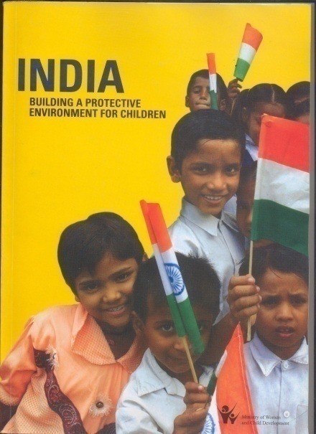
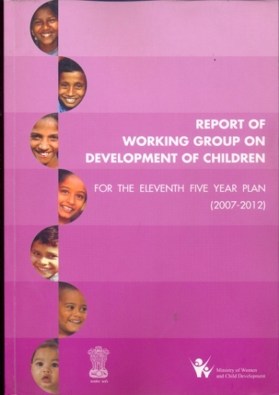
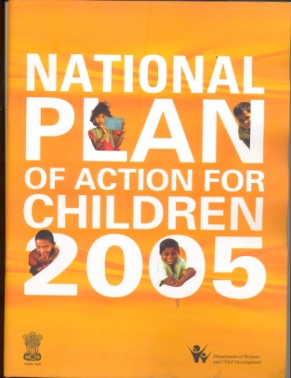
Some Success:
Government of India has adopted Child Budget as its mandate
On October 26, 2005 in a meeting of State Secretaries organised by the Ministry of Women and Child Development, the government promised that it would henceforth undertake Child Budgeting
Inclusion in various other important policy documents

Slide 16
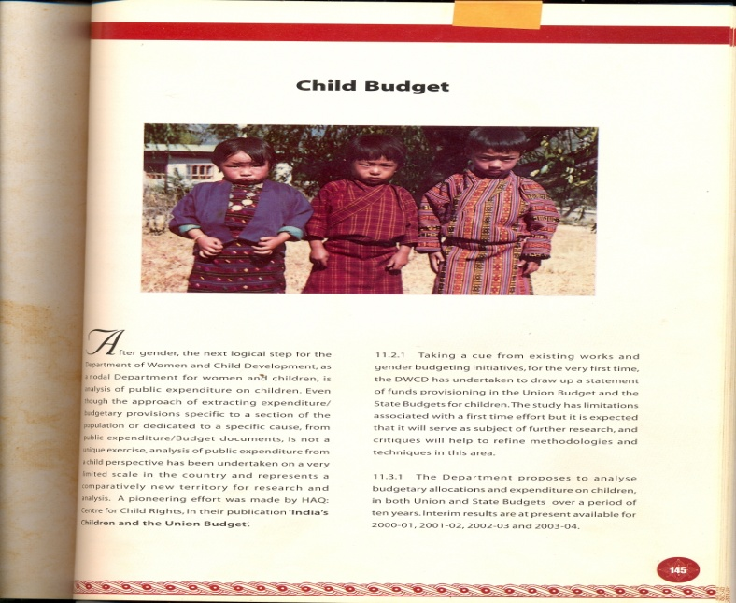
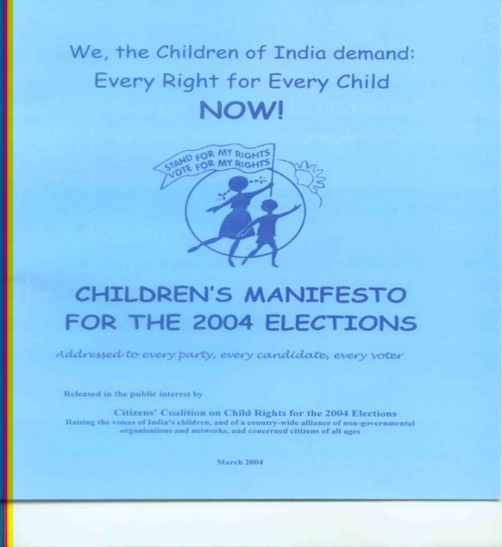
Advocating for BfC - At the National Level
Presentation and discussions with the government since 2001. (First recognition was MWCD’s chapter in its Annual Report in 2003 (since then almost every year)
To file a Petition with the National Commission for Women to argue for inclusion of 0-6 in Right to Education Amendment
Developing a Children’s Manifesto
File legal petitions
Questions in Parliament and Legislative Assemblies
Strengthening arguments of various campaigns
Arguing for better allocations for Protection Sector

Slide 17
But final recognition only when Finance Minister accepts BfC
“We will score another 'first' this year. A statement on child related schemes is included in the budget documents…
P. Chidambaram, Budget 2008-2009
“Recognizing that children under 18 constitute a significant percentage of the Indian population, the Government is committed to their welfare and development. This statement reflects budget provisions of schemes that are meant substantially for the welfare of children. These provisions indicate educational outlays, provisions for the girl child, health, provisions for Child protection, etc.”
Expenditure Budget, Vol II, Budget 2008-2009

Slide 18
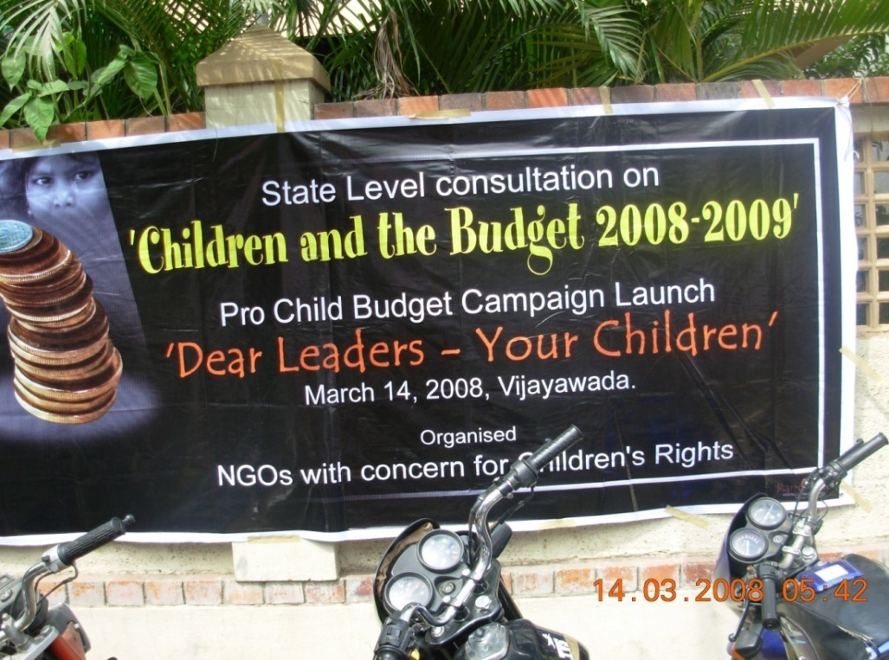
State Level
Advocacy with local self governments, panchayats (linking BfC with communities)
Setting up alliances
Starting a campaign
Linking up with national campaigns on child labour
Tracking the flow

Slide 19
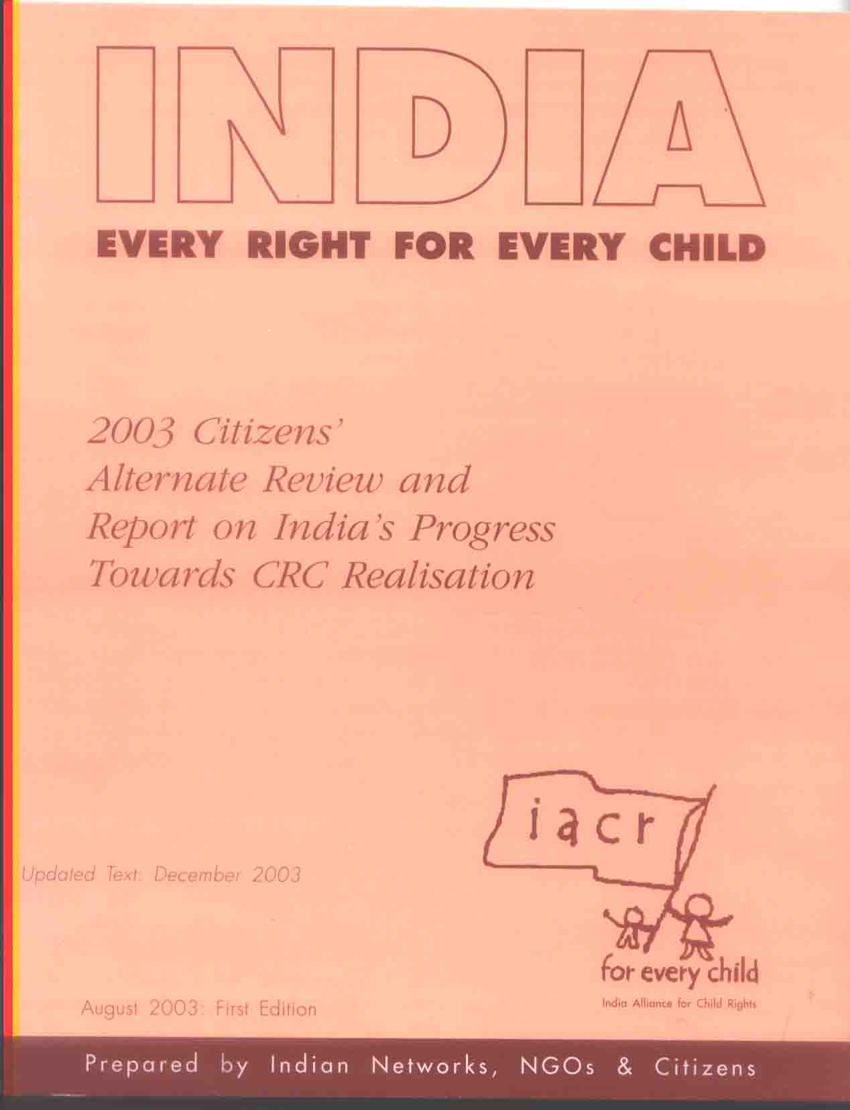
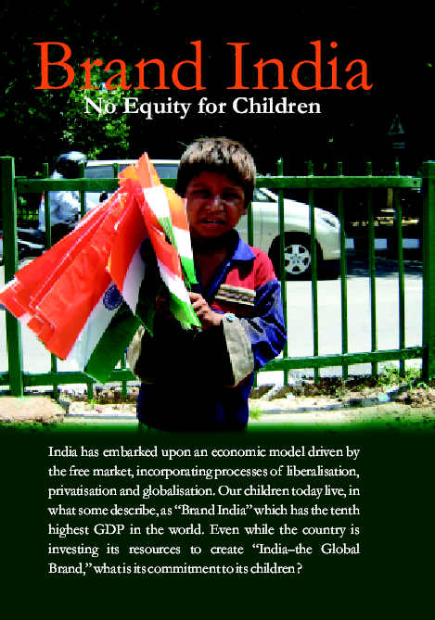
Advocacy at International Level
For alternate report to the UNCRC Committee and recommendations in the concluding observations
Submission at the General Day of Discussion on Right to Adequate Resources

Slide 20
HAQ Works On…
Financial accountability, which is about allocation, disbursement and utilisation of funds (through Budget for Children (BfC) analysis)
Performance accountability, which is about demonstrating and accounting for performance through implementation of initiatives in the light of agreed indicators (through Status of Children reports and other research)
Political or democratic accountability involves policy making, political process and elections (through its Parliament Watch and other policy advocacy work)
Judicial Accountability involves responsiveness and performance of the judicial process (Through direct legal intervention as well as action research, particularly Juvenile Justice)

Slide 21
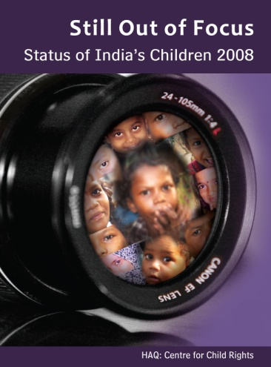
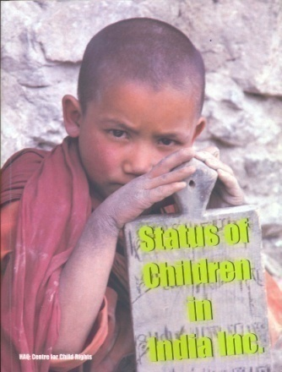
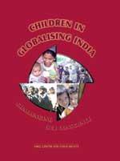
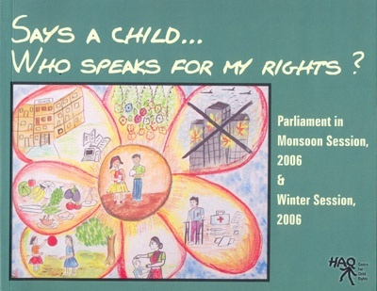
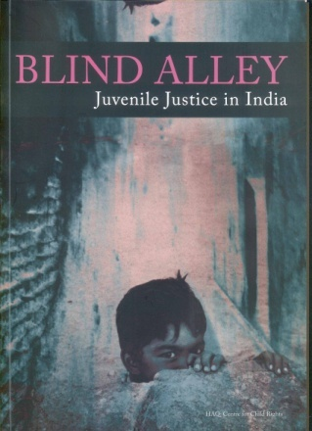
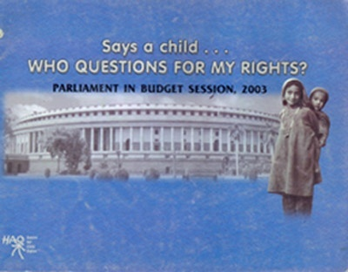
It is each of them separately and also together (complimenting each other) forms the basis of advocacy…
BfC is only one dish in the menu and not the whole meal

Slide 22
Case Example:
Enhanced Budget for Protection and New Comprehensive Programme
HAQ’s BfC analysis, since its very first time, has been pointing out that child protection was inadequately resourced and received the least allocation. Every BfC document that HAQ put out pointed to this
The 2nd status report highlighted the need for a protective environment and programming and investing on it
The Juvenile Justice work pointed to the urgent need for intervention in protecting children
Concluding observations have made comments on both need for more resources and greater protection
HAQ’s status report and BfC work was picked up by the ministry to argue for a new and comprehensive programme, The Integrated Child Protection Scheme approved by the Planning Commission in 2009

Slide 23
“Provision of Child Protection will be a key intervention in the Eleventh Plan. ‘Child Protection’ refers to protection from violence, exploitation, abuse, and neglect...Thus the Eleventh Plan intervention for Child Protection takes both a preventive and a protective approach. During the Eleventh Plan, the Ministry of WCD will launch an Integrated Child Protection Scheme.”

Slide 24
Challenges That Remain
Accessing and Unpacking the Data
Selection of programmes and schemes for children remains a huge challenge, especially when there are several of them that address both women and children
Direct transfer of funds from centre to autonomous bodies—no reflection in state budget documents
Abdication of state responsibility—Privatisation of services
Good things happen when there are good people...and then they sometimes stop..
Going beyond UNCRC to other treaty bodies

Slide 25
States have adopted the rhetoric...this makes our task more difficult
The methodology is still evolving. Hence, even if they draw upon each other, researchers tend to customise the methodology to their needs leading to different results
The most difficult challenge remains the acknowledgment and acceptance of citizenship of children and the relevance of focussing on children in the larger governance and human rights discourse

Slide 26
India’s Response to Crisis
India has 28 states and 604 districts
There is always an emergency or one in the making somewhere in the country….
  21 out of 28 states of India face internal armed conflicts in the form of ethnic conflict, Naxalism, separatist movements etc.
  Practically the entire north-eastern region, comprising eight states and part of one state, have suffered from poor development and ethnic as well as border conflicts since before independence and fall into a “special category”.
  Twelve of the 17 states studied for the India State Hunger Report fall in the “alarming hunger” category, and one--Madhya Pradesh – in the “extremely alarming” category.
  The drought in 2009 was the worst since the 1918 drought and the post-independence one of 1972. Some 259 districts were severely affected. Extreme cold too killed several in the winter of 2009.
  The same year, floods killed 250 people and destroyed over 200,000 homes, leaving 1.5 million homeless.
  Then there are those that make international news…
  Tsunami in 2004; Gujarat Earthquake in 2001; Supercylone in Orissa; Kargil war in 1999; Kashmir earthquake in 2004. The 2001 Gujarat earthquake killed more than 400 children in India, while the Kashmir one killed over 17,000 children in India and Pakistan.

Slide 27
Initiatives by the government
The expenditure on restoration of infrastructure and other capital assets (except immediate relief operations and restoring connectivity with the affected areas and people) are required to be met from the Plan funds of the States.
To ensure ready availability of funds, a Calamity Relief Fund (CRF) of a pre-determined amount exists in each State.
The Disaster Management Act, 2005 provided for a National Disaster Response Fund (NDRF) and National Disaster Mitigation Fund (NDMF) by the Central Government and for setting up the National Disaster Institute for Management (NIDM)
To respond to states affected by left-wing extremism, there is a Special Scheme for Special Infrastructure now applicable to 8 States And 13 Districts
NONE OF THESE ARE SPECIFIC TO CHILDREN

Slide 28
Then there are ‘Smaller’ State-level Disasters
The aerial spraying of Endosulfan started in 1978 over the cashew plantations in Kasaragod district Kerala led to health problems. The State Government set up the Victims Relief and Remediation Cell in 2007 as the outcome of a consultative workshop in 2005, with an initial allocation of Rs 50 Lakh for the R&R measures

Slide 29
Response to global crisis…
The highlights of the fiscal stimulus package
Huge Expenditure– highest post-independence budget of over Rs 10208 billion
4 per cent across-the-board VAT rate cut
Several incentives to increase exports, stimulate property and construction, protect and help small business and build infrastructure
Huge jump in budget for rural infrastructure and social security schemes such as Pradhan Mantri Gram Sadak Yojana (Prime Minister’s Village Road Construction Scheme), Jawaharlal Nehru National Urban Renewal Mission, National Rural Employment Guarantee Scheme, Indira Awas Yojana (Indira Gandhi Housing Scheme), Accelerated Irrigation Benefit Programme, and National Social Assistance Programme.

Slide 30
What it meant for children…
None of the stimulus packages made any financial provision to develop areas that would impact children, through programmes such as Education for All (Sarva Shiksha Abhiyan), Integrated Child Development Services catering to children of 0-6 years, the National Child Labour Project and the Integrated Child Protection Scheme, among others.
SO….
These schemes still have huge deficit in terms of infrastructural facilities such as class rooms, child care centres, Health sub-centres, teachers and general staff, homes and courts for children, addressing which could have helped children affected by contracting family income.
Thus, the government chose not to use this window of opportunity of providing additional funds in the interim budget to create public infrastructure benefiting children.

Slide 31
Clearly….
No separate and targeted response for children during crisis by government
This is a lost opportunity

Slide 32
PICO
Author- Lansford JE, Deater-Deckard K, Bornstein MH, Putnick DL, Bradley RH.
Title-Attitudes Justifying Domestic Violence Predict Endorsement of Corporal Punishment and Physical and Psychological Aggression towards Children: A Study in 25 Low- and Middle-Income Countries.
Web- http://www.ncbi.nlm.nih.gov/pubmed/24412139

Slide 33
PROBLEM/POPULATION | INTERVENTION | COMPARISON | OUTCOME
Attitudes Justifying Domestic Violence Predict Endorsement of Corporal Punishment and Physical and Psychological Aggression towards Children Population the ages of 2 and 14 years | Data were drawn from the Multiple Indicator Cluster Survey, a nationally representative and internationally comparable household survey developed by the United Nations Children's Fund. | The Rights of the Child has prompted countries to protect children from abuse and exploitation. Exposure to domestic violence and corporal punishment are risk factors in children's development | Pediatricians can address parents' psychological aggression and physical violence toward children by discussing parents' attitudes and behaviors within a framework that incorporates social norms regarding the acceptability of domestic violence and corporal punishment.

Slide 34
From the Centre for Evidence-Based Medicine, Oxford
PROBLEM | CONCLUSION | RESULT | LEVEL OF EVIDENCE
Domestic Violence | Discussing parents' attitudes and behaviours within a framework that incorporates social norms regarding the acceptability of domestic violence and corporal punishment | Mothers who believed that husbands were justified in hitting their wives were more likely to believe that corporal punishment is necessary to rear children. Mothers who believed that husbands were justified in hitting their wives and that corporal punishment is necessary to rear children were more likely to report that their child had experienced psychological aggression and physical violence. Countrywide norms regarding the acceptability of husbands hitting wives and advisability of corporal punishment moderated the links between mothers' attitudes and their behaviors toward children. | 3b(LEVEL 3)

Slide 35
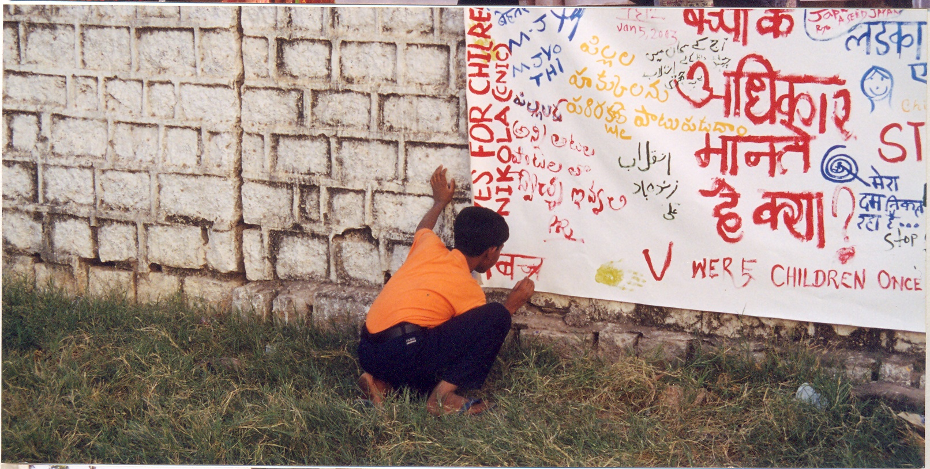
THANK YOU

