Slide 1


National policy and legislation in relation to child health and welfare
Presented By,
Mr. Rajesh P
Assistant Professor
Department of Child Health Nursing, SNC

Slide 2
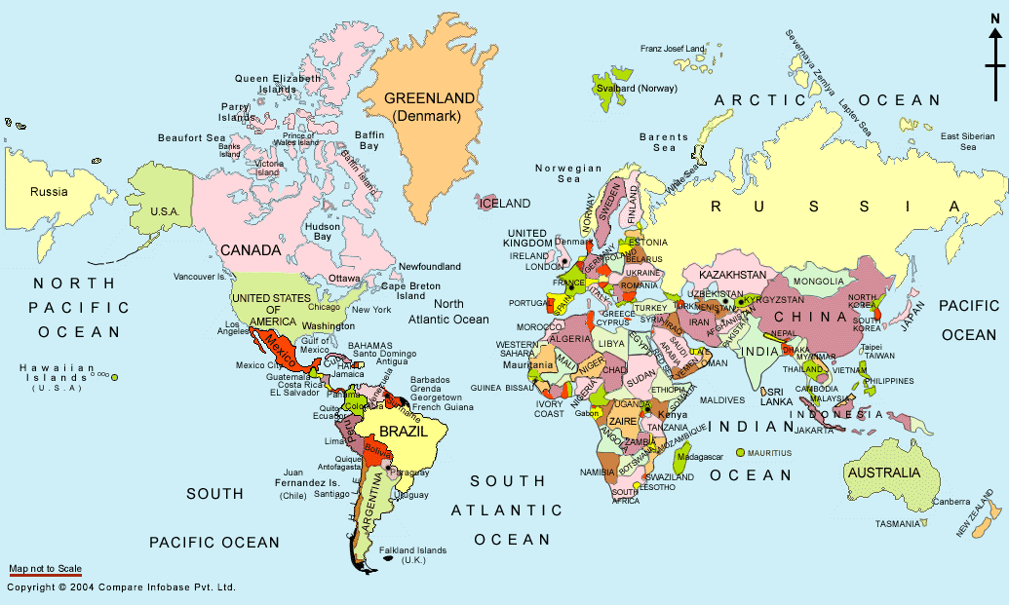
World Political Map

Slide 3
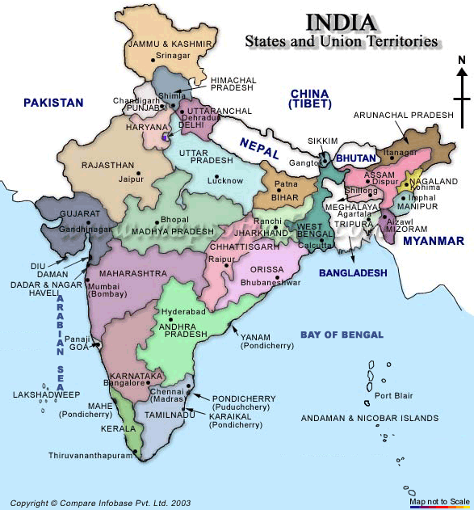

Slide 4
Demographics
Overall Population-1,027,015,247 (1.027 Billion)
0-6 Population - 158 million, about 15.8% of total population ( ranging 11.5% - 20.25% in States)
593 Districts (.64 million villages)
1.23 million habitation
0-4 population 117 million
0-5 population 130 million
0-6 population 154 million
11-14 population 80.19 million
6-11 population 131.7 million

Slide 5
Child in India
Profile of the Child in India
Child population (0 - 6 years) is 158 million.
One third of the babies are born low birth weight.
Only 42% children (12 - 23 months) are fully vaccinated
14% are not vaccinated at all
India has largest number of malnourished children in the world
47% of all children below two years are malnourished
5% of all children 0-6 years suffer from severe or moderate anemia
25 million children born each year.
Infant Mortality Rate 70 per 1000 live births.
60 million children (< 5 years) live in poverty.
Of them only 19.4 million children (3-5) are getting preschool education under ICDS
Source : Government of India 2002 (a) Child in India : A Profile 2002, New Delhi : UNDP 2003 : Human Development Report.

Slide 6

Policies for Child in India
National Policy on Children 1974
National Policy on Education (NPE)1986/92
NPE Program of Action 1992
National Plan of Action for Children 1992
National Health policy 2002
National Nutrition Policy 1993
National Plan of Action Nutrition 1995
National Plan for SAARC decade for the Girl child 1990-2000
National Charter2003/ National Commission for children
Ratification of CRC in Dec 1992
Constitutional provisions-86th amendment
Fundamental Rights/Directive Principles

Slide 7
Integrated child development services scheme
An Integrated programme using the life cycle approach to cover women ,adolescent girls and children (0-6) years
Objectives of ICDS focus on reducing mortality,morbidity,malnutrition, referral service and enhancing capability of mothers in child care.
Services offered are health checkups, immunization,nonformal education and supplementary nutrition
Research shows that the programme has shown positive gains to a certain extent

Slide 8
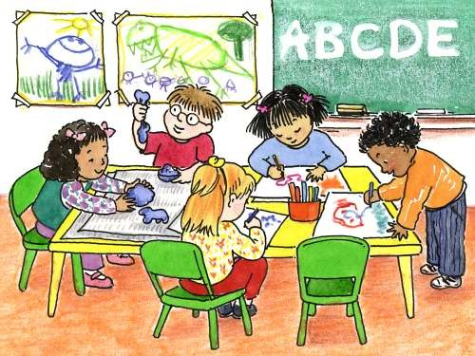
Relating ECCE programme to primary Education
Role of ECCE in Primary school enrollment and retention
National Programme like SSA and DPEP

Slide 9
Private Sector in ECCE
From burden to boredom
Admissions
Early start in structured learning
Expected competencies in conflict with children’s developmental stages
Over-crowded classrooms
Formal method of teaching and evaluation
Appraisal
Homework
Lack of suitable equipment and play materials

Slide 10
Role of NGO
Large voluntary sector in ECCE
Serve disadvantaged communities
ECCE is used as a entry point in community
Generally have an integrated approach
Work in partnership with government through grant in aid programmes.
Have many other goals of community development
Often have untrained worker or trained within the organization.

Slide 11
Teacher Education
Non availability
Paucity of training colleges
Emphasis on English medium
NCERT / NCTE
Diff. types of TE programs
from Aarganwadi to University level

Slide 12
Issues and Concerns of TE
Nomenclature
Attitudes
Employment
Compensation
Status
Inservice?
Quality / Goals

Slide 13
Visual Insights into Primary school teaching in India

Slide 14
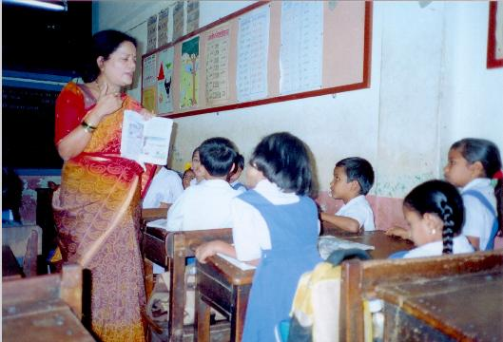

Slide 15
Current Issues
Curriculum load, formal methods /homework, admission procedures, testing states
capacity building/In-service /pre service training
lack of regulatory mechanism
infrastructure facilities /worker child ratio
Language issue/demand for English
advocacy,convergence
special needs of children
linkage with primary,cultural context and community empowerment
Accessibility and availability and affordability
Commercialization of Education

Slide 16
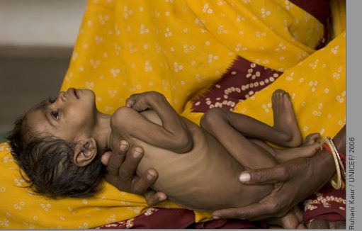
48 percent children in India are stunted
43 percent are underweight

Slide 17
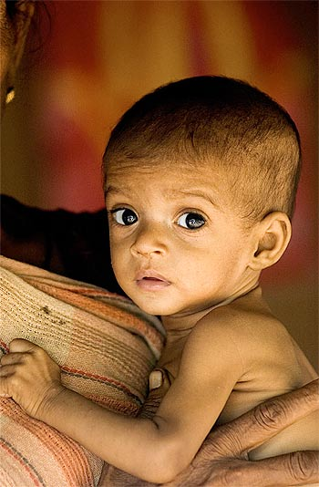
7 in 10 children age 6-59 months are anaemic

Slide 18
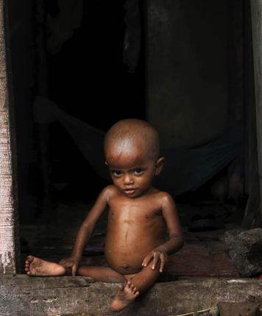
40% of child malnutrition in the developing world is in India

Slide 19
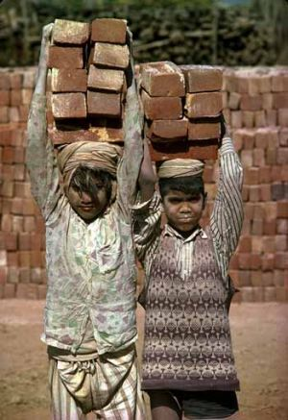
12 percent children age 5-14 years works either for their own household or for somebody else

Slide 20
Some of the National Policies for Children
National Policy on Children 1974
National Policy on Education (NPE)1986/92
NPE Program of Action 1992
National Plan of Action for Children 1992
National Health policy 2002
National Nutrition Policy 1993
National Plan of Action Nutrition 1995
National Plan for SAARC decade for the Girl child 1990-2000
National Charter2003/ National Commission for children
Ratification of CRC in Dec 1992
Constitutional provisions-86th amendment
Fundamental Rights/Directive Principles

Slide 21
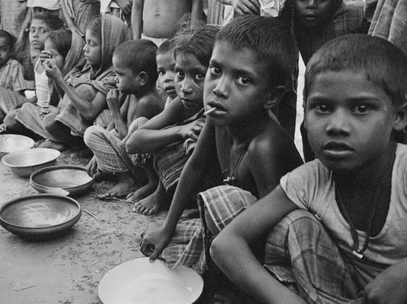
The Draft National Policy for Children, 2012
40% of child malnutrition in the developing world is in India

Slide 22
Child Budgeting in India
Of every 100 Rupee allocated by the government, only three rupees and seventy-seven paise is being allocated for children
Percentage Share of Various Sectors in the Total Child Budget

Slide 23
What is Public Good in the Policy?
Finds a prominent place in the national plans for the development of the children to become robust citizens, physically fit, mentally alert and morally healthy, endowed with the skills and motivations provided by society
Provides equal opportunities for the development of all Indian children during their period of growth
Creates a foundation for a strong young India.
Notes:
Ays

Slide 24

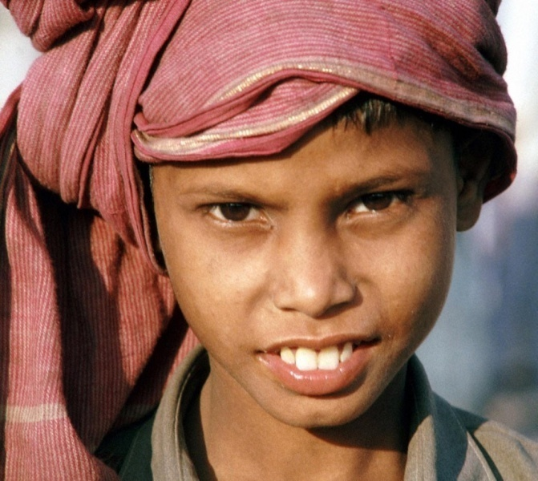
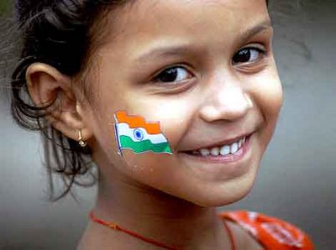
What is Public Good in the Policy?
Addresses new challenges regarding children that have emerged with the advent of globalisation
Ultimately the policy will strengthen the family, society and the nation

Slide 25
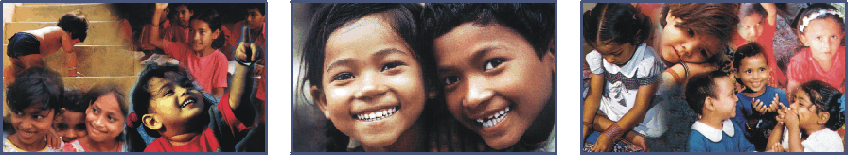
Who are the Stakeholders?
Children
Government
Families
Local Communities
NGOs
Media
Private Business Sector

Slide 26
Elements of the Policy
Survival, Health and Nutrition
Right against Malnutrition
Maternal healthcare
Infant healthcare
Special care for girl child
Protection from water, vector borne diseases
Addresses child mortality
Special care for children with disabilities

Slide 27
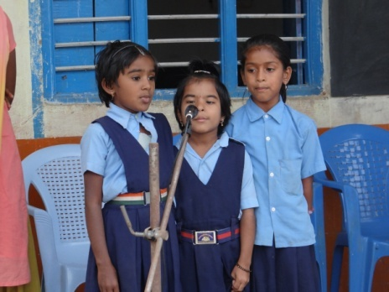
Elements of the Policy
Education and Development
Providing basic environment and support to develop the child’s fullest potential
Early Childhood Care and Education (0-6)
Quality education upto secondary level
Address all forms of discrimination
Creating enabling environment for disadvantaged groups
Child friendly process of teaching
ICT tools esp in remote areas

Slide 28
Elements of the Policy
Sports, cultural and scientific activities
Preventing any physical or mental harassment
Vocational teaching and guidance
Use schools to promote health and hygiene in communities
Use local governments, NGOs etc to map gaps in education
Encourage gifted Children
Provide creches
Promote baby-feeding facilities in public places

Slide 29
Elements of the Policy
Protection
Create a protective environment and prevent all kinds of vulnerabilities and exploitation
Secure rights and care for abandoned children
Special protection for children in difficult circumstances
Build a Child responsive system

Slide 30
Elements of the Policy
Participation
Make children aware of their rights and make them active partners in their own development
Promote respect for views of the girl child, minority and marginalized children
Engage all stakeholders
Employ monitorable indicators

Slide 31
Implementation
Nodal Ministry: Ministry of Women and Child Development
Reviewing: National Co-ordination and Action Group
Plan of Action at National and State Level
Active involvement of Local Communities, Civil Society, Media and Private Business Sector
Establishing a knowledge base through child focused research and documentation
Indicator based child impact assessment and evaluation
Child Budgeting

Slide 32
Merits
Umbrella policy covering all the diverse schemes previously divided among different ministries
Covers all those aspects that could not be covered by policies like ICDS, RTE etc
Special mention of equal rights for the girl child
Special mention for protection of children in difficult circumstances
Gives voice to children in the community and state

Slide 33

Merits
Amends the definition of Children from below 14 to below 18 years.
Child budgeting included
Awareness creation in the community, administration and stakeholders is the responsibility of the state

Slide 34
Demerits
No mention of provision of safe drinking water for children
No special certification or courses for disabled children
No mention of time-bound elimination of child labour
No concrete plan or system to enable participation of children
The draft also includes aspects covering ministry of Health and HRD but no mechanism for interaction

Slide 35


International Perspective
UN Convention on the Rights of the Child
(Articles 24-37)
Australia
Bangladesh
Norway

Slide 36
Alternate Policy Recommendations
Periodic child development report as HDR with proper child development indicators and feedback mechanism
NCPCR can be a better choice than creating a New National Coordination and Action group for monitoring and ensuring the effective implementation of the policy
Civic education should be added

Slide 37
Contd….
Principles and guidelines for institutional co-ordination within and between ministries and all stakeholders
Fixed percentage of GDP for children
More elaborate discussions and targets to address the children of migrant poor, tribal children and increasing slum children.
Separate awareness creation among common public, parents and children about the rights and policies which deals children
Child Impact Assessment

Slide 38
PICO
Author- Cross TP1, Mathews B, Tonmyr L, Scott D, Ouimet C.
Title-Child welfare policy and practice on children's exposure to domestic violence.
Web- http://www.ncbi.nlm.nih.gov/pubmed/22425164

Slide 39
Problem/population | Intervention | comparison | outcome
Domestic violence. Population 7% to 23% of youths in general population surveys | The review draws on searches of standard research databases, interviews with researchers and practitioners, and the authors' own research. | Increase the number of cases that come to the attention of child welfare, but without resources for training and programming can lead to inappropriate reports, lack of referral for further assessment, and strains on the child welfare system. Improving the child welfare response to EDV can include collaboration between child welfare workers | Resources to support training and programming, consider methods that avoid stigmatizing parents, and build in a program evaluation component to increase knowledge about effective practice.

Slide 40
From the Centre for Evidence-Based Medicine, Oxford
For the most up-to-date levels of evidence, see www.cebm.net/?o=1025
PROBLEM | RECOMMENDATION | LEVEL OF EVIDENCE
Domestic violence. | Support training and programming Consider methods that avoid stigmatizing parents Build in a program evaluation component to increase knowledge about effective practice Systematic review (with homogeneity) | 3b

Slide 41

THANK YOU

