Slide 1

Nursing Care of the
Hospitalized Child
Presented By,
Mr. Nirmal Raj E V
Assistant Professor
Department of Child Health Nursing, SNC

Slide 2
If a child becomes
Ill, what options are
Available for
Obtaining care.

Slide 3
Settings for Care
Hospital
  24-hour observation
  Emergency hospitalization
  Outpatient and day facilities
  Rehabilitative care
  Medical-surgical unit
  Intensive care unit
School-based clinics
Community clinics
Home

Slide 4
Common Stressors and Children’s Response to Hospitalization/Illness
Fear of the unknown
Separation anxiety
Fear of pain or mutilation
Loss of control
Anger
Guilt
Regression

Slide 5

Infant
At about 6 months of age are acutely aware of the absence of parent and become fearful of unfamiliar persons.
They can sense the anxiety their parents are experiencing
Accustomed to having basic needs of food and sleep met by parent and constraints of hospitalization results in loss of needs being met.

Slide 6

Toddlers
**Separation anxiety
Nurses experience protest and despair in this group
Fear of injury and pain
Regressive behavior

Slide 7
Stages of Separation
Protest | Despair | Detachment
Screaming, crying, inconsolable Clinging to parents, pleading for parents to stay Agitated, temper tantrums, refuse to comply with care Resists caregivers | Child becomes hopeless and becomes quiet, withdrawn, apathetic Sadness, depression Withdrawal or complaint behavior Crying when parents appear | Lack of protest when parents leave Appearance of being happy and content with caregivers and other children. Close relationships not established If parents reappear, child may ignore.

Slide 8

Preschooler
Separation anxiety generally less than the toddler
Less direct with protests; cries quietly
May be uncooperative
Fear of injury
Loss of control
Guilt and shame

Slide 9

School Age Child
Separation: may have already experienced when starting to school
Fear of injury and pain
Want to know reason
for procedures and
Like being involved and wants to make choices

Slide 10
Adolescence
Separation from friends rather than family more important
Fear of altered appearance
Will act as though not afraid when they really are.
Give them some control to avoid a power struggle

Slide 11
What age group
is most
Impacted by
Separation Anxiety?

Slide 12

Children’s Understanding of Hospitalization
A child or adolescent bases their understanding of hospitalization on:
  Cognitive ability at various developmental stages
  Previous experiences with health care professionals

Slide 13
Families Response to Hospitalization
Hospitalization is disruptive to the family’s usual routines
  May lead to change in roles
Family members are anxious and fearful

Slide 14
Nursing Care to Assist the Child with Hospitalization
Related to Age

Slide 15
Infant – Trust vs. Mistrust
Encourage parent to visit / rooming in
Encourage parents to participate in care, Teach parents procedures they are capable of doing
Discuss arrangements for care of other family at home
Try to simulate home routine
Try to assign same nurse
Allow parents to be present during procedures and comfort afterwards
Keep frightening objects from view
Provide swaddling, soft talking to soothe
Play close attention to light and sound stimulation
Allow non-nutritive sucking for comfort

Slide 16
Older Infant / Toddler
Autonomy vs. Shame and Doubt
Encourage parent to room in and if have to leave, leave when awake and leave something of meaning with child for support.
Provide warmth and support
Explain to parent stage child is in
Bring infants security object -- favorite toy, blanket
Set limits, give choices on simple decisions
Teach parents child may regress, may promote potty chair if child is trained. Offer frequently (4x per shift)
Promote ritualistic behavior for bedtime
Teach parents about hazards (crib, chair, toys, equipment) be sure to supervise when out of crib.

Slide 17
Preschooler – Initiative vs. Guilt
Acknowledge child’s fears regarding hospitalization
Orient to the hospital, spend time with child to build trust
Encourage presence of parent if possible and encourage to
participate in care. Provide comfort and support .
Nutrition – assess food likes (hamburger, PBJ sandwich, etc) Give small portions. Make environment comfortable and accept messes. Encourage intake of fluids with games.
Provide consistent environment ; Reinforce coping behavior
Provide with as much mobility as possible
Provide play and divisional activities
Avoid intrusive procedures as much as possible
Assess child’s perception by asking to draw a picture and tell about it
Notes:
6. What are age-appropriate nursing interventions and approaches to caring for the
hospitalized child?

Slide 18
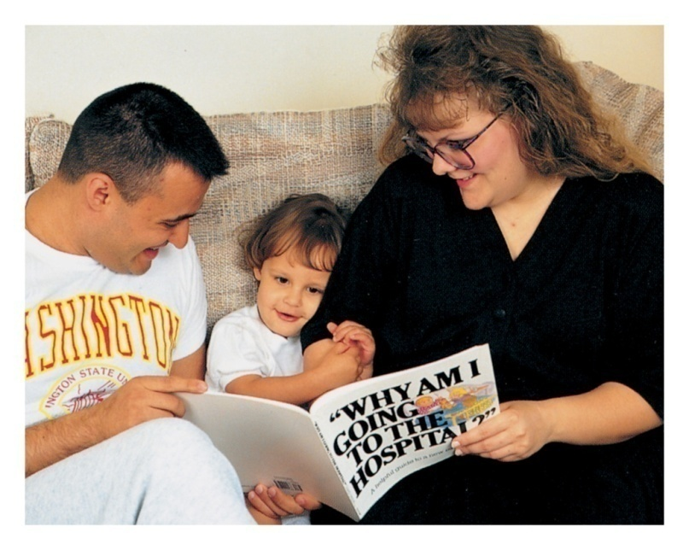
This pre-schoolers parents are taking the time to prepare her for hospitalization by reading a book recommended by the nurse. Such material should be appropriate to the child’s age and culture. Why do you think that having the parents read this material is valuable?
Pre Schooler
See Box 35-2
p. 891

Slide 19
School Age – Industry vs.
Ascertain what child knows. Clarify using scientific terminology and how body functions
Direct questions more to the child when teaching them (help master over feelings of inferiority)
Use audiovisuals, pictures, body outlines.
Suggest ways of maintaining control (i.e.: deep breathing relaxation).
Gain cooperation. Give positive feedback
Include in decision-making (time to do it, preferred site).
Encourage active participation (removing dressings, doing PIN care). Plan child’s day if possible with child’s input
Maintain clear and consistent limits
Allow for privacy

Slide 20
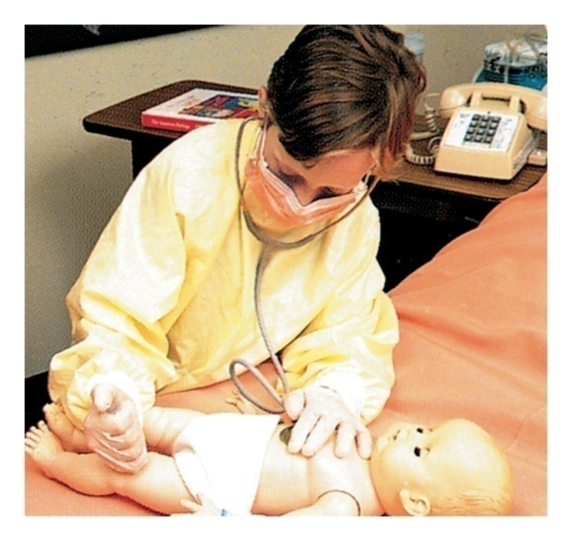
School Age Child
Allowing the child to dress up as a doctor or a nurse helps prepare the child for the hospitalization experience.
This helps the child adjust to treatment, care, and the recovery process.

Slide 21
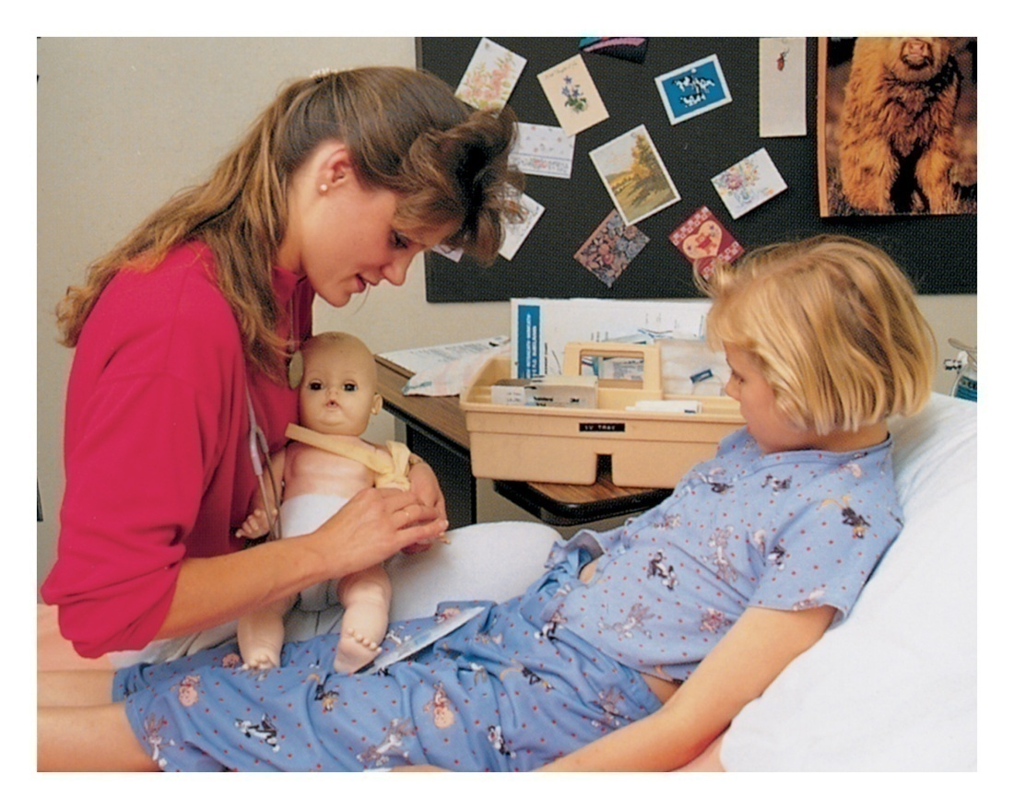
The child’s anxiety and fear often will be reduced if the nurse explains what is going to happen and demonstrates how the procedure will be done by using a doll. Based on your experience, can you list five actions you can take to prepare a school-age child for hospitalization?
School Age Child

Slide 22
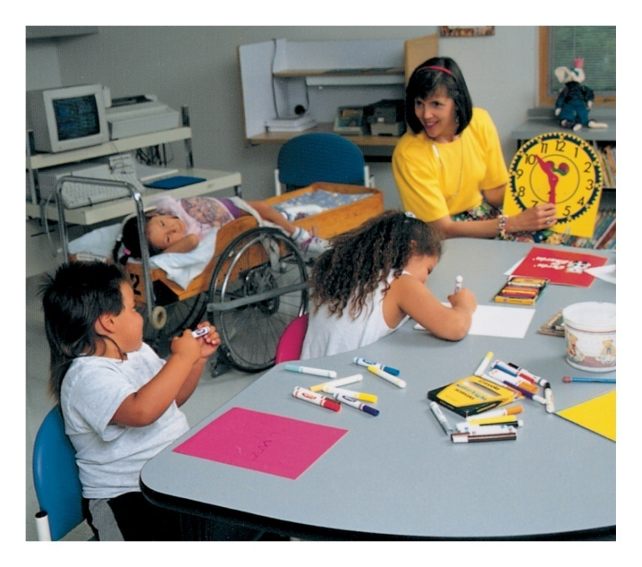
Some hospitals offer a special classroom and teacher for children undergoing a lengthy hospital stay, enabling them to remain current with their school work. The child who falls behind other students might not fit in when he or she returns to school or might be required to repeat a grade.
School Age Child

Slide 23
Adolescent – Identity vs Identity Diffusion
Assess knowledge.
Encourage questioning regarding fears, or risks.
Involve in decision-making.
Ask if patient wants parent there.
Make as few of restrictions as possible.
Suggest ways of maintaining control.
Accept regression to more childish ways of coping.
Give positive reinforcement.
Provide privacy for care
Encourage to wear street clothes and perform normal grooming
Allow favorite food to be brought in if not on a special diet

Slide 24
Playrooms in
Health Care Settings

Slide 25

Advantages of play to the hospitalized child
Therapeutic – activities are guided
Emotional outlet – acts out real stressors
Used to teach child prior to situation
Enhances cooperation – used during an unpleasant procedure.

Slide 26
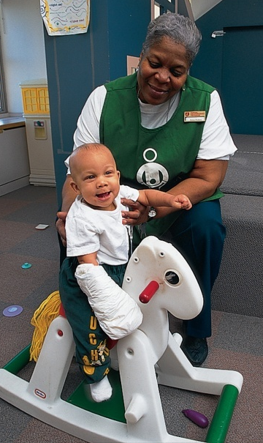
Therapeutic Play Techniques
Infant
  Crib Mobiles
  Soft toys
  Music
Toddler
  Play peek-a-boo or Hide-and-Seek
  Read familiar stories
  Play with dolls that have similar “illness” as them
  Puzzles, building blocks, push-and-pull toys
  Play with safe hospital equipment – bandaids, stethoscopes, syringes without needles. – remove when finished playing

Slide 27
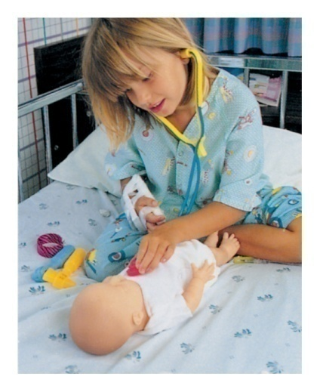
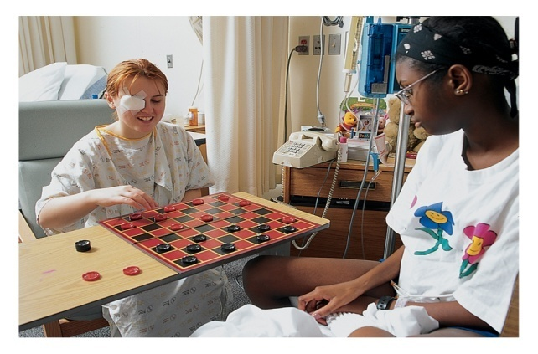
Therapeutic Play Techniques
Pre-schooler
  Play with safe hospital equipment
  Crayons and coloring books,
  Puppets, Felt and magnetic boards
  Books and recorded stories
  Videos
School-age
  Dolls
  Hospital equipment
  Board games, crafts
  Books, computers

Slide 28
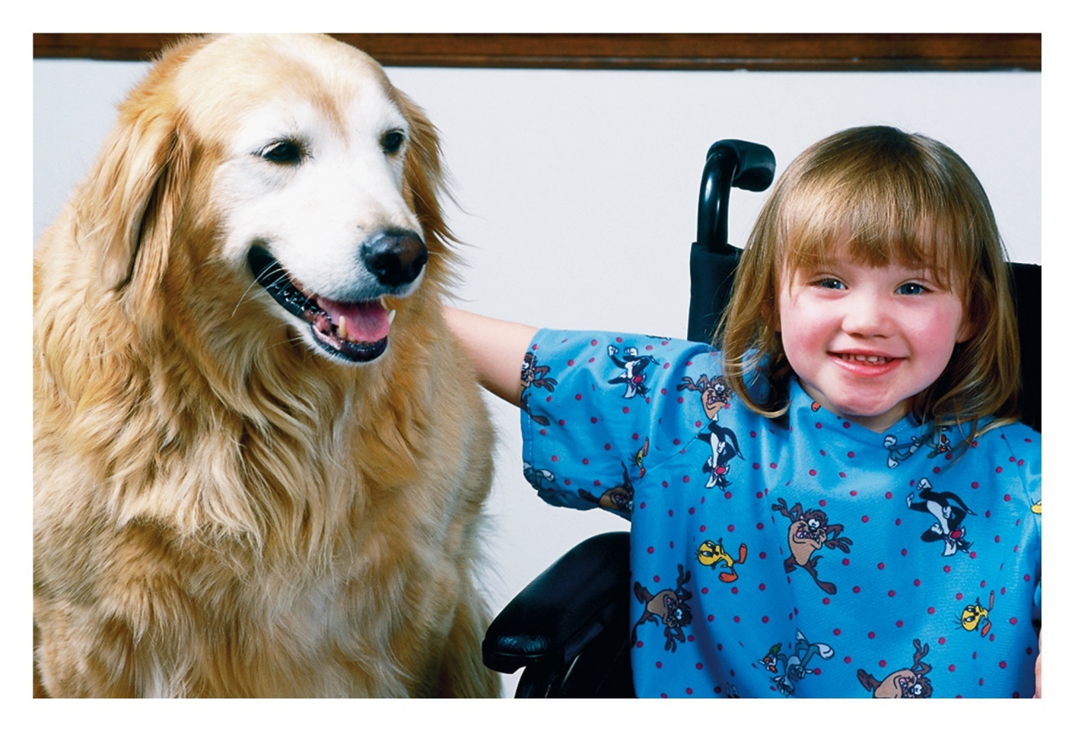
Pet Therapy
Hospitals may have pet therapy from specially trained animals to provide comfort and distraction during healthcare.

Slide 29
Children with Special Needs
For those with visual or hearing impairment – provide material in auditory, tactile, or visual means to assist child
Provide special equipment for those with psychomotor difficulties
During patient teaching - provide more reinforcement and shorter teaching sessions

Slide 30
Admission to the
Hospital

Slide 31
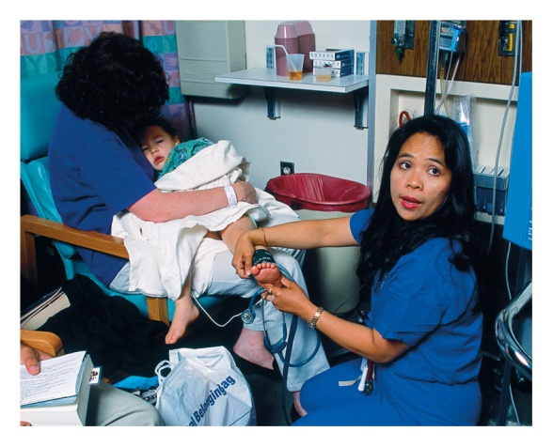
Nursing Measures to Tailoring Care
Encourage positive communication with health care team
View care as a partnership
Be aware that the parents are the
ones who knows the child best
Provide support to the parents,
allow them to assist with the care
Recognize influences of cultural background

Slide 32
Preparation
Tour of the Hospital or surgical area
Photographs or a videotape of medical setting and procedures
Health Fairs
Contact with peers who had similar experience

Slide 33

Preparation Strategies
Allowing the child to dress up as a doctor or a nurse helps prepare the child for hospitalization.
This helps the child adjust to treatment care and the recovery process.

Slide 34
Things Parents can do to Prepare Child
Read stories
Talk about hospital and coming home
Encourage child to ask questions
Visit a hospital or surgical area and allow to touch equipment
Encourage child to draw pictures of what they think it will be like
Be honest and tell about pain, etc.

Slide 35
Nursing Care to Assist Families to Cope
Orient to hospital
Assess what parent/child know of illness and treatment
Assess teaching needs - keep updated on condition of child
Reinforce and encourage questions
Discuss ways the parents can participate in the care
Assess & discuss family support, make referrals

Slide 36
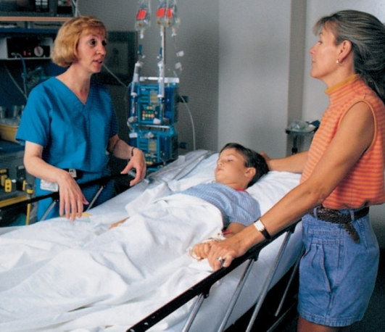
It is important to allow the parents to be a part of the child’s care.
Reunite the family as soon as possible after surgery. This child has just undergone surgery and is in the post anesthesia care unit (PACU). Although the child’s physical care is immediate and important, remember that both the child and the family have strong psychosocial needs that must be addressed concurrently. It is important to reunite the family as soon as possible after surgery.
Nursing Care to Assist Families to Cope

Slide 37

Preparation for Procedures
Take the child to a treatment room
Encourage a parent or loved one to provide comfort and support
Use developmentally appropriate terminology
Offer the child choices
Tell the child and family how they can help with the procedure
Do not threaten punishment for lack of cooperation
Do not force an unwilling parent to stay; encourage participation

Slide 38
Using Restraints
Use the least restrictive restraint
Choose proper device for condition
Ensure proper fit
Tie knots that can be untied easily for quick access
Secure ties to bed frames or another stable device
Frequently check the extremity distal to the restraint for circulation, sensation, and motion
Remove restraints every 2 hours for range-of-motion movement, repositioning and to offer child food or opportunity to use the bathroom
Document findings from neurovascular checks

Slide 39
Child Life Specialist
A person who plans activities to provide age-appropriate playtime for children either in the child’s room or in a playroom.
Goal: Assist children to work through feelings about their illness

Slide 40
Pain Assessment
and
Management

Slide 41
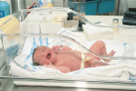
Myths About Pain
Neonates do not experience pain
Children have no memory of pain
There is a correct amount of pain for
a given injury
Children can easily become addicted
to narcotics
Narcotics can easily cause respiratory depression

Slide 42
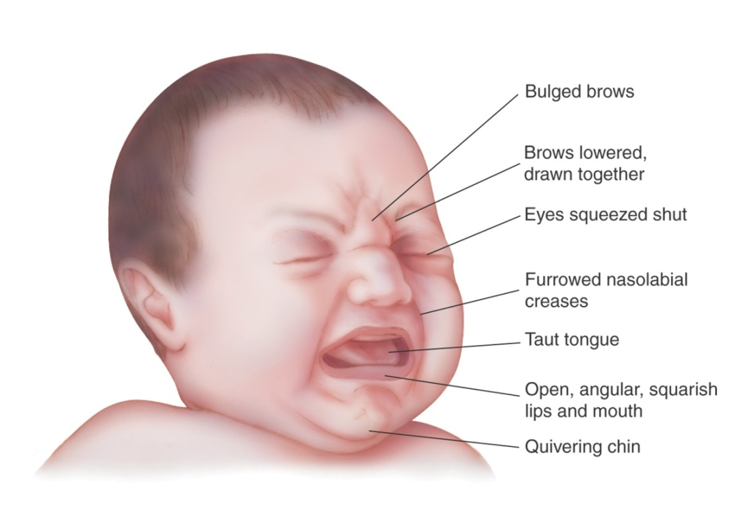
Pain Assessment
Neonatal characteristic facial responses to pain include: bulged brow, eyes squeezed shut, furrowed nasolabial creases, open lips, pursed lips, stretched mouth, taut tongue, and a quivering chin.
Physiological Response = increased B/P and decreased arterial saturation

Slide 43
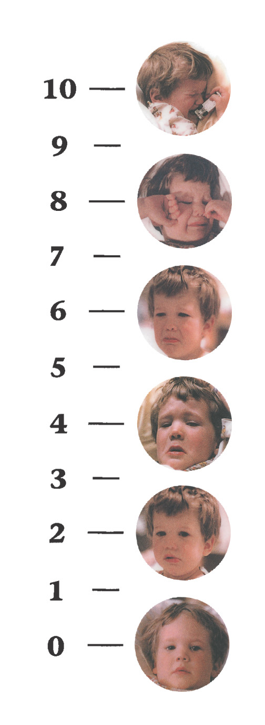
Oucher Scale
After determining that the child has an understanding of number concepts, teach the child to use the scale. Pre-schooler age is first to do this.
Point to each photo, explain that the bottom picture is a “no hurt,” the second picture is a “little hurt,” the third picture is “a little more hurt,” the fourth picture is “even more hurt” the fifth picture is “a lot of hurt” and the sixth picture is the “biggest or most hurt you could ever have.”
The numbers beside the photos can be used to score the amount of pain the child reports.

Slide 44
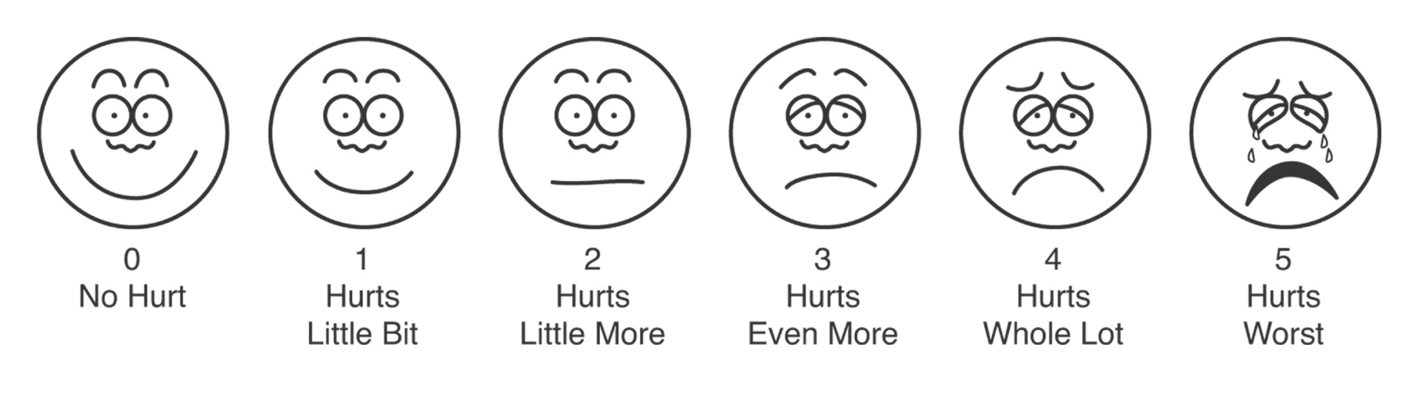
Faces Pain Scale
Make sure the child has an understanding of number concepts and then teach the child to use the scale.
Point to each face and use the words under the picture to describe the amount of pain the child feels.
Then ask the child to select the face that comes closest to the amount of pain felt.

Slide 45
Consequences of Pain
Cardiovascular and respiratory changes
  Tachypnea, increased B/P and heart rate
  Inadequate lung expansion, decreased arterial saturation
  Inadequate cough
Neurologic changes
  Fight /flight response- Tachycardia, insomnia, glucose
Metabolic changes
  Increased fluid and electrolyte losses
Immune system changes
  Depression of immune system with increase in risk for infection
Gastrointestinal changes
  Increased intestinal secretions, prone to ileus

Slide 46
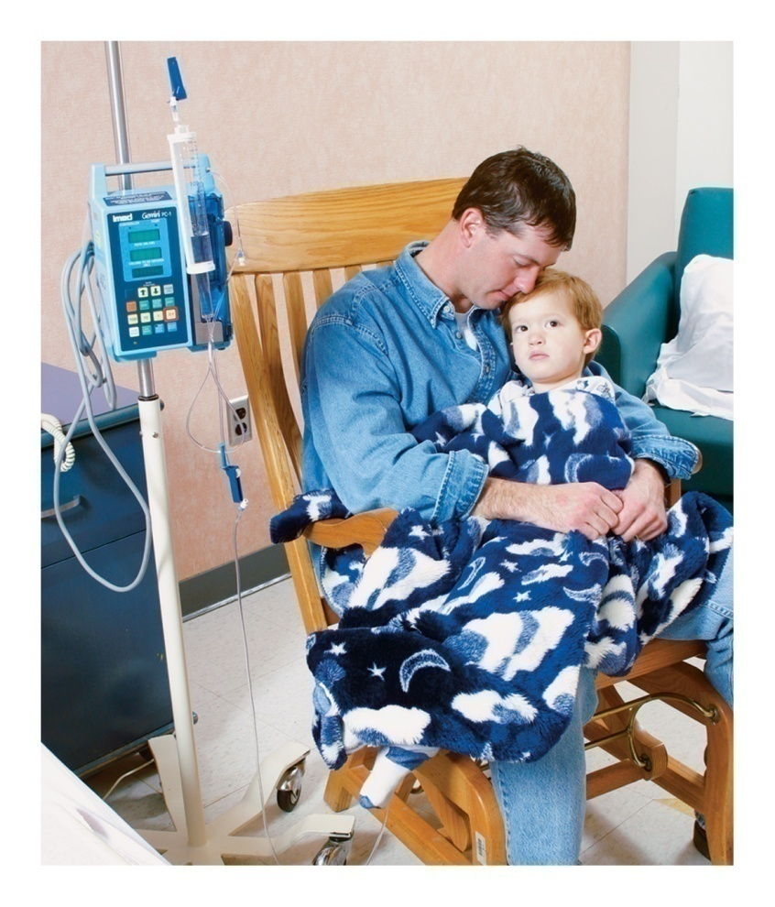
Pain Management
The presence of the parent is an important part of pain management. Children often feel more secure telling their parents about their pain and anxiety

Slide 47
Non-pharmacological
Pain Management
Behavioral distraction
Assorted visuals
Breathing techniques
Comfort measure
  Repositioning, holding
  Touching, massaging
  Warm or cold compresses
Diversional talk
Guided imagery
Biofeedback
Progressive muscle relaxation

Slide 48
Pharmacologic Interventions for Pain
Analgesics
  Patient-controlled analgesia
  Topical anesthetic cream
Nonsteroidal antiinflammatory drugs
Opioids
Conscious sedation
Epidural analgesia

Slide 49
Administering Analgesics to Children
The preferred routes are intravenous or oral.
Infants and children receiving IV and epidural opioids should be monitored by pulse oximetry.
If respiratory depression occurs with opioid use, naloxone hydrochloride should be used for reversal when oxygen and stimulation of the child are ineffective.

Slide 50
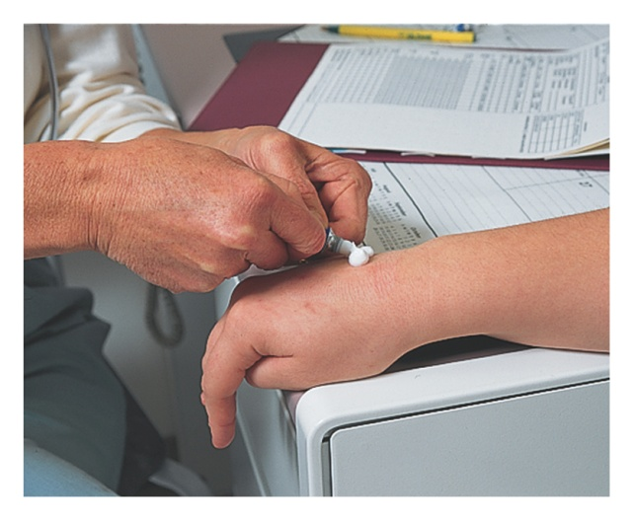
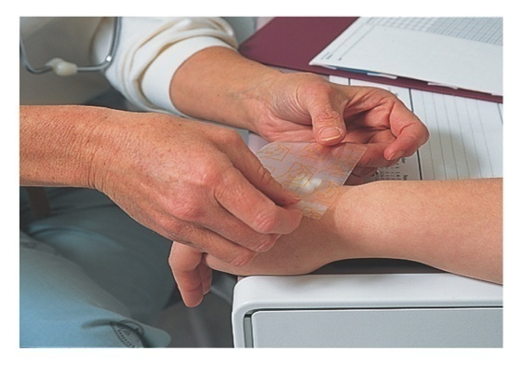
Nursing Interventions
When painful procedures are planned, use EMLA cream to anesthetize the skin where the painful stick will be made.
Procedure :
  Apply a thick layer of cream over intact skin.
  Cover the cream with a transparent adhesive dressing, sealing all the sides.
The cream anesthetizes the dermal surface in 45 to 60 min.

Slide 51
PICO
Author- Darling EK, Guttmann A, Sprague AE, Ramsay T, Walker MC.
Title-mplementation of the Canadian Paediatric Society's hyperbilirubinemia guidelines
Web- http://www.ncbi.nlm.nih.gov/pubmed/24665223

Slide 52
Problem/population | Intervention | comparison | outcome
Implementation of the Canadian Paediatric Society's hyperbilirubinemia guidelines Population December 2011 to May 2012 of all Ontario hospitals offering maternal-newborn services. | The present study was an online survey conducted from December 2011 to May 2012 of all Ontario hospitals offering maternal-newborn services. | Investigate how guideline-recommended care is organized; and to understand the factors influencing guideline implementation. | The majority of Ontario hospitals implemented universal bilirubin screening following the release of the CPS guidelines. Further analysis is needed to determine the impact that the guidelines and the differences in implementation have had on clinical outcomes and the utilization of health services.

Slide 53
From the Centre for Evidence-Based Medicine, Oxford
PROBLEM | RECOMMENDATION | LEVEL OF EVIDENCE
Hyperbilirubinaemia in newborn | Implementation of the Canadian Paediatric Society's hyperbilirubinemia guidelines | 3a

Slide 54
THANK YOU

