Slide 1
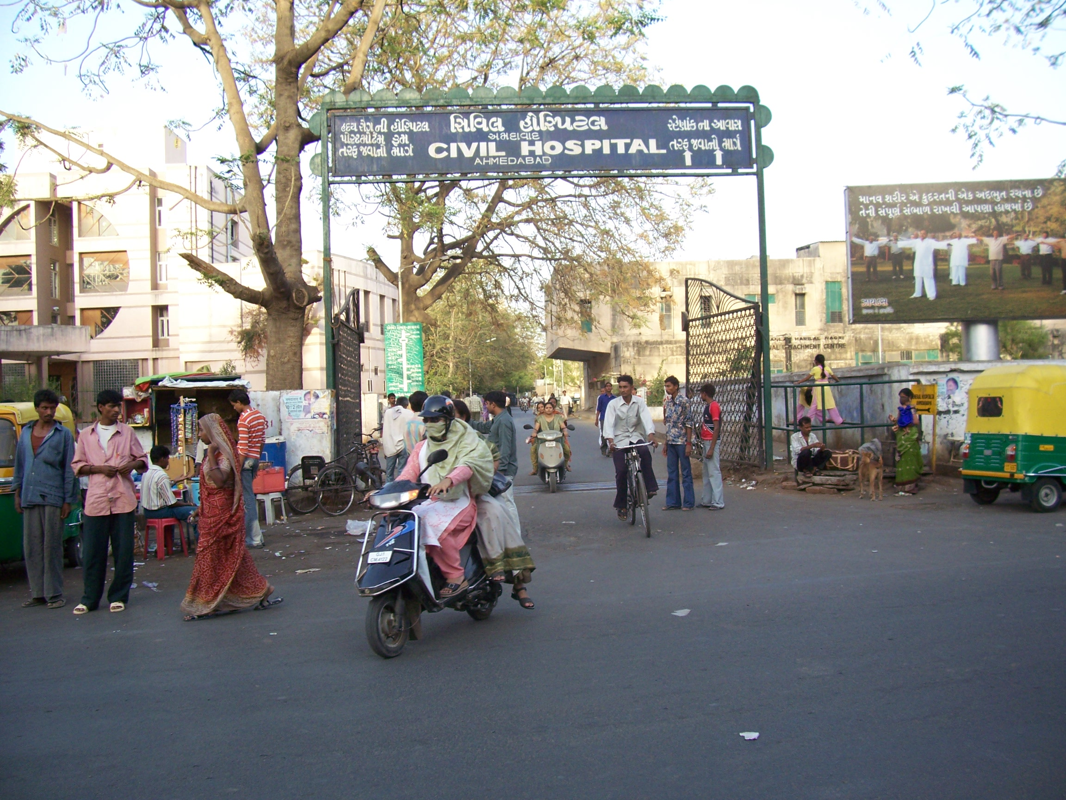

NATIONAL HEALTH PROGRAMMES RELATED TO CHILD HEALTH
Presented By,
Mr. Rajesh P
Assistant Professor
Department of Child Health Nursing, SNC

Slide 2
NATIONAL HEALTH PROGRAMMES RELATED TO CHILD HEALTH
MATERNAL AND CHILD HEALTH PROGRAMME
THE CHILD SURVIVAL AND SAFE MOTHERHOOD PROGRAMME
REPRODUCTIVE CHILD HEALTH PROGRAMME (RCH)

Slide 3
NATIONAL HEALTH PROGRAMMES RELATED TO CHILD HEALTH
Universal Immunisation Programme
- Pulse Polio Immunization
Nutritional programs
INTEGRATED MANAGEMENT OF NEONATAL & CHILDHOOD ILLNESSES (IMNCI)

Slide 4
1) MATERNAL AND CHILD HEALTH PROGRAMME (MCH)
The major focus of public health in India have been to improve maternal and child health services and to prevent and control various communicable diseases in order to reduce morbidity, mortality among mothers, children and people in general.

Slide 5
MATERNAL AND CHILD HEALTH PROGRAMME
In 1946, Bhore committee revealed high rates of morbidity and mortality prevailing among mothers and children in India. The committee emphasized the need for maternal and child welfare services and assigned highest priority to maternal and child welfare services in short term and long term health programme.

Slide 6
The functions of maternity and child welfare centre in primary health Centres
(a) to get in touch with as many pregnant women in the area as possible and to persuade them to visit the clinic regularly, so that periodical examinations may be carried out and a record of their medical history kept;
(b) to provide for the skilled assistance of a midwife or trained dai at the time of delivery and for domiciliary visits by her for two weeks thereafter;

Slide 7
The functions of maternity and child welfare centre in primary health Centres
(c) to keep the mother and infant under observation, if possible, for a year;
(d) to teach mothercraft in all its branches and to inculcate sound hygienic habits in the mother and child;

Slide 8
The functions of maternity and child welfare centre in primary health Centres
(e) to keep children under observation, if possible, till five years of age;
(f) to organise periodical talks, by suitable persons, for husbands and fathers in order to secure their cooperation in the development of a healthy and happy home; and
(g) to aim, in general, at becoming the focus of social activity in the area as far as mothers and children are concerned.

Slide 9
2) THE CHILD SURVIVAL AND SAFE MOTHERHOOD PROGRAMME (CSSM)
Following the great success of expanded programme of immunisation, the Government of India decided to expand their focus from immunization to a wider range of programme which would include various child survival and safe motherhood interventions.

Slide 10
2) THE CHILD SURVIVAL AND SAFE MOTHERHOOD PROGRAMME (CSSM)
Thus, the Child Survival and Safe Motherhood Programme (CSSM) was launched in 1992 and developed with the assistance of UNICEF and World Bank. The programme was for five years and for covering the entire country

Slide 11
The objectives of CSSM were:
to reduce infant mortality below 60 per 1000 live births and childhood mortality below 10 per 1000 child population.
to reduce maternal mortality below 2 per 1000 live births.

Slide 12
CSSM Programme Interventions
Child Surivival
* Essential newborn care
* Immunization
* Management of diarrhoea
* Management of Acute Respiratory
* Vitamin A Prophylaxis

Slide 13
CONT’D …
Safe Motherhood
* Immunization of Pregnant women.
* Prevention and treatment of anaemia.
* Antenatal care and early identifications of maternal complications.

Slide 14
CONT’D …
* Delivery by trained personnel. Infections (ARIs)
* Promotion of Institutional delivery.
* Management of obstetric emergencies.
* Birth spacing

Slide 15
Strategies:
Establishment of first referral units to provide emergency obstetric Services :
Conversion of existing village level immunization sections to maternal and child protection sections (MCPs) to improve maternal care.

Slide 16
Strategies:
Training of Traditional Birth Attendants (TBAs),
Strengthening of subcentres by providing equipments, drugs necessary to handle maternal and child health conditions at that level.

Slide 17
Strategies:
Training of health personnel in CSSM Programme:
The programme strategy also emphasised on information, education and communication (IEC) to create awareness and motivate

Slide 18
REPRODUCTIVE CHILD HEALTH PROGRAMME (RCH)
    The Government of India reoriented the existing family planning and CSSM programme into a new programme called Reproductive and Child Health (RCH). The programme started in August 1997 and is almost four times the size of the CSSM in terms of financial allocations. Financially the programme is supported by World Bank and European Union.

Slide 19
REPRODUCTIVE CHILD HEALTH PROGRAMME (RCH)
    Objective of this programme is
    to promote Reproductive and Child Health
    The programme components.
    These are Reproductive Health (RH) and
    Child Health (CH).

Slide 20
Maternal Health Interventions.
Essential Obstetric Care (EsOC )
Emergency Obstetric Care (EOC)
Twenty Four hours Delivery services at PHCs/ CHCs
Referral Transport

Slide 21
Maternal Health Interventions.
Medical Termination of Pregnancy (MTP)
Prevention, Management and Control of Reproductive Tract Infection (RTI Infection)
Training of Tradition Birth Attendants (TBAs )
RCH Camps

Slide 22
Child Health Interventions
Universal Immunisation Programme
Control of Acute Respiratory Infections (ARls)
Essential New Born Care

Slide 23
Child Health Interventions
Oral Rehydration Therapy for Diarrhoea Control among Children
Prevention and Control of Vltamin-A Deficiency among Children
Border District Cluster Project (BDCP)
National Technical Committee on Child Health

Slide 24
4) Universal Immunisation Programme
Under the programme the children are immunized as per schedule against six killer diseases of the childhood namely tuberculosis, diphtheria, pertussis, poliomyelitis, measles and neo-natal tetanus.

Slide 25
Universal Immunisation
Programme
Pulse Polio Immunization
Pulse Polio Immunization is carried on in its full swing to eradicate Polio.
Hepatitis-B Vaccine is being introduced as part of Universal Immunization Programme

Slide 26
5) NUTRITIONAL PROGRAMS
Some of the nutritional programs are:
Mid-day school meal
Applied Nutritional Program
Specific Nutrients

Slide 27
6) INTEGRATED MANAGEMENT OF NEONATAL & CHILDHOOD ILLNESSES (IMNCI)
Every year more than 10 million children die in developing countries before they reach their fifth birthday

Slide 28
6) INTEGRATED MANAGEMENT OF NEONATAL & CHILDHOOD ILLNESSES (IMNCI)
Distribution of 10.5 million deaths among children less than 5 years old in all developing countries as shown below
Malaria 7%
Other 28%
Measles 8%
HIV/AIDS 3%
Diarrhoea 15%
Perinatal 20%
Pneumonia 19%

Slide 29
6) INTEGRATED MANAGEMENT OF NEONATAL & CHILDHOOD ILLNESSES (IMNCI)
During the mid-1990s, the World Health Organization (WHO), in collaboration with UNICEF and many other agencies, institutions and individuals, responded to this challenge by developing a strategy known as the Integrated Management of Childhood Illness (IMCI).
The IMNCI clinical guidelines target children less than 5 years old — the age group that bears the highest burden of deaths from common childhood diseases.

Slide 30
6) INTEGRATED MANAGEMENT OF NEONATAL & CHILDHOOD ILLNESSES (IMNCI)
An evidence-based syndromic approach can be used to determine the:
Health problem(s) the child may have;
Seventy of the child's condition:
Actions that can be taken to care for the child (e.g. refer the child immediately, irranage with available-resources, or manage at home).

Slide 31
6) INTEGRATED MANAGEMENT OF NEONATAL & CHILDHOOD ILLNESSES (IMNCI)
The strategy includes three main components:
Improvements in the case-management skills of health staff through the provision of locally-adapted guidelines on Integrated Management of Neonatal and Childhood illness and activities to promote their use;
Improvements in the overall health system required for effective management of childhood illness;
Improvements in family and community health care practices.

Slide 32
The Principles of Integrated Care
All sick young infants age up to 2 months must be examined for signs of "possible serious bacterial infection" and all children 2 months to 5 years must be examined for "general danger signs" which indicate the need for immediate referral or admission to a hospital.

Slide 33
The Principles of Integrated Care
All sick children must be routinely assessed for major symptoms (for young infants up to 2 months: diarrhoea; and for children age 2 months up to 5 years: cough or difficult breathing, diarrhoea, fever and ear problem). They must also be routinely assessed for nutritional and immunization status, feeding problems, and other potential problems.

Slide 34
The Principles of Integrated Care
Only a limited number of carefully selected clinical signs are used, based on evidence of their sensitivity and specificity to detect disease. These signs were selected considering the conditions and realities of first-level health facilities..

Slide 35
The Principles of Integrated Care
A combination of individual signs leads to a child's classification(s) rather than a diagnosis. Classification(s) indicate the severity of condition(s). They call for specific actions based on whether the young infant or the child (a) should be urgently referred to another level of care, (b) requires specific .treatments (such as antibiotics or antimalarial treatment), or (c) may be safely managed at home. The classifications are colour coded: "pink" suggests hospital referral or admission..* "yellow" indicates initiation of treatment, and "green" calls for home treatment.

Slide 36
The Principles of Integrated Care
The IMNCI guidelines address most, but not all, of the major reasons a sick child is brought to a clinic. A child returning with chronic problems or less common illnesses may require special care. The guidelines do not describe the care at birth and the management of trauma or other acute emergencies due to accidents or injuries.

Slide 37
The Principles of Integrated Care
IMNCI management procedures use a limited number of essential drugs and encourage active participation of caretaker* in the treatment of children.
An essential component of the 1MNCI guidelines is the counselling of caretakers about home care, including counselling about feeding, fluids and when to return to a health facility.

Slide 38
7) SCHOOL HEALTH PROGRAMMES
The school health committee set up by thye Government of India in 1960 .It had recommended that school health services should be an integral part of the general health services .
The school health programme refers to the initiation,maintenance & improvement of health of school children & school personnel.

Slide 39
Main components of school health programme
Health examination
Prevention of infection
First aid & sick room care
Nutrition & drinking water supply
Health education
Mental health &
Environmental sanitation

Slide 40
PICO Format
Problem | Intervention | Comparison | Outcome
Infant Nutritional Status and Illness | Prospective cohort study | No comparison | Infants of prenatally depressed mothers showed significantly more growth retardation than controls at all time points

Slide 41
From the Centre for Evidence-Based Medicine, Oxford
For the most up-to-date levels of evidence, see www.cebm.net/?o=1025
Problem | RECOMMENDATION | LEVEL OF EVIDENCE
Infant Nutritional Status and Illness | Impact of Maternal Depression on Infant Nutritional Status and Illness(COHORT STUDY- Validating cohort study with good reference standards) | 1b

