Slide 1

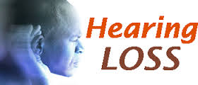
deafness
Presented By:
Ms. Sonal Patel
Assistant Professor
Sumandeep Nursing College
Sumandeep Vidyapeeth deemed to be University

Slide 2
Hearing loss, deafness, hard of hearing or hearing impairment is a partial or total inability to hear.
In children it may affect the development of language.

Slide 3
Hearing loss, or deafness, can be present at birth (congenital), or become evident later in life (acquired).
Hearing impairment may be inherited, caused by maternal rubella or complications at birth, certain infectious diseases such as meningitis, use of ototoxic drugs, exposure to excessive noise and ageing.
Around half of all deafness and hearing impairment can be prevented if common causes were dealt with at primary health care level.

Slide 4
It is caused by many factors, including: genetics, age, exposure to noise, illness, chemicals and physical trauma.
Hearing testing may be used to determine the severity of the hearing loss.
While the results are expressed in decibels, hearing loss is usually described as mild, mild-moderate, moderate, moderately severe, severe, or profound.

Slide 5
Causes
1. Age
There is a progressive loss of ability to hear high frequencies with increasing age known as presbycusis. For men, this can start as early as 25 and women at 30, but may even affect teenagers and children. Although genetically variable it is a normal concomitant of aging and is distinct from hearing losses caused by noise exposure, toxins or disease agents.[

Slide 6
2.Noise
Noise is the cause of approximately half of all cases of hearing loss, causing some degree of problems in 5% of the population globally.
Many people are unaware of the presence of environmental sound at damaging levels, or of the level at which sound becomes harmful. Common sources of damaging noise levels include car stereos, children's toys, motor vehicles, crowds, lawn and maintenance equipment, power tools, gun use, musical instruments, and even hair dryers.

Slide 7
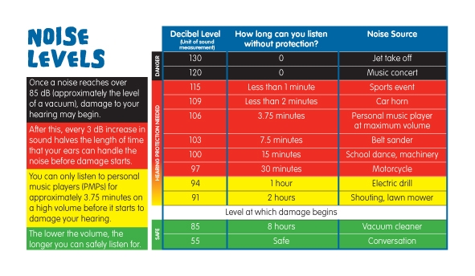

Slide 8
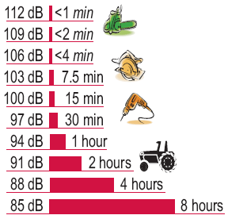
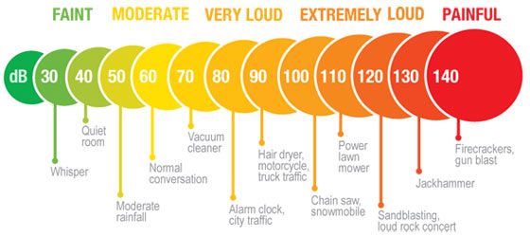

Slide 9
3.Genetic
Hearing loss can be inherited. Around 75–80% of all cases are inherited by recessive genes,
When looking at the genetics of deafness, there are 2 different forms, syndromic and nonsyndromic.
Syndromic deafness occurs when there are other medical problems aside from deafness in an individual. This accounts for around 30% of deaf individuals who are deaf from a genetic standpoint.[
Nonsyndromic deafness occurs when there are no other problems associated with an individual other than deafness.

Slide 10
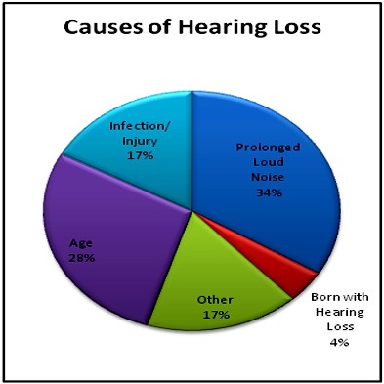
4. Others
Illness
Neurological disorders
Medications
Chemicals
Physical trauma

Slide 11
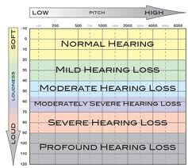
Classification of hearing loss

Slide 12
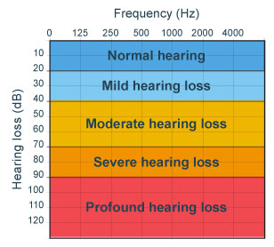

Slide 13
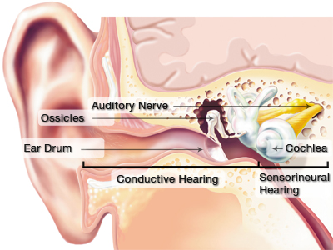
Types of hearing loss

Slide 14
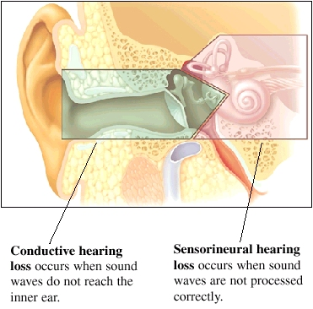

Slide 15
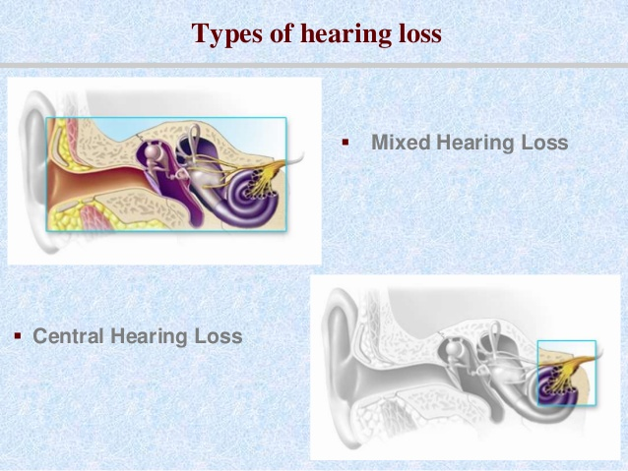

Slide 16
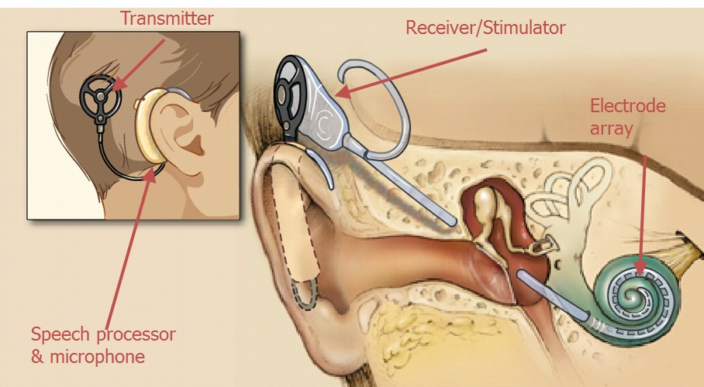
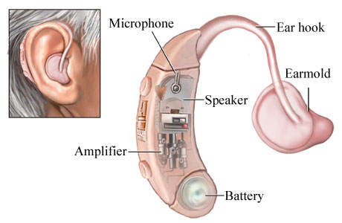
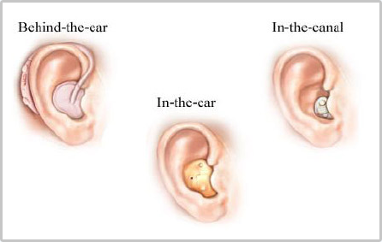
Management
1. Symptomatic management
2. Hearing aids
3. Cochlear implants
4. Aural rehabilitation

Slide 17
Surgical management
1. Restore conductive hearing loss
Myringotomy
Stapedectomy
2.Assisted hearing in profound deafness
Chochlear implant
Temporal bone stimulator
Middle ear implant
3. Tumor excision

Slide 18
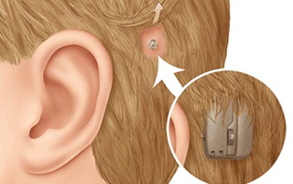
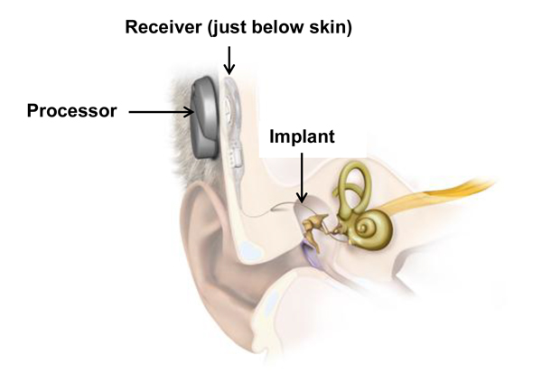

Slide 19
1. Partial or total inability to hear is known as:-
Hearing loss
Deafness
hearing impairment
All of the above
2. Which is the not cause of Hearing impairment
Maternal rubella or complications at birth
Common cold
Use of ototoxic drugs
Exposure to excessive noise and ageing.

Slide 20
3. Which is the notTypes of Hearing losse:-
    Sensorineural hearing loss
    Conductive hearing loss
    Obstractive hearing loss
    Mixed hearing loss.
    4. The level of voice for normal hearing is:-
    30-40 db
    40-50 db
    50-60 db
    Above 70 db

Slide 21
5. Management of deafness includes:-
Hearing aids
Cochlear implants
Aural rehabilitation
All of the above

Slide 22
Answer key
1. D
2. B
3. C
4. C
5. D

Slide 23
HEARING AIDS

Slide 24
Hearing aids are sound-amplifying devices designed to aid people who have a hearing impairment.
Hearing aids are small, lightweight electronic devices that sit in the outer ear, within the ear canal, or behind the ear.
Their main function is to amplify sound in a natural and comfortable way.

Slide 25
Hearing aids differ by:
design
technology used to achieve amplification
special features

Slide 26
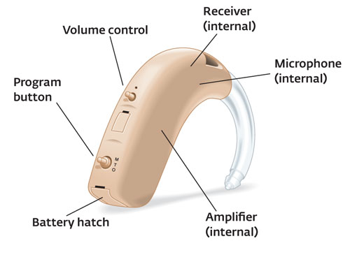
Hearing aid has four basic parts:-
Microphone:-receive sound waves and change in electrical signal
Amplifier:-Increase strength of electrical signal
Receiver:-earphones to change the electrical signal into sound waves
Battery

Slide 27
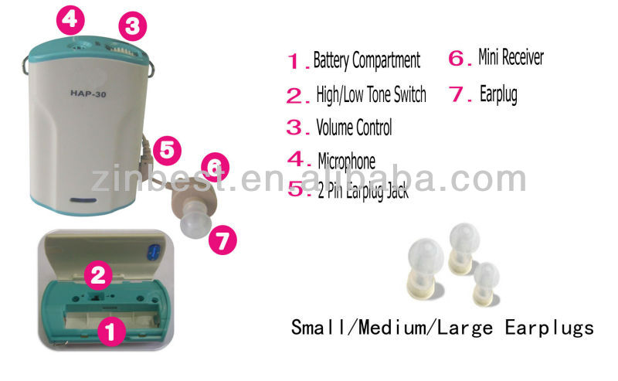
Types of Hearing Aids
1. POCKET MODEL

Slide 28
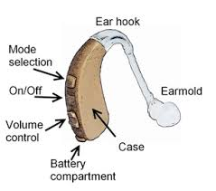
2. BEHIND THE EAR( BTE)
Behind the ear aids consist of a case, an ear mold or dome and a connection between them.
The case contains the electronics, controls, battery, microphone(s) and often the loudspeaker.
Generally, the case sits behind the pinna with the connection from the case coming down the front into the ear.
The sound from the instrument can be routed acoustically or electrically to the ear.
Easy to clean. For mild to severe hearing loss.

Slide 29
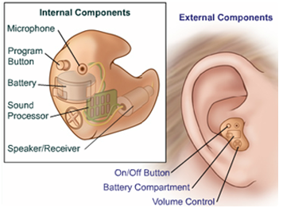
3. In the ear (ITE)
ITE hearing aids are suitable for most types of hearing losses. They are usually small like an ear tip and sit in the outer portion of the ear canal.
Depending on the size of the ear canal an in the ear hearing aid may be relatively discreet.

Slide 30
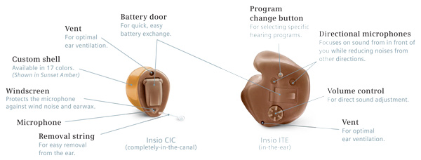
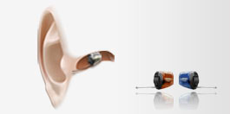
4. In the Canal(ITC), Mini canal(MIC) and complete in the canal(CIC)
Completely-in-canal (CIC) hearing aids are a great option for those with mild to moderate-severe hearing loss who are looking for a discreet hearing aid solution.
Depending on the size and shape of your ear, a CIC hearing aid can fit deep inside the ear canal, making it almost invisible.
CIC hearing aids can be removed via a small extension cord.

Slide 31
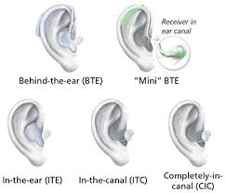

Slide 32
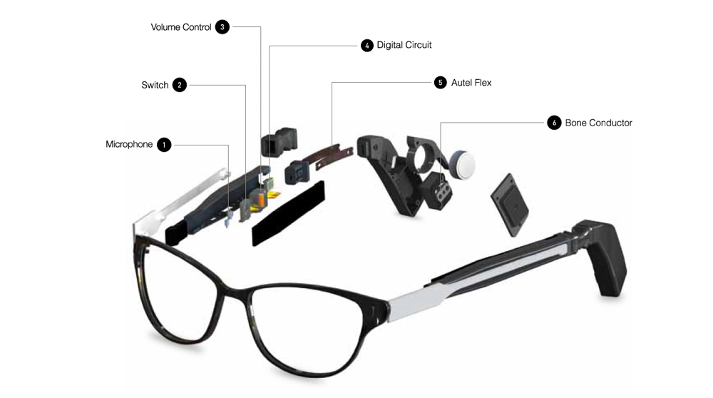
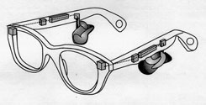
5. Spectacle type

Slide 33
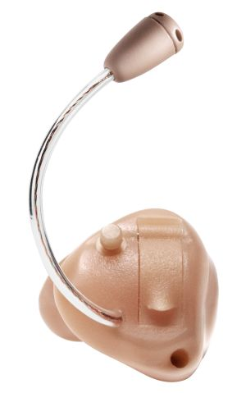
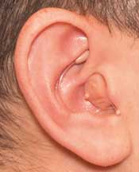
6. Remote microphone

Slide 34
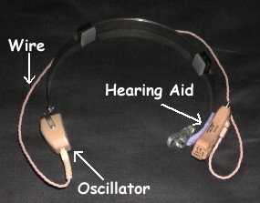
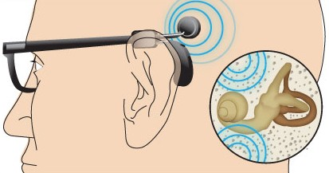
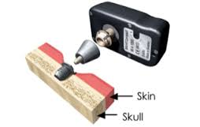
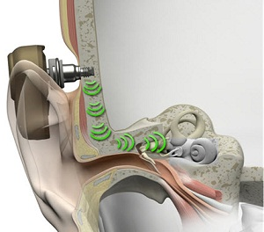
7. BONE CONDUCTION HEARING AIDS

Slide 35
Cochlear Implant
A cochlear implant is an auditory prosthesis used for people with profound sensorineural hearing loss bilaterally who do not benefit from conventional hearing aids.
A cochlear implant compensates for damaged or nonworking of inner ear.
The implant is designed to provide stimulation directly to the auditory nerve, bypassing the hair cells of the inner ear, which are not functioning.
The microphone and signal processor are worn outside the body and transmit electrical stimuli inside the body to the implanted electrodes.
The electrical signals stimulate the auditory nerve fibers and then the brain, where they are interpreted.

Slide 36
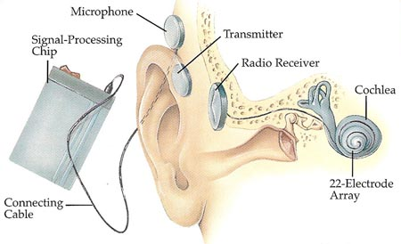
Several criteria apply for choosing adults who may benefit from a cochlear implant:
• Profound sensorineural hearing loss in both ears
• Inability to hear and recognize speech well with hearing aids
• No medical contraindication to a cochlear implant or general anesthesia
• Indications that being able to hear would enhance the patient’s life

Slide 37
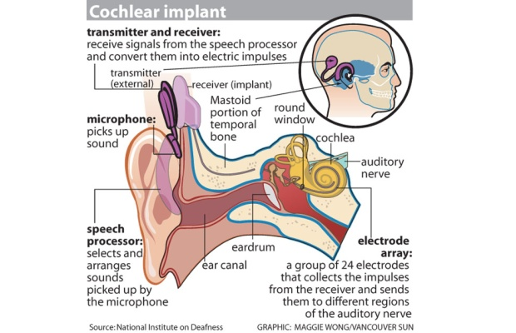

Slide 38
Cochlear Implant Surgery
Implant surgery is performed under general anesthesia and lasts from two to three hours.
An incision is made behind the ear to open the mastoid bone leading to the middle ear and then the inner ear is opened and implant electrodes are inserted.
A well is created in the skull bone for the placement of the receiver-stimulating system.
The procedure requires a stay in the hospital for 7 to 10 days.
Antibiotics and other supportive medicines are given to such a patient.

Slide 39
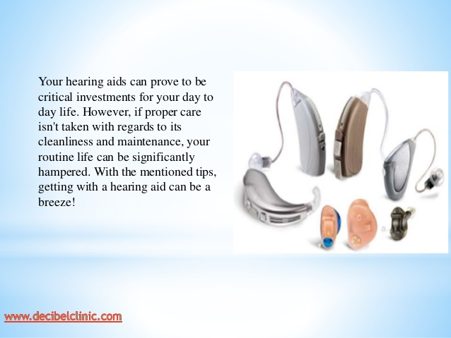
CARE OF HEARING AIDS

Slide 40
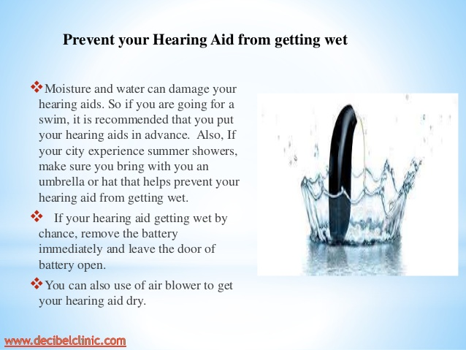

Slide 41


Slide 42
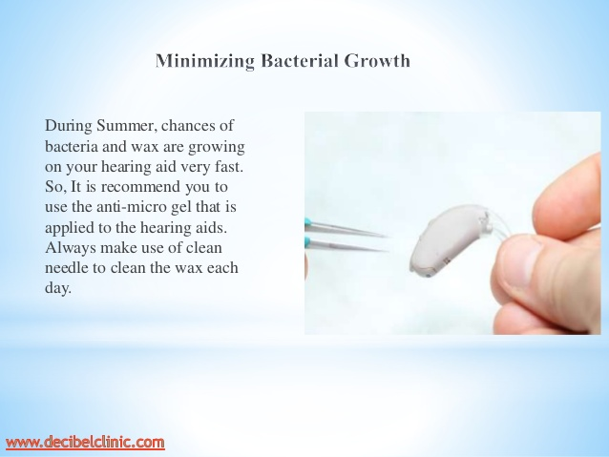

Slide 43
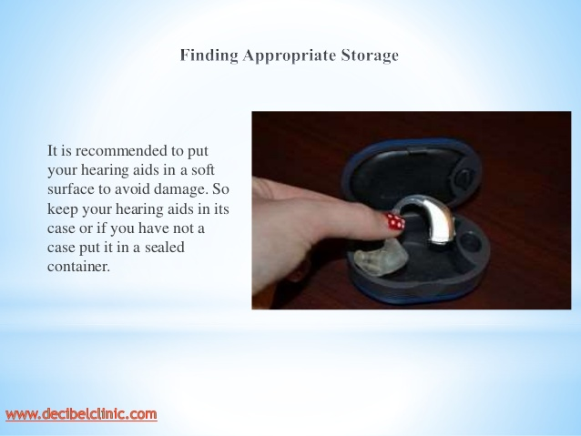

Slide 44
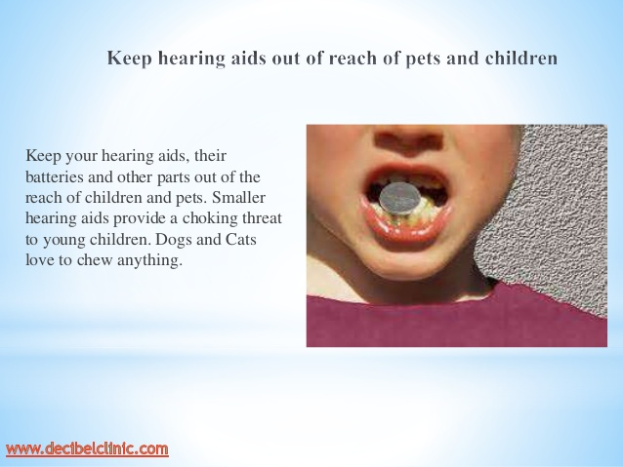

Slide 45


Slide 46
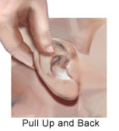
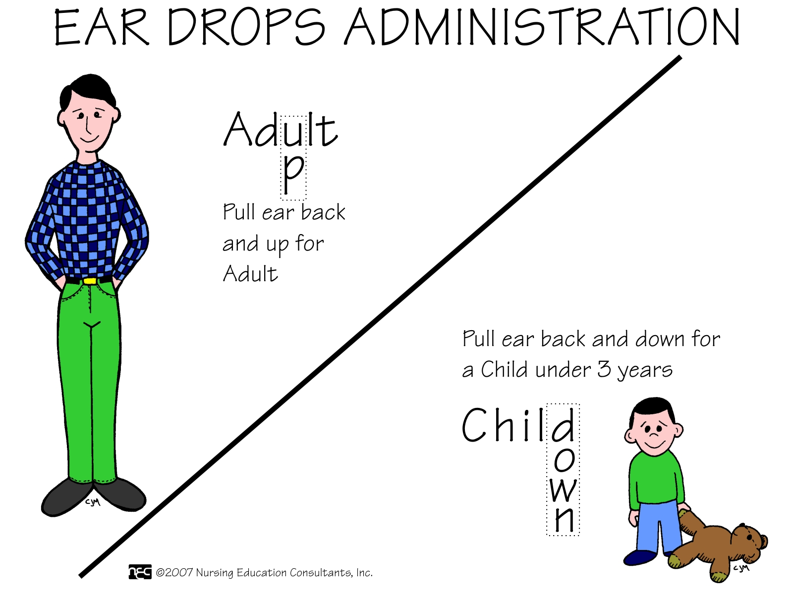
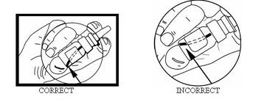
Manually open the ear canal and administer the appropriate dose.
Aural Medication Administration

Slide 47
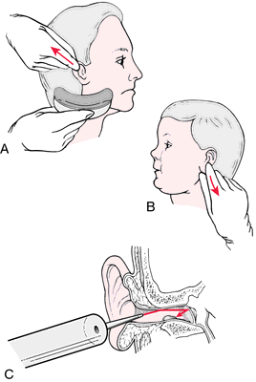
EAR IRRIGATION

Slide 48
1. Hearing aids are the:-
Devices used to clean the ear
Device used to decrease the frequency of sound inside the ear
Sound-amplifying devices designed to aid people who have a hearing impairment.
Used for the checking blood sugar level

Slide 49
2. The parts of Hearing aid are:-
Microphone
Amplifier and Receiver
Battery
All of the above

Slide 50
3. The types of hearing aids which sits in the curve of the ear is known as:-
Remote microphone
Behind the ear
In the ear
Complete in the canal

Slide 51
4. The care of hearing aids includes:-
Protect from direct sunlight
Minimize the bacterial growth
Proper storage
All of the above

Slide 52
5. To administration of ear drop in the adult ear we have to pull the ear:-
Pull ear Up and back
Pull ear up and front
Pull ear down and back
Pull ear down and front

Slide 53
C
D
A
D
A

