Slide 1

LEUKEMIAS
Mrs Sujitha S
Assistant Professor
Mrs Sujitha, Assistant Professor, Sumandeep Nursing College, SVDU.

Slide 2
What is leukemia?
Leukemia is cancer of the white blood cells. In leukemia, however, the bone marrow produces abnormal white blood cells. These cells crowd out the healthy blood cells, making it hard for blood to do its work.

Slide 3
Definition
Leukemia: is a cancer of the blood or bone marrow characterized by abnormal proliferation of blood cells,usually WBCs(Leukocytes).
Acute leukemia: rapid increase of immature blood cells.
Chronic leukemia: excessive build up of relatively mature,but still abnormal blood cells.

Slide 4
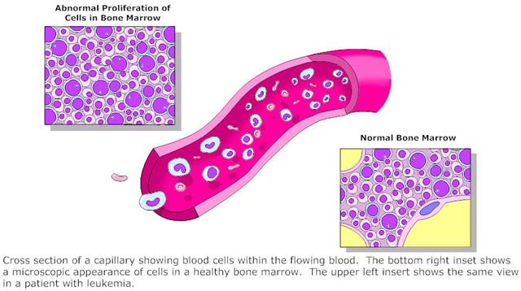

Slide 5
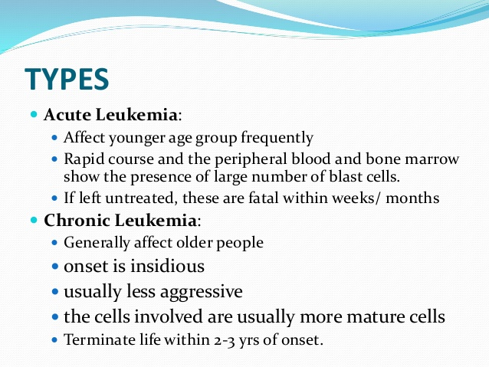
Mrs Sujitha, Assistant Professor, Sumandeep Nursing College, SVDU.

Slide 6
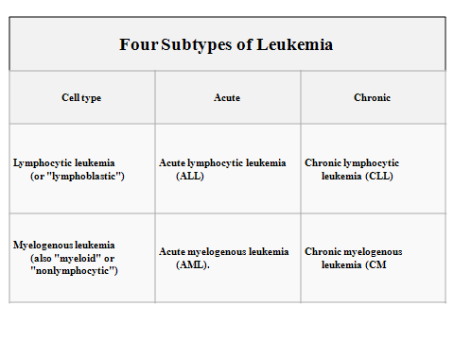
Mrs Sujitha, Assistant Professor, Sumandeep Nursing College, SVDU.

Slide 7
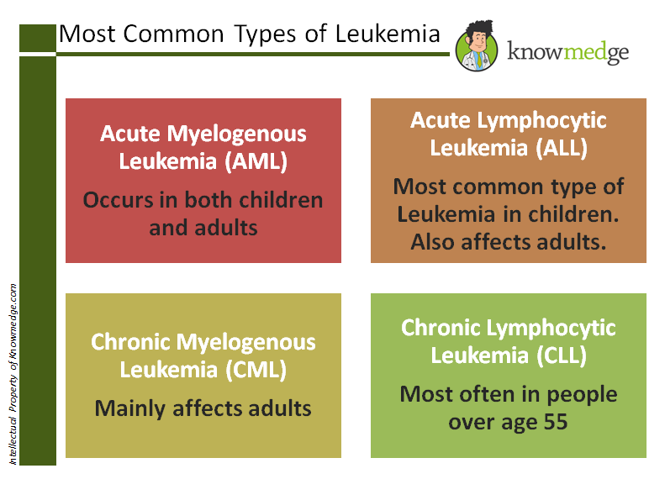
Mrs Sujitha, Assistant Professor, Sumandeep Nursing College, SVDU.

Slide 8
Causes
Leukemia like other malignancies, results
from abnormal mutations in the DNA.
These mutations may occur spontaneously or as a result of exposure to radiation or carcinogenic substances and likely be influenced by genetic factors.

Slide 9
Causes-cont’d
Ionizing radiation
Viruses: Human T-lymphotropic virus (HTLV-1)
Chemicals: Benzene,chemotherapy.
Smoking: slight increase in leukemia
incidence.
Genetic predisposition toward developing
leukemia

Slide 10
Signs and Symptoms
Most of the signs and symptoms are due to:
1-Anemia.
2-Leukopenia.
3-Thrombocytopenia.

Slide 11
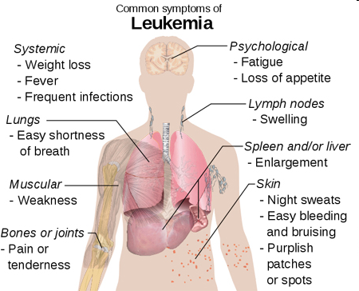

Slide 12
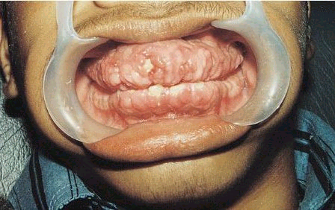
Gum hypertrophy

Slide 13
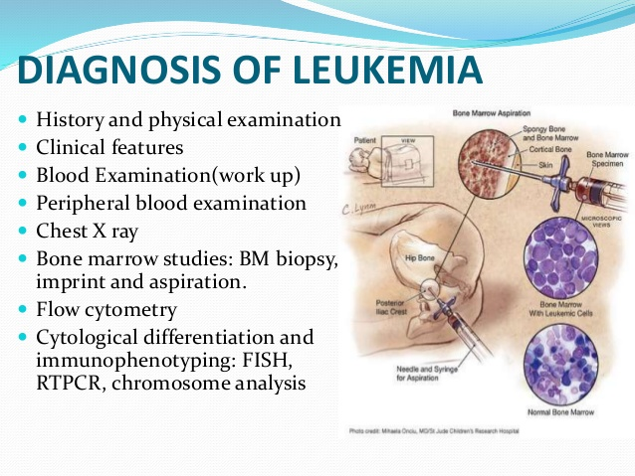

Slide 14
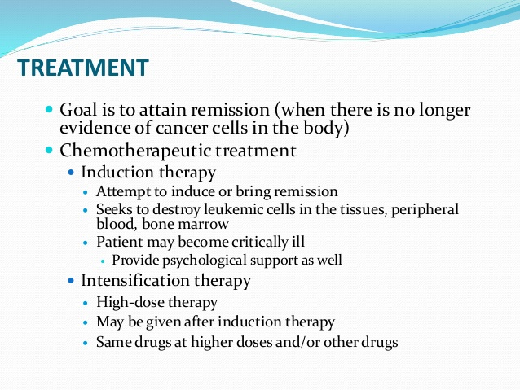
Mrs Sujitha, Assistant Professor, Sumandeep Nursing College, SVDU.

Slide 15
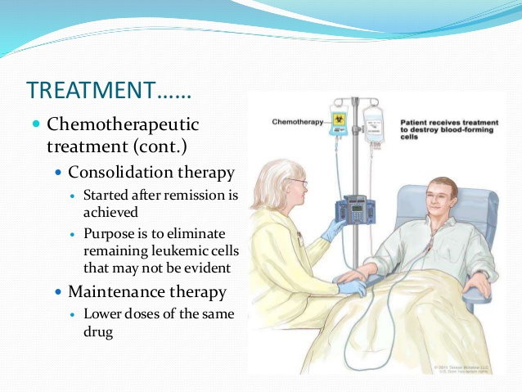
Mrs Sujitha, Assistant Professor, Sumandeep Nursing College, SVDU.

Slide 16
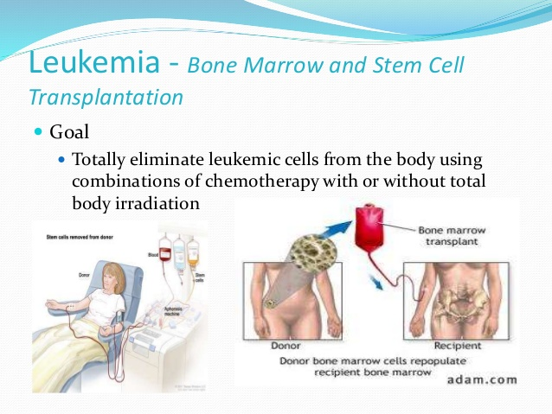
Mrs Sujitha, Assistant Professor, Sumandeep Nursing College, SVDU.

Slide 17
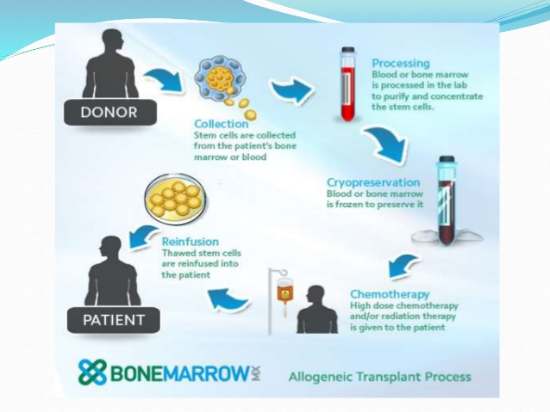
Mrs Sujitha, Assistant Professor, Sumandeep Nursing College, SVDU.

