Slide 1
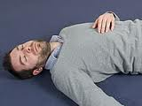

Management of patient with
Unconsciousness
Presented By:
Ms. Sonal Patel
Assistant Professor
Sumandeep Nursing College
Sumandeep Vidyapeeth Deemed to be University.

Slide 2
Definitions
Unconsciousness can be defined as near complete or complete depressed cerebral function that results an abnormal loss of awareness of the self and surroundings.

Slide 3
A state of complete or partial unawareness or lack of response to sensory stimuli as a result of hypoxia caused by respiratory insufficiency or shock; from metabolic or chemical brain depressants such as drugs, poisons, ketones, or electrolyte imbalance; or from a form of brain pathologic condition such as trauma, seizures, cerebrovascular insult, brain tumor, or infection.

Slide 4
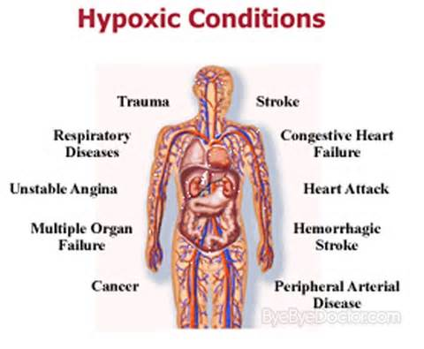
Causes:
1 ) Hypoxia
Airway Obstruction(Foreign body, secretions)
Pneumothorax
Spinal cord Injury
Cardiogenic Shock
Hypovolemic shock
2)Metabolic
i)Extrinsic:
DrugsAlchohol,narcotics,barbiturates,antihistamines
Poisons: Carbon monoxide,Methane

Slide 5
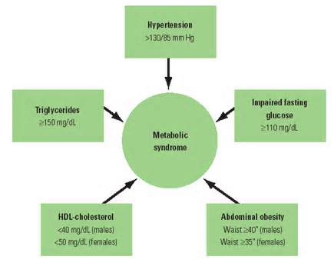
ii)Intrinsic:
Ketones:Diabetic Ketoacidosis,starvation
Glucose: Hypoglycemia,Hyperglycemia
Ammonia :liver failiure
Urea: renal failiure
Hormonal: Hypofunction, Hypothyroidism, Hyperthyroidism, Addisson’s disease
Electrolyte Imbalance: sodium,potassium,calcium

Slide 6
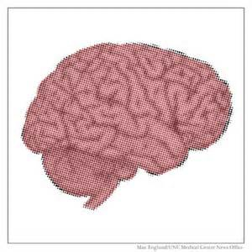
3)Brain Pathologic Conditions
TRAUMA: concussion, brainstem contusions
SEIZURES: Epilepsy ,tumors
Tumors: Benign, Malignant
Infections: Meningitis

Slide 7
Risk Factors:
  Diabetes mellitus
  Dehydration
  Burns
  Renal infection
  Liver cirrhosis
  Drug overdose
  Cardiac Arrest

Slide 8
Clinical Manifestations:-
I) Respiratory System:
Apneustic breathing
Cheyne-stokes respiration
Stridor
Assymetrical rise and fall of chest
bradypnea
Pulmonary edema
Decreased rate, decrease depth

Slide 9
II) Cardiovascular system:
Bradycardia
Feeble pulse
Hypotension
Decreased cardiac output
Hyperkalemia
Arrhythmia
Murmurs
Ventricular fibrillation

Slide 10
III) Neurological system:
Asterexis
Absent corneal reflex
Absent deep tendon reflexes
Absent Gag reflex
Myoclonus
Cranial nerve palsies
Lethargy
Increased ICP
Unequal Pupillary Dilation
Absent Occulocephalic reflex
Low Glasgow coma score

Slide 11
III) Gastrointestinal System:
Abdominal Distention
Ascites
Decreased Bowel sounds
Constipation
Hyperlipidemia

Slide 12
IV) Urinary system:
Urinary Incontinence
Oliguria
UTI
Suprapubic Distention
Pyuria
High Creatinine Index
Anuria

Slide 13
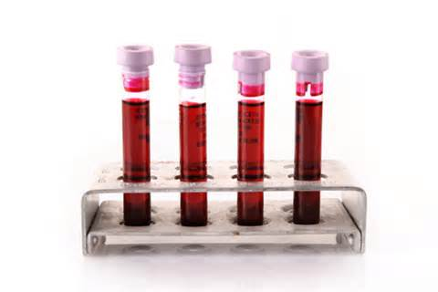
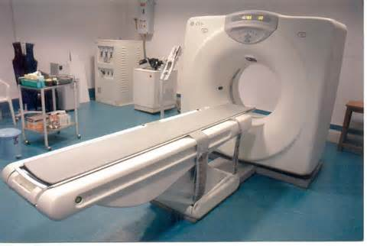
Diagnostic Evaluation:
Blood tests
CT,MRI

Slide 14
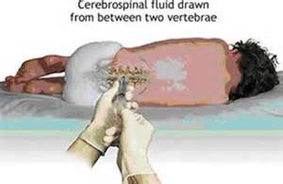
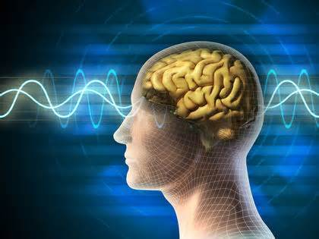
Lumbar Puncture
Electroencephalography

Slide 15
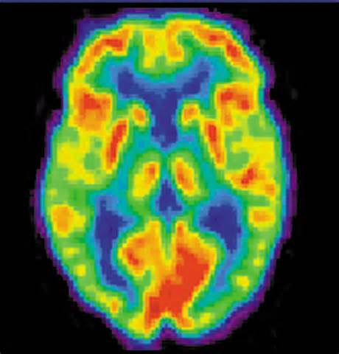
PET Scan

Slide 16
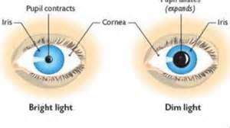
Tests for Abnormal ocular Reflexes
  Oculocephalic reflex-The oculocephalic reflex is a medical sign seen in comatose patients in which the eyes will move opposite the direction the head is turned, thus maintaining a more-or-less steady gaze. It is also called the doll's eye reflex due to the fact that many dolls with movable eyes mimic the reflex.
  Oculovestibular Reflex-oculovestibular reflex is a reflex eye movement that stabilizes images on the retina during head movement by producing an eye movement in the direction opposite to head movement, thus preserving the image on the center of the visual field

Slide 17
Medical Management:
Goal of Medical management:
Treatment of the underlying cause(tumors, head injury, renal failure ,brain abscess) is a main priority in treating unconsciousness.
History taking: A brief history is taken by the physician regarding the condition of the patient and treated accordingly.
Physical Assessment: A physical assessment is done by the physician
Emergency Medical Management:-On Admission of Unconscious patient 3 main parameters are usually checked:
  Airway obstruction(any foreign body, secretions)
  Breathing(asymmetrical chest rise,apneustic breathing)
  Circulation(Bradycardia,feeble pulse)

Slide 18
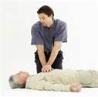
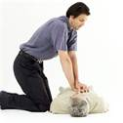
Emergency Medical Management:-
    CPR - Cardio-pulmonary Resuscitation used to revive the unconscious patient along with increased oxygenation, and prevent hypoxia of the brain.

Slide 19
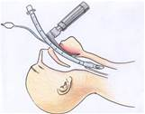
    Endo-Tracheal Intubation:

Slide 20
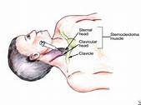
Central line insertion

Slide 21
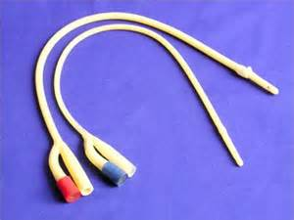
Foley’s Catheterization

Slide 22
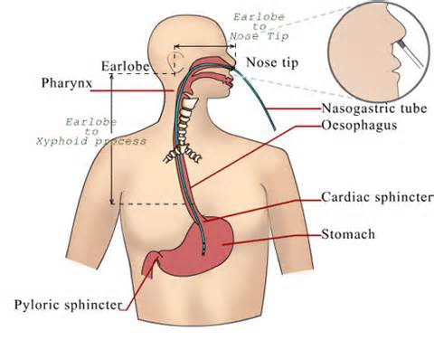
Ryles tube insertion

Slide 23
PHARMACOLOGICAL THERAPHY
DRUG NAME | INDICATION | DOSE | ACTION
Inj Dopamine | Hypotension | 1-5 mcg/kg | Anti-shock drug
Inj NitroGlycerine | Hypertension | 2-4 gm/day | Anti-hypertensive
Inj phenytoin | Seizure activity | 100mg/6-8 hrs | Anti-convulsant
Inj .Atropine sulphate | Bradycardia | As per physician’s order | Anti-cholinergic
Inj.Amiodarone | Atrial fibrillation | 5-10/kg | Anti-arrythmic
Inj Midazolam | Agitation | 0.2-7mg/kg | Sedative

Slide 24
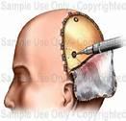
Surgical Management:
BURR HOLE SURGERY: Burr holes or keyhole craniotomy is a surgery in which incision made in the cranial vault for various purposes like:
insert a shunt into the ventricles to drain cerebrospinal fluid (hydrocephalus)
insert an intracranial pressure (ICP) monitor
remove a small sample of abnormal tissue (needle biopsy)
drain a blood clot (stereotactic hematoma aspiration)
insert an endoscope to remove small tumors and clip aneurysms

Slide 25
Post operative nursing care:
1. Monitor vital-signs carefully
2. Watch for rise in temperature, a sign of infection
3.Measure the ICP at frequent intervals
4..Measure the amount of drain and empty at regular intervals
5.keep the bed flat(risk of increased ICP.)

Slide 26
Nursing Management
NURSING PROCESS:
1) NURSING DIAGNOSIS: Ineffective airway clearance related to accumulation of secretion secondary to unconsciousness.
2)NURSING DIAGNOSIS: Ineffective breathing patterns related to brain stem regulatory dysfunction and immobility
3)NURSING DIAGNOSIS: Altered urinary and bowel pattern related to sensory-neural dysfunction.
4)NURSING DIAGNOSIS: Altered nutrition less than body requirements related to unconsciousness, as evidenced by decreased weight.
5)NURSING DIAGNOSIS: Impaired skin integrity related to immobility, nutritional deficiency secondary to unconsciousness

Slide 27
THANK YOU

