Slide 1
MECHANICAL
VENTILATION
AND NURSING RESPONSIBILITY

Slide 2
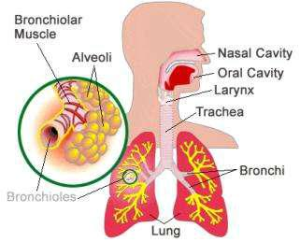
ANATOMY AND PHYSIOLOGY OF LUNGS

Slide 3
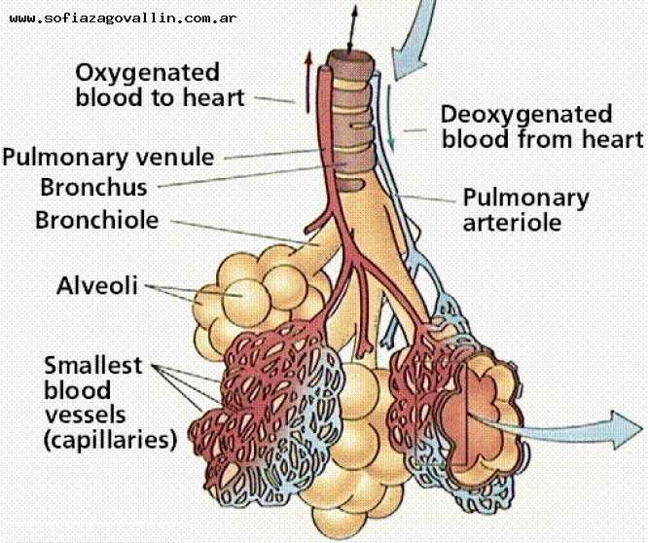

Slide 4
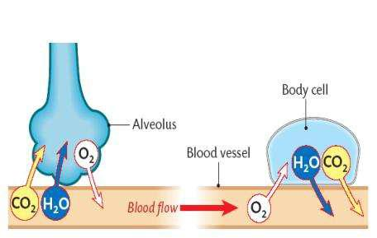

Slide 5
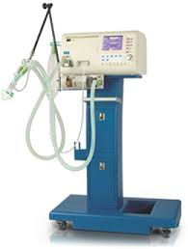
VENTILATOR:
A mechanical ventilator is a machine that generates a controlled flow of gas into a patient’s airways.

Slide 6
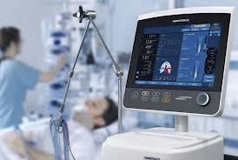
DEFINITION:
Oxygen and air are received from cylinders or wall outlets, the gas is pressure reduced and blended according to the prescribed inspired oxygen tension (FiO2), accumulated in a receptacle within the machine, and delivered to the patient using one of many available modes of ventilation.

Slide 7
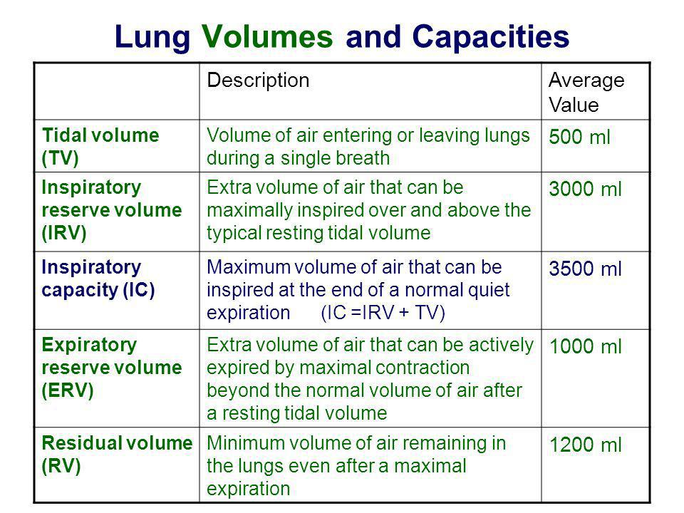

Slide 8
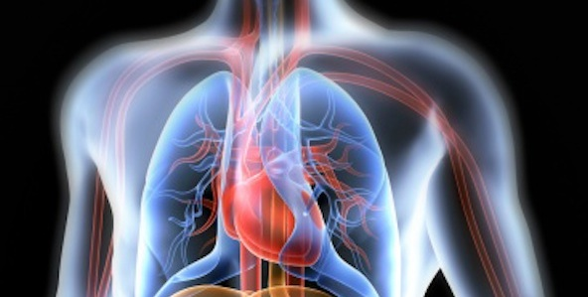
Indication
1. Impaired Lung Function
Common medical indications:
Acute lung injury (including ARDS, trauma)
Apnea with respiratory arrest, including cases from intoxication
Chronic obstructive pulmonary disease (COPD)
Acute respiratory acidosis with partial pressure of carbon dioxide (pCO₂) > 50 mmHg and pH < 7.25

Slide 9



Continue…
Hypotension including sepsis, shock, congestive heart failure
Neurological diseases such as Muscular Dystrophy and Amyotrophic Lateral Sclerosis
Brain injury or stroke
Drug overdose

Slide 10
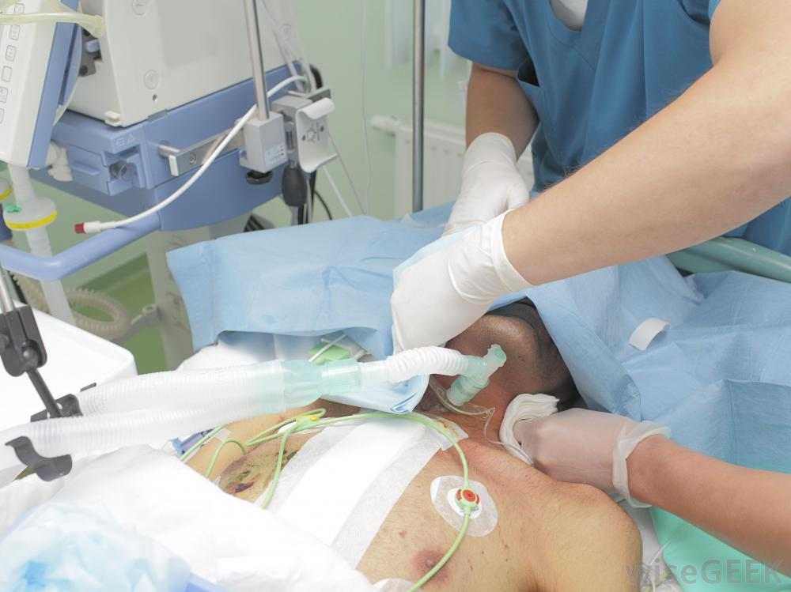
During Surgery

Slide 11
TYPES OF MECHANICAL VENTILATORS
1. TRANSPORT VENTILATORS
2. ICU VENTILATORS
3. NICU VENTILATORS:

Slide 12
4. PAP VENTILATORS
5. PRESSURE CYCLED VENTILATOR
6. TIME CYCLED VENTILATOR
7. VOLUME CYCLED VENTILATOR
8. MICROPROCESSOR VENTILATOR

Slide 13
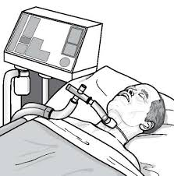
MECHANISM OF ACTION
Ventilators blow air—or air with extra oxygen—into the airways and then the lungs. The airways are pipes that carry oxygen-rich air to your lungs. They also carry carbon dioxide, a waste gas, out of lungs.

Slide 14

The Breathing Tube
A ventilator blows air into your airways through a breathing tube. One end of the tube is inserted into your windpipe and the other end is attached to the ventilator.

Slide 15
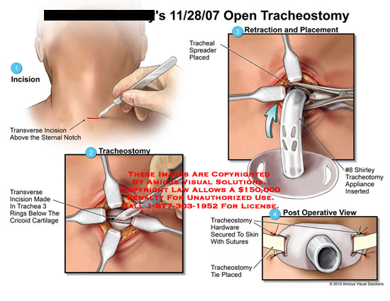
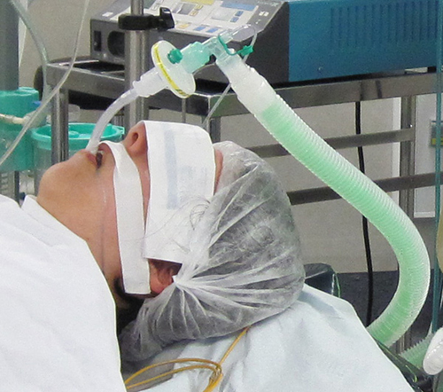
The process of inserting the tube into your windpipe is called intubation.

Slide 16
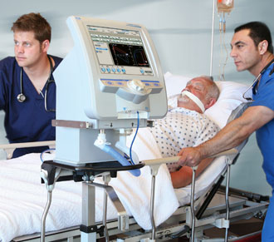
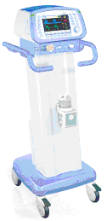
A ventilator uses pressure to blow air or a mixture of gases (like oxygen and air) into the lungs. This pressure is known as positive pressure.

Slide 17
MODES
OF VENTILATOR

Slide 18
INVASIVE VENTILATION

Slide 19
Modes of ventilation
Volume control
Pressure control
Others modes

Slide 20
A. VOLUME MODES
Assist-Control Ventilation (ACV)
Also known as continuous mandatory ventilation (CMV). Each breath is either an assist or control breath, but they are all of the same volume.
Delivers pre-set volumes at a pre-set rate and a pre-set flow rate.

Slide 21
The patient cannot generate spontaneous volumes, or flow rates in this mode.
Each patient generated respiratory effort over and above the set rate are delivered at the set volume and flow rate
Uses most often in the paralyzed or apneic patient because it can increase the work of breathing if respiratory effort is present.

Slide 22
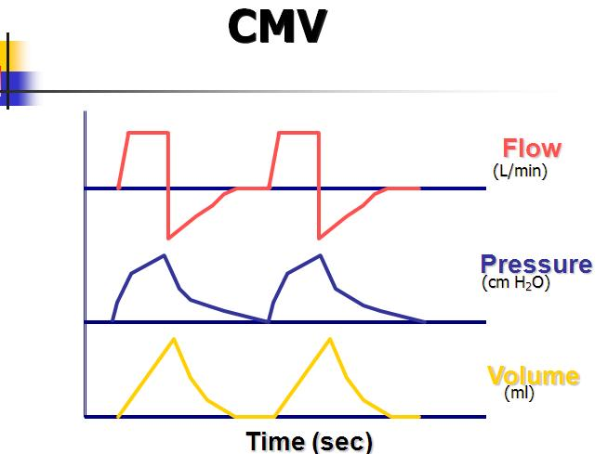

Slide 23
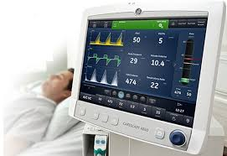
2. Synchronized Intermittent-Mandatory Ventilation (SIMV)
The ventilator delivers pre-set breaths in coordination with the respiratory effort of the patient.
Spontaneous breathing is allowed between breaths.

Slide 24
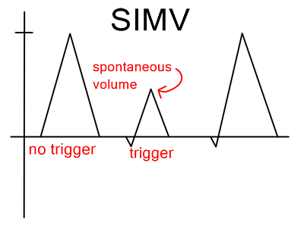
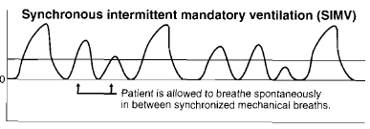

Slide 25
Continue..
Here ventilator delivers set tidal volume and rate as set by doctor. But when patient is awake and not paralysed , and starts his breathing, ventilator detects efforts and supports it.
Used in partially awake and non parlayed patients and during weaning.

Slide 26
ACV vs. SIMV
Patients who breathe rapidly on ACV should switch to SIMV
Patients who have respiratory muscle weakness and/or left-ventricular dysfunction should be switched to ACV

Slide 27
B. PRESSURE MODES:
Pressure-Controlled Ventilation (PCV)
A set peak inspiratory pressure (PIP) is applied, and the pressure difference between the ventilator and the lungs results in inflation until the peak pressure is attained and passive exhalation follows.

Slide 28
2. Pressure Support Ventilation (PSV)
Allows the patient to determine inflation volume and respiratory frequency thus can only be used to increase spontaneous breathing.
Pressure support can be used to overcome the resistance of ventilator tubing in another cycle

Slide 29
3. Pressure Controlled Inverse Ratio Ventilation (PCIRV)
Pressure controlled ventilatory mode in which the majority of time is spent at the higher (inspiratory) pressure.
Early trials were promising, however the risks of auto PEEP and hemodynamic deterioration due to the decreased expiratory time and increased mean airway pressure generally outweight the small potential for improved oxygenation.

Slide 30
4. Airway Pressure Release Ventilation (APRV)
Airway pressure release ventilation is similar to PCIRV – instead of being a variation of PCV in which the I:E ratio is reversed, APRV is a variation of CPAP that releases pressure temporarily on exhalation

Slide 31
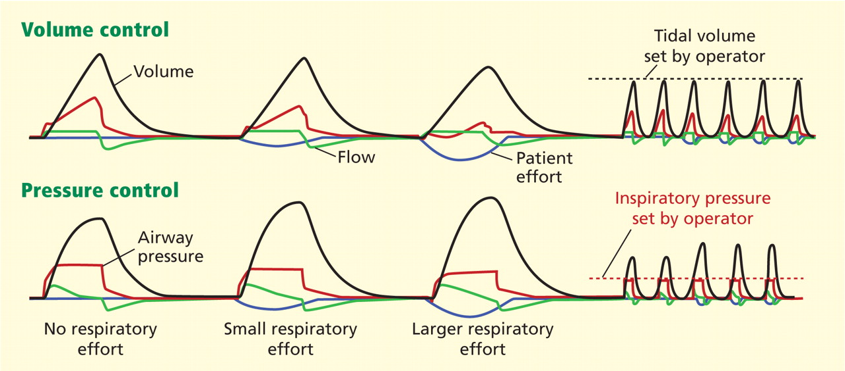

Slide 32
C. OTHER MODES:
I. DUAL MODE
      1.Pressure Regulated Volume Control (PRVC)
This is a volume targeted, pressure limited mode. (available in SIMV or AC)
Each breath is delivered at a set volume with a variable flow rate and an absolute pressure limit.
The vent delivers this pre-set volume at the LOWEST required peak pressure and adjust with each breath.

Slide 33
II. INTERACTIVE MODE:
Proportional Assist Ventilation (PAV)
During PAV, the clinician sets the percentage of work of breathing to be provided by the ventilator.

Slide 34
Continuous Positive Airway Pressure (CPAP)
Positive pressure given throughout the cycle.
It can be delivered through a mask and is can be used in obstructive sleep apnea (esp. with a nasal mask), to postpone intubation, or to treat acute exacerbations of COPD

Slide 35
PSV is frequently the mode of choice in patients whose respiratory failure is not severe and who have an adequate respiratory drive.
It can result in improved patient comfort, reduced cardiovascular effects, reduced risk of barotrauma, and improved distribution of gas.

Slide 36
Non-invasive ventilation/ BiPAP:
The application of mechanical ventilatory support through a mask in place of endotracheal intubation is becoming increasingly accepted and used in the emergency department.
Considering this modality for patients with mild-to-moderate respiratory failure is appropriate.

Slide 37
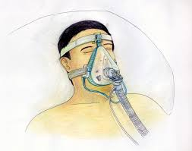

Slide 38
Clinical situations in which it has proven useful include acute exacerbation of chronic obstructive pulmonary disease (COPD) or asthma, decompensated congestive heart failure (CHF) with mild-to-moderate pulmonary edema, and pulmonary edema from hypervolemia.

Slide 39
BiPAP is commonly misunderstood to be a form of pressure support ventilation triggered by patient breaths; in actuality, BiPAP is a form of CPAP that alternates between high and low.
positive airway pressures, permitting inspiration (and expiration) throughout.

Slide 40
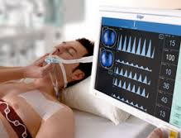
COMMON SETTINGS OF VENTILATION
SIMV and A/C are versatile modes that can be used for initial settings. In patients with a good respiratory drive and mild-to-moderate respiratory failure, PSV is a good initial choice.

Slide 41
Tidal volume
An initial TV of 5-8 mL/kg of ideal body weight is generally indicated, with the lowest values recommended in the presence of obstructive airway disease and ARDS.
The goal is to adjust the TV so that plateau pressures are less than 35 cm H₂ O.

Slide 42
VENTILATOR TROUBLESHOOTING - MANAGING COMPLICATIONS IN THE EMERGENCY DEPARTMENT:
The complications most commonly encountered in the emergency department include hypoxia, hypotension, high pressure alarms, and low exhaled volume alarms.
High pressure alarms are triggered when resistance to ventilation is high.

Slide 43
patients should be evaluated for pneumothorax, bronchospasm, elevated abdominal pressure, mainstem intubation, tube plugs or kinks, tube biting, dynamic hyperinflation/air trapping, psychomotor agitation, and worsening pulmonary compliance secondary to progressive pulmonary disease.
Tube suctioning and adequate patient sedation are recommended after other causes of obstruction are ruled out.

Slide 44
NURSING CARE OF PATIENT WITH VENTILATOR
Sedation and Paralysis
Midazolam
Muscle relaxant eg: baclofen
"neuromuscular blockades“: prevent skeletal muscle from contracting and thereby stop all patient movement including respiratory efforts.
Eg. Pancuronium, rocuronium, vecuronium etc.

Slide 45
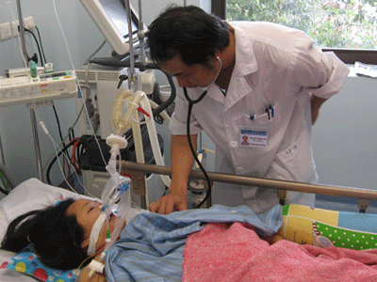
PRELIMINARY ASSESSMENT

Slide 46
Patients' beds are often elevated to about 30°.
Deep vein thrombosis prophylaxis.
Histamine receptor (H2) blocker or proton-pump inhibitor.
Preparation of intubation and tracheostomy.
Esophageal obturator airway.
Care of the airway
Check the bedside emergency equipment
Care of ventilator alarms
Suction of an Artificial Airway
Oral Care
Eye Care
Care of G I tract
Genital/Urinary Tract

Slide 47
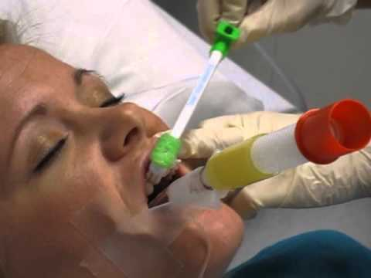

Slide 48

Repositioning And Pressure Area Care:

Slide 49
COMPLICATIONS OF MECHANICAL VENTILATION
Decreased Cardiac Output
Barotrauma
Nosocomial Pneumonia
Decreased Renal Perfusion – can be treated with low dose dopamine therapy.
Increased Intracranial Pressure (ICP) – reduce PEEP Hepatic congestion – reduce PEEP
Worsening of intra cardiac shunts –reduce PEEP Associated with ventilator malfunction

Slide 50
OTHER COMPLICATIONS RELATED TO ENDOTRACHEAL INTUBATION.
Sinusitis and nasal injury – obstruction of paranasal sinus drainage; pressure necrosis of nares
Tracheoesophageal fistula
Mucosal lesions – pressure at tube and mucosal interface
Troubleshooting Ventilator Alarms

Slide 51


Slide 52

s

