Slide 1

BULIMIA NERVOSA AND OBESITY
Prepared by:
Mr. Suresh V.
Associate Professor
Department of Mental health nursing
Sumandeep Nursing college

Slide 2


Slide 3
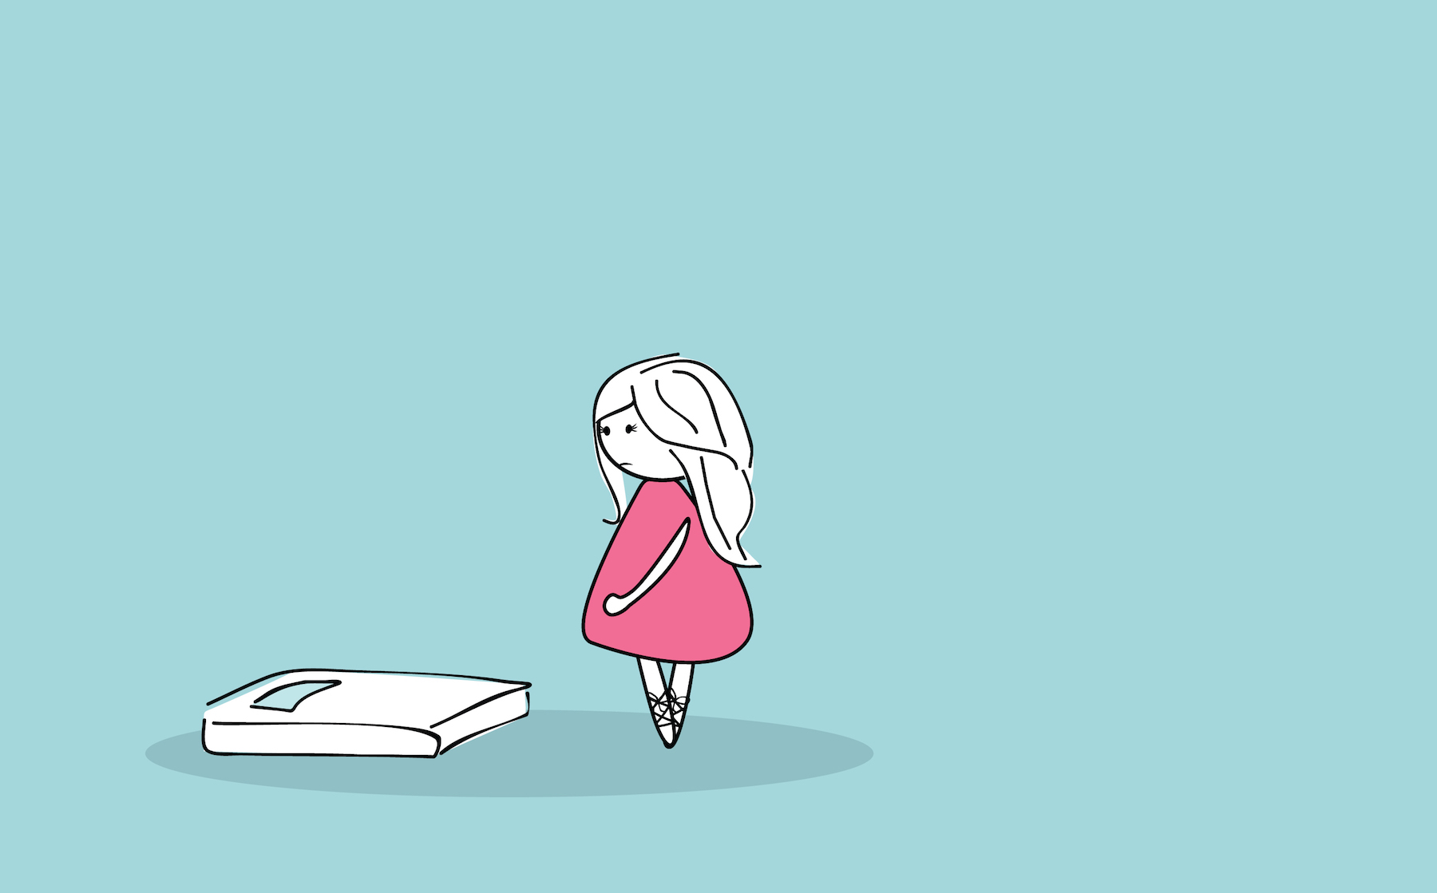
Introduction
Bulimia nervosa is an eating disorder in which a person binges and purges. The person may eat a lot of food at once and then try to get rid of it by vomiting, using laxatives, or sometimes over-exercising.
Bulimia is linked to depression and other psychiatric disorders
Because many people with bulimia can stay at a normal weight, they may keep their condition a secret for years.

Slide 4

Binge eating of high-carbohydrate foods, usually in secret
Going to the bathroom during meals
Constipation, diarrhea, nausea, gas, abdominal pain
Exercising for hours
Eating until painfully full
Losing control over eating, and feeling guilt and shame
Weight that goes up and down
Dehydration
Missed periods or lack of menstrual periods
Damaged tooth enamel
Bad breath
Depression
Sore throat or mouth sores

Slide 5
Causes
No one knows what causes bulimia, although there are several theories. Genes may play a part. Women who have a sister or mother with bulimia may be at higher risk of developing the condition.

Slide 6
Social
Biological
Genetic
Sex hormones
Dieting

Slide 7
Epidemiology
Bulimia nervosa is more prevalent than anorexia nervosa, with estimates up to 4 percent of young women. Onset of bulimia nervosa occurs in late adolescence or early adulthood. Cross-cultural research suggests that bulimia nervosa occurs primarily in societies that place emphasis on thinness as the model of attractiveness for women and where an abundance of food is available.

Slide 8
Risk factor
White, middle-class women -- mostly teenagers and college students
Those with a family history of mood disorders and substance abuse
People with low self-esteem.

Slide 9

Drug Therapies
Antidepressants are used for bulimia, usually those called selective serotonin reuptake inhibitors (SSRIs). They include:
Fluoxetine (Prozac)
Sertraline (Zoloft)
Paroxetine (Paxil)
Fluvoxamine (Luvox)

Slide 10
Prozac is the only antidepressant approved by the Food and Drug Administration to treat bulimia. Some studies suggest that similar drugs, such as Luvox, may work even better.
Some studies have found that Prozac and other antidepressants may cause some children and teenagers to have suicidal thoughts. Children who take these drugs should be watched very carefully for signs of suicidal behavior.
People with bulimia may not be getting the nutrients their bodies need. Your health care provider may prescribe potassium or iron supplements, or other supplements to make up for any loss.

Slide 11
Complementary and Alternative Therapies:-

