Slide 1


IMPULSE CONTROL DISORDERS (ICDs)
Prepared by:
Mrs. Bhoomika Patel
Assistant Professor
Department of Mental health nursing
Sumandeep Nursing college

Slide 2
Overview
‘Throughout the past few years, ICDs have attracted the attention of clinicians and psychiatrists due to their impact on the society. Interestingly enough, the rapid advancement of technology and its effects on the society is incriminated to be the cause for the rise in the prevalence of ICDs. The advent of the Internet has created unlimited access to gambling, shopping, porn and stock trading; thus, the incidence of impulsive behavior patterns has risen sharply. Even more, new forms of impulsive disorders have emerged such

Slide 3
Definition of terms
Impulse-control disorders
(ICDs) are the
psychological disorders characterized by
repeated inability to refrain from performing a particular action that is harmful either to oneself or others.
The individual fails potentially harmful
to resist performing a act and it is usually
accompanied by a sense of tension or arousal before committing the act and a sense of relief or pleasure when it is committed.

Slide 4
OUTLINE OF IMPULSE CONTROL DISORDERS (ICDs)

Slide 5
Outline of ICDs
According to the DSM-IV-TR classification:
  Impulse control disorders not elsewhere classified:
    Intermittent explosive disorders
    Pyromania
    Kleptomania
    Pathological gambling
    Trichotillomania
  Impulse control disorders not otherwise specified:
    Impulsive compulsive self injurious disorders
    Impulsive compulsive sexual disorders
    Impulsive compulsive buying disorders
    Impulsive compulsive Internet usage disorders

Slide 6
Major Cognitive Components
Failure to delay gratifications
Distractibility
Dis-inhibition

Slide 7
Incidence
As compared to other mental disorders, impulse control disorders were found in 8.9% (12-month prevalence) and 24.8% (lifetime prevalence) of the population with a greater proportion at the serious level.
Recent studies have shown that the prevalence was approximately 7.4% for individuals between 30 and 44 years of age, while it was only 5.7% for those between 30 and 44 years and dropped to 4.9% for those between 45 and 59 years

Slide 8
Risk factors
Traumatic Brain Injury may result in some individuals developing impulsive disorder. This is particularly true when the damage has been to the frontal cortex area.
Substance abuse appears to be commonly associated with impulsivity. While not all individuals with substance abuse problems will develop impulse control problems, research has noted a strong correlation between the two.

Slide 9
Etiology
Biological : limbic system, Serious head injuries, epilepsy, side effects of other medical conditions
Psychological : Instinctual drives or by diminished ego defenses against the drives
Social: Early-life events, exposure to violence in the home, alcohol abuse, promiscuity, and antisocial behavior, Modeling

Slide 10




INTERMITTENT EXPLOSIVE DISORDER (IED)

Slide 11
IED
Intermittent explosive disorder manifests as discrete episodes of losing control of aggressive impulses; these episodes can result in serious assault or the destruction of property.
The symptoms, which patients may describe as spells
or attacks, appear within minutes or hours and,
and
regardless of duration, remit spontaneously quickly.

Slide 12
IED – Case Presentations
A 31-year-old male presented with features of remaining aloof, sad, having prominent guilt ideas and entertaining thoughts of causing self- harm. The symptoms had developed insidiously when his wife learnt about his extramarital affair with a known relative. After his wife left him, the feelings of low mood became more intense and he started to entertain suicidal thoughts. While driving his motorcycle in the night, he met with an accident and started to bleed profusely. He tasted his own blood and liked the smell and taste of it. Thus, the frequent incidences of wrist cutting started so that he could suck his own blood. The act would be preceded by a mounting tension and arousal and subsequent relief would be noted later. He would break bottles and, with the glass pieces, would slash his palm, wrist and feet to see and feel the blood. He would also chew the glass pieces and the hurt caused by the glass pieces to his cheek and lips would actually be enjoyed by the individual. He even resorted to head banging so that the injuries caused to the scalp would produce more blood. As his unusual behavior was noted, he was admitted to the psychiatric center. While he was admitted to the hospital, he remained symptomatic. He was noted to remain quiet and aloof only to be shattered with episodic outbursts of intense anger and aggression. He assaulted other inpatients and derived pleasure from this fact. The episode lasted from 15 to 30 min and subsided on its own. The individual would remember the incident, but would give no

Slide 13
IED – Case Presentations
Kevin is diagnosed with an intermittent explosive behavior. He was raged with anger when a friend of him, Mike, mocked the way his hair looks. He suddenly punched Mike hardly in the face breaking the poor guy’s nose. This is just one of many examples of Kevin’s unnecessary aggressive responses. When he is really angry, his temper builds up so fast and bursts with aggressive actions that usually harm people around him. His rage usually cools down in around 30 minutes after which he sometimes even forgets that he has harmed any one.

Slide 14
DSM-IV-TR CRITERIA
Several discrete episodes of failure to resist aggressive impulses that result in serious assaultive acts or destruction of property.
The degree of aggressiveness expressed during the episodes is grossly out of proportion to any precipitating psychosocial stressors.
The aggressive episodes are not better accounted for by any other mental disorder (e.g. Antisocial PD, Borderline PD, Conduct Disorder, ADHD, a Manic Episode, a Psychotic Disorder), are not due to the direct physiological effects of a substance, or a general medical condition (e.g. head trauma, Alzheimer’s disease).

Slide 15
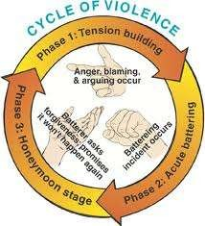
Facts and Figures
Gender Differences: more common in men than women
Prevalence: rare
Course: variable; chronic or episodic course
Onset: childhood to the early 20’s

Slide 16
Contributing Factors
Behavioral theory:
  Antecedents: a sense of tension or arousal
  Behavior: explosive behavior, aggressive episodes
  Immediate consequences: a sense of relief & release
  Delayed consequences: feeling upset, remorseful, regretful, embarrassed about the aggressive behavior
Personality factors: Generalized impulsivity or aggressiveness, chronic anger management problems
Childhood history of temper tantrums, impaired attention, hyperactivity, and other behavioral difficulties
Early learning: modeling, parenting styles, family conflict
Biological factors: low levels of serotonin & norepinephrine,
high levels of testosterone
Stress

Slide 17
Differential Diagnosis
Delirium
Dementia
Personality change due to a general medical condition, general type
Substance intoxication
Substance withdrawal
Oppositional defiant disorder
Conduct disorder
Antisocial disorder
Borderline disorder
Mania
Schizophrenia
Tourette’s Syndrome
“Anger attacks” are seen sometimes as part of MDD or panic disorder

Slide 18
Treatment – Psychosocial
Individual psychotherapies
Group psychotherapies
Anger management
Medications used in the treatment of IEDs are all off –label!
Examples include:
  Mood stabilizers such as Lithium and the anticonvulsants
  Beta blockers
  SSRIs

Slide 19
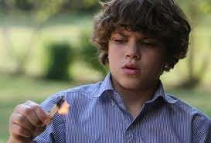
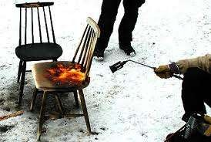
PYROMANIA

Slide 20
Pyromania
Pyromania is the
recurrent, deliberate, and purposeful
setting of fires. Associated features include tension or affective arousal before setting the fires; fascination with, interest in, curiosity about, or attraction to fire and the activities and equipment associated with firefighting; and pleasure, gratification, or relief when setting fires or when witnessing or participating in their aftermath.
Moreover, the patient usually feels stressed before setting the fire and relieved after performing the act.
Pyromania is extremely rare and literature data is rather scarce.
Incidence <1%, M>F

Slide 21
Etiology
Environmental : limited supervision, parental lack of involvement, parental pathology, stressful events
Temperamental factor
Parental Psychiatric disorders
Neuro-biological : low levels of Monoamine Oxidase, diminished serotonin activity
Substance abuse

Slide 22
DSM-IV-TR CRITERIA
Deliberate and purposeful fire setting on more than one occasion.
Tension or affective arousal before the act.
Fascination with, interest in, curiosity about, or attraction to fire and its situational contexts (e.g. paraphernalia, uses, consequences).
Pleasure, gratification, or relief when setting fires, or when witnessing or participating in their aftermath.
The fire setting is not done for monetary gain, as an expression of sociopolitical ideology, to conceal criminal activity, to express anger or vengeance, to improve one’s living circumstances, in response to a delusion or hallucination, or as a result of impaired judgment (e.g. in dementia, Mental Retardation, Substance Intoxication)
The fire setting is not better accounted for by Conduct Disorder, a Manic Episode, or Antisocial Personality

Slide 23
Facts and Figures
Age factors: although fire setting is a major problem in childhood and adolescence, pyromania is rare; juvenile fire setting is usually associated with ADHD, Conduct Disorder, or Adjustment Disorder
Prevalence: rare
Gender differences: more common in males
Typical age of onset: unknown
Course: episodic; fire setting incidents may wax and wane
in frequency

Slide 24
Contributing Factors
Considerable planning and advance preparation for starting a fire
Reaction to fire-setting: gratification, pleasure, release
Reaction to consequences: indifference or satisfaction
Consequences of behavior: property damage, legal consequences, injury &/or loss of life to fire setter or others
Co-morbid disorders: Alcohol Abuse or Dependence
Individual factors: poor social skills, learning difficulties,
sensation-seeking, attention-seeking
Environmental factors: limited supervision, parental lack of involvement, parental pathology, stressful events
Physiological factors: low levels of Monoamine Oxidase,
diminished serotonin activity

Slide 25
Differential diagnosis
Arson
Psychosis
Impaired judgment due to substance abuse
mental retardation or dementia
Dissocial personality disorder
Mood disorders
Conduct disorders
Temporal lobe epilepsy
Learning disability

Slide 26
Treatment – Psychosocial
The literature focuses on treating pts with fire setting more broadly, that is addressing other signs of psychopathology, not just on pyromania:
  Education, including helping patients find alternative routes to relieve tensions that have been associated with fire-setting.
  Cognitive-Behavioural Therapy (CBT)

Slide 27

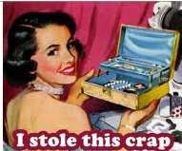

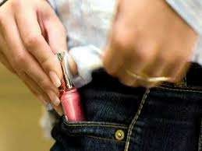
KLEPTOMANIA

Slide 28
Kleptomania
Kleptomania is the irresistible urge to steal items that you generally don't really need and that usually have little value.
The essential feature of kleptomania is a recurrent failure to resist impulses to steal objects, not needed for personal use or for monetary value. The objects taken are often given away, returned surreptitiously, or kept and hidden. Kleptomanics usually have the money to pay for the objects they impulsively steal.

Slide 29
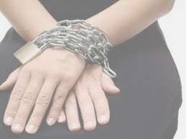
Kleptomania - Case Presentation
A 24 years old female, highly successful, single executive from a wealthy background. She was brought to the psychiatrist ward by the police officer. She was accused of stealing several times from the same shop in the same month.
She further states that the items she had stolen were hair-chips and that she have kept them in a box at home.

Slide 30
DSM-IV-TR CRITERIA
Recurrent failure to resist impulses to steal objects that are not needed for personal use or for their monetary value.
Increasing sense of tension immediately before committing the theft.
Pleasure, gratification, or relief at the time of committing the theft.
The stealing is not committed to express anger or vengeance and is not in response to a delusion or hallucination.
The stealing is not better accounted for by Conduct Disorder, a Manic Episode, or Antisocial Personality Disorder

Slide 31
Facts and Figures
Gender: 66% to 80% are female
Prevalence: occurs in less than 5% of identified shoplifters; prevalence in general population is rare and unknown
Course:
  Sporadic with brief episodes & long periods of remissions;
  Episodic with protracted periods of stealing and periods of remission;
  Chronic with some degree of fluctuation
Onset: variable; earlier onset and treatment for women

Slide 32
Related & Contributing Factors
Associated Disorders & Behaviors: compulsive shopping, Mood Disorders (particularly depression), Eating Disorders (particularly Bulimia Nervosa), Personality Disorders, other Impulse Control Disorders, substance related disorders
Childhood Experiences: stressful childhood, sibling rivalries, separation from parents, neglectful parenting
Psychoanalytic: defense against, or catharsis for, underlying
anxiety and anger
Behavioral:
  Antecedents: tension, unpleasant feelings
  Immediate consequences: pleasure, gratification, relief
  Delayed consequences: depression, guilt, remorse; legal problems (e.g. multiple convictions for shoplifting); family, career, and personal difficulties

Slide 33
Treatment
Successful anecdotal treatments include:
  Complete abstinence from prospective stores
  Aversive conditioning
  Systemic desensitization
  Covert sensitization
Antidepressants
Mood stabilizers such as Lithium
Combination therapy – Antidepressants and Mood Stabilizers
Antipsychotics
CNS – Stimulants
ECT

Slide 34
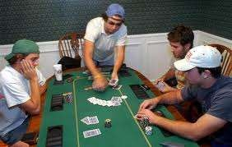

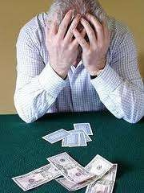
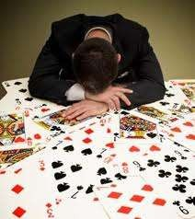
PATHOLOGICAL GAMBLING

Slide 35
Pathological Gambling
Also known as Compulsive Gambling, it is the uncontrollable urge to keep gambling despite the toll it takes on your life.
Apart from other forms of impulse control disorders, pathological gambling is somehow correlated to substance abuse disorders as the behavior is often associated with an urge to increase the amount of risked money or assets to feel satisfied which is similar to tolerance to drugs of abuse.
Some studies have shown that nearly 73.2% of individuals with pathological gambling have associated alcohol abuse disorders, while 38.2% of pathological gamblers suffer from other substance abuse disorders.

Slide 36
Neuro-pathology
Ventro-medial prefrontal cerebral cortex, striatum and dopaminergic neurons within the midbrain comprise the higher centers for perception and anticipation of monetary loss
Decreased activity of the neuronal pathways in the left ventro-medial portions of the prefrontal cortex.

Slide 37
DSM-IV-TR CRITERIA
Persistent and recurrent maladaptive gambling behavior as indicated by 5 or more of the following:
  Is preoccupied with gambling (e.g. reliving past gambling experiences, planning the next venture, thinking of ways to get money to gamble with)
  Needs to gamble with increasing amounts of money to achieve the desired excitement
  Has repeated unsuccessful efforts to control, cut back,
or stop gambling
  Is restless or irritable when attempting to cut down or stop gambling
  Gambles as a way of escaping from problems or of relieving a dysphoric mood (e.g. feelings of helplessness, guilt, anxiety, depression

Slide 38
DSM-IV-TR CRITERIA
6) After losing money gambling, often another day to get even (“chasing” losses)
returns one’s
Lies to family members, therapist, or others to conceal the extent of involvement with gambling
Has committed illegal acts such as forgery, fraud, theft, or embezzlement to finance gambling
Relies on others to provide money to relieve a desperate financial situation caused by gambling
B. The gambling behavior is not better accounted for

Slide 39
Facts and Figures
Gender: approximately 1/3 are female; females are more likely to be depressed and to gamble as an escape; females are under-represented in treatment programs & Gamblers Anonymous
Cultural factors: cultural variations in the prevalence and type of gambling activities (e.g. cock fights, horse racing, stock market, slot machines)
Prevalence: varies depending on the availability of
gambling; <1% to 7%
Course: regular or episodic;
typically
chronic;
general
progression in frequency of gambling, level of preoccupation with gambling, and amount wagered
Onset: early adolescence for males; later for females

Slide 40
Associated and Contributing Factors
Distortions in thinking: denial; superstitions; overconfidence; sense of power and control; belief that money is the cause of & solution to all of their problems
Personality traits: highly competitive, energetic, restless, easily bored, generous, extravagant, overly concerned with the approval of others, high levels of impulsivity
Workaholics or “binge” workers
Medical conditions associated
ulcers, hypertension
with stress: migraines,
Co-morbid psychological disorders: suicidal ideation & attempts; ADHD; Mood Disorders; Substance Abuse or Dependence (alcohol & nicotine); Antisocial, Narcissistic, and Borderline Personality Disorders; other Impulse-Control Disorders
Abnormalities in neurotransmitter systems: 5HT, NE, D
Stress and depression

Slide 41
Treatment
Treatment approach is like treatment for substance dependence:
  Gamblers anonymous
  Individual psychotherapy
Family therapy is often needed to a extent than with substance dependence.
Cognitive-Behavioural Therapy (CBT)
greater

Slide 42
Treatment – Biological
The following have some support:
  Selective Serotonin Reuptake Inhibitors (SSRIs)
  Naltrexone
  Lithium
  Carbamazepine

Slide 43
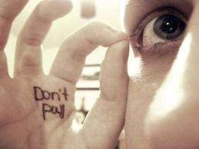
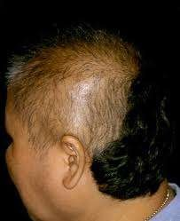
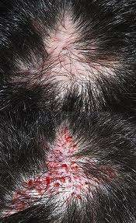
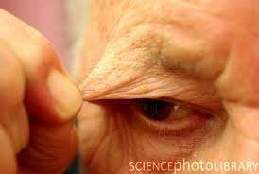
TRICHOTILLOMANIA

Slide 44
Trichotillomania
Trichotillomania is hair loss from repeated urges to pull or twist the hair until it breaks off. Patients are unable to stop this behavior, even as their hair becomes thinner.
The criteria for the diagnosis of trichotillomania are generally similar to obsessive compulsive disorders, with an associated heightened tension immediately before doing the act and a sense of gratification and/or relief of tension after committing the act.

Slide 45
Etiology
Little is known about the etiology of trichotillomania. It usually presents itself in late childhood and adolescence. Trichotillomania is more prevalent among women as compared to men.
Several studies that investigated the neurobiological
mechanisms behind trichotillomania examined the
MRI.
volumes of the putamen and caudate using
These regions were selected because of evidence that they are affected in patients with obsessive compulsive disorders and Tourette’s syndrome.

Slide 46
DSM-IV-TR CRITERIA
Recurrent pulling out of one’s hair resulting in noticeable hair loss
An increasing sense of tension immediately before pulling out the hair or when attempting to resist the behavior
Pleasure, gratification, or relief when pulling out the hair
The disturbance is not better accounted for by another mental disorder and is not due to a general medical condition (e.g. a dermatological condition)
The disturbance causes clinically significant distress or impairment in social, occupational, or

Slide 47
Facts and Figures
Gender differences: males and females are equally represented among children; much more common for females among adults
Prevalence: unknown, but more common previously thought; 1-5% of college students
Onset: early adolescence
Course: self-limiting, continuous, or episodic
than

Slide 48
Contributing and Associated Features
Most common sites for hair pulling:
scalp,
eyebrows, and eyelashes
Triggers: relaxation, distraction, stressful circumstances, “itch-like” sensation, being alone
Associated behaviors: hair twirling, examining the hair root, pulling the strand between the teeth,
eating hairs, nail pulling
biting, scratching, hairs from other
distress, people or
animals, pulling fibers from objects

Slide 49
Treatment
Behavior therapy’s - “habit reversal.”
Cognitive-Behavioural Therapy (CBT)
Hypnosis [also use in children]
Self-help groups
Clomipramine
SSRIs are used and have positive reports, but not in controlled studies.
Antipsychotics, but not in controlled studies
Lithium used, but not is controlled study

Slide 50

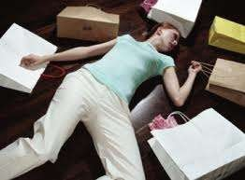


COMPULSIVE BUYING DISORDER

Slide 51
Compulsive Buying Disorder (CBD)
Compulsive buying disorder (CBD) is characterized by an obsession with shopping and buying behavior that causes adverse consequences. Most people with CBD meet the criteria for an axis II disorder.
CBD is frequently comorbid with mood, anxiety, substance abuse and eating disorders. Onset of CBD occurs in the late teens and early twenties and is generally chronic. CBD is similar to, but distinguished from OCD hoarding and mania.
Compulsive buying is not limited to people who spend beyond their means, it also includes people who spend an inordinate amount of time shopping or who chronically think about buying things but never purchase them.

Slide 52
Compulsive Buying Disorder (CBD)
Promising treatments for CBD include medication such as selective serotonin reuptake inhibitors (SSRIs), and support groups such as Debtors Anonymous
Social psychology sees the compulsive buying of consumer goods in terms of identity seeking - as an exaggerated form of a more normal search for validation through purchasing.

Slide 53




INTERNET ADDICTION

Slide 54
Internet Addiction Disorder
The Internet itself is a neutral device originally designed to facilitate research among academic and military agencies. How some people have come to use this medium, however, has created a stir among the mental health community by great discussion of Internet addiction.
Addictive use of the Internet is a new phenomenon which many practitioners are unaware of and subsequently unprepared to treat.
Young’s Internet Addiction Diagnositc Questionnaire (IADQ)

Slide 55
Proposed DSM-V Criteria
The American Psychiatric Association considered inclusion of diagnosis of problematic Internet use in the new version of the DSM-V. The diagnosis is a form of an impulsive compulsive disorder that should include both online and offline computer activities and comprises 3 subtypes; excessive gaming, email/text messaging and sexual preoccupation. All of the proposed variants share the following criteria:
Excessive use that is often accompanied by disorientation to time and neglect of basic responsibilities.
Manifestations of withdrawal which include feelings of tension, anger and/or depression when computer usage is not possible.
Tolerance which involves an increasing demand for more computer usage hours, better hardware, more advanced software…etc.
Negative repercussions such as lying, arguments, social

Slide 56
Negative Consequences
Forty to eighty hours per week, with single sessions that could last up to twenty hours.
Sleep patterns: Caffeine pills are used to facilitate longer Internet sessions.
Excessive fatigue often making academic or occupational functioning impaired and may decrease one’s immune system,
Increased risk for carpal tunnel syndrome, back strain, or eyestrain.
While the physical side-effects of utilizing the Internet are
1. Familial Impairment
2. Academic Impairment
3. Occupational Impairment

Slide 57
Treatment
Cognitive behavioral therapeutic models are the primarily proposed treatment strategies to manage problematic internet use and replace it with other forms of activities.
Family and
group therapy formats aid in the refurbishment
are often of social
encouraged to
relationships and to allow family and friends engage in the treatment plan.
Practicing Abstinence.

Slide 58
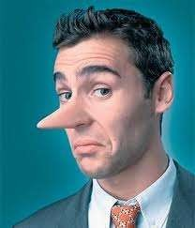
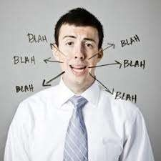
PATHOLOGICAL LYING

Slide 59
Pathological Lying
Pathological lying is also known as pseudologia fantastica or mythomania.
It is simply described as habitual and compulsive lying.
Although somewhat controversial, pathological lying has been defined as falsification entirely disproportionate to any discernible end in view, may be extensive and very complicated, and may manifest over a period of years or even a lifetime.
Pathological lying is considered a mental illness, because it takes over rational judgment and progresses into the fantasy

Slide 60
Characteristics
The stories told are not entirely improbable and often have some element of truth. They are not a manifestation of delusion or some broader type of psychosis: upon confrontation, the teller can admit them to be untrue, even if unwillingly.
The fabricative tendency is long lasting; it is not provoked by the immediate situation or social pressure as much as it is an innate trait of the personality.
A definitely internal, not an external, motive for the behavior can be discerned clinically

Slide 61
Defining Characteristics
The stories told tend toward presenting the liar favorably. For example, the person might be presented as being fantastically brave, knowing or being related to many famous people.
Pseudologia fantastica may also present as false memory syndrome, where the sufferer genuinely believes that fictitious events have taken place, regardless that these events are fantasies. The sufferer may believe that he or she has committed superhuman acts of altruism and love or has committed equally grandiose acts of diabolical evil, for which the sufferer must atone, or has already atoned for in her/his fantasies.

Slide 62
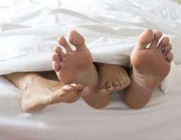


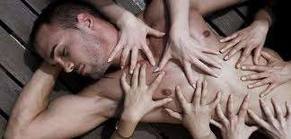
SEX ADDICTION

Slide 63
Sexual Addiction
Sexual addiction is used to describe the behavior of a person who has an unusually intense sex drive or an obsession with sex. Sex and the thought of sex tend to dominate the sex addict's thinking, making it difficult to work or engage in healthy personal relationships.
Sex addicts engage in distorted thinking, often rationalizing and justifying their behavior and blaming others for problems. They generally deny they have a problem and make excuses for their actions.
Generally, a person with a sex addiction gains little satisfaction from the sexual activity and forms no emotional bond with his or her sex partners. In addition, the problem of sex addiction often leads to feelings of guilt and shame. A sex addict also feels a lack of control over the behavior, despite negative consequences (financial, health, social, and emotional).

Slide 64
Sexual Addiction & Risk Taking
Sexual addiction also is associated with risk-taking. A person with a sex addiction engages in various forms of sexual activity, despite the potential for negative and/or dangerous consequences.
In addition to damaging the addict's relationships and interfering with his or her work and social life, a sexual addiction also puts the person at risk for emotional and physical injury.
For some people, the sex addiction progresses to involve illegal activities, such as exhibitionism (exposing oneself in public), making obscene phone calls, or molestation. However, it should be noted that sex addicts do not necessarily become sex offenders.

Slide 65
Associated/Related Behaviors
Behaviors associated with sexual addiction include:
  Compulsive masturbation (self-stimulation)
  Multiple affairs (extra-marital affairs)
  Multiple or anonymous sexual partners and/or one- night stands
  Consistent use of pornography
  Unsafe sex
  Phone or computer sex (cybersex)
  Prostitution or use of prostitutes
  Exhibitionism
  Obsessive dating through personal ads
  Voyeurism (watching others) and/or stalking
  Sexual harassment
  Molestation/rape

Slide 66
Treatment
Treatment of sexual addiction focuses on controlling the addictive behavior and helping the person develop a healthy sexuality. Treatment includes education about healthy sexuality, individual counseling, and marital and/or family therapy.
Support groups and 12 step recovery programs for people with sexual addictions (like Sex Addicts Anonymous) also are available. In some cases, medications used to treat obsessive-compulsive

Slide 67
THANK
YOU

