Slide 1

Learning
Prepared by:
Mr. Ismail P.A.
Lecturer
Department of Mental health nursing
Sumandeep Nursing college

Slide 2
Introduction
One of the most important characteristics of human beings is their capacity to learn.
An individual starts learning immediately after his birth.
Our personality, our habits, skills, knowledge, attitude and interest is largely the result of learning.
All our adaptive as well as maladaptive, and cognitive as well as affective behavior formed by learning process.
These are the vital important in helping the individual to adapt to his environment.

Slide 3
Definitions
The term learning covers every modification in behavior to meet environmental requirements.
      (OR)
Learning is the acquisition of habits, knowledge and attitudes. It involves new way of doing things and it operates on an individual’s attempt to overcome the obstacles or to adjust the new situations. it represent progressive changes in behavior. It enable him to satisfy interests to attain goal.

Slide 4
Nature of learning
Learning is a process.
It involves all those experiences and training of an individual which helps to change his behavior.
Learning prepares the individual to adjust and adopt in the situations.
All the learning is purposeful and goal-oriented.
Learning is universal and continuous.
It is a continuous and never-ending process that goes from womb to tomb.

Slide 5
LEARNING PROCESS
STEPS IN LEARNING PROCESS
Learning process is carried over through various steps according to HP Smith.
  A motive or drive
  An attractive goal
  And a block to the attainment of the goal.

Slide 6
Motive :
  Motive are the dynamic force that compel the individual to act.
  The direction of the motive depends upon the relative strength of motives.
  Unsatisfied motives or needs compel the individual to satisfy them, which initiate the learners to learn something.

Slide 7
  An attractive goal:
    For the satisfaction of the needs the individual sets definite goals for achievement.
    The setting of the goal helps in making the learning purposeful and interesting.
A block to the attainment of the goal:
    If the individual faces no difficulty in attending the goal, he will not change his present behavior, this means there is no necessity to learn.
    If block or barrier obstruct the individual to reach a goal then the individual will try to change his behavior.
    Means something to change his behavior to reach goal.

Slide 8
Some other steps involved in learning are
  Reinforcement
  Integration
  And learning situation.
Reinforcement:
  If the responses is successful in action and satisfied the needs, on the subsequent occasions the individual will tend to repeat it.
Integration: (Addition)
  The individual integrate the successful responses with individual previous learning, so that it becomes a part of new functional whole.

Slide 9
learning situation:
  Learning situation provides opportunity for learning. The quality speed and effectiveness of learning depends much upon the kind of learning situation and environments available to the learners.

Slide 10
Learning process in different steps
Perception learning:
  Sight, hearing, taste, smell and touch are considered as the five gateway of knowledge. All the knowledge is based on the sense of perception.
Conceptual learning:
  The learning implies that the individual start to think in an abstract terms.
Association learning:
  The individual has some mental pictures of his previous observations. He try to link up his new association with his previous mental picture and he learns.

Slide 11
Appreciation learning:
  The feeling make the individual to learn more.
Attitudinal learning:
  These attitudes confirmed as the individual acquires more and more knowledge.

Slide 12
Factors influencing learning
Learning is a process of bringing relatively permanent changes in behavior of the learner through the experience.
Learning process is centered on three elements.
  Factors associated with the learners.
  Factors associated with the type of learning
  Factors associated with the men and material.

Slide 13
Factors associated with the learners
Learner’s physical health
Learners mental health
Basic potential of the learner
The level of motivation
Goal of life
Readiness and will power
Maturation
Age
Emotions
sex

Slide 14
Law of learning
Law of readiness (Person ready to learn)
Law of effect (Stressful situation)
Law of exercise (practice number of time)
Law of disuse (which is not practiced become decays)
Law of primacy (interested novels)
Law of purpose (work towards goal)
Law of association

Slide 15
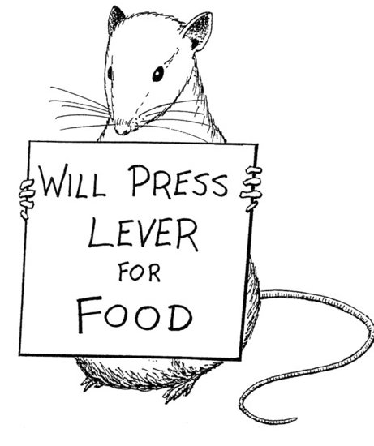
Theories of learning
Behaviourism

Slide 16
Behaviourism
All things should be looked at from the perspective of behaviour.
And it doesn’t matter what is going on in the mind, it just matters what the behaviour
So there is no difference in the behaviourist mind between external behaviour and internal thoughts.

Slide 17
Behaviourists
Ivan Pavlov
Edward Lee Thorndike
John B. Watson
B.F. Skinner

Slide 18
Behaviourists
Classic
Conditioning
(stimulus-response)
Ivan Pavlov
Edward Lee Thorndike
John B. Watson
B.F. Skinner

Slide 19
Behaviourists
Classic
Conditioning
(stimulus-response)
Ivan Pavlov
Edward Lee Thorndike
John B. Watson
B.F. Skinner
Experimental
approach only

Slide 20
Behaviourists
Classic
Conditioning
(stimulus-response)
Ivan Pavlov
Edward Lee Thorndike
John B. Watson
B.F. Skinner
Experimental
approach only
Operand
Conditioning

Slide 21
Classical conditioning

Slide 22
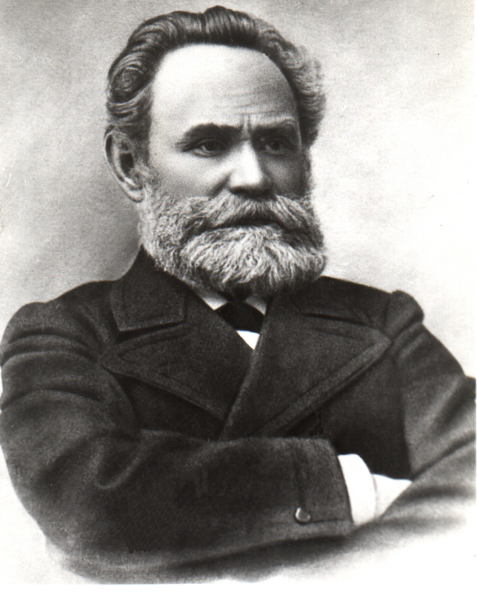
Ivan Pavlov
Born Sept 14, 1849
Died Feb 27, 1936
born in Russia
physiologist, psychologist, and physician
awarded the Nobel Prize in Physiology or Medicine in 1904 for research on the digestive system

Slide 23
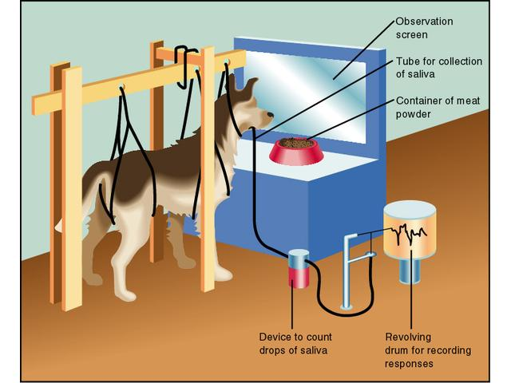

Slide 24
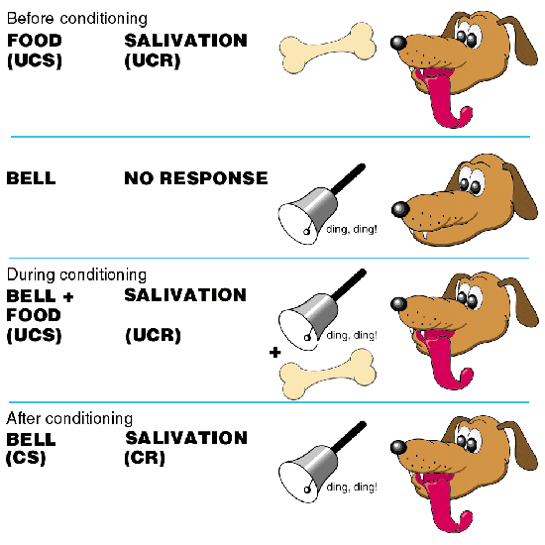
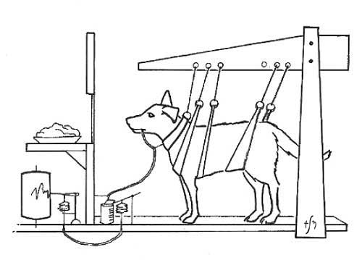
UCS = unconditioned stimulus
UCR = unconditioned response
CS = conditioned stimulus
CR = conditioned response

Slide 25
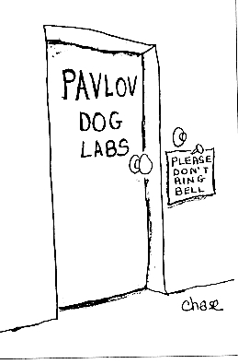
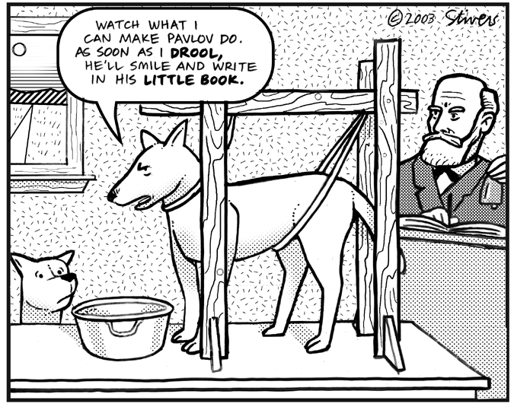
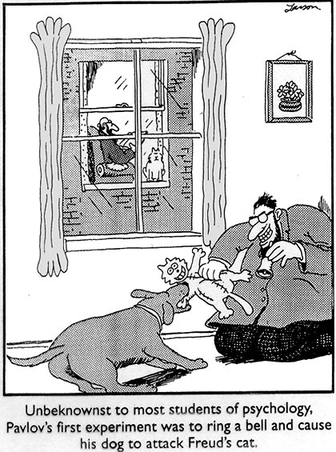
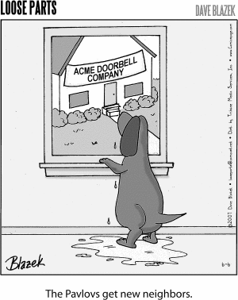

Slide 26
Educational implication of classical conditioning theory
Fear, love towards a particular subject is created through conditioning.
A teacher, method of teaching or harsh treatment of his students, create strong dislike among them towards subject.
The theory of classical conditioning emphasizes that the students should be exposed to positive stimuli in order to develop desirable habits, interest and attitudes in them.

Slide 27
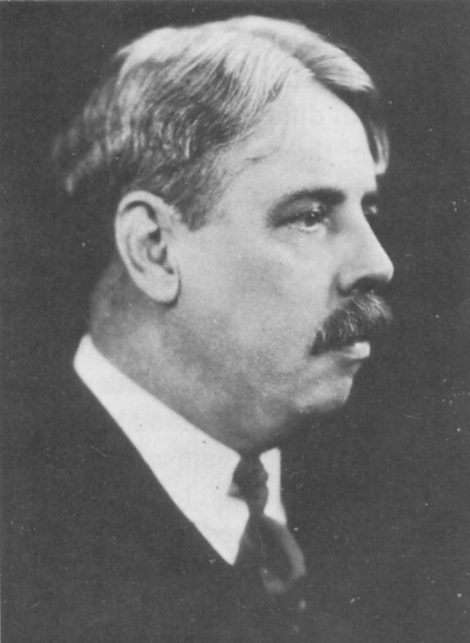
Edward Lee Thorndike
Born August 31, 1874
Died August 9, 1949
Born in Williamsburg,
Studied animal behaviour and the learning process
led to the theory of connectionism
Laying the foundation for modern educational psychology.

Slide 28
Trial and error theory of learning

Slide 29
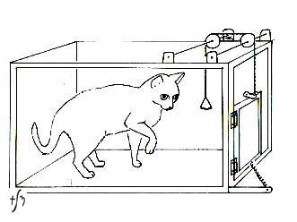
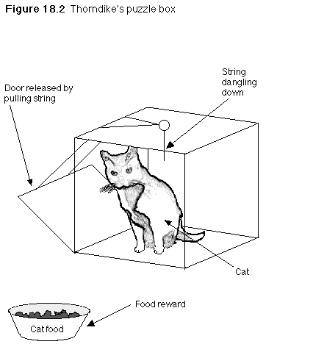
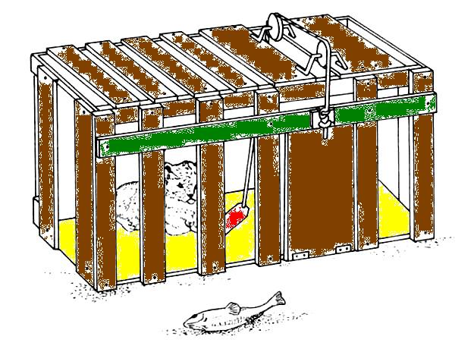
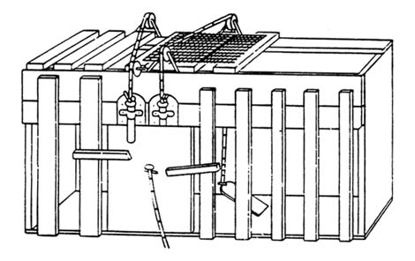
Cats in Puzzle Boxes

Slide 30
Cats in Puzzle Boxes
Thorndike looked at how cats learned to escape from puzzle boxes
The puzzle box experiments were motivated by Thorndike's dislike for statements that animals made use of extraordinary faculties such as insight in their problem solving.

Slide 31
Cats in Puzzle Boxes
Thorndike's instruments in answering this question were learning curves revealed by plotting the time it took for an animal to escape the box each time it was in the box
if the animals were showing insight, then their time to escape would suddenly drop to a negligible period, which would also be shown in the learning curve as an abrupt drop;
while animals using a more ordinary method of trial and error would show gradual curves.

Slide 32
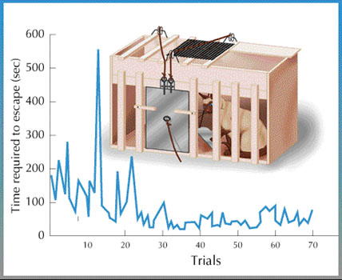
Cats in Puzzle Boxes
His finding was that cats consistently showed gradual learning.

Slide 33
Educational implication of Thorndike’s theory
According to him, when the child is ready to learn, he learns more quickly and effectively. He warns that the child should not forced to learn.
And teacher must provide learning environment.
The task of the teacher is to motivate the students by arousing interest.
Learners should be encouraged to perform his task independently. He must try various solutions to the problem before arriving at the correct time.

Slide 34
Skinner’s Theory
“All we need to know in order to describe and explain behavior is this: actions followed by good outcomes are likely to recur , and actions followed by bad outcomes are less likely to recur.” (Skinner, 1953)

Slide 35
B. F. Skinner
Science of behavior: Study of conditioning and extinction of operants
Dependent variable in the "Skinner box": rate of response
Law of acquisition
key variable: reinforcement
practice provides opportunities for
additional reinforcement

Slide 36
LAW OF EFFECT
Behavior Better state Increased
of affairs probability of behavior occurring again
Behavior Worse state Decreased
of affairs probability of behavior occurring again

Slide 37
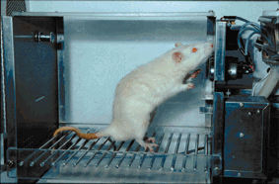

Slide 38
OPERANT CONDITIONING TECHNIQUES
POSITIVE REINFORCEMENT = increasing a behavior by administering a reward
NEGATIVE REINFORCEMENT = increasing a behavior by removing an aversive stimulus when a behavior occurs
PUNISHMENT = decreasing a behavior by administering an aversive stimulus following a behavior OR by removing a positive stimulus
EXTINCTION = decreasing a behavior by not rewarding it

Slide 39
Theory of insightful learning
(Gestalt psychology)
Gestalt psychology was found in Germany in 1912 by max Wertheimer and his colleagues.
The word “Gestalt” means Form or shape or a particular arrangement of elements.

Slide 40
Gesalt Theory
The Gestalt Theory believes individuals use insight and their prior experiences to determine their responses to stimuli. They also use the laws of Gestalt Theory to try to make sense of, and provide order to, information in their perception. This information leaves a trace in memory; traces link together to form connections of information. The Gestalt theory is closely related to the present day cognitive constructivist view of learning. Problem solving is a good choice of instructional methods to use to incorporate the beliefs of the Gestalt theory.

Slide 41
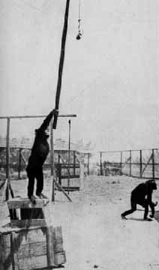
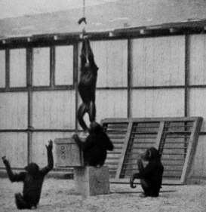

Slide 42
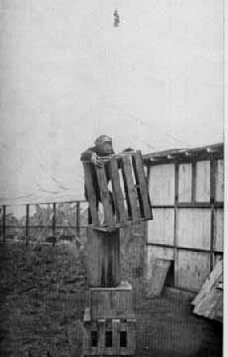
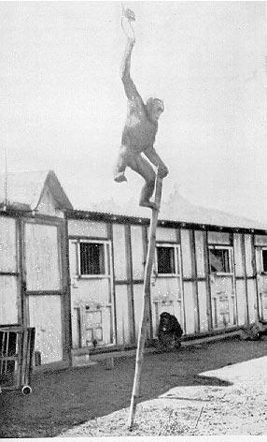
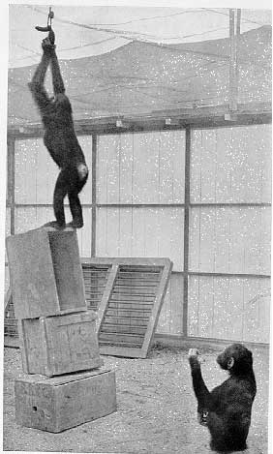

Slide 43
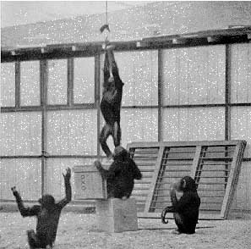
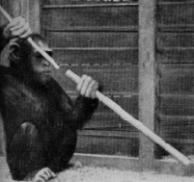

Slide 44
Educational implication of gestalt theory
The organization of the syllabus and planning of the curriculum should give plenty of opportunity to use the mental abilities.

Slide 45
Cognitive theory of learning
According to this theory learning through imitation.
Learning through observing the behavior of others
Four steps in observational learning
  Paying attention
  Remembering behavior
  Reproducing action
  Being motivated to learn and carry out the behavior.

Slide 46
Transfer of learning
Definition:
  Transfer refers to the transfer of knowledge, training and habits acquired in one situation to the another situation.

Slide 47
Types of transfer
Positive transfer
Negative transfer
Zero transfer

Slide 48
Positive transfer:
  When something previously learned benefit performance or learning in a new situation. Eg: if one has learned to play tennis and he find it easier to learn to plat badminton.
Negative transfer
  When someone previously learnt hinders performance or learning in a new situation, we call it negative transfer. Eg: Tamil or Guajarati his pronunciation of English is affected.
Zero:
  Previous learning makes no difference at all to the performance or learning in a new situation. Eg: learning history may neither help nor hinder the learning.

Slide 49
Thanks to learners for
learning the learning

