Slide 1


Prepared by:
Mr. Suresh V.
Associate Professor
Department of Mental health nursing
Sumandeep Nursing college

Slide 2
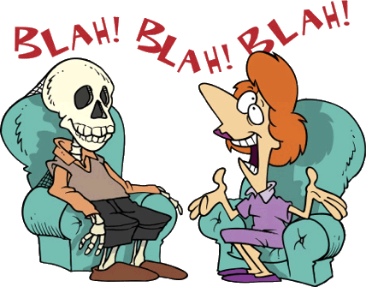
Psychotherapy
Treatment by listening to what the patient says and talking with him.

Slide 3
Definition:-
According to LEGO S :-
“A method of treatment on the development of therapeutic relationship between client and therapist for the purpose of exploring and modifying the clients behavior in satisfying directions”
OR
It is defined as the treatment of emotional disorder by psychological means.

Slide 4
Qualities of Nurse
She should understand patients family and cultural background.
She should be a good listener.
She should have patient , sympathetic ,understanding.
She should have interest and concern for patients problems.
She should not be upset with patients selfish and irresponsible behavior.
She should not be too emotionally involved with patients.

Slide 5
Goals
Changing maladaptive behavior pattern.
Reducing environment condition that may be causing such a behavior.
Improving interpersonal and communication skills.
Helping the patient to resolve inner conflict.
Modifying an individuals accurate assessment and world around him.
Help him to develop a sense of self identity.

Slide 6

Therapists
Psychiatrist
Psychologist
Psychiatry social worker
Trained psychiatry nurse

Slide 7
Types and Techniques.
Individual
psychotherapy
Behavioral
psychotherapy
Interpersonal
psychotherapy
Group
psychotherapy
Others
Psychotherapy

Slide 8

i)Individual Psychotherapy:-
1)Psychoanalysis
2)Hypnosis
3)Abreaction
4)Reality therapy
5)Uncovering or Insight Therapy
6)Supportive Therapy

Slide 9
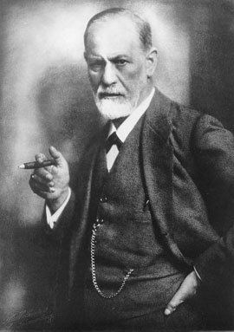
1)Psychoanalysis:-
It focuses on the influence of unconscious forces such as repressed impulses and memories and inner conflicts and adjustment of individual.

Slide 10

2)Hypnosis:-
It is induced in a patients by suggestion of relaxation and concentrating attention on a single object and the patient becomes highly controlled and gives abandons response to the therapist .He can be induced to recall forgotten events.

Slide 11
3)Abreaction:-
In this the patient talks abound his repressed emotions that have been buried in the unconscious.

Slide 12
4)Reality therapy:-
It focuses on the present behavior and development of patients ability to cope with stresses of reality and to take responsibilities.

Slide 13
5)Uncovering or Insight Therapy:-
It is used to break through the patients repressed conflicts and traumatic experience to the surface.

Slide 14

6)Supportive Therapy :-
The therapist helps the clients to relief emotional symptoms by reinforcing the existing defenses used by the client.
Techniques:-
a) Ventilation
b)environmental modification
c) persuasion
d) reeducation
e)reassurance

