Slide 1


STRESS
Prepared by:
Mrs. Bhoomika Patel
Assistant Professor
Department of Mental health nursing
Sumandeep Nursing college

Slide 2

What is stress?
Normal response
It helps you to stay focused, be energetic and stay alert
Helps you rise to meet challenges
Optimal stress leads to optimal performance levels

Slide 3

Definition:
An internal state which can be caused by physical demands on the body (disease conditions, exercise, extremes of temperature) or by environmental and social situations which are evaluated as potentially harmful, uncontrollable or exceeding our resources for coping.
Involves physical and psychological responses

Slide 4
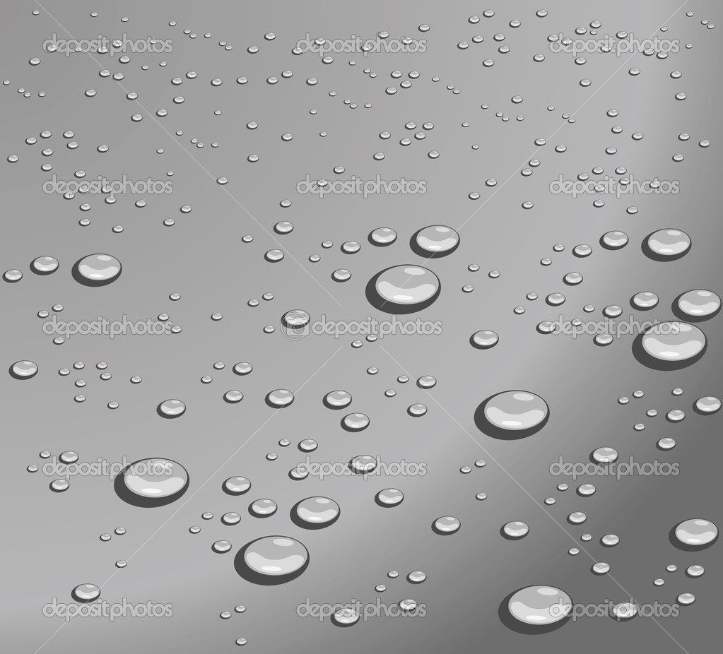
TYPES OF STRES
stress
distress
burnout

Slide 5
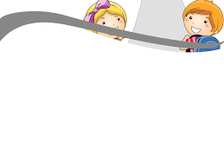
STRESSORS
JOB RELATED STRESSOR
too routine ,dull , baring / too demanding
frequest shifts , transfers
time pressures
hazardous work
morally conflicating work

Slide 6
INTRA - PERSSONAL STRESSOR
role conflict
role ambiguity
role overload
ethical dilemmas .

Slide 7
INTER PERSONAL - GROUP - STRESSOR
inter personal conflicts
poor communication
unpleasant inter personal communication
fear of isolation at workplace .

Slide 8
ENVIRONMENTAL STRESSORS
noise
heat
poor lighting
radiation/smoke
limited resources
other health hazards .

Slide 9
JOB STRESSORS
working condition
relationship at work
role conflict and ambiguity

Slide 10

EFECTES OF STRESS
A. POTENTIAL IMPACT
fatigue and inattention
increased physical problems
behavioral problems
feelings of helplessness , isolation and frustration
feeling unsafe including increased fear of violence
increased absenteeism , tardiness and attrition

Slide 11
STRESS RELIF
deal with immediate issue first
be optimistic
see things in context of a larger positive plan that make sense to you
recognize that troubles are temporary
don't blame yourself needlessly
practice deep breathing
refocus your thinking to some thing pleasant

Slide 12
PREVENTING STRESS
explore your life -style approach to stress reduction .
strive for balance , talk , priorities , relax , and help others .
learn to diffuse stress -make a habit of planning a head , be positive , take breaks , rehearse difficult anticipated situations .

Slide 13
OTHER INTERVENTIONS
do a minimum of 30 minutes of aerobic execute daily or take walk
eat 3balaced meals eq : inceeaud the amount of fruits and vegetables .
avoid caffeine and carbonated beverages
reduce refined caffeine and carbonated beverages
avoid sugar and alcohol intake
sleep about & hrs in the night
spend time each day with relaxation techniques imagery , day dreaming , listening for music , prayer
take a warm bath
plan some fun

Slide 14

DISASTER
A disaster is a serious disruption of the functioning of a community or a society involving widespread human, material, economic or environmental loss and impacts, which exceeds the ability of the affected community or society to cope using its own resources.

Slide 15
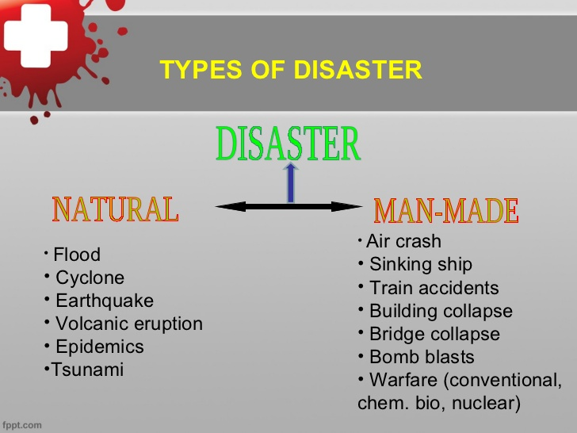

Slide 16
RESPONSE TO TRAUMA AND DISASTER
The behavior and psychological responses seen in disaster are not random : they frequently have a predictable structure and time course.
For most individual post-trauma psychiatric symptoms are transitory.
For some, however the effects of a disaster linger long after its occurrence, rekindled by new experiences that remind the person of the part treatment event.
Even normal life events can cause anxiety and bring to mind destroyed home as decreased loved one.

Slide 17
COMMON EMOTIONAL / BEHAVOIUR STATUS DURING FIRST 24 HRS
Fear
crying
Running around
Fear fettering building
Worry
Leaving the place
Sadness
Palpitations
Inability to think

Slide 18
EMOTIONAL / BEHAVOIUR STATUS AFTER 1 WEEK
Fear
Hope
Sadness
Weeping
Remembering god

Slide 19
IMMEDIATE PSYCHOLOGICAL REACTION
During a disaster and in the period immediately by after if there may be narrowing attention , feelings of numbness with drawl from expected social interaction , apathy and apparent disorientation , profound diminution of voluntary movements and speech and of normal responsiveness to light noise and touch are observed.

Slide 20
PATHOLOGICAL GRIEF
Grieving is a reaction to death of near and dear once and the reaction is usually with in the expected norms of the society . There may be total lack of reaction , delayed reaction or prolonged reaction occasionally victims have procumbent hallucinate or delusions. Some harbor suicide ideas and show suicidal behavior.

Slide 21
DELAYED REACTION
As the days pass gradually , there will be a yearning far what has been lost , guilt , depression , irritability , suicidal ideation , excessive physical complaints insomnia and decreased help , alcohol and other substance abuse.

Slide 22
PSYCHIATRIC DISORDERS
Various psychiatric symptoms and syndromes are seen after disaster . They are,
Acute stress reaction .
Post-treatment stress disorder (PTSD)
Adjustment disorder
Depressive episode
Dysthymic
Acute psychoses
Dissociative disorders
Anxiety disorders
Suicides
Personality changes

Slide 23


Slide 24

ETIOLOGY BIO-PSYCHO-SOCIAL FACTORS
Personality of a person and use of various defense mechanisms, helpful individual to adjust to various stressful situation of life.
The capacity to adjustments keeps the individual mentally healthy.
When an individual is not able to adjust to the situation, he may develop maladaptive behavior and become mentally ill.

Slide 25
It is difficult to pin point one cause of mental disease.
However, various predisposing factors leading to mental disorder are discussed below. But let's first clarity terms: Primary cause; predisposing cause and precipitator cause.

Slide 26
BIO-PSYCHO-SOCIAL MODEL [ENGEL]
George Engel has been the most prominent proponent of the bio-psychosocial model of disease.
The bio-psychosocial model is derived from general system theory.
The bio-logical systems emphasize the anatomical, structural, and molecular substrate of disease and its effects on the patients biological functioning.

Slide 27
The psychological system emphasizes the effects of psychodynamic factors, motivation and personality on the experience of illness and the reaction to its , the social system emphasize cultural , environmental and familial influences on the experience and the experience of illness.

Slide 28
CAUSES OF MENTAL DISORDERS
The causes of mental illness can be chronologically divided into
Predisposing factors
Precipitating factors
Perpetuating factor

Slide 29
PREDISPOSTING FACTORS
These factors will occur before the onset of the disease or before psychopathology have appeared. These factors determine an individual’s susceptibility to illness.
There predisposing factors interact with precipitating factors to result in mental illness. Many of these factors operate from easily life and determine a person’s vulnerability to causes, which occur at the time of the illness.
These factors including generic , biological, psychological, social factors in infancy and early childhood

Slide 30
PRECIPITATING FACTORS
These are events that occur shortly before the onset of disorders and appear to have induced it. Whether these produce a disorder at all depends partly on the constitutional factors of the patient.
They are physical factors , psychological factors, and social factors.

Slide 31
PREDETUATING FACTORS
There are factors that prolog the course of a disorder after it has been provoked. It is extremely vital to consider these factors while planning treatment.
The original predisposing and precipitating factors may have ceased to act by the time the patient is seen , but the perpetuating factors may well be treated.

Slide 32
Example patient with alcoholism might have marital disharmony as a predisposing factor and been treated for the alcoholism , but the marital disharmony continues to remain as a cause for further mental illness.

Slide 33
CAUSES OF ABNORMAL BEHAVOIUR
The causes of abnormal behavior are categorized under their main headings,
Biological factors
Psycho-social factor
Socio-cultural factor

Slide 34
BIOLOGICAL FACTORS
Biological factors influences our behavior to a great extend foe example : our intellectual ability, how we cope with a stressful situation, adjustment and adaptations are affected by different biological factors.
Biological factors may be genetic constitutional , physical deprivation and disruptive emotional factors.

Slide 35
PSYCHO-SOCIAL FACTORS
Psychological factors are maternal deprivation, pathogenic family pattern, pathogenic interpersonal relationship and sever stress.

Slide 36
SOCIO CULTURAL FACTORS
Human being is a animal .he lives in a community following the norms, tradition and culture of that society. Every group teaches its own offspring systematically.
So people belonging to one community may differ from those of another community.
Sociocultural factors influencing the development of abnormal behavior are war and violence, economic and employment problem, technological and social changes.

Slide 37
ECONOMIC AND EMPLOYMENT PROBLEM
This problem is another contributing factor to mental illness. Some times the economic problem leads to suicide and even homicide.
Incases of homicide due to economic hardships are being increasing young people feel frustrated due to unemployment and on the other hand, they are ejected or treated sympathically by society because of their jobless. This may lead to abnormal behavior.

Slide 38
TECHNICAL AND SOCIAL CHANGES
Rapid technological changes is causing too much of stress, for example, a child sees advertisement of sophisticated toys on TV every day.
He demands there toys from his parents. He does not understand

Slide 39
BIO-PSYCHOSOCIAL COMPONENTS OF THE STUART STRESS ADAPTATION MODEL
The student adaptation model of psychiatric nursing care views human behavior from a holistic perspective that integrates biological, psychological and socio cultural aspects of care.

Slide 40
PREDISPOSING FACTORS
There factor are biological , psychological and sociocultural in nature.
They may be seen as conditioning or risk factor that influences both the type and amount of recourses the person can use to handle stress.

Slide 41
PRECIPITATING STRESSORS
Precipitating stresses are stimulate that the individual perceives as challenging threatening demanding.
They require excess energy and produce a state of tension and stress.
They may be biological psychological or sociocultural in nature, and they may originate in the nature and origins of a streams.

Slide 42


