Slide 1

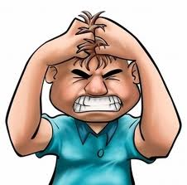
CONDUCT DISODRES
Prepared by:
Mr. Ismail P .A .
Associate Professor
Department of Mental health nursing
Sumandeep Nursing college

Slide 2
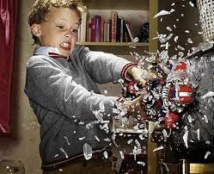
INTRODUCTION
Conduct of a child is the behavior of the total individual as expressed in psychological as well as physical activity; behaviors conforms to the standards established by the person’s social group .

Slide 3
DEFINITION
“A repetitive and persistent pattern of behavior in which the basic rights of others or major age-appropriate social rules are violated.”
“conduct disorders are marked by repetative ,persistant ,aggressive conduct in which basic rights are violeted .”

Slide 4
EPIDEMIOLOGY
Among children age 9 to 17 , the prevalence of conduct disorders is approximetaly 1% to 4% .
disorders occurs in both males and females . It’s more common in males.

Slide 5
TYPES OF CONDUCT DISORDERS
Conduct disorders can be classified as mild, moderate, or severe (APA, 2000):
• Mild
• Moderate
• Severe

Slide 6
• MILD:
The person has some conduct problems that cause relatively minor harm to others.
Examples include lying, truancy, and staying out late without permission.
• MODERATE:
The number of conduct problems increases as does the amount of harm to others.
Examples: vandalism(damage of property) and theft
• SEVERE:
The person has many conduct problems with considerable harm to others. Examples: rape, cruelty to animals,use of a weapon, burglary, and robbery.
.

Slide 7
PREDISPOSING FACTOR
BIOLOGICAL FACTOR
Genetics :
( monozygotics and dizygotics twins)
Biochemical factors:
( in boys testosterone association with violence)
PSYCHOLOGICAL FACTORS
Peer relationship
Family influences
Poor parental practice
Social problems
Scholastic problems
Socio – cultural factors

Slide 8
CAUSES
The causes of conduct disorders isn’t fully known.
Social risk factors :
Early maternal rejection
Sepration from patient ,with no adequate alternation caregiver available .
Early institulization
Family neglect ,abuse or violence, lack of discipline
Frequent verbal abuse from parent , teacher or other.
Parental psychaitric illness ,substance abuse
Large family size or poverty.
Neurological damage
learning impairments

Slide 9
characteristics
aggressive ,fights,bullies,assults others physically or sexually
has poor relationships with peers.
violets others rights and society’s rules.
causing acedemic, social, and developmental problems
perform poorly at school or work
expelled from school and have problems with law.
at the risk for sexually transmitted disease,rape,teenage pregnancy, injuries, substance abuse, depression, suicidal thoughts, suicide attempts, and suicide.

Slide 10
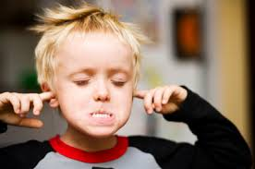
CLINICAL FEATURES
Aggressive
Disturbed peer relationship
School dropouts
Lower attainments
Illegal behaviour
Criminal behaviour
Aggressive
Isolated sympotoms
Higher rates of divorce
Remarriage/sepration
Less contacts with friends

Slide 11
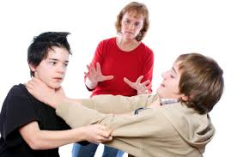
Fighting with family members and peers.
Speaking to others in nasty manner

Slide 12
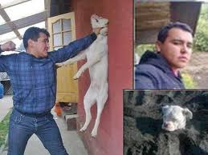
Being cruel to animals
Vandalizing or destroying property

Slide 13
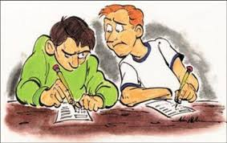
Cheating in school
Skipping classes

Slide 14
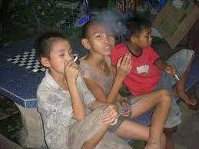
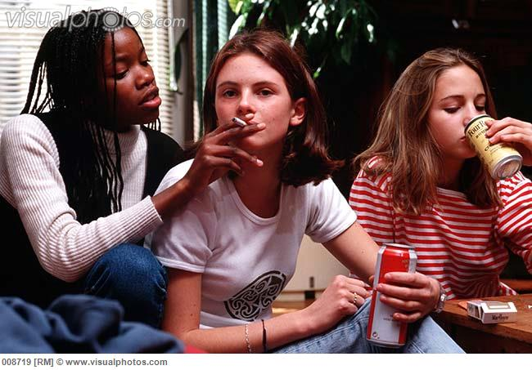
Smoking cigarettes
Using drugs or alcohol

Slide 15

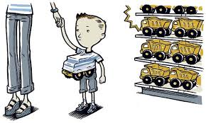
Stealing or shoplifting
Engage in sexual activity
Abusing others sexually

Slide 16
ASSESSMENT
HISTORY
history of disturbed relationships with peers, aggression toward people or animals, destruction of property, theft, and serious violation of rules (e.g., truancy, running away from home, staying out all night without permission).

Slide 17
GENERAL APPEARANCE AND
MOTOR BEHAVIOR
Appearance, speech, and motor behavior are typically normal for the age group but may be somewhat extreme (e.g., body piercings, tattoos, hairstyle, clothing).
These clients often unwilling to be interviewed. They may call the nurse or physician names, and make bad remarks about parents, teachers, police, and other authority figures

Slide 18
MOOD AND AFFECT
Clients may be quiet to talk or openly hostile and angry.
attitude is likely to be disrespectful toward parents, the nurse, or anyone in a position of authority.
Irritability, frustration, and temper outbursts are common.
Clients may be unwilling to answer questions or to cooperate with the interview; they believe that they do not need help or treatment.
If a client has legal problems, he or she may express superficial guilt but it is unlikely that these emotions are sincere.

Slide 19
SENSORIUM AND INTELLECTUAL
PROCESSES
Clients are alert and oriented with intact memory.
Intellectual capacity is not impaired, but typically these clients have poor grades because of academic underachievement, or failure to attend class and to complete assignments.

Slide 20
JUDGMENT AND INSIGHT
Clients consistently break rules with no regard for the consequences.
risky behavior is common such as use of drugs or alcohol, reckless driving, sexual activity, and illegal activities such as theft.
Clients lack insight and usually blame others or society for their problems they rarely believe that their behavior is the cause of difficulties.

Slide 21
Although these clients generally try to appear tough, their self-esteem is low.
They do not value them-selves any more than they value others.

Slide 22
ROLES AND RELATIONSHIPS
Relationships with others, especially those in authority, are disruptive and may be violent.
This includes parents, teachers, police, and most other adults. Verbal and physical aggression is common.
Siblings may be a target for ridicule or aggression.
Relationships with peers are limited to others who display similar behaviors; these clients see peers who follow rules as dumb or afraid.
Clients usually have poor grades, have been expelled, or have dropped out.

Slide 23
TREATMENT
PHARMACOTHERAPY :
Mood stabilize : - lithium carbamazepine
- valporic acid
Anti psychotic : - chlorpromzine
- haloperidole
- clozapine
Adrenargic agents : - clonidine propranolol
- metaprolol

Slide 24
MANAGEMENT:
Home care management:
Limit Television
Limit all media use to no more than 1 to 2 hours per day.
Monitor their children's use of the media.
Co view television with their children.
Eliminate or reduce video and Computer games
  A safe school
  School-Based Treatment Programs

Slide 25
Counseling and guidance
Cognitive behavioral therapy
  Family Therapy
  Social Skills Training
  A safe community
  Telephonic check-to ensure other adult responsible.

Slide 26
The most common mode of management is placement in a corrective institution .
Parental instruction to teach how to deal with the child’s demand.
Juvenile justice system , if needed to provide structured rules and a means for monitoring and controlling the child’s behavior .

Slide 27
Behavioral psychotherapy:
Behavioral psychotherapy often is effective when used in combination with an effective medication regimen.
Improving the surrounding home and school environment can improve the behavior.
working to establish ways of decreasing distractions and improving organizational skills may be helpful.

Slide 28
Psychosocial interventions:
psychosocial treatments are effective.
behavioral parent training :(BPT): a consistent application of rewards for meeting goals and good behavior (positive reinforcement) and punishments such as time-outs or revocation of privileges for failing to meet goals or poor behavior
behavioral classroom management (BCM):educators learn about condition and techniques to improve behavior applied to a classroom setting. include increased structuring of classroom activities, daily feedback, and token economy

Slide 29
For preschoolers, intervention is best with parental training.
For school-aged children, interventions of group training for parents and classroom.
Severe cases benefit from medication and behavioral interventions.

Slide 30
Diet:
foods containing preservatives or food coloring or foods high in simple sugars may lead.
Many controlled studies have examined this question. no adequate data set has confirmed the speculation.

Slide 31
THANK YOU

Slide 32
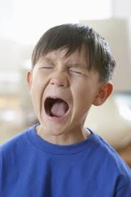
TERMINOLOGY:
Disruptive Behavior Disorders:
A disturbance of conduct severe enough
to produce significant impairment in
social, occupational, or academic functioning because of symptoms that range from oppositional defiant to moderate and severe conduct disturbances.
Temperament :
Personality characteristics that define an individual’s mood and behavioral tendencies. The sum of physical, emotional, and intellectual components that affect or determine a person’s actions and reactions.

