Slide 1

PRESENTATION ON
LEGAL AND ETHICAL ISSUES :
CODE OF ETHICS AND
STANDARD OF MIDWIFERY PRACTICE
PRESENTED BY
MRS. ROBBY SOLANKI
ASSOCIATE PROFESSOR,
SNC, SVDU

Slide 2

s

Slide 3

With the advancement in medical technology for identification and treatment of various disorders and conditions, today’s health care providers often have to face complex legal and ethical questions. The clinicians often make decisions without appealing for guidance or justification. Proper knowledge of the legal and ethical aspects of practice is beneficial for both the health care provider and the patient.

Slide 4

the legal and ethical principles

Slide 5

1. INFORMED DECISION MAKING.

Slide 6
The healthcare provider should disclose the following details to patients/individual before a decision is made by them:
The individual’s currently assessed health status regarding the general or reproductive health.
Reasonably accessible medical, social and other means of response to the individual’s conditions, including predictable success rates, side effects and risks associated with each option.

Slide 7
The implications for the individual’s general, sexual and reproductive health and lifestyle declining any of the options.
The healthcare provider’s reasoned recommendations for a particular treatment option or suggestion.
This legal duty of informing the individual about all the procedures is an ongoing duty that continues throughout the healthcare relationship.

Slide 8

2. PRIVACY AND CONFIDENTIALITY.

Slide 9
The following three predominant legal aspects of confidentiality are to be kept in mind:
Healthcare provider’s duties to protect patient’s information against unauthorized disclosures.
Patient’s right to know what their healthcare providers think about them.
Healthcare provider’s duties to ensure that patients, who authorize releases of their confidential health-related information to others, exercise an adequately informed and free choice.

Slide 10

3. COMPETENT DELIVERY OF SERVICES.

Slide 11
According to the laws, medical negligence is shown when the following four elements are all established by a complaining party:
A legal duty of care must be owed by a provider to the complaining party.
Breach of the established legal duty of care must be shown, which means that a healthcare provider has failed to meet the legally determined standard of care.

Slide 12
Damage must be shown, meaning a hardship or loss, perhaps of a future opportunity, that law recognizes as an injury.
Causation must be shown, meaning that damage must be proven on a balance of probabilities to have been caused by the breach of duty of care. This often requires evidence from expert witnesses.

Slide 13

4. SAFETY AND EFFICACY OF PRODUCTS.

Slide 14
Healthcare providers are responsible for any accidental or deliberate use of products that differs from their approved purposes or methods of use , for instance, the dosage levels for drugs. The healthcare provider should give importance to the information received regarding the contraindications of each of the drugs and devices employed in practice. They are also required to inspect the devices and drugs that they supply to the patients directly, in order to ensure that there are no defects apparent upon component inspection that would render them unfit for use, such as looking for expiry dates for the effectiveness of drugs.

Slide 15

LEGAL ISSUES IN OBSTETRIC AND GYNAECOLOGY:-

Slide 16
PREGNANCY TERMINATION
INTRODUCTION: since the Medical Termination of Pregnancy (MTP) Act was enacted by the parliament in 1972, it has become a major instrument for protection of maternal health. The govt. amended the MTP Act in 2002 to make certain changes in order to liberalize the abortion services.

Slide 17
Conditions under which pregnancy can be terminated:
Termination of pregnancy is permissible up to 20 week duration, if an opinion is formed by one registered medical practitioner (for pregnancies less than 12 weeks) or two registered medical practitioners (for 12-20 week pregnancies), in good faith, that-
Continuation of pregnancy would involve a risk to the life of the pregnant woman or grave injury to her physical or mental health.

Slide 18
2. There is a substantial risk for the child born to suffer from such physical or mental abnormalities as to be seriously handicapped.
3. Pregnancy resulting from rape and from failure of contraceptive methods constitutes a grave injury to mental health of the women.

Slide 19
Experience or training required for MTP:
A person having any one of the following experiences can be authorized:
For medical practitioners registered in a state medical register immediately before commencement of the Act, minimum experience of 3 yr in the practice of OBG.
For practitioners registered on or after the date of commencement of the Act, 6 months of house job in OBG or one year of experience in the practice of OBG at a hospital or if the person has assisted a registered medical practitioner in performing 25 cases of MTP in an institution approved for training by the govt.
Postgraduate degree or diploma holder in OBG.

Slide 20
PNDT Act: (pre-natal diagnostic techniques act)
The Pre-natal Diagnostic Techniques (Regulation and Prevention of Misuse) Act, 1994, was enacted and brought into operation from 1st January, 1996, in order to check female foeticide. Rules have also been framed under the Act. The Act prohibits determination and disclosure of the sex of foetus . It also prohibits any advertisements relating to pre-natal determination of sex and prescribes punishment for its contravention. The person who contravenes the provisions of this Act is punishable with imprisonment and fine.

Slide 21
SALIENT FEATURES:
The Act provides for the prohibition of sex selection, before or after conception.
It regulates the use of pre-natal diagnostic techniques, like ultrasound and amniocentesis by allowing them their use only to detect :
  genetic abnormalities
  metabolic disorders
  chromosomal abnormalities
  certain congenital malformations
  haemoglobinopathies
  sex linked disorders.

Slide 22
No laboratory or centre or clinic will conduct any test including ultrasonography for the purpose of determining the sex of the foetus.
No person, including the one who is conducting the procedure as per the law, will communicate the sex of the foetus to the pregnant woman or her relatives by words, signs or any other method.
Any person who puts an advertisement for pre-natal and pre-conception sex determination facilities in the form of a notice, circular, label, wrapper or any document, or advertises through interior or other media in electronic or print form or engages in any visible representation made by means of hoarding, wall painting, signal, light, sound, smoke or gas, can be imprisoned for up to three years and fined Rs. 10,000.

Slide 23

A wide range of ethical and legal issues arise in maternity and newborn nursing. Many of the ethical dilemmas are a result of new medical technology and expanded roles for nurses. Because maternity health care raises monumental ethical and legal questions, is it essential to understand these issues.
The goal of ethical midwifery is to do the right thing for right reasons. Knowing how to make good decisions as well as why these decisions were made constitutes ethical midwifery practice.

Slide 24
ETHICAL PRINCIPLES OF
BENEFICENCE:
NON-MALEFICENCE:
RESPECT FOR AUTONOMY:
BENEFICENCE AND RESPECT FOR AUTONOMY IN GYNAECOLOGICAL PRACTICE:
CARING:
EMPOWERMENT AND ADVOCACY:
HEALTH AS A BASIC RIGHT FOR ALL:

Slide 25

CODE OF

Slide 26
1. Nurse-midwifery exists for the good of women and their families..

Slide 27
2.Nurse-midwives uphold the belief that childbearing and maturation are normal life processes when intervention is indicated, it is integrated into care in a way that preserves the dignity of the women and her family.

Slide 28
3.Decisions regarding nurse-midwifery can require client participation in an ongoing negotiation process in order to develop a safe plan of care. This process consider cultural diversity, individual autonomy and legal responsibilities.

Slide 29
4. Nurse-midwives share professional information with their clients that leads to informed participation and consent. This sharing is done without coercion or deception.

Slide 30
5. Nurse-midwives practice competently. They consult and refer when indicated by their professional scope of practice and/or personal limitations.

Slide 31
6. Nurse-midwives provide care without discrimination based on race, religion, life-style, sexual orientation, socio-economic status or nature of health problem.

Slide 32
7. Nurse-midwives interact respectfully with the people with whom they work and practice.

Slide 33
8. Nurse-midwives maintain confidentiality except when there is a clear, serious and immediate danger or when mandated by law.

Slide 34
9.Nurse-midwives take appropriate action to protect clients from harm when endangered by incompetent or unethical practices.

Slide 35
10.Nurse-midwives participate in developing and improving the care of women and families through supporting the profession of nurse-midwifery, research, and the education of nurse-midwifery students and national efforts such as public education of nurse-midwifery students and nurse-midwives.

Slide 36
11. Nurse-midwives promote community, state and national efforts such as public education and legislation to ensure access to quality care and to meet the health needs of women and their families.

Slide 37
MIDWIFE’S RIGHTS:

Slide 38

STANDARDS FOR OBSTETRIC AND GYNAECOLOGICAL NURSING:

Slide 39
STANDARD I:
The nurse helps children and parents attain and maintain optimum health.

Slide 40
STANDARD II:
The nurse assists families to achieve and maintain a balance between the personal growth needs of individual, family members and optimum family functioning.

Slide 41
STANDARD III:
The nurse intervenes with vulnerable clients and families at risk to prevent potential development and health problems.

Slide 42
STANDARD IV:
The nurse promotes an environment free of hazards to reproduction, growth and development, wellness and recovery from illness.

Slide 43
STANDARD V:
The nurse detects changes in health status and deviations from optimum development.

Slide 44
STANDARD VI:
The nurse carries out appropriate interventions and treatment to facilitate survival and recovery from illness.

Slide 45
STANDARD VII:
The nurse assists clients and families to understand and cope with developmental and traumatic situations during illness, childbearing, childrearing and childhood.

Slide 46
STANDARD VIII:
The nurse actively pursues strategies to enhance access to and utilization of adequate health care services.

Slide 47
STANDARD IX:
The nurse improves maternal and child health nursing practice through evaluation of practice, education, and research.

Slide 48
SELECTED LIFE SAVING DRUGS:-
Recommendations of the Expert Advisory Group Meeting on the 14th Oct, 2004

Slide 49

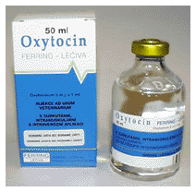
Administration of Inj. Oxytocin and Misoprostol:

Slide 50
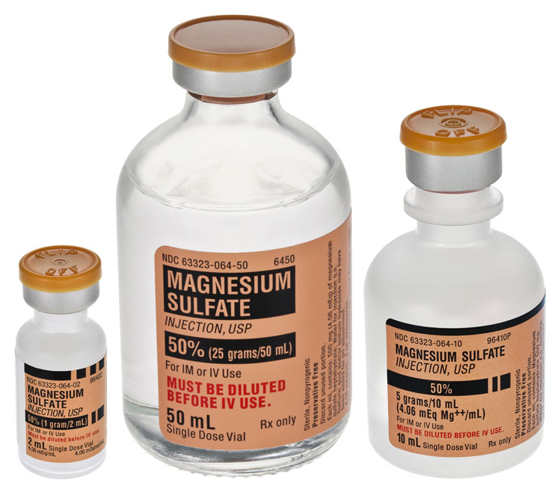
Administration of Inj. Magnesium sulphate

Slide 51

Administration of IV infusions

Slide 52
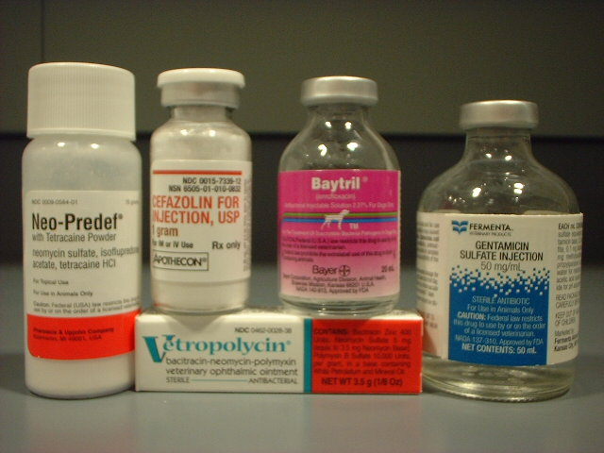
Administration of antibiotics:

Slide 53

Administration of anti-hypertensive:

Slide 54
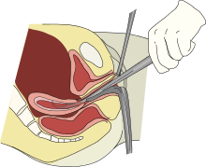
Removal of retained products of conception:

Slide 55

Manual removal of placenta (MRP):

Slide 56
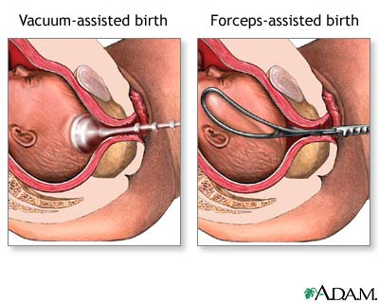
Conduction of an Assisted Vaginal Delivery (forceps & vacuum extraction):

Slide 57
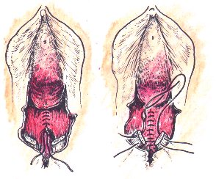
Repair of vaginal and perineal tears:

Slide 58

A wide range of ethical and legal issues arise in maternity and newborn nursing. Many of the ethical dilemmas are a result of new medical technology and expanded roles for nurses. Because maternity health care raises monumental ethical and legal questions, is it essential to understand these issues.

Slide 59

Write an assignment on-
What is the importance of legal and ethical aspects of midwifery in clinical midwifery practice?
Submit on 08th feb 2014.

Slide 60


