Slide 1

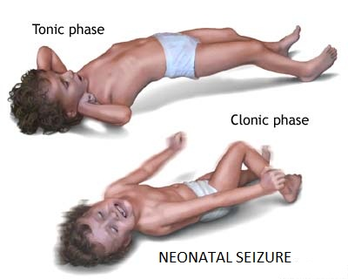
Neonatal Seizures
Presented by:
PRESENTED BY:
Mrs. Vruti Patel
Asst. Professor
Sumandeep Nursing College

Slide 2
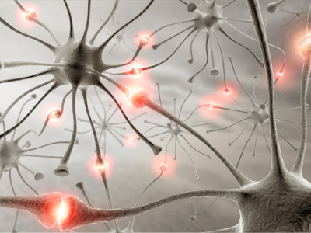
Definition
Neonatal convulsion is usually a visible manisfestation of the underlying pathology.
Rarely a baby may have convulsion where the cause cannot be detected.

Slide 3
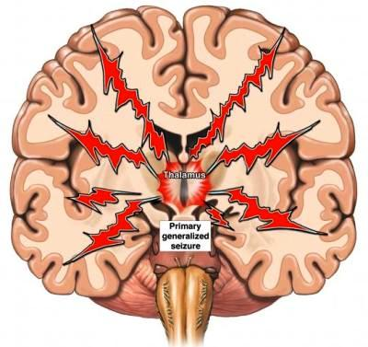
Causes
Trauma
Metabolic
Infective
Iatrogenic
Others (Congenital)
Mrs. Vruti Patel, Asst. Professor, Sumandeep Nursing College, SVDU.

Slide 4

Diagnosis
History
Method of delivery
Apgar score of birth
Mrs. Vruti Patel, Asst. Professor, Sumandeep Nursing College, SVDU.

Slide 5
Investigation
Full blood count
Blood, urine and CSF culture
Serum IgG and IgM – specific TORCH titers
Blood biochemistry- estimation of glucose, calcium and magnesium, bilirubin and electrolytes if needed.
Blood gas levels to detect acidosis and hypoxia
USG and CT scan of head.
Mrs. Vruti Patel, Asst. Professor, Sumandeep Nursing College, SVDU.

Slide 6
Neonatal Seizures - types
Tonic Seizures —focal or generalized, may mimic decorticate or decerebrate posturing, primarily seen in preterms with intracranial hemorrhage & generally have poor prognosis
Subtle seizures
  Consist of chewing motion, excessive salivation and alteration in respiratory rate including apnea, blinking, nystagmus, bicycling and pedaling movements, changes in color
Mrs. Vruti Patel, Asst. Professor, Sumandeep Nursing College, SVDU.

Slide 7
Clonic- focal (repetitive movements localized to a single limb) or multifocal (random migration of movements from limb to limb), consciousness may be preserved, primarily seen in term infants
Myoclonic- sudden flexor movements (lightning-like jerks), may be focal, multifocal or generalized, may occuring singly or in clusters, if due to early myoclonic encephalopathy it carries a poor prognosis. Brief focal or generalized jerks of the extremities or body that tend to involve distal muscle groups
Mrs. Vruti Patel, Asst. Professor, Sumandeep Nursing College, SVDU.

Slide 8
Treatment
To control convulsion
IV administration of phenobarbitone 10 mg/kg body weight slowly over a period of 3-5 min is effective.
To treat underlying pathology
If hypoglycemia – glucose infusion
If hypomagnesemai – magnesium of 2meq/kg given IV
If infection – appropriate antibiotic therapy
If hypocalcemia – IV administration of 2 ml/kg of 10% calcium gluconate
Mrs. Vruti Patel, Asst. Professor, Sumandeep Nursing College, SVDU.

Slide 9
Nursing management
Oxygenation
Positioning
IV medications
Emotional support to parents
Educate the parents about the medication regimen
Mrs. Vruti Patel, Asst. Professor, Sumandeep Nursing College, SVDU.

