Slide 1
ANTI FUNGAL AGENTS
BY- Mr. DILLIP DASH

Slide 2
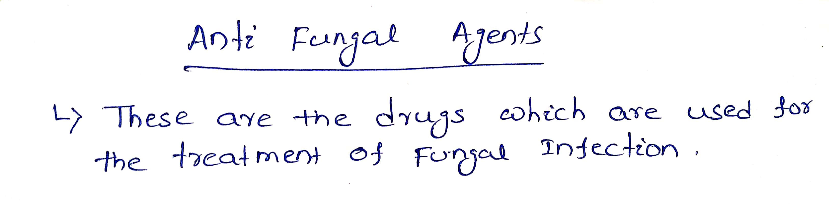

Slide 3
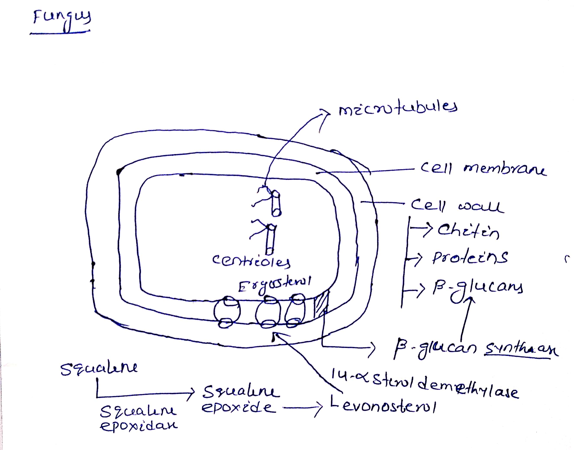

Slide 4
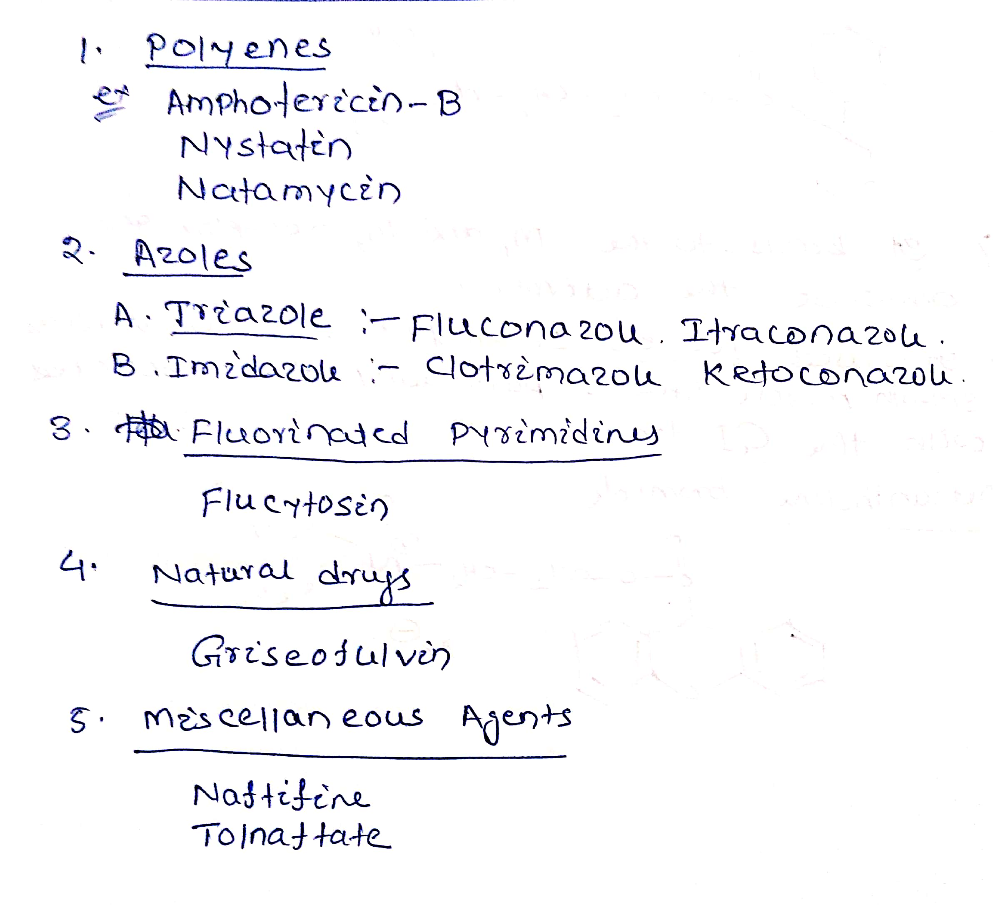
Drug classification

Slide 5
POLYENES
Ampotericin-B, Nystatin, Natamycin
These drugs binds with Ergosterol, the component of fungal cell membrane forming pores that cause rapid leakage of monovalent ions(K+, Na+, H+,Cl-) and water that leads to cell lysis.

Slide 6
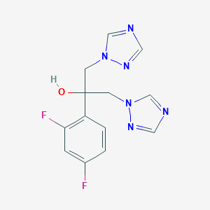
AZOLES
1. Triazole
Fluconazole

Slide 7
Imidazole

Slide 8
MOA
Triazole and imidazole inhibit 14-α-sterol demythylase. These drugs inhibit the conversion of levonosterol to Ergosterol. Ergosterol is an essential component of fungal cytoplasmic membrane.

Slide 9
Natural Product
The drug binds to tubulin, interfering with microtubule function, thus inhibiting mitosis. It binds to keratin and makes them resistant to fungal infections.

Slide 10
MISCELLANOUS:
MOA: These drugs mainly inhibit squalene epoxidase enzyme and interfere with the biosynthesis of ergosterol.

