Slide 1






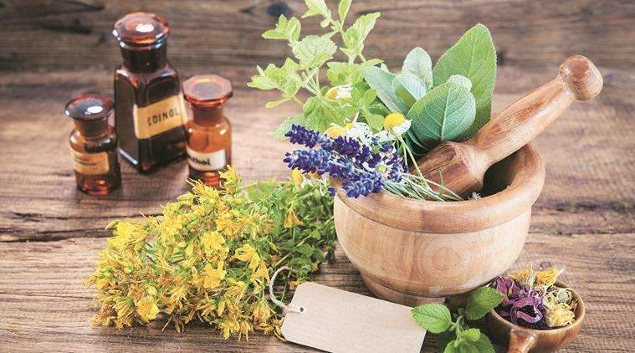
CULTIVATION,COLLECTION, PROCESSING,PRESERVATION
AND STORAGE OF IMPORTANT MEDICINAL
PLANTS

Slide 2
Prepaired By
Sunil Baile
(Assistant Professor)

Slide 3

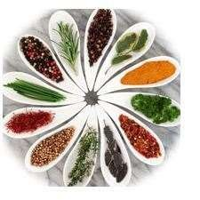
Topic
CULTIVATION.
COLLECTION.
PROCESSING.
PRESERVATION.
STORAGE.
USES

Slide 4

Cultivation
The crude drugs which reach the market and pharmaceutical industries will have passed through different stages that have some effect in the nature and amount of active constituents responsible for therapeutic activity. Those stages are to be concerned more in order to make a drug useful to the mankind by all means.

Slide 5

Methods of Plant Propagation
Medicinal plants can be propagated by two usual methods as applicable to non- medicinal plants or crops. These methods are referred as sexual method and asexual method. Each of these methods has certain advantages, and also, disadvantages.
1. Sexual method
2. Asexual method

Slide 6

Sexual method
In case of sexual method, the plants are raised from seeds and such plants are known as seedlings.
Seedlings are long-lived and bear more heavily
Plants are more sturdier.
Seedlings are comparatively cheaper and easy to raise.

Slide 7

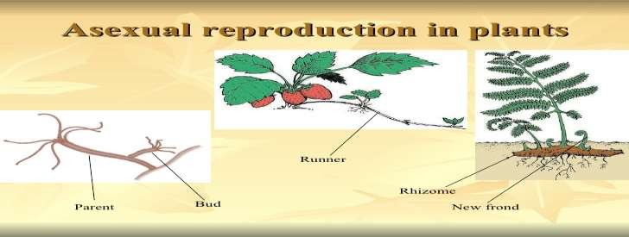
ASEXUAL METHOD
In case of asexual method of vegetative propagation, the vegetative part of a plant, such as stem or root, is placed in such an environment that it develops into a new plant.

Slide 8
Advantages:
There is no variation between the plant grown and plant from which it is grown. As such, the plants are uniform in growth and yielding capacity.
Seedless varieties of fruits can only be propagated vegetativel e.g. grapes, pomegranates and lemon.
Plants start bearing earlier as compared to seedling trees.
Budding or grafting encourages disease-resistant varieties of plants.
Modifying influence of root-stocks on scion can be availed of Inferior or unsuitable varieties can be over-
looked.

Slide 9


FACTORS AFFECTING CULTIVATION
ALTITUDE
Altitude is a very important factor in cultivation of medicinal plants. Tea, cinchona and eucalyptus are cultivated favourably at an altitude of 1,000–2,000 metres. Cinnamon and cardamom are grown at a height of 500 1000 metres, while senna can be cultivated at sea level.
TEMPERATURE
Temperature is a crucial factor controlling the growth, Many plants will grow better in temperate regions during summer.

Slide 10


RAINFALL
For the proper development of plant, rainfall is required in proper measurements. The effects of rainfall on plants must be considered in relation to the annual rainfall throughout the year with the water holding properties of the soil.
SOIL
Each and every plant species have its own soil and nutritive requirements. The three important basic characteristics of soils are their physical, chemical and microbiological properties. Soil provides mechanical support, water and essential foods for the development of plants.

Slide 11
SOIL FERTILITY:
It is the capacity of soil to provide nutrients in adequate amounts and in balanced proportion to plants.
FERTILIZER AND MANURES:
Plant also needs food for their growth and development. What plants need basically for their growth are the carbon dioxide, sun-rays, water and mineral matter from the soil.

Slide 12


PLANT HORMONES AND GROWTH REGULATOR
Plant hormones are physiological intercellular messengers that control the complete plant lifecycle, including germination, rooting, growth, flowering, fruit ripening, foliage and death.
FUNCTION OF AXUINS
Stimulates cell elongation
Auxin stimulates root initiation on stem cuttings and lateral root development in tissue culture .
Auxin has various effects on leaf fruit set, development, and ripening, and flowering.

Slide 13
FUNCTION OF CYTOKININ
Stimulate cell division.
Stimulate leaf expansion resulting from cell enlargement.
Enhance stomatal opening in some species.
DRYING OF CRUDE DRUG
Drying consists of removal of sufficient moisture content of crude drug, so as to improve its quality and make it resistant to the growth of microorganisms.
Drying inhibits partially enzymatic reactions.
The slicing and cutting into smaller pieces is done to enhance drying

Slide 14

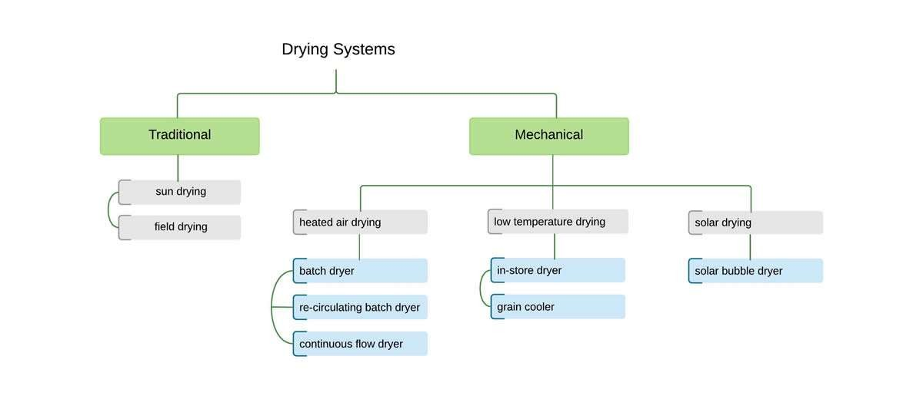

Slide 15

STORAGE OF CRUDE DRUG
Preservation of crude drugs needs knowledge of their
physical and chemical properties.
All the drugs should be preserved in well closed and, possibly in the filled containers. They should be stored in the premises which are water-proof, fire proof and rodent proof.
A number of drugs absorb moisture during their storage and become susceptible to the microbial growth.

Slide 16

PACKING OF CRUDE DRUG
The morphological and chemical nature of drug, its ultimate use and effects of climatic conditions during transportation and storage should be taken into consideration while packing the drugs.
Aloe is packed in goat skin.
Cod liver oil, being sensitive to sunlight, should be stored in such containers, which will not have effect of sunlight.
The drugs which are very sensitive to moisture and also costly at the same time need special attention, e.g. digitalis, ergot and squill.

Slide 17

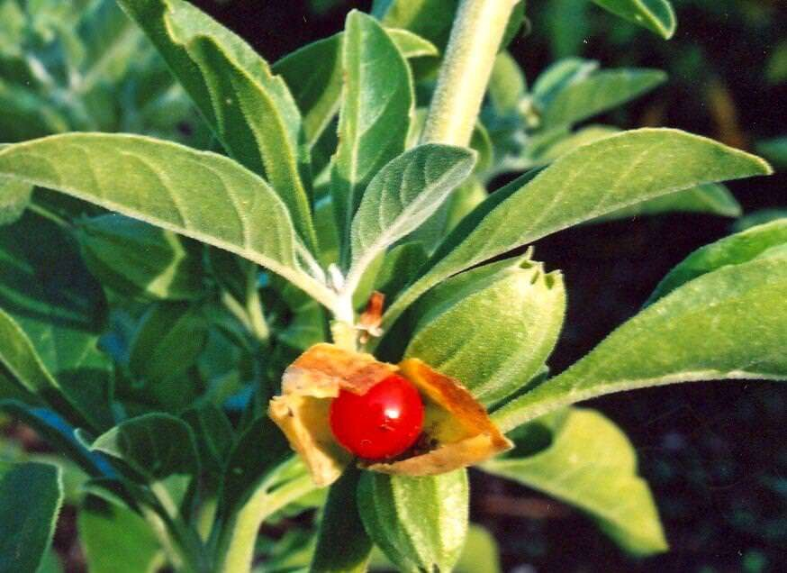
ASHWAGANDHA

Slide 18
Synonyms: Withania root, Asgandh,Winter cherry.
Biological Source: It consits of dried roots and stem bases of Withania Somnifera (linn),belonging to family Solanaceae.
Cultivation And Collection :
It is cultivate as various morpholgical and therapeutic properties.
The cultivation is mainly done in Madhya Pradesh.
The propagation is done by seeds.

Slide 19
The sowings is done towards june-july and during growth.
The propagation is done by seeds.
The sowings is done towards june-july.
The nitrogenous fertilzers lead formation of small.
Towards December or january ,the plants bear flowers and furits and during january harvesting is intiated which lasts upto march.
The roots are collected by uprooting.

Slide 20
Chemical Constituents:
The main constituents of ashwagandha are alkaloids and steroidal lactones.
Important alkaloids are Withanine, Somniferine,
Somnine, Tropine, Choline etc.
Steroids are Withaferin, Withanolide etc.
Uses:
Ashwagandha use aslo as sedative and hypnotic
effects.
It is use as treatment of Rehumastism, Gout, Hypertension, Skin diseases.
It is use as anti-stress activity as mood stabilizer revives mind and body.
Ashwagandha use widely as sex stimulant.

Slide 21

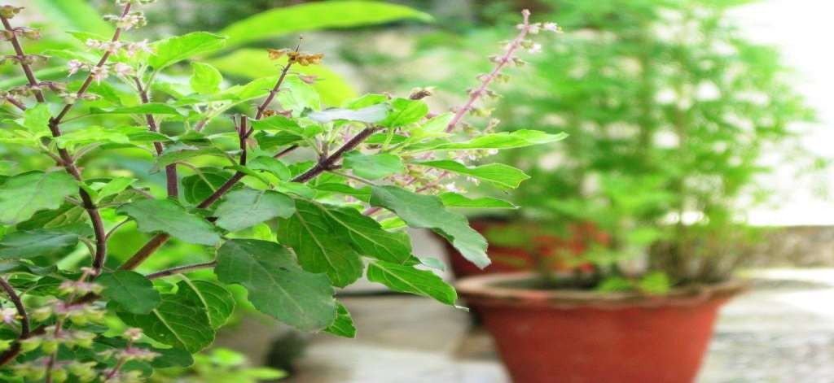
TULSI

Slide 22
Synonyms : Sacred Basil, Holy Basil
Biological Source:
Tulsi consists o fresh and dried leaves of Ocimum
Sanctum Linn.
family Lamiaceae.
Chemical Constituents:
Tulsi leaves contain bright, yellow coloured and
pleasent volatile oil.
The plant is also contain alkaloid , glycoside, saponin, tannins, vitamin C and tartaric acid. Tulsi contain 70 percent eugenol, carvacrol 3 percent.
It also contain caryophyllin.

Slide 23
USES:
The oil of tulsi is antibacterial and insecticidal.
The leavess are used as stimulant, aromatic, anticatarrhal and diaphoretic.
Several preparation for skin diseases and to cure ear- ache.
Tulsi has expectorant and anti inflammatory properties.

Slide 24

CONCLUSION
On this project work, I have disscussed about cultivation,collection, preservatio and storage of only a few medicinal plant,but there are more medicinal plant grow in our country. Medicinal herbs can be a good alternative for many diseases and conditions.If we do proper management and cultivation of medicinal plant, our country will be developed in herbal medicine and many peopole will be benefited by medicinal as use it medicine.

Slide 25

References
C.k. Kokate, A.P. purohit ,S.B. Gokhale Pharmacognosy Golden Jubilee 50 Edition, Nirali Prakashan Page-04.01-04.12(14.77- 14.80)
Shah Biren ,Seth A.K. Text book of Pharmacognosy and Phytochemistry, second edition , CBS publishers pvt. ltd, Chapter- Cultivation collection and processing of some medicinal plants, pg 67-78.

Slide 26


