Slide 1
Syphilis

Slide 2
Introduction
Syphilis is a venereal (sexually-transmitted) disease caused by spirochaetes, Treponema pallidum.
Other treponemal diseases are yaws, pinta and bejel.
The word ‘syphilis’ is derived from the name of the mythological handsome boy, Syphilus, who was cursed by Greek god Apollo with the disease.

Slide 3
Causative Organism
T. pallidum is a coiled spiral filament 10 μm long that moves actively in fresh preparations.
The organism cannot be stained by the usual methods and can be demonstrated in the exudates and tissues by:
  dark ground illumination (DGI) in fresh preparation;
  fluorescent antibody technique;
  silver impregnation techniques; and
  nucleic acid amplification technique by PCR.
The organism has not been cultivated in any culture media but experimental infection can be produced in rabbits and chimpanzees.
The organism is rapidly destroyed by cold, heat, and antiseptics.

Slide 4
Incidence
Since the advent of penicillin therapy in 1943, syphilis has shown a decline in incidence.
However, the disease continues to have global presence.
Most commonly affected regions in the world are in Sub-Saharan Africa, South America, and South East Asia.
Male homosexuals are at greater risk.
Some African countries have very high incidence of congenital syphilis and also responsible for high rate of stillbirths.

Slide 5
Immunology
T. pallidum does not produce any endotoxin or exotoxin.
The pathogenesis of the lesions appears to be due to host immune response.
There are two types of serological tests for syphilis: treponemal and non-treponemal.
A. Treponemal serological tests These tests measure antibody to T. pallidum antigen and are more useful and sensitive for the diagnosis of syphilis:
  Fluorescent treponemal antibody-absorbed (FTA-ABS) test.
  Agglutinin assays e.g. microhaemagglutination assay for T. pallidum (MHA-TP), and Serodia TP-PA; the latter is more sensitive.
  T. pallidum passive haemagglutination (TPHA) test.
B. Non-treponemal serological tests These tests measure non-specific reaginic antibodies IgM and IgG immunoglobulins directed against cardiolipin-lecithin-cholesterol complex and are more commonly used. These tests are as under:
  Reiter protein complement fixation (RPCF) test: test of choice for rapid diagnosis.
  Venereal Disease Research Laboratory (VDRL) or Rapid Plasma Reagin (RPR) test: Wassermann described a complement fixing antibody against antigen of human syphilitic tissue. This antigen is used in the Standard Test for Syphilis (STS) in Wassermann complement fixing test and VDRL test.

Slide 6
Mode of Transmission
Sexual intercourse is the most common route of infection and results in lesions on glans penis, vulva, vagina and cervix.
Intimate person-to-person contact with lesions on lips, tongue or fingers.
Transfusion of infected blood.
Materno-foetal transmission in congenital syphilis if the mother is infected.

Slide 7
Stages of Acquired Syphilis
Acquired syphilis is divided into 3 stages depending upon the period after which the lesions appear and the type of lesions.
These are: primary, secondary and tertiary syphilis.
PRIMARY SYPHILIS
Typical lesion of primary syphilis is chancre which appears on genitals or at extra-genital sites in 2-4 weeks after exposure to infection (Figure).
Initially, the lesion is a painless papule which ulcerates in the centre.
The fully-developed chancre is an indurated lesion with central ulceration accompanied by regional lymphadenitis.
The chancre heals without scarring, even in the absence of treatment.
Antibody tests are positive in 1-3 weeks after the appearance of chancre.
Spirochaetes can be demonstrated in the exudates by DGI.

Slide 8
Stages of Acquired Syphilis
SECONDARY SYPHILIS
Inadequately treated patients of primary syphilis develop mucocutaneous lesions and painless lymphadenopathy in 2-3 months after the exposure (Fig. 5.36,B).
Mucocutaneous lesions may be in the form of the mucous patches on mouth, pharynx and vagina; and generalised skin eruptions and condylomalata in anogenital region.
Antibody tests are always positive at this stage.
Secondary syphilis is highly infective stage and spirochaetes can be easily demonstrated in the mucocutaneous lesions.

Slide 9
Stages of Acquired Syphilis
TERTIARY SYPHILIS
After a latent period of appearance of secondary lesions and about 2-3 years following first exposure, tertiary lesions of syphilis appear.
Lesions of tertiary syphilis are much less infective than the other two stages and spirochaetes can be demonstrated with great difficulty.
These lesions are of 2 main types (Figure):
Syphilitic Gumma
  It is a solitary, localised, rubbery lesion with central necrosis, seen in organs like liver, testis, bone and brain. In the liver, the gumma is associated with scarring of hepatic parenchyma.

Slide 10
Stages of Acquired Syphilis
TERTIARY SYPHILIS
Diffuse Lesions Of Tertiary Syphilis:
The lesions appear following widespread dissemination of spirochaetes in the body.
The diffuse lesions are predominantly seen in cardiovascular and nervous systems which are described in detail later in the relevant chapters.
Briefly, these lesions are as under:
a) Cardiovascular syphilis mainly involves thoracic aorta. The wall of aorta is weakened and dilated due to syphilitic aortitis and results in aortic aneurysm, incompetence of aortic valve and narrowing of mouths of coronary ostia.

Slide 11
Stages of Acquired Syphilis
TERTIARY SYPHILIS
b) Neurosyphilis may manifest as: meningovascular syphilis affecting chiefly the meninges; tabes dorsalis affecting the spinal cord; and general paresis affecting the brain.

Slide 12
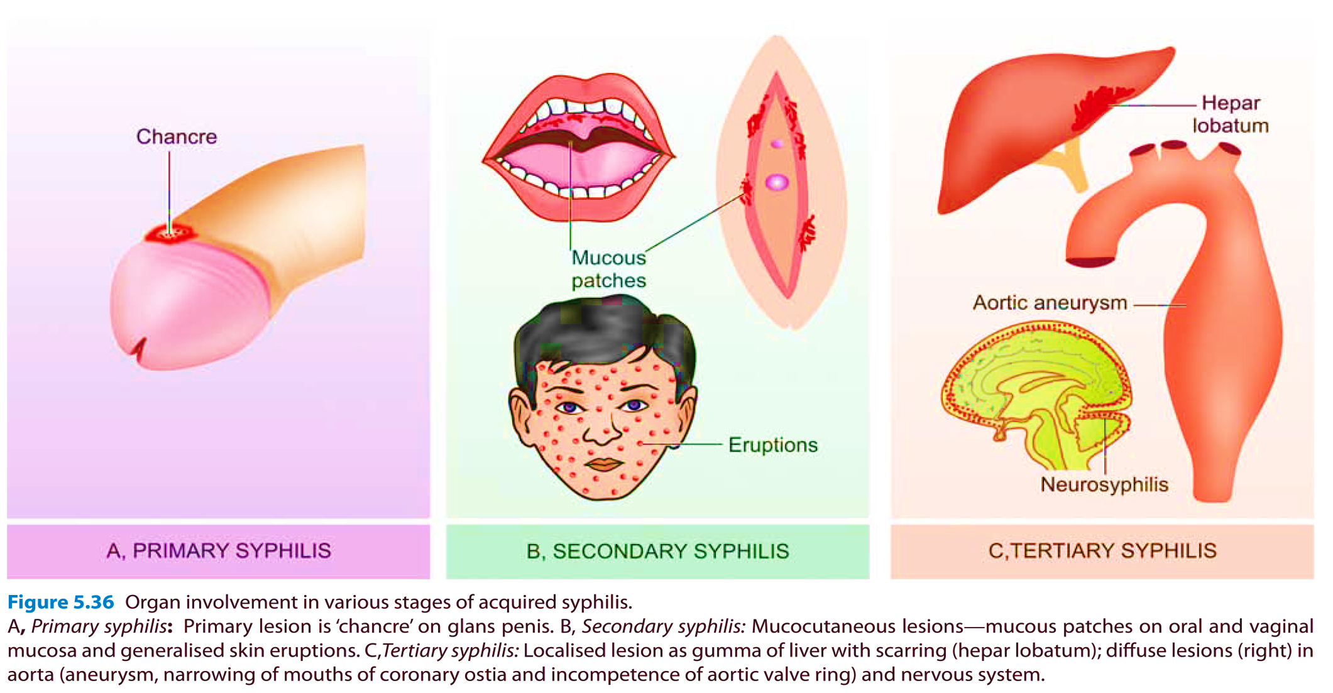

Slide 13
Congenital Syphilis
Congenital syphilis may develop in a foetus of more than 16 weeks gestation who is exposed to maternal spirochaetaemia.
The major morphologic features as under:
  Saddle-shaped nose deformity due to destruction of bridge of the nose.
  The characteristic ‘Hutchinson’s teeth’ which are small, widely spaced, peg-shaped permanent teeth.
  Mucocutaneous lesions of acquired secondary syphilis.
  Bony lesions like epiphysitis and periostitis.
  Interstitial keratitis with corneal opacity.
  Diffuse fibrosis in the liver.
  Interstitial fibrosis of lungs.
  If the foetus with congenital syphilis is born dead, it is premature, with macerated skin, enlarged spleen and liver, and with syphilitic epiphysitis.

Slide 14
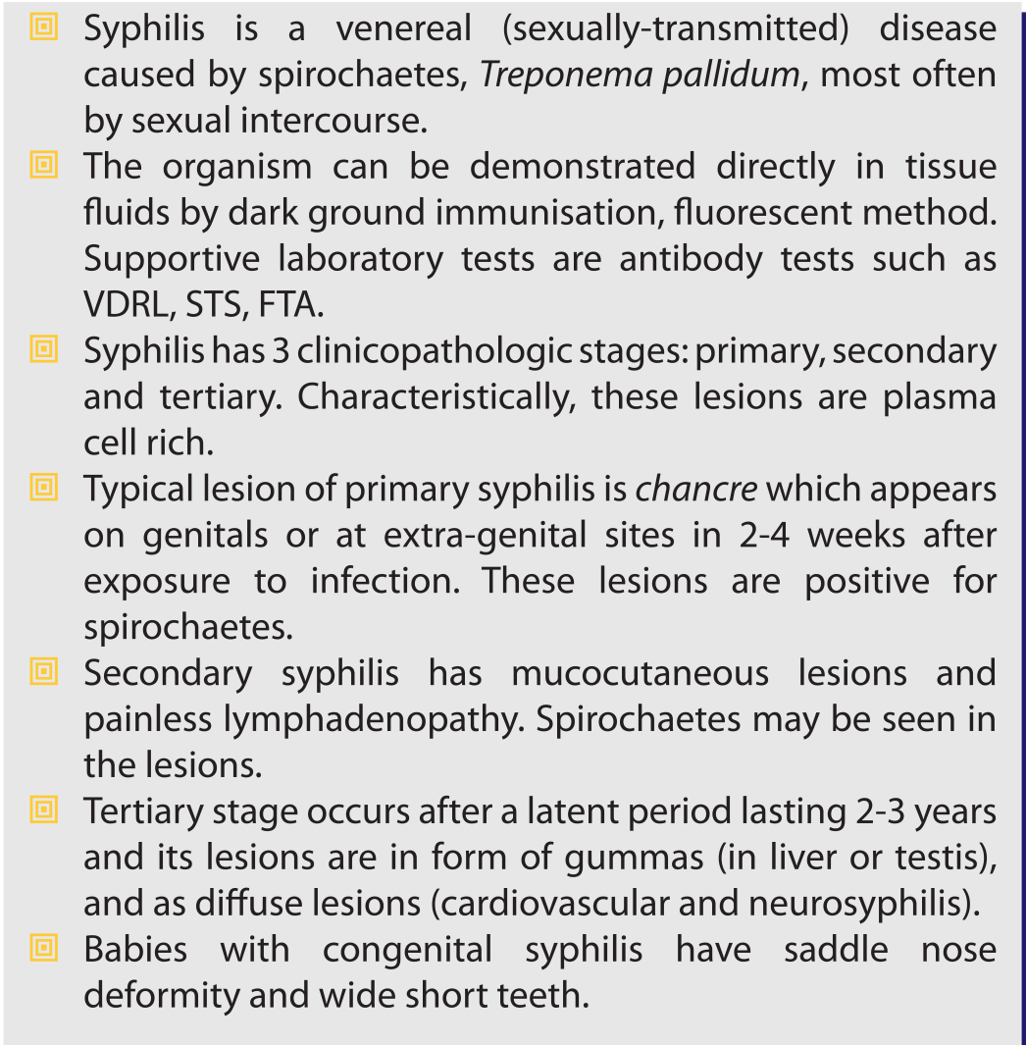
Summary:

