Slide 1


Introduction to Pediatric Operative Dentistry
Dr Seema Bargale
Professor and Guide

Slide 2
Content
Introduction
History
Objectives
Epidemiology
Importance of primary teeth
Primary v/s permanent teeth differences

Slide 3
Introduction
Operative dentistry is the art and science of the diagnosis, treatment, and prognosis of defects of teeth that do not require full coverage restorations for correction. Such treatment should result in the restoration of proper tooth form, function, and esthetics while maintaining the physiologic integrity of the teeth in harmonious relationship with the adjacent hard and soft tissues, all of which should enhance the general health and welfare of the patient.
- Sturdevant

Slide 4
History
Early dentists- barbers
Later, cavity preparation and tooth restoration became widely popular.
The first successful tooth restorations were developed in the United States.
G.V.Black (1924) –” Father of operative dentistry”
Charles E. Woodbury, E.K. Wedelstaedt, Waldon Ferrier and George Hollenback made significant contributions to the early development of operative dentistry.
M.E.J.Curzon, J.F.Roberts, D.B.Kennedy.Kennedy’s Paediatric Operative Dentistry.4th edition. Reed publishing house;1996.

Slide 5
Objectives (AAPD)
To repair or limit the damage from caries,
To protect and preserve the tooth structure,
To reestablish adequate function, restore esthetics (where applicable),
To provide ease in maintaining good oral hygiene
Pulp vitality should be maintained whenever possible
AAPD Guideline On Restorative Dentistry. American Academy Of Pediatric Dentistry . V 36 / NO 6 14 / 15

Slide 6
Epidemiology
Primary dentition
0-2yrs – 8% - sites lingual, interproximal areas of maxillary incisors, occlusal surfaces of 1st primary molars
3 yrs- occlusal surfaces of 2nd primary molars > 1st primary molars; mand> maxillary
Mixed dentition
Occlusal surfaces of permanent molars
Lingual pits in maxillary permanent incisors – lateral incisors
Early permanent dentition
1st permanent molar > 2nd permanent molar > premolars > maxillary anterior teeth > canine and mandibular incisors
M.E.J.Curzon, J.F.Roberts, D.B.Kennedy.Kennedy’s Paediatric Operative Dentistry.4th edition. Reed publishing house;1996.

Slide 7

Importance of primary teeth
Help in Mastication
Impairment of speech
Maintenance and importance of appearance (Esthetics)
Maintenance of arch length
Prevents development of oral habits
Prevent associated psychological effects with premature tooth loss
Nikhil Marwah. Textbook of Pediatric Dentistry.4rd edition. Jaypee Brothers Medical Publishers Private Limited;2019

Slide 8
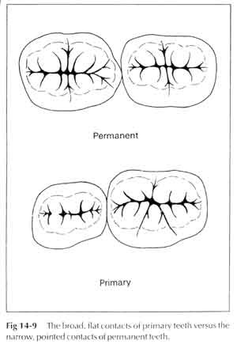
Morphological & Anatomical Difference b/w Primary & Permanent Tooth
Narrow bucco-lingual occlusal table.
Shorter
Contact areas in primary teeth Broader, flatter, situated farther gingivally
Constricted in cervical portion.
Occlusal table is not narrow
Broader
Contact points in permanent teeth are placed more occlusally
Cervical constriction is not well marked.
M. S. Duggal,M. E. J. Curzon,S. A. Fayle, K. J. Toynba. Restorative Techniques in Paediatric Dentistry: An Illustrated Guide to the Restoration of Extensive Carious Primary Teeth.2nd edition. CRC Press:2002.

Slide 9
 | DECIDUOUS | PERMANENT
Crown Dimension | Longer Mesiodistally than incisocervically | Longer Incisocervically than mesiodistally
Developmental lines | Labial Surface of incisors are smooth they don’t show any depression and developmental lines | Labial Surface of incisors smooth and convex with to faint vertical development lines & grooves
Cingulum | More prominent | Less Prominent
Mamelons | Absent | Incisal ridge consist of three prominent mamelons

Slide 10
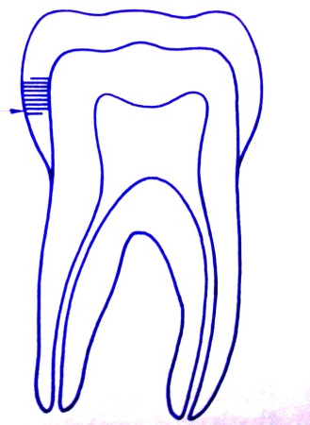

Thick enamel and dentin layer
Enamel rod in the cervical area directed Gingivally
Point contacts
Color is much darker
- Thinner enamel and dentin layers, (1mm)
- Enamel rods in the cervical area directed
Occlusally.
- Broad and flat contacts.
Color is usually lighter.

Slide 11
Thank you

