Slide 1

Traumatic Dental Injuries (TDI) to Anterior Teeth
Dr Pratik Kariya
  Associate Professor
  Dept of Pediatric and Preventive Dentistry
  K M Shah Dental College and Hospital, SVDU
  Vadodara, Gujarat

Slide 2

Traumatic Dental Injuries (TDI) to Anterior Teeth
Ellis & Davey classification
(1970)

Slide 3
INTRODUCTION
Injury can be defined as an interruption in the continuity of tissues.
Traumatic injury can be defined as a damage to a part of body tissue due to external forces.
Traumatic Dental Injury (Dental trauma) is an impact injury to the teeth and/or other hard and soft tissues within and around the vicinity of the mouth and oral cavity.
It is usually sudden, circumstantial, unexpected, accidental and often requires emergency attention.

Slide 4
CLASSIFICATION

Slide 5
Ellis & Davey Classification
1970

Slide 6
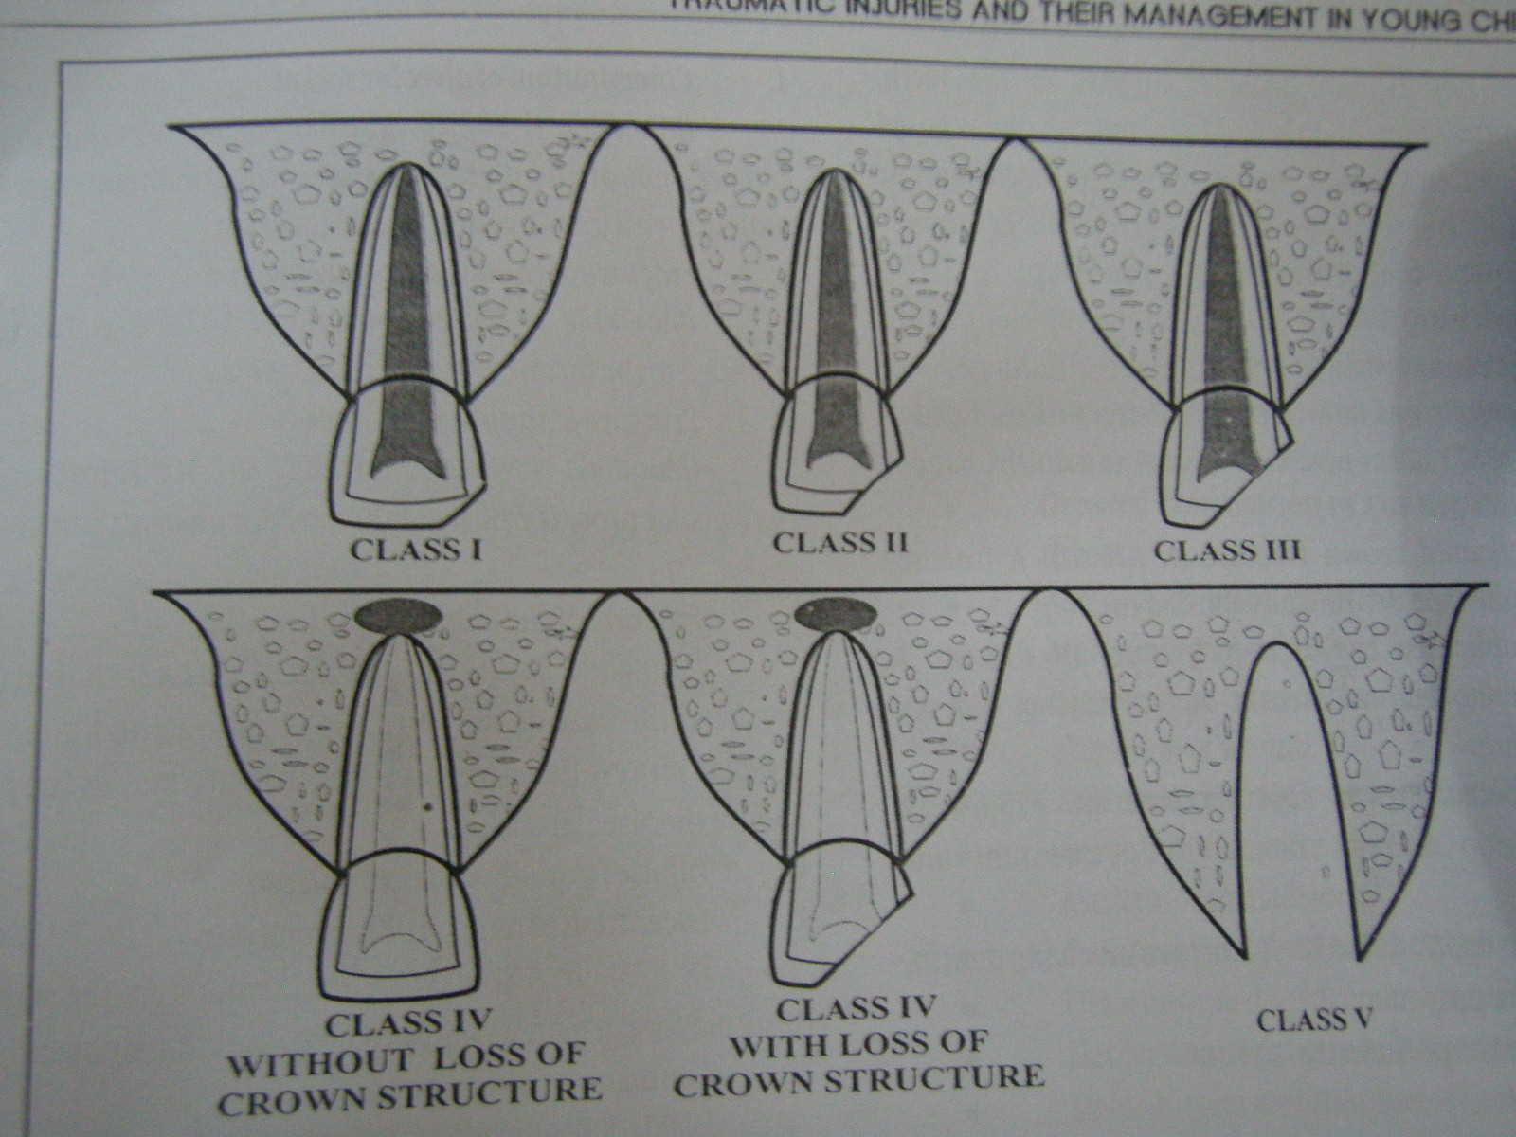
ELLIS AND DAVEY CLASSIFICATION (1970)
CLASS I | Simple fracture of crown, involving little or no dentin

Slide 7
ELLIS AND DAVEY CLASSIFICATION (1970)
CLASS II | Extensive fracture of the crown involving considerable dentin, but not the dental pulp

Slide 8
ELLIS AND DAVEY CLASSIFICATION (1970)
CLASS III | Extensive fracture of the crown involving considerable dentin, and exposing the pulp

Slide 9
ELLIS AND DAVEY CLASSIFICATION (1970)
CLASS IV | Traumatized tooth which becomes non vital with or without loss of crown structure

Slide 10
ELLIS AND DAVEY CLASSIFICATION (1970)
CLASS V | Teeth lost as a result of trauma

Slide 11
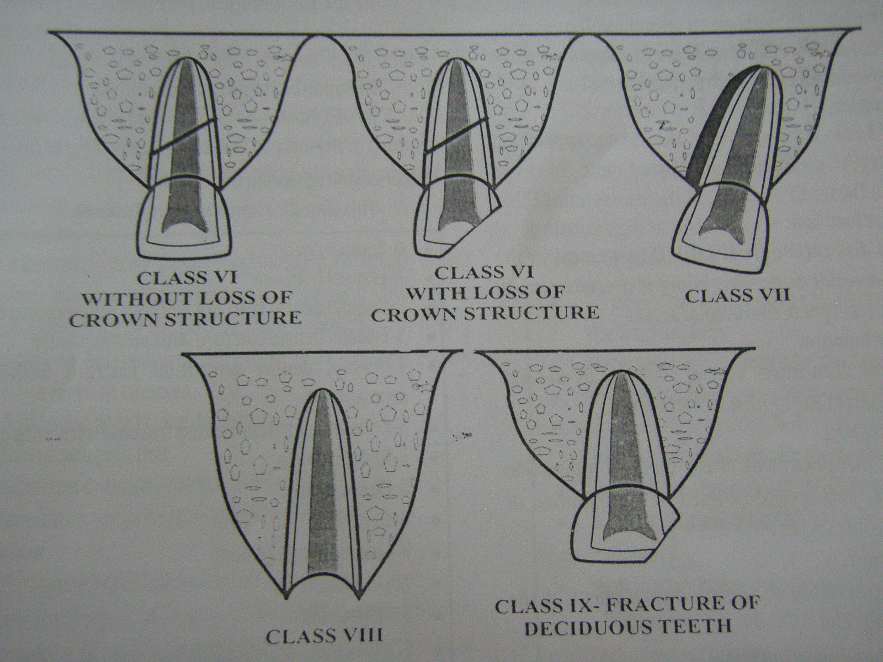
ELLIS AND DAVEY CLASSIFICATION (1970)
CLASS VI | Fracture of the root with or without loss of crown structure

Slide 12
ELLIS AND DAVEY CLASSIFICATION (1970)
CLASS VII | Displacement of tooth without fracture of crown or root

Slide 13
ELLIS AND DAVEY CLASSIFICATION (1970)
CLASS VIII | Fracture of the crown en-mass and its replacement

Slide 14
ELLIS AND DAVEY CLASSIFICATION (1970)
CLASS IX | Traumatic injuries of primary teeth

Slide 15



Thank You

