Slide 1
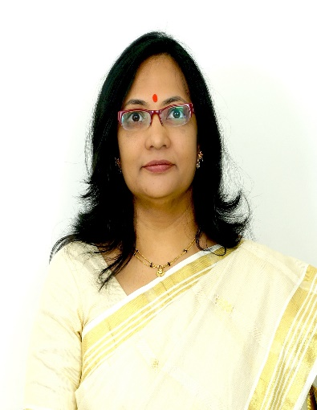

Armamentarium in Pediatric Operative Dentistry
Dr Seema Bargale
Professor and Guide

Slide 2

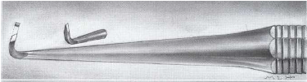
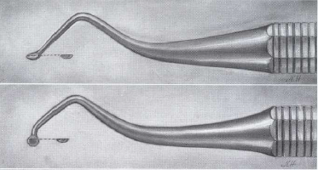
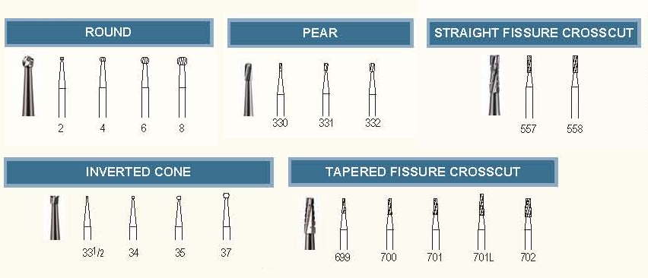
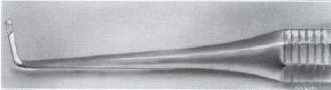
Armamentarium
G.V.Black’s classification:
Cutting instruments
Hand
Chisels
Hatchets
Excavators
Hoes
Rotary
Burs
Stones
Discs

Slide 3
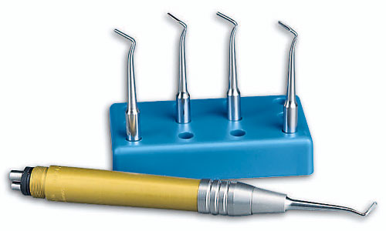
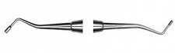
Condensing instruments
Hand pluggers Mechanical pluggers
Theodore M. Roberson, Harald 0. Heymann Edward J. Swift, Jr.Sturdevant’s Art and Science of Operative Dentistry. 4th edition. St. Louis: Mosby; 2002.
Nikhil Marwah. Textbook of Pediatric Dentistry.3rd edition. Jaypee Brothers Medical Publishers Private Limited;2014

Slide 4
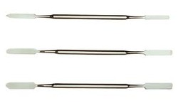
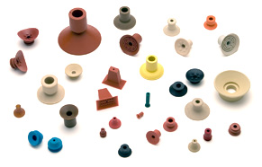
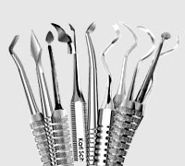
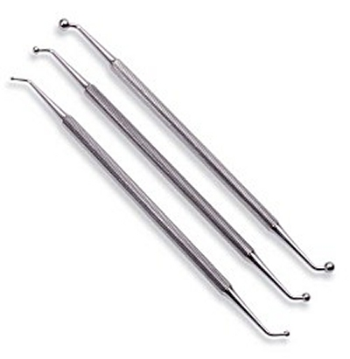
Plastic instruments
Spatulas
Carriers
Carvers
Plastic filling instruments
Burnishers
Finishing and polishing instruments
Hand Rotary
Orangewood sticks Finishing burs
Polishing points Mounted brushes
Finishing strips Rubber cups and discs
Theodore M. Roberson, Harald 0. Heymann Edward J. Swift, Jr.Sturdevant’s Art and Science of Operative Dentistry. 4th edition. St. Louis: Mosby; 2002.

Slide 5
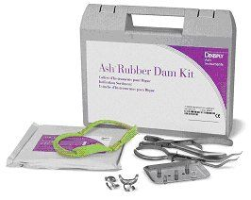
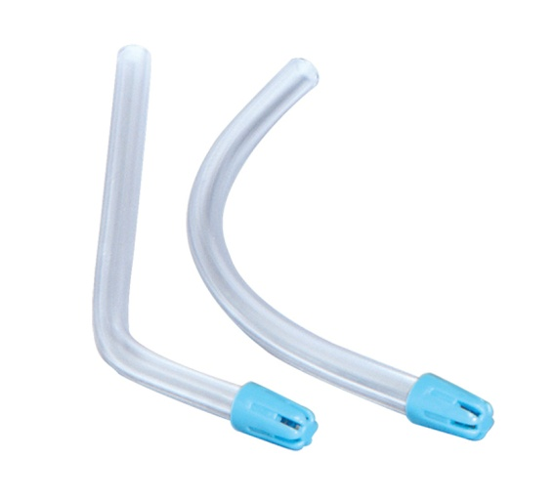
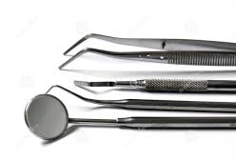
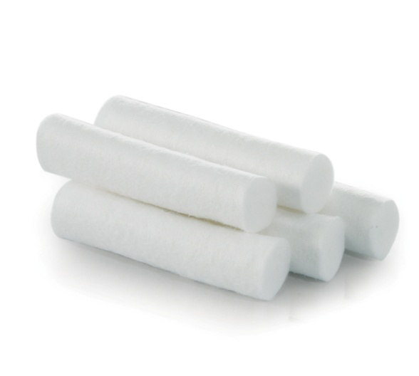
Isolation instruments
Rubber dam kit
Saliva ejector
Cotton rolls
High volume ejector
Miscellaneous instruments
Mouth mirrors
Probes
Pliers
Cotton tweezers
Theodore M. Roberson, Harald 0. Heymann Edward J. Swift, Jr.Sturdevant’s Art and Science of Operative Dentistry. 4th edition. St. Louis: Mosby; 2002.

Slide 6
Marzouk’s classification:
Exploring instruments
Mouth mirrors
Instruments for tooth structure removal
Hand – chisels, excavators
Restoring instruments
Cement spatulas
Plastic filling instrument
Explorers
Probes
Cotton tweezers
Rotary – headpieces, burs, abrasives
Amalgam carriers
Condensers
Burnishers
Carvers
Finishing and polishing instruments
Finishing strips
Finishing burs
Brushes
Rubber cups
Nikhil Marwah. Textbook of Pediatric Dentistry.3rd edition. Jaypee Brothers Medical Publishers Private Limited;2014

Slide 7
Matrices
It is thereby used as a temporary wall, which is created opposite to the axial walls, surrounding areas of the tooth structure that were lost during cavity preparation.
Matrix is a device used during the restorative procedures to hold the plastic restorative material within the tooth while it is setting.

Slide 8
Classification:
Place of application
  Posterior – T-Band, Toffelmire
  Anterior – Celluloid matrix
Constituents
  Metallic – Ivory no.1, Ivory no.8
  Non metallic – Mylar strips
Presence / absence of retainer
  With retainer – Ivory no.1, Ivory no.8
  Without retainer – S-band

Slide 9
Form
  Anatomical – Celluloid crown form
  Non anatomical – Ivory no.1
Use
  Universal – Ivory no.8, Toffelmire
  Unilateral – Ivory no.1
Edwina A. M. Kidd, Bernard G. N., Smith Timothy F, Watson H. M, Pickard. Pickard’s Manual of Operative Dentistry.8th edition. Oxford: University Press; 2003

Slide 10
Recent modifications of matrix
Sectional matrix
  Easy to place, gives a large preparation area and reduces working time
  Mesial and distal proximal area restorations can be accomplished by one matrix
Smartview matrix
  Comes with smartband sectional matrices and titanium instruments
  Non stick surfaces, anatomical contours
  Mostly used for composite restorations
Edwina A. M. Kidd, Bernard G. N., Smith Timothy F, Watson H. M, Pickard. Pickard’s Manual of Operative Dentistry.8th edition. Oxford: University Press; 2003

Slide 11
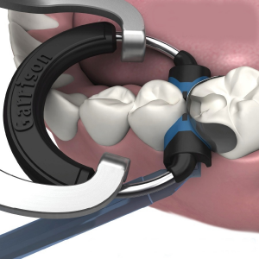
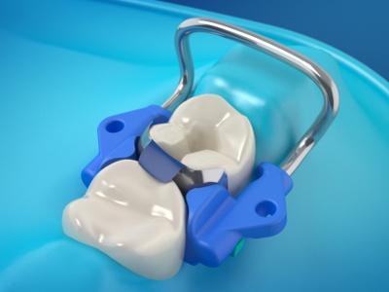
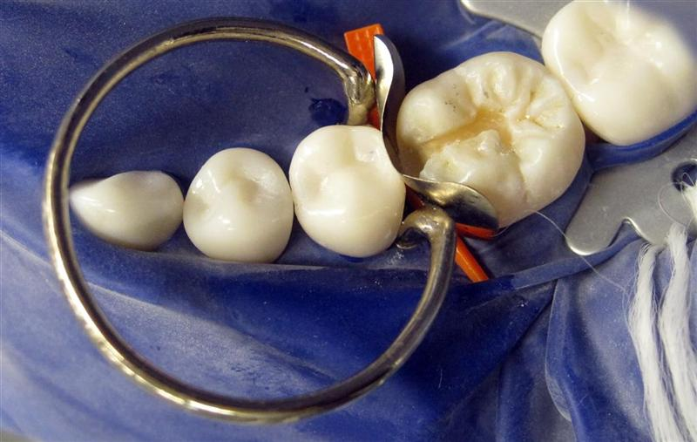
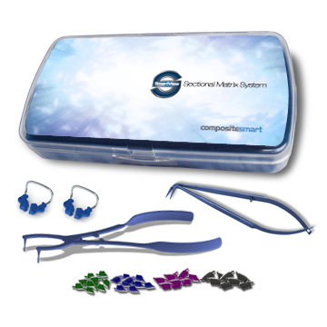
Sectional matrix
Smart view matrix system

Slide 12
Wedges
It is defined as a piece of wood, metal etc. one end of which is an acute angled edge formed by two converging planes used to tighten or exert force in various ways.
1883- wedges of boxwood, orangewood, balsam wood were made.
1st metal wedge- Ottolengui steel wedge.
Current wedges – plastic, metal, wood, celluloid
Recent wedges – Luci-wedge, Hawe-Neos dental
Edwina A. M. Kidd, Bernard G. N., Smith Timothy F, Watson H. M, Pickard. Pickard’s Manual of Operative Dentistry.8th edition. Oxford: University Press; 2003

Slide 13
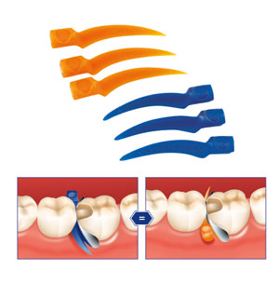
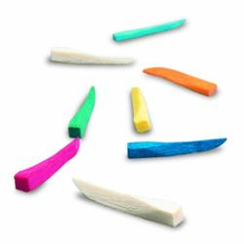
Types
Acc. to anatomy
  Anatomical – in shape of embrassures
  Non- anatomical – round
Acc. to material used
  Wooden – hard wood or soft wood
  Plastic – in various shapes
Acc. to color
  Colored
  Light reflecting – used with composite
Edwina A. M. Kidd, Bernard G. N., Smith Timothy F, Watson H. M, Pickard. Pickard’s Manual of Operative Dentistry.8th edition. Oxford: University Press; 2003

Slide 14
Thank you

