Slide 1

Dr Pratik Kariya
  Associate Professor
  Dept of Pediatric and Preventive Dentistry
  K M Shah Dental College and Hospital, SVDU
  Vadodara, Gujarat
Traumatic Dental Injuries (TDI) to Anterior Teeth

Slide 2

Traumatic Dental Injuries (TDI) to Anterior Teeth
Andreasen Classification
(1981)

Slide 3
Terminologies Regarding TDI
Crown craze or crack: Crack or incomplete fracture of enamel without loss of tooth structure in horizontal or vertical direction
Crown fracture: Confined to enamel; to enamel and dentin; to enamel, dentin and pulp; may be horizontal, vertical or oblique direction involving mesioincisal or destoincisal line angles
Crown root fracture: With or without pulp involvement

Slide 4
Terminologies Regarding TDI
Root fracture: Involving apical, middle or cervical third in either horizontal or vertical direction
Labial displacement- movement of tooth towards patients lip
Palatal/Lingual displacement- towards patients palate
Lateral displacement- mesial or distal displacement

Slide 5
Intrusion- displacement of the tooth into its socket
Extrusion- partial displacement or tooth out of its socket
Avulsion- (lost or exarticulated) -complete displacement of tooth from its socket

Slide 6
Clinical Classification By Andreasen (1981)
A | INJURIES TO HARD DENTAL TISSUES AND PULP
B | INJURIES TO THE PERIODONTAL TISSUES
C | INJURY TO THE SUPPORTING BONE
D | INJURIES TO GINGIVA OR ORAL MUCOSA

Slide 7
Clinical Classification By Andreasen (1981)
INJURIES TO HARD DENTAL TISSUES AND PULP
N 502.50 | Enamel infraction: An incomplete fracture (crack) of enamel without loss of the tooth substance
N 502.50 | Enamel fracture- Uncomplicated crown fracture: A Fracture with loss of tooth substance confined to enamel
N 502.51 | Enamel dentin fracture-Involving-Uncomplicated crown fracture: A fracture with loss of tooth substance confined to enamel and dentin, but not involving the pulp
N 502.52 | Complicated crown facture: A Fracture involving enamel and dentin, and exposing the pulp

Slide 8
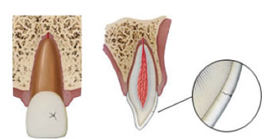
Clinical Classification By Andreasen (1981)
INJURIES TO HARD DENTAL TISSUES AND PULP
N 502.50 | Enamel infraction: An incomplete fracture (crack) of enamel without loss of the tooth substance

Slide 9
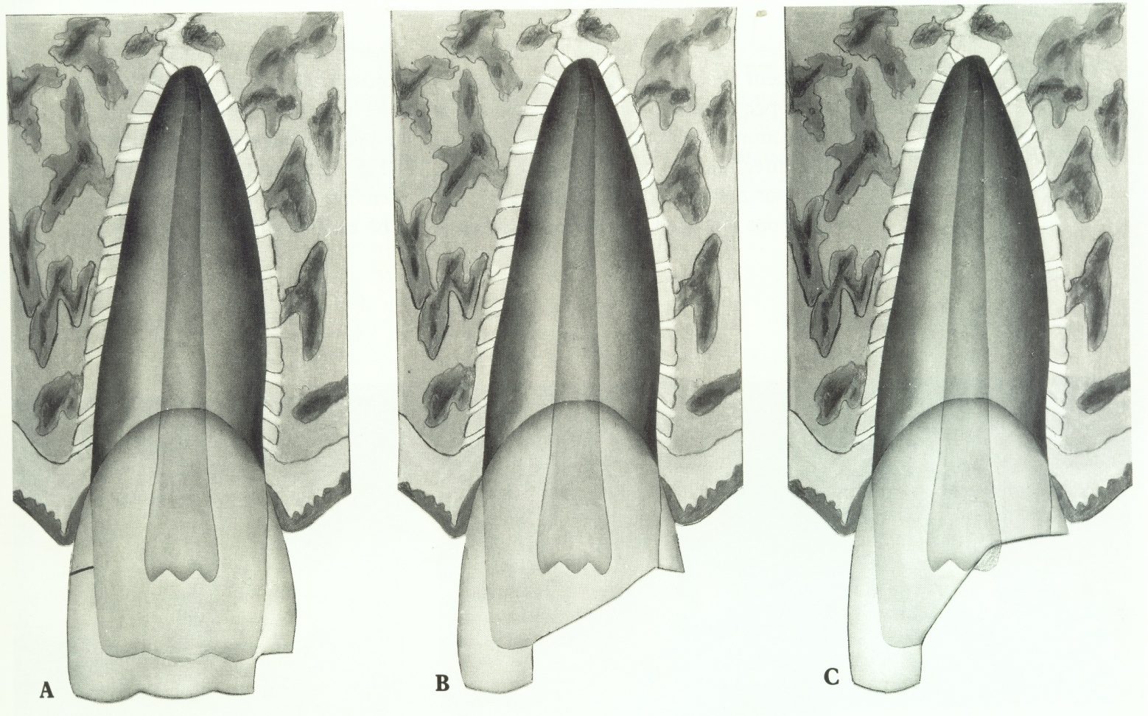
Clinical Classification By Andreasen (1981)
INJURIES TO HARD DENTAL TISSUES AND PULP
N 502.50 | Enamel fracture- Uncomplicated crown fracture: A Fracture with loss of tooth substance confined to enamel

Slide 10
Clinical Classification By Andreasen (1981)
INJURIES TO HARD DENTAL TISSUES AND PULP
N 502.51 | Enamel dentin fracture- Uncomplicated crown fracture: A fracture with loss of tooth substance confined to enamel and dentin, but not involving the pulp

Slide 11
Clinical Classification By Andreasen (1981)
INJURIES TO HARD DENTAL TISSUES AND PULP
N 502.52 | Complicated crown facture: A Fracture involving enamel and dentin, and exposing the pulp

Slide 12
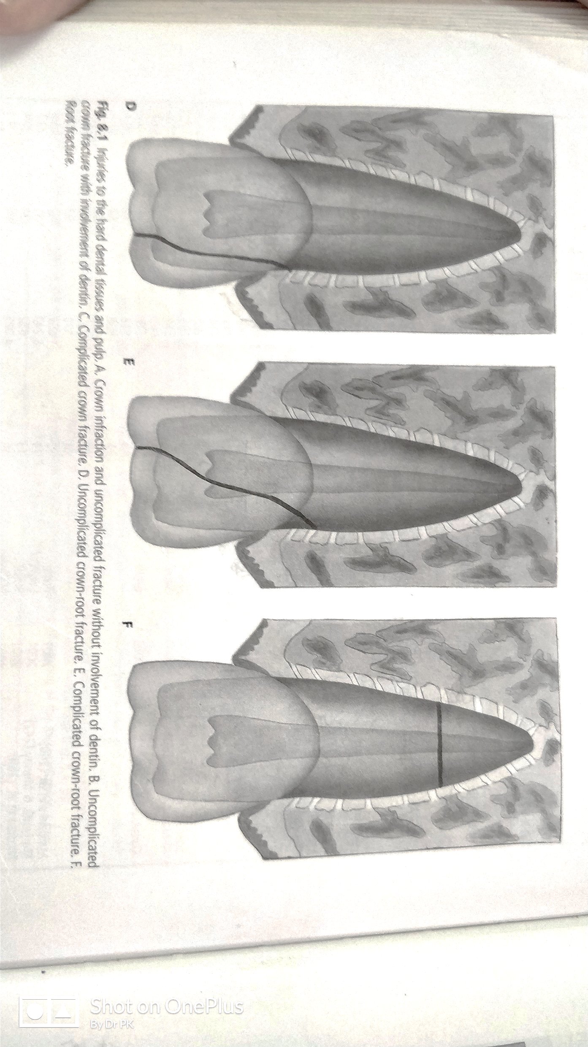
Clinical Classification By Andreasen (1981)
INJURIES TO HARD DENTAL TISSUES AND PULP
N 502.54 | Uncomplicated crown root fracture: A Fracture involving enamel, dentin, and cementum but not exposing the pulp

Slide 13
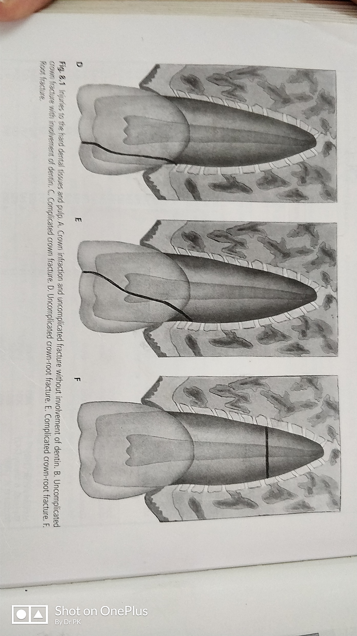
Clinical Classification By Andreasen (1981)
INJURIES TO HARD DENTAL TISSUES AND PULP
N 502.54 | Complicated crown root fracture: A Fracture involving enamel, dentin, and cementum and exposing the pulp

Slide 14
Clinical Classification By Andreasen (1981)
INJURIES TO HARD DENTAL TISSUES AND PULP
N 502.53 | Root fracture: A Fracture involving dentin, cementum and pulp

Slide 15
Clinical Classification By Andreasen (1981)
B) INJURIES TO THE PERIODONTAL TISSUES

Slide 16
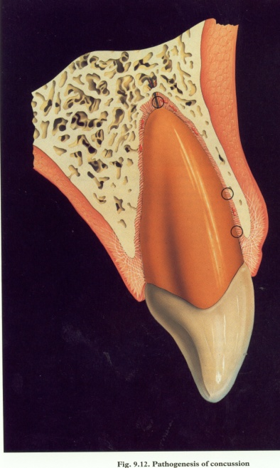
Clinical Classification By Andreasen (1981)
B) INJURIES TO THE PERIODONTAL TISSUES
N 503.20 | Concussion: An injury to tooth supporting structure without abnormal loosening or displacement of tooth, but marked reaction to percussion

Slide 17
Clinical Classification By Andreasen (1981)
B) INJURIES TO THE PERIODONTAL TISSUES
N 503.20 | Subluxation: An Injury to the tooth supporting structures with abnormal loosening, but without displacement of the tooth

Slide 18
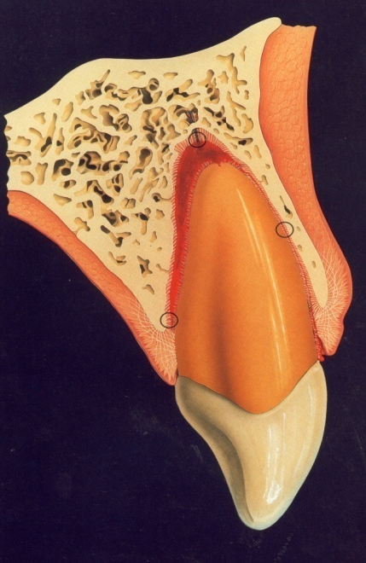
Clinical Classification By Andreasen (1981)
B) INJURIES TO THE PERIODONTAL TISSUES
N 503.20 | Extrusive luxation (peripheral dislocation, partial avulsion): Partial displacement of tooth out of its socket

Slide 19
Clinical Classification By Andreasen (1981)
B) INJURIES TO THE PERIODONTAL TISSUES
N 503.20 | Lateral luxation: Displacement of the tooth in a direction other than axially. This is accompanied by comminution of fracture of the alveolar socket.

Slide 20
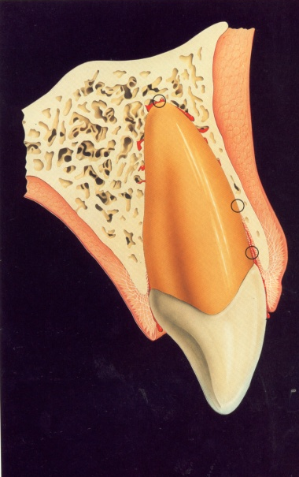
Clinical Classification By Andreasen (1981)
B) INJURIES TO THE PERIODONTAL TISSUES
N 503.21 | Intrusive luxation (central dislocation): Displacement of the tooth into the alveolar bone. This is accompanied by comminution of fracture of the alveolar socket.

Slide 21
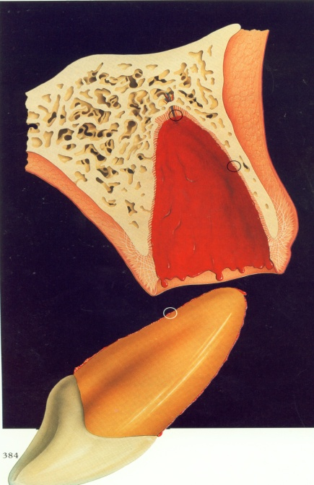
Clinical Classification By Andreasen (1981)
B) INJURIES TO THE PERIODONTAL TISSUES
N 503.22 | Exarticulation (complete avulsion): Complete displacement of tooth out of its socket

Slide 22
Clinical Classification By Andreasen (1981)
C) Injury to the supporting bone

Slide 23
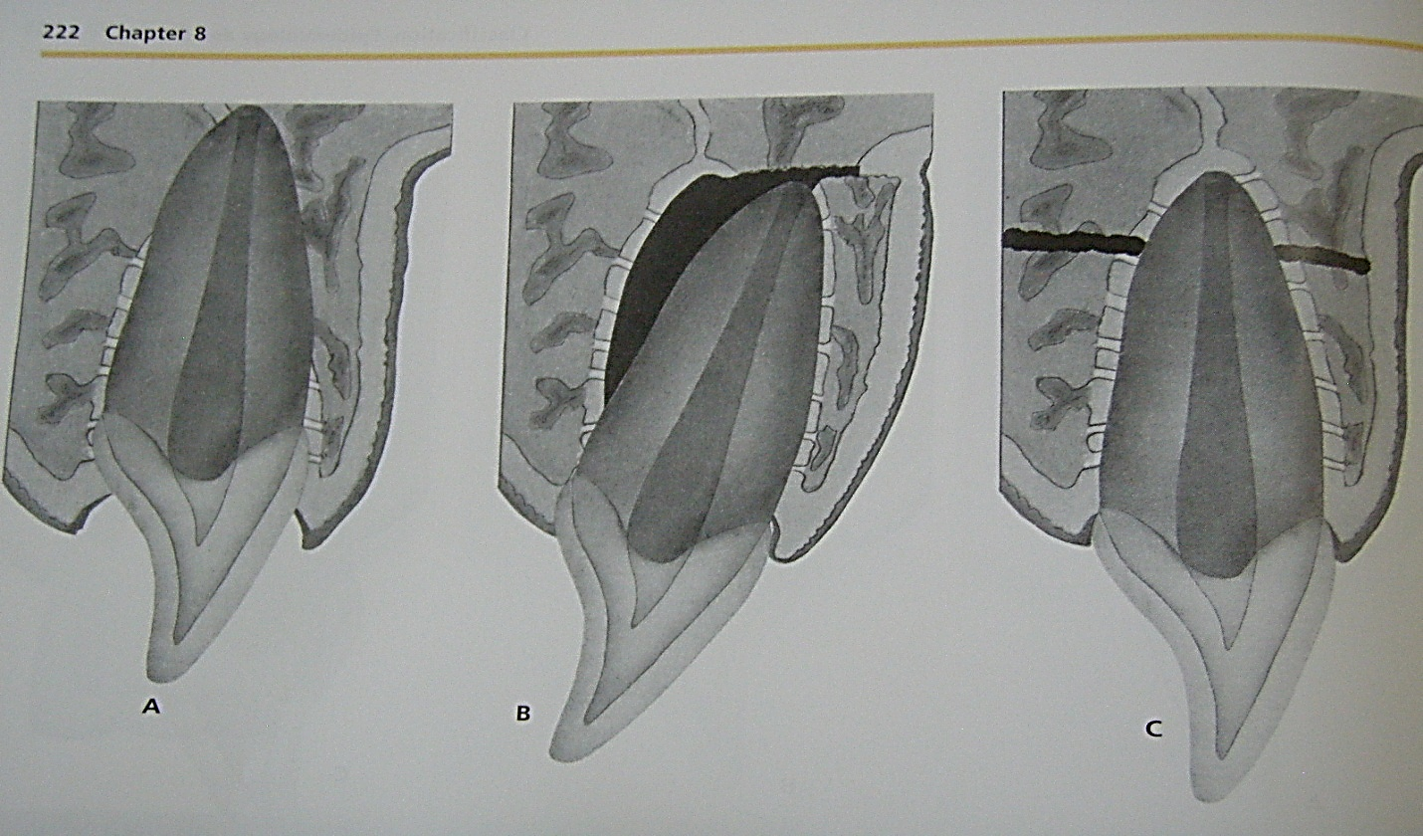
Clinical Classification By Andreasen (1981)
C) Injury to the supporting bone
N-502.40 N-502.60 | Comminution of maxillary alveolar socket Comminution of mandibular alveolar socket Crushing and compression of the alveolar socket. This condition is found concomitantly with during intrusive and lateral luxation injury to dentition

Slide 24
Clinical Classification By Andreasen (1981)
C) Injury to the supporting bone
N-502.40 N-502.60 | Fracture of the maxillary alveolar socket wall Fracture of the mandibular alveolar socket wall A fracture confined to the fascial or oral socket wall

Slide 25
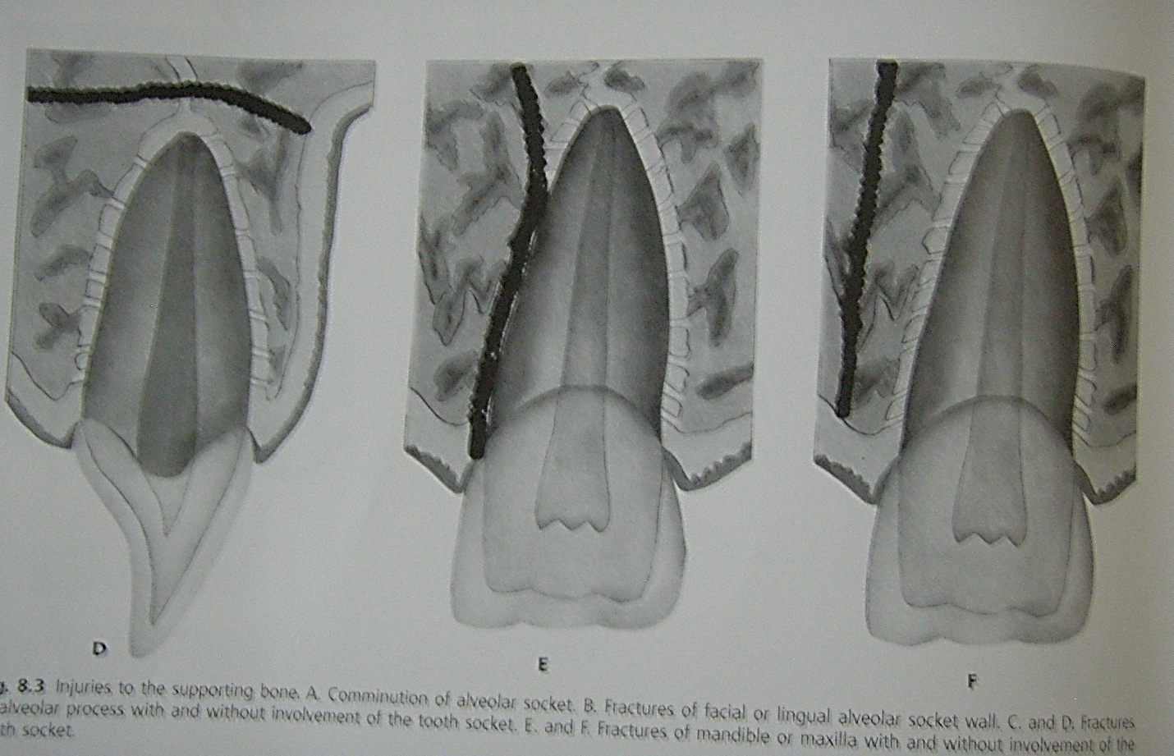
Clinical Classification By Andreasen (1981)
C) Injury to the supporting bone
N-502.40 N-502.60 | Fracture of Maxillary Alveolar process Fracture of Maxillary Alveolar process A Fracture of alveolar process which may or may not involving alveolar socket

Slide 26
Clinical Classification By Andreasen (1981)
C) Injury to the supporting bone
N 502.42 | Maxillary fracture Fracture involving base of maxilla and often alveolar process may or may not involve alveolar socket
N 502.61 | Mandibular fracture Fracture involving mandible, often alveolar process. The Fracture may or may not involve alveolar socket.

Slide 27
Clinical Classification By Andreasen (1981)
D) Injuries to gingiva or oral mucosa

Slide 28
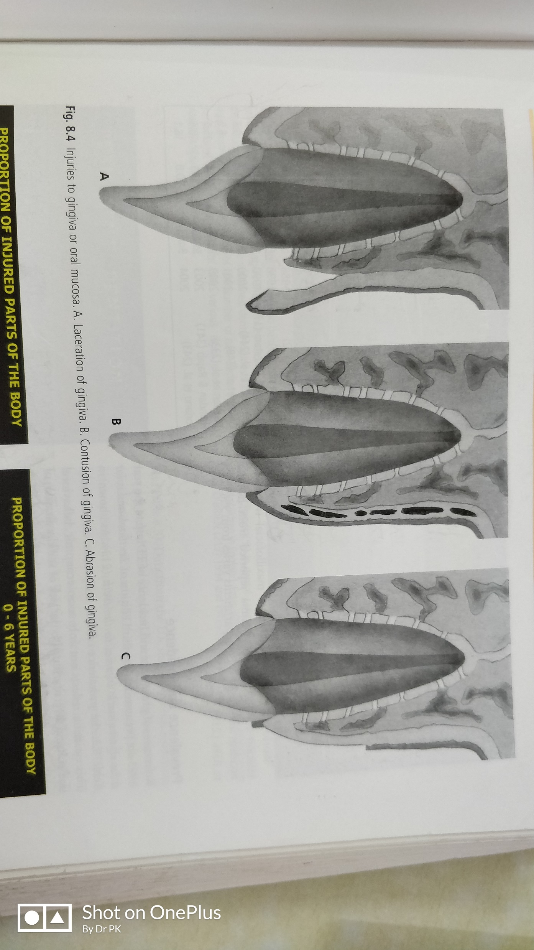
Clinical Classification By Andreasen (1981)
D) Injuries to gingiva or oral mucosa
S 01.50 | Laceration of gingiva or oral mucosa A shallow or deep wound in mucosa resulting from a tear, and usually produced by a sharp object.

Slide 29
Clinical Classification By Andreasen (1981)
D) Injuries to gingiva or oral mucosa
S 00.50 | Contusion of gingiva or oral mucosa A bruise usually produced by impact from a blunt object and not accompanied by a break in the continuity of mucosa; usually causing submucosal hemorrhage.

Slide 30
Clinical Classification By Andreasen (1981)
D) Injuries to gingiva or oral mucosa
S 00.50 | Abrasion of gingiva or oral mucosa A superficial wound produced by rubbing or scraping of mucosa leaving a raw bleeding surface.

Slide 31
WHO recently (1993) has recommended Andreasen’s classification following only injuries to dental hard tissues and periodontal tissue in WHO classification of trauma to anterior teeth

Slide 32



Thank You

