Slide 1


Isolation in Pediatric Dentistry
Dr Seema Bargale
Professor and Guide

Slide 2
Introduction
Used to isolate a tooth or teeth from the oral environment and to prevent migration of fluids or foreign objects into or out of the operative field
1864, New York City – S.C Barnum, introduced rubber dam
Providing a dry, visible and clean operative field
Rubber dam can be defined as a flat thin sheet of latex/non-latex that is held by a clamp and frame which is perforated to show the tooth/teeth to protrude through the perforations while all other teeth are covered and protected by sheet.

Slide 3
Advantages
Moisture control, dry field, aseptic
Prevents aspiration
Disadvantages
Patient acceptance
Trauma to tissues
Accessibility
Improved material properties
Latex allergy
Frame causes indentations

Slide 4

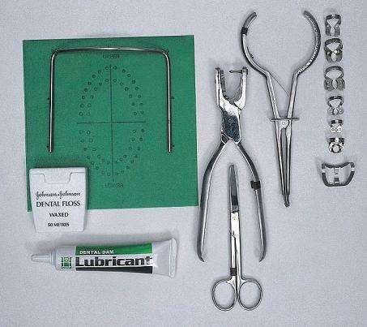
RUBBER DAM EQUIPMENT
Rubber dam punch
Rubber dam clamps
Rubber dam forceps
Rubber dam sheet
Rubber dam frame

Slide 5



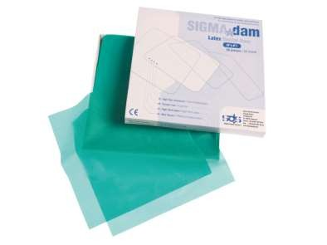
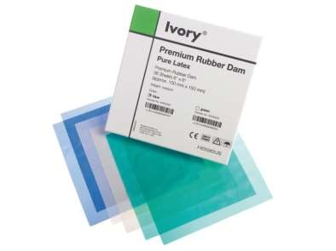
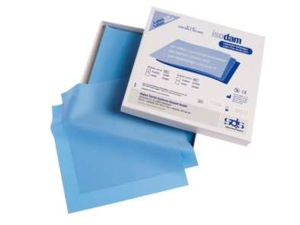
RUBBER DAM SHEET
Rubber dam sheet is normally available in sizes 5x5 inches, 6x6 inches squares in green or black color
It is available in three thickness i.e light , medium, heavy

Slide 6
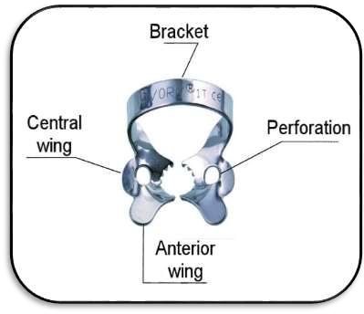
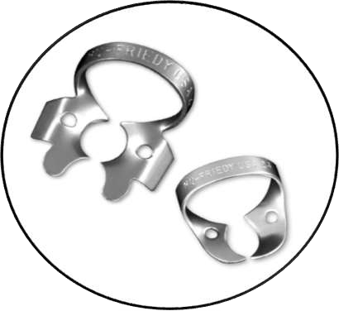
RUBBER DAM CLAMPS
Rubber dam clamps, to hold the rubber dam onto the tooth are available in different shapes and sizes
Clamps mainly serve two functions :
  They anchor the rubber dam to the tooth
  Help in retracting the gingiva
Classification of Rubber Dam Clamps
On the basis of jaw design :
  Bland 2) Retentive
On the basis of material used :
  Metallic 2) Nonmetallic/plastic

Slide 7


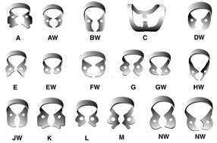



Usually identified by the jaws, which are flat and point directly towards each other
They can be used in fully erupted tooth where cervical constriction prevents clamp from slipping off the tooth
BLAND CLAMPS
Provides retention by providing four-point contact with the tooth
RETENTIVE CLAMPS

Slide 8


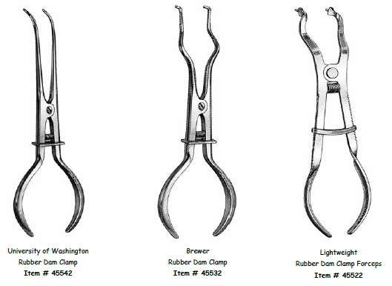
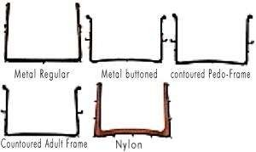
RUBBER DAM FORCEPS
Used to carry the clamp to the tooth
They are designed to spread the two working ends of the forceps apart when the handles are squeezed together
RUBBER DAM FRAME
It supports the edges of rubber dam
They are available in either metal or plastic
It improves accessibility to the isolated

Slide 9
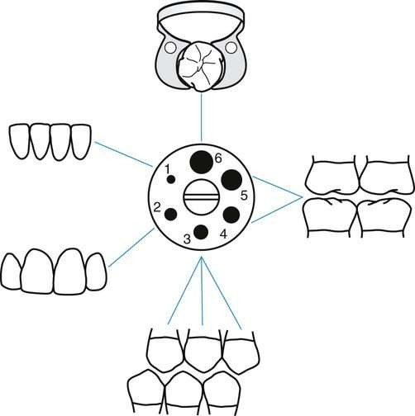
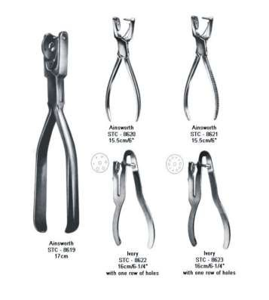
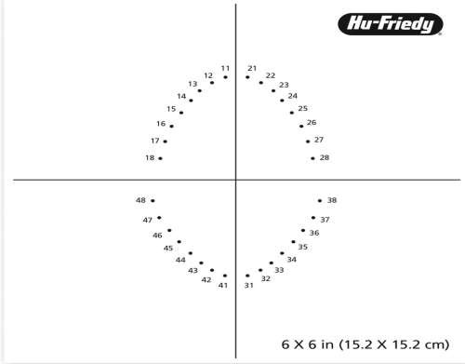
Used to make the holes in the rubber sheet through which the teeth can be isolated
The working end is designed with a plunger
on one side and a wheel on the other side
RUBBER DAM PUNCH
RUBBER DAM TEMPLATE
An inked rubber stamp which helps in marking the dots on the sheet according to position of the tooth
Holes should be punched according to arch and missing teeth

Slide 10
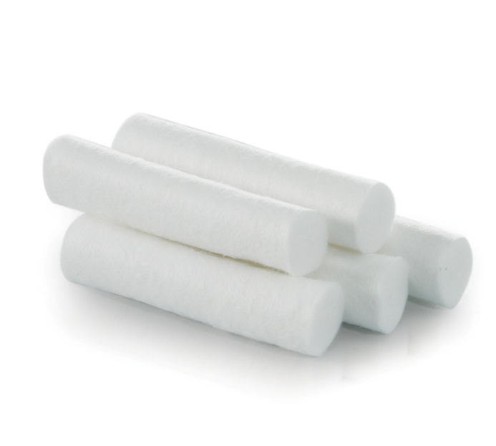
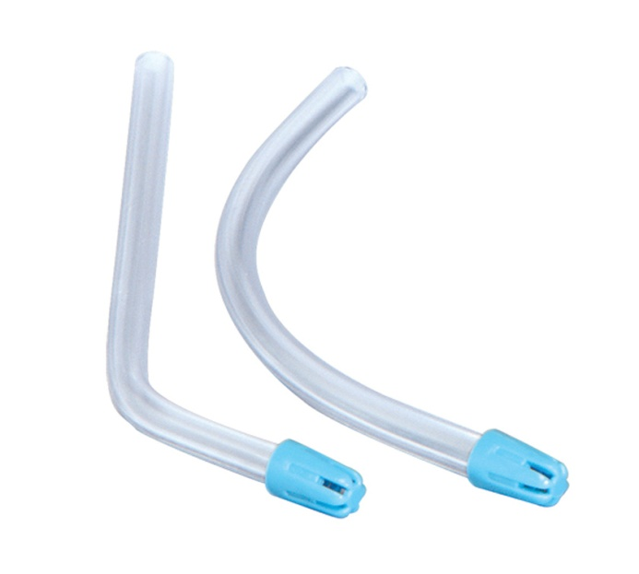
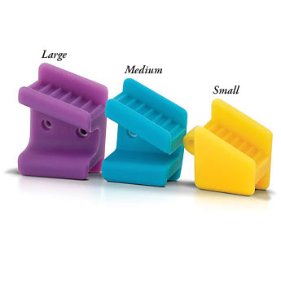
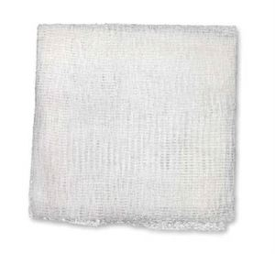
Other isolation methods:
Suction tips
Cotton Rolls
Gauze piece
Mouth props

Slide 11
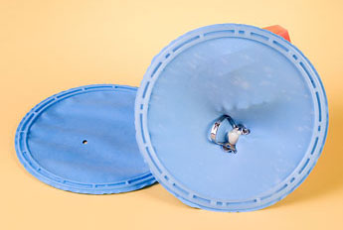
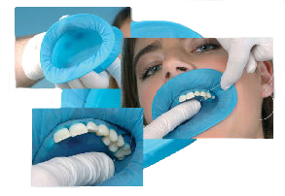
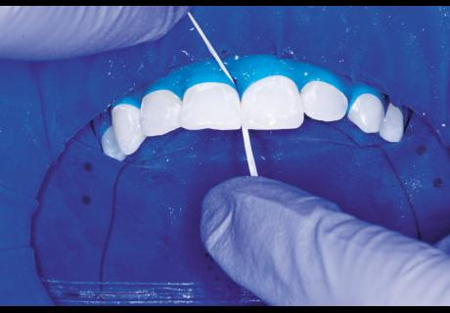
Insta dam
Recent advances:
  Quick dam or insta dam
  Optra dam
  Split dam technique
Optra dam
Edwina A. M. Kidd, Bernard G. N., Smith Timothy F, Watson H. M, Pickard. Pickard’s Manual of Operative Dentistry.8th edition. Oxford: University Press; 2003

Slide 12
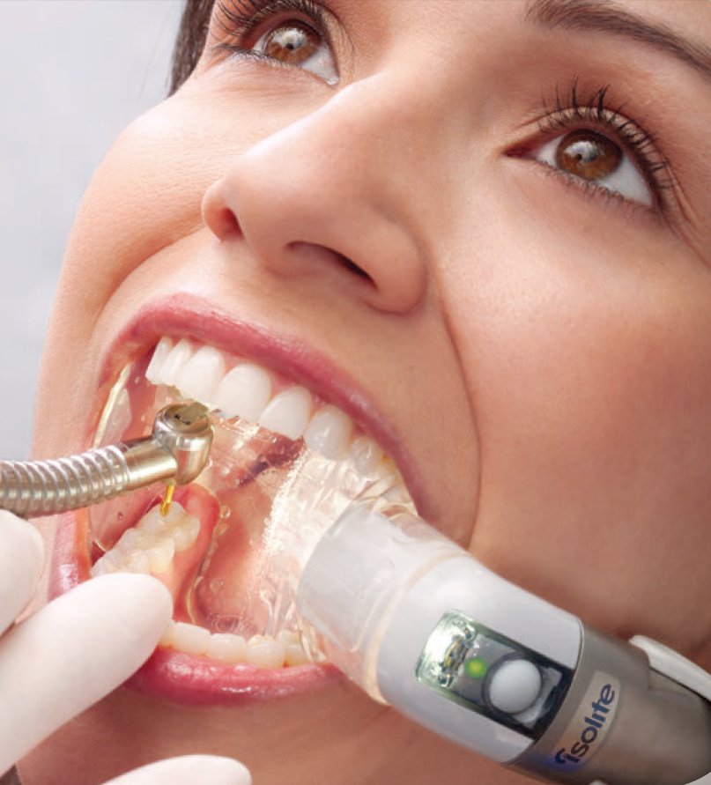
ISOLITE
Provides hands-free evacuation, retraction, and safety shielding, as well as illumination

Slide 13
Placement of rubber dam
Before placement of rubber dam, following procedures should be done:
Thorough prophylaxis of the oral cavity
Check contacts with dental floss
Check for any rough contact areas
Anesthetize the gingiva if required
Rinse and dry the operated field

Slide 14
Method I : Clamp placed before rubber dam:
Select an appropriate clamp according to the tooth size
Tie a floss to clamp bow and place clamp on the tooth
Larger holes are required in this technique as rubber dam has to be stretched over the clamp.
Usually two or three overlapping holes are made.

Slide 15
Method II : Placement of rubber dam and clamp together:
Select an appropriate clamp according to tooth anatomy
Tie a floss around the clamp and check the stability
Punch the hole in rubber dam sheet
Clamp is held with clamp forceps and its wings are inserted into the punched hole

Slide 16
Both clamp and rubber dam are carried to the oral cavity and clamp is tensed to stretch the hole
Both clamp and rubber dam is advanced over the crown. First, jaw of clamp is tilted to the lingual side to lie on the gingival margin of lingual side
After this, the jaw of clamp is positioned on buccal side
After seating the clamp, again check stability of clamp
Remove the forceps from the clamp
Now, release the rubber sheet from wings to lie around the cervical margin of the tooth

Slide 17
METHOD III : Split dam technique:
Rubber dam is placed to isolate the tooth without the use of rubber dam clamp
Two overlapping holes are punched in the dam
Dam is stretched over the tooth to be treated and over the adjacent tooth on each side
Edge of rubber dam is carefully teased through the contacts of distal side of adjacent teeth

Slide 18
INDICATIONS:
  To isolate anterior teeth
  When there is insufficient crown structure
  When isolation of teeth with porcelain crown is required
  Dam is placed without using clamp

Slide 19
Removal of rubber dam
Before the rubber dam is removed, use water syringe and high volume evacuator to flush out all debris that collected during the procedure
Cut away tied thread from the neck of the teeth. Stretch the rubber dam facially and pull the septal rubber away from the gingival tissue and the tooth
Protect underlying soft tissue by placing a fingertip beneath the septum
Free the dam from the interproximal space, but leave the rubber dam over the anterior and posterior anchor teeth

Slide 20
Use the clamp forceps to remove the clamp
Once the retainer is removed, release the dam from the anchor tooth and remove the dam and frame simultaneously
Wipe the patient’s mouth, lips, and chin with a tissue or gauze to prevent saliva from getting on the patient’s face
Check for any missing fragment after procedure
If a fragment of the rubber dam is found missing, inspect interproximal area because pieces of the rubber dam left under the free gingiva can result in gingival irritation

Slide 21
Bibliography
Theodore M. Roberson, Harald 0. Heymann Edward J. Swift, Jr.Sturdevant’s Art and Science of Operative Dentistry. 5th edition. St. Louis: Mosby; 2006.
M. S. Duggal,M. E. J. Curzon,S. A. Fayle, K. J. Toynba. Restorative Techniques in Paediatric Dentistry: An Illustrated Guide to the Restoration of Extensive Carious Primary Teeth.2nd edition. CRC Press:2002.
M.E.J.Curzon, J.F.Roberts, D.B.Kennedy.Kennedy’s Paediatric Operative Dentistry.4th edition. Reed publishing house;1996.
Paul S. Casamassimo, Henry W. Fields Jr., Dennis J. McTigue, Arthur Nowak. Pediatric Dentistry: Infancy through Adolescence.5th edition. Saunders: Elsevier ; 2013
Nikhil Marwah. Textbook of Pediatric Dentistry. 4th edition. Jaypee Brothers Medical Publishers Private Limited;2018

