Slide 1


Traumatic Dental Injuries (TDI) to Anterior Teeth
Dr Pratik Kariya
  Associate Professor
  Dept of Pediatric and Preventive Dentistry
  K M Shah Dental College and Hospital, SVDU
  Vadodara, Gujarat

Slide 2
INTRODUCTION
Injury can be defined as an interruption in the continuity of tissues.
Traumatic injury can be defined as a damage to a part of body tissue due to external forces.
Traumatic Dental Injury (Dental trauma) is an impact injury to the teeth and/or other hard and soft tissues within and around the vicinity of the mouth and oral cavity.
It is usually sudden, circumstantial, unexpected, accidental and often requires emergency attention.

Slide 3
CLASSIFICATION

Slide 4
Robinowich Classification
1956
Classification of trauma to Primary Teeth

Slide 5
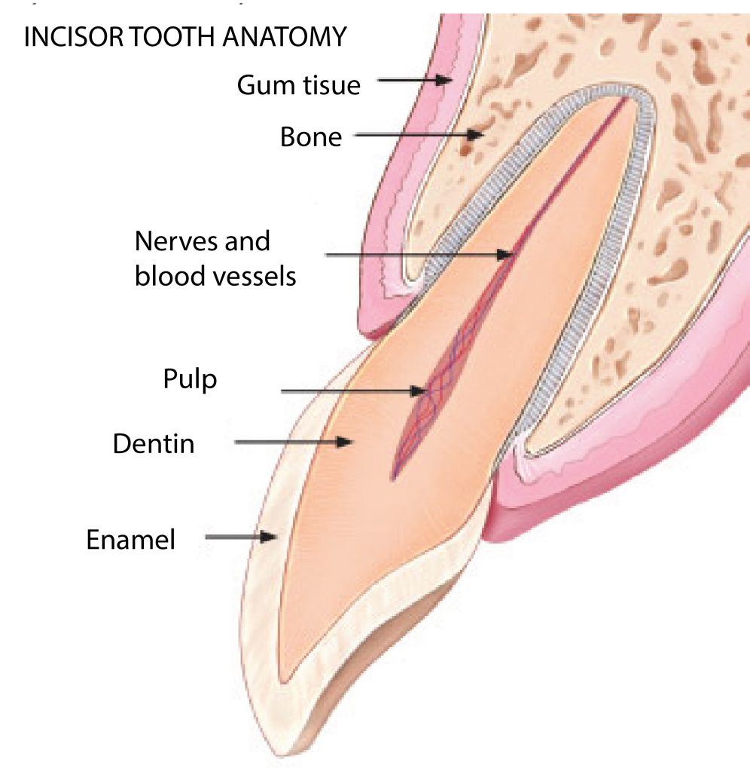
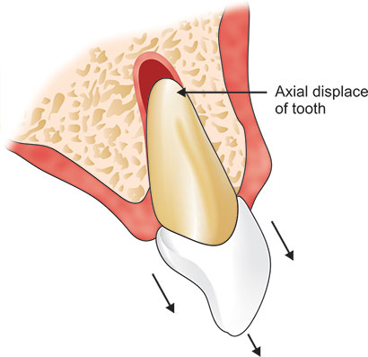
Robinowitch classification (1956)
Class I- Fracture of the enamel or slightly into the dentin
Class II- Fracture into the dentin
Class III- Fracture into the pulp
Class IV- Fracture of the root
Class V- Comminuted fracture
Class VI- Displaced teeth

Slide 6
Garcia Godoy Classification 1981
Classification of trauma to Primary Teeth

Slide 7
Garcia Godoy Classification 1981
0 - Enamel crack
1 - Enamel fracture
2 - Enamel dentin fracture without pulp exposure
3 - Enamel dentin fracture with pulp exposure
4 - Enamel dentin cementum fracture without pulp exposure
5 - Enamel dentin cementum fracture with pulp exposure

Slide 8
Garcia Godoy Classification 1981
6 - Root fracture
7 - Concussion
8 - Luxation
9 - Lateral displacement
10 - Intrusion
11 - Extrusion
12 – Avulsion

Slide 9



Thank You

