Slide 1


Principles of cavity preparation
Dr Seema Bargale
Professor and Guide

Slide 2
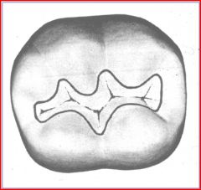
Principles of cavity preparation
Tooth preparation is defined as the mechanical alteration of a defective, injured, or diseased tooth to best receive a restorative material that will reestablish a healthy state for the tooth, including esthetic corrections where indicated, along with normal form and function.
- Sturdevant

Slide 3
Initial tooth preparation – the mechanical alterations of the tooth are extended to sound tooth structure (sound dentin or enamel supported by noncarious dentin) in all directions (facially, lingually, gingivally, incisally or occlusally, mesially, and distally) while adhering to a specific, limited pulpal or axial depth.
  Outline form and initial depth
  Primary resistance form
  Primary retention form
  Convenience form
Theodore M. Roberson, Harald 0. Heymann Edward J. Swift, Jr.Sturdevant’s Art and Science of Operative Dentistry. 4th edition. St. Louis: Mosby; 2002.

Slide 4
Final tooth preparation
  Removal of any remaining infected dentin and old restoration
  Pulp protection if needed
  Secondary resistance and retention form
  Procedure for finishing the external walls
  Final procedures
Theodore M. Roberson, Harald 0. Heymann Edward J. Swift, Jr.Sturdevant’s Art and Science of Operative Dentistry. 4th edition. St. Louis: Mosby; 2002.

Slide 5
Modifications of cavity preparation in primary teeth:
Class I
Narrow occlusal table – buccolingual dimension of cavity is reduced
0.5mm pulpal to DEJ
Maximum intercuspal width should be minimum
Walls should be parallel or slightly convergent
Outline form should limit to the central pit, its buccal and lingual grooves and triangular fossa
Pulpal floor should be slightly concave
Total depth of the cavity – 1.5 to 2.0 mm
All pits and fissures should be included
M. S. Duggal,M. E. J. Curzon,S. A. Fayle, K. J. Toynba. Restorative Techniques in Paediatric Dentistry: An Illustrated Guide to the Restoration of Extensive Carious Primary Teeth.2nd edition. CRC Press:2002.
Paul S. Casamassimo, Henry W. Fields Jr., Dennis J. McTigue, Arthur Nowak. Pediatric Dentistry: Infancy through Adolescence.5th edition. Saunders: Elsevier ; 2013

Slide 6
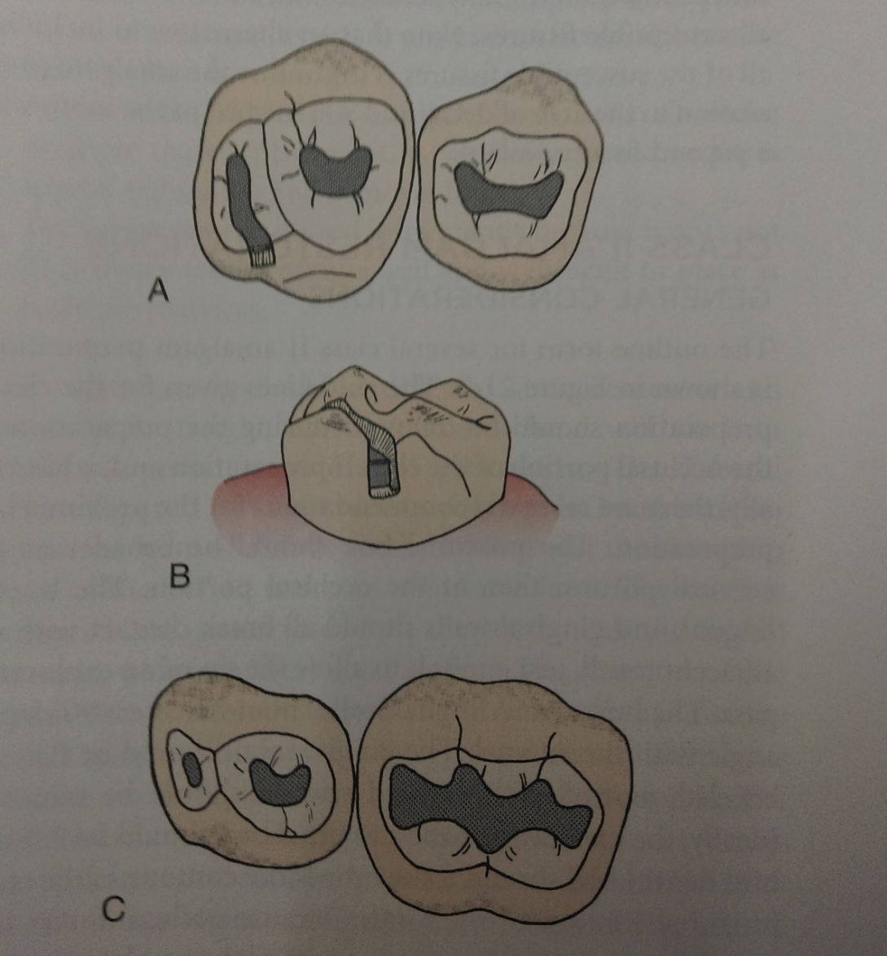
Common errors in Class I amalgam restorations
Preparing cavity too deep
Undercutting marginal ridges
Carving the anatomy of amalgam too deep
Undercarving that leads to fracture
Not including all susceptible fissures

Slide 7
Class II
Occlusal box
  1st molars – extend the occlusal box half way mesiodistally like dovetail
  Mandibular 2nd molar – all pits and fissures should be included
  Maxillary 2nd molars – nearest occlusal pit should be included
Sharp cavosurface angle
Rounded / beveled/ grooved axiopulpal line angle
Isthmus width – ½ the intercuspal width
Proximal box – greater width
More buccolingual extension of gingival seat / floor
Occlusal convergence
Axial wall should follow contour of external wall
No retention grooves
M. S. Duggal,M. E. J. Curzon,S. A. Fayle, K. J. Toynba. Restorative Techniques in Paediatric Dentistry: An Illustrated Guide to the Restoration of Extensive Carious Primary Teeth.2nd edition. CRC Press:2002.
Paul S. Casamassimo, Henry W. Fields Jr., Dennis J. McTigue, Arthur Nowak. Pediatric Dentistry: Infancy through Adolescence.5th edition. Saunders: Elsevier ; 2013

Slide 8
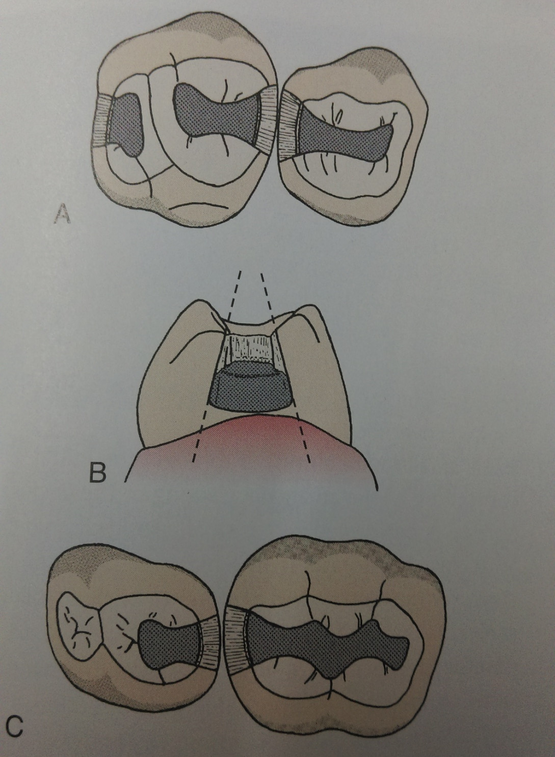
Common errors in Class II amalgam restorations
Failure to extend occlusal outline into all susceptible pits and fissures
Failure to follow the outline of the cusps
Isthmus cut too wide
Flare of the proximal wall too great
Angle formed by the axial, buccal and lingual walls too great
Gingival contact not broken
Axial wall not confirming to the proximal contour of the tooth

Slide 9
Class III restotrations:
Preparations should be kept very small, due to large pulp chamber
A slot preparation, with a short cavosurface bevel is recommended
In children with bruxism when such restorations are done, an additional mechanical retention is required
Retentive locks on facial and lingual surfaces and by beveling the cavosurface margin to increase the surface area
Restoring the distal surface of canines, a proximal box directed at a different angle towards the gingiva is essential
A dovetail maybe also placed on the facial surface for resin restorations and lingual dovetail for amalgam restoration
M. S. Duggal,M. E. J. Curzon,S. A. Fayle, K. J. Toynba. Restorative Techniques in Paediatric Dentistry: An Illustrated Guide to the Restoration of Extensive Carious Primary Teeth.2nd edition. CRC Press:2002.
Paul S. Casamassimo, Henry W. Fields Jr., Dennis J. McTigue, Arthur Nowak. Pediatric Dentistry: Infancy through Adolescence.5th edition. Saunders: Elsevier ; 2013

Slide 10
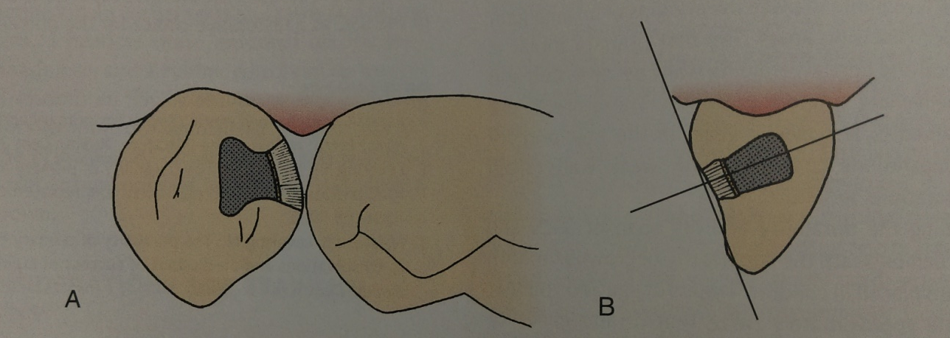
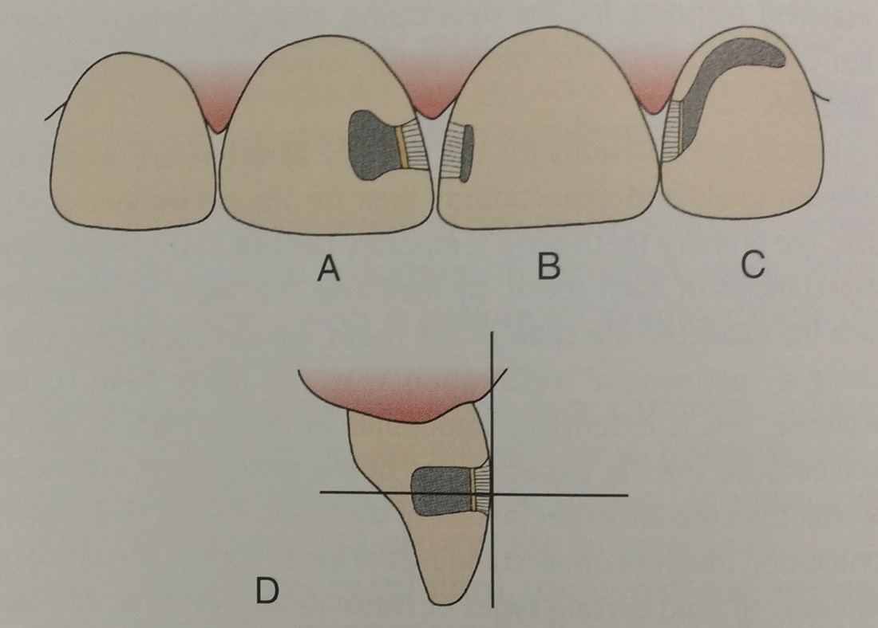

Slide 11
Class V restorations:
Pulpal wall should be convex, parallel to the outer enamel surface
Lateral walls are slightly flared near proximal surfaces to prevent undermining of the enamel
The final preparation should include all the carious tooth structure
A short bevel is placed around the entire cavosurface margin
M. S. Duggal,M. E. J. Curzon,S. A. Fayle, K. J. Toynba. Restorative Techniques in Paediatric Dentistry: An Illustrated Guide to the Restoration of Extensive Carious Primary Teeth.2nd edition. CRC Press:2002.
Paul S. Casamassimo, Henry W. Fields Jr., Dennis J. McTigue, Arthur Nowak. Pediatric Dentistry: Infancy through Adolescence.5th edition. Saunders: Elsevier ; 2013

Slide 12
Tunnel Preparation in class ii cavity
T he early proximal lesion on a posterior tooth will commence in enamel immediately below the contact area because this is where plaque will accumulate and mature.
As the lesion develops, some degree of breakdown and cavitation of the enamel will eventually occur, but this will remain confined to the area below the contact until it is quite advanced.
A zone of demineralized enamel surrounding the cavitation occurs, but as long as the surface is smooth, this remains capable of remineralization in the presence of fluoride.
The contact area may remain sound and the marginal ridge may be quite strong, provided the lesion is more than 2.5 mm below the crest of the marginal ridge (Wilson and McLean, 1988).

Slide 13
Access to the lesion through the occlusal surfaces should be limited to the extent required to achieve visibility and should be undertaken from an area that is not under direct occlusal load (Knight, 1984).
Fossa immediately next to medial marginal ridge is the most suitable position for entry.
Glass ionomer is best suited for such cavities as it readily flows into a small cavity and has the ability to remineralize the enamel margins and any dentin on axial wall.
Hasselrot (1998) reported a 50% survival rate of tunnel restorations in permanent teeth over a 6-year period.

Slide 14
Two variations are described:
Closed ‘tunnel’
Which leaves the demineralized approximal enamel intact
Open ‘tunnel’
Which is accessed from occlusal and exits through the approximal surface
Hugh Devlin. Operative Dentistry-A Practical Guide to Recent Innovations.1st edition. Springer. Germany:2006.
Nikhil Marwah. Textbook of Pediatric Dentistry.3rd edition. Jaypee Brothers Medical Publishers Private Limited;2014

Slide 15
Indications and contraindications
Indications | Contraindications
Use of tunnel preparation can be considered when small, proximal carious lesions necessitate restoration | Large carious lesion are diagnosed, where access is particularly difficult. Overlying marginal ridge is subjected to heavy occlusion or demonstrates a crack

Slide 16
Disadvantages
Highly technique sensitive, demanding careful control of the preparation by the operator
Angulations of preparation often passes close pulp
Visibility is decreased and caries removal is more uncertain -
Fragile marginal ridge
Hugh Devlin. Operative Dentistry-A Practical Guide to Recent Innovations.1st edition. Springer. Germany:2006.
Nikhil Marwah. Textbook of Pediatric Dentistry.3rd edition. Jaypee Brothers Medical Publishers Private Limited;2014

Slide 17
Slot cavity preparation
It is the creation of a small slot on the proximal aspect of posterior teeth. (Mount and Ngo 2000)
Indicated if there is a small lesion involving the area of or below the marginal ridge only in deciduous teeth.
The outline form will be dictated entirely by the extent of the breakdown of the enamel, removing only that which is friable and easily eliminated without applying undue pressure.
Retention will be through adhesion, so it is only necessary to clean the walls around the full circumference of the lesion, leaving the axial wall because it will be affected by dentin only.
Hugh Devlin. Operative Dentistry-A Practical Guide to Recent Innovations.1st edition. Springer. Germany:2006.
Nikhil Marwah. Textbook of Pediatric Dentistry.3rd edition. Jaypee Brothers Medical Publishers Private Limited;2014

Slide 18
Whenever required the contact area should be preserved while cavity preparation for maintaining a good contact area.
For such a lesion, resin composite may be a useful material because on many occasions there will be a useful material because on many occasions there will be an enamel margin around the full circumference.
However, glass ionomer is still a sound option because the occlusal load will not be great and the ion exchange will remain valuable both for adhesion and remineralization.

Slide 19
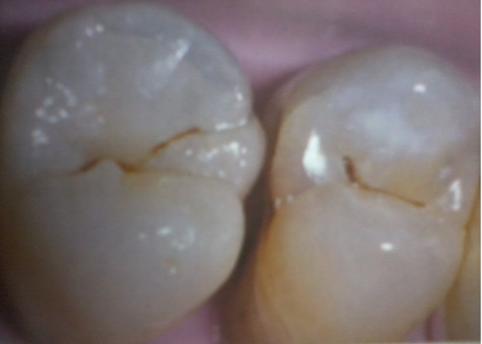
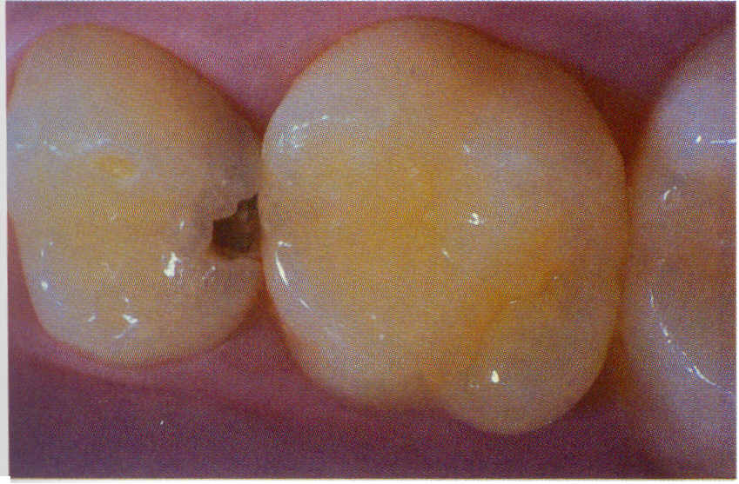
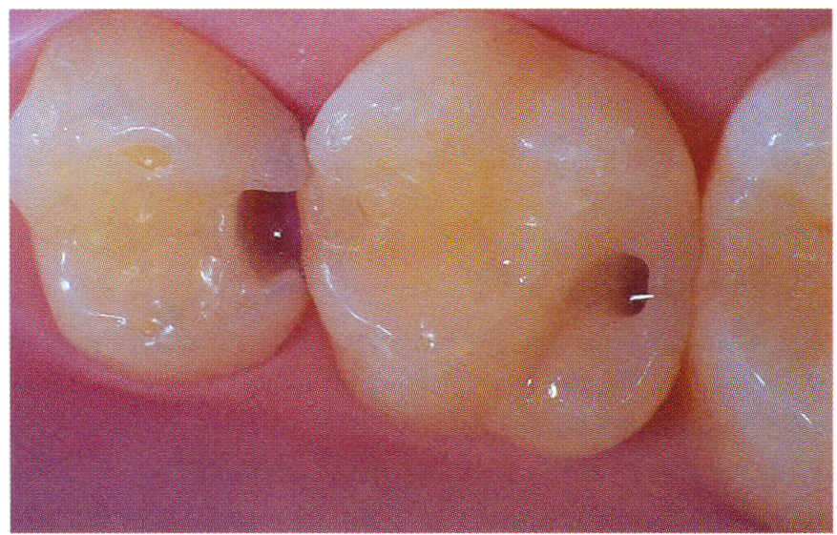
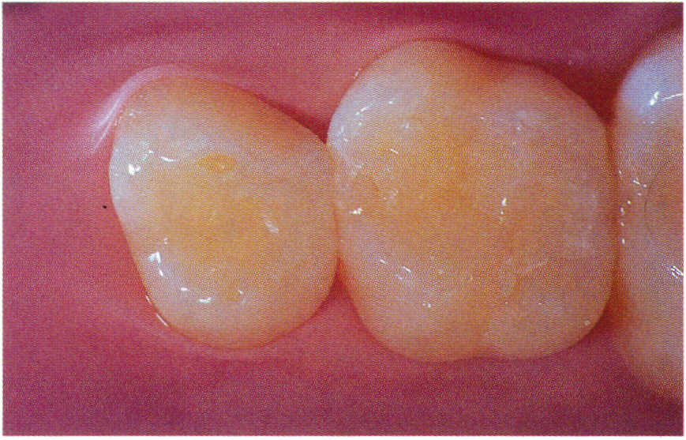
Fig. 1. Small carious lesion on the proximal surface of the first bicuspid
Fig. 2. Slot cavity preparation
Fig. 3. Finished slot cavity
Fig . 4 Resin modified GIC Restoration done

Slide 20
Proximal approach
This is a very conservative approach used when the proximal surface of a tooth becomes accessible at the time of cavity preparation in an adjacent tooth.
The lesion may have been revealed through radiographs or it may be noted only during cavity preparation.
The larger cavity in the adjacent tooth will normally need to be of reasonably generous proportions to allow room to maneuver, but when such an approach is possible, it leads to considerable conservation of natural tooth structure.
It is only necessary to remove enamel that is broken down beyond remineralisation.
Hugh Devlin. Operative Dentistry-A Practical Guide to Recent Innovations.1st edition. Springer. Germany:2006.
Nikhil Marwah. Textbook of Pediatric Dentistry.3rd edition. Jaypee Brothers Medical Publishers Private Limited;2014

Slide 21
Bibliography
Theodore M. Roberson, Harald 0. Heymann Edward J. Swift, Jr.Sturdevant’s Art and Science of Operative Dentistry. 4th edition. St. Louis: Mosby; 2002.
M. S. Duggal,M. E. J. Curzon,S. A. Fayle, K. J. Toynba. Restorative Techniques in Paediatric Dentistry: An Illustrated Guide to the Restoration of Extensive Carious Primary Teeth.2nd edition. CRC Press:2002.
Edwina A. M. Kidd, Bernard G. N., Smith Timothy F, Watson H. M, Pickard. Pickard’s Manual of Operative Dentistry.8th edition. Oxford: University Press; 2003
M.E.J.Curzon, J.F.Roberts, D.B.Kennedy.Kennedy’s Paediatric Operative Dentistry.4th edition. Reed publishing house;1996.
Paul S. Casamassimo, Henry W. Fields Jr., Dennis J. McTigue, Arthur Nowak. Pediatric Dentistry: Infancy through Adolescence.5th edition. Saunders: Elsevier ; 2013
Nikhil Marwah. Textbook of Pediatric Dentistry.3rd edition. Jaypee Brothers Medical Publishers Private Limited;2014

Slide 22
Vivekananda Reddy K,Vamsi Krishna D V V, MadhusudhanaK. A microleakage study of class v restorations using thee self-etching Adhesives and microfill compostie resin-an in vitro Stereo microscopic study.Annals and Essences of Dentistry. Oct– Dec 2013. Vol. V Issue 4
Fabiana BucholdzTeixeira Alves,Daniela Hesse, Tathiane Larissa Lenzi, Camila De Almeida Brandao Guglielmi, Alessandra Reis, Alessandro Dourado Loguercio,Thiago Saads Carvalho,Daniela Prócida Raggio. The Bonding of Glass lonomer Cements to Caries-affected Primary Tooth Dentin. Pediatr Dent 2013:35:320-4
Shilpa Gunjal, L Nagesh, Raju HG. Comparative evaluation of marginal integrity of glass ionomer and resin based fissure sealants using invasive and non-invasive techniques: An in vitro study. Indian Journal of Dental Research, 23(3), 2012: 320-25
Hübel S, Mejàre L. Conventional versus resin-modified glass ionomer cement for Class II restorations in primary molars. A 3-year clinical study. Int J Paediatr Dent 2003; 13: 2-8

Slide 23
Thank you

