Slide 1


Traumatic Dental Injuries (TDI) to Anterior Teeth
Dr Pratik Kariya
  Associate Professor
  Dept of Pediatric and Preventive Dentistry
  K M Shah Dental College and Hospital, SVDU
  Vadodara, Gujarat

Slide 2

INTRODUCTION
Injury can be defined as an interruption in the continuity of tissues.
Traumatic injury can be defined as a damage to a part of body tissue due to external forces.
Traumatic Dental Injury (Dental trauma) is an impact injury to the teeth and/or other hard and soft tissues within and around the vicinity of the mouth and oral cavity.
It is usually sudden, circumstantial, unexpected, accidental and often requires emergency attention.

Slide 3
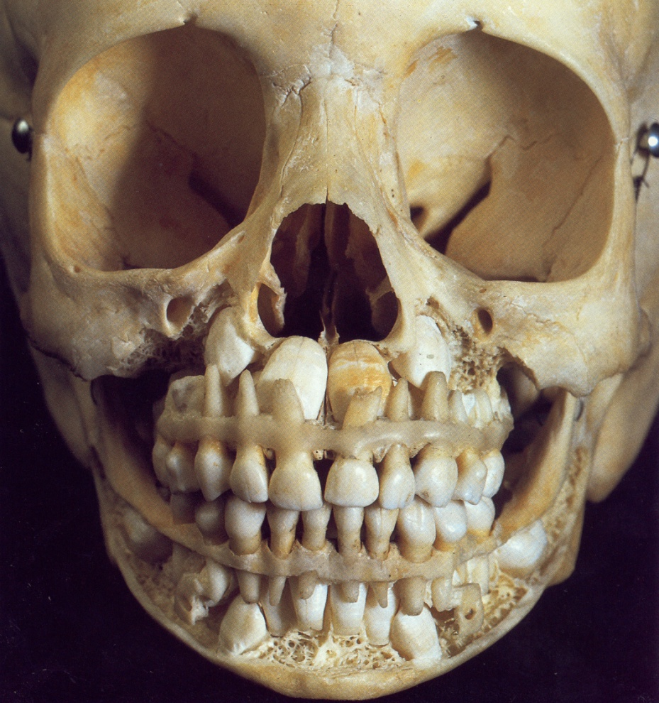

MANAGEMENT OF TRAUMATIC INJURIES TO THE
PRIMARY DENTITION

Slide 4
TREATMENT APPROACHES
The treatment strategy following injury to the primary teeth is dictated by concern for safety of the permanent dentition.
Relieve pain
Stop bleeding and clean the area
Restore dentition
In very young children – co-operation is the main problem
Advise parents regarding - analgesia
- soft diet
- oral hygiene
Recall the child after a week when he or she is less upset

Slide 5
Enamel crack
No specific treatment is required.
Patient is kept under observation

Slide 6
Enamel fracture
Small chip-
  1. Left as it is
  2. Edge smoothened off and topical fluoride applied
Larger chip- composite resin restoration

Slide 7
Enamel dentin fracture without pulp exposure
protect pulp- CaOH / GIC lining followed by composite restoration or using strip crown

Slide 8
Enamel dentin fracture with pulp exposure
Whole crown fracture
Coronal pulpotomy and strip crown
Pulpectomy and strip crown
Extraction

Slide 9
Enamel dentin cementum fracture without pulp exposure
• Often no treatment may be the most appropriate option in the emergency Situation.
If restorable and no pulp exposed, cover the exposed dentine with glass ionomer

Slide 10
Enamel dentin cementum fracture with pulp exposure
If restorable and the pulp is exposed, perform a pulpotomy (see crown fracture with exposed pulp) or root canal treatment, depending on the stage of root development and thelevel of the fracture.
If unrestorable, extract all loose fragments taking care not to damage
the permanent successor tooth and leave any firm root fragment in situ, or extract the entire tooth

Slide 11
Root fracture
Root fractures
Uncommon in small children
If coronal fragment stable- leave it alone and monitor
Root communicates with gingiva- poor prognosis, should be extracted
Best to extract coronal fragment and leave the root to resorb if not accessible to forceps.

Slide 12
Concussion
No treatment is needed.
• Observation.

Slide 13
Luxation
Luxation injuries
Slight injury- left as it is, advise soft diet and oral hygiene instructions
If the tooth does not show an improvement in mobility within 2 weeks- extraction

Slide 14
Lateral displacement
Displaced palatally- less then 2mm- reposition
- more than 2mm- extraction
If the tooth does not show an improvement in mobility within 2 weeks- extraction

Slide 15
Intrusion
Establish where they are in the alveolus and leave them alone
If less than ¾ of the crown intruded- allow to re-erupt, normally occurs in 2-4 months of injury
If more than ¾ of the crown intruded- still can re-erupt, careful monitoring required.
Damage to alveolus causing pain- extraction
Radiograph: anterior lateral radiograph should be taken to determine the position of primary tooth in relation to the permanent tooth
If very close or touching the permanent tooth- extraction
Complication: 1/3 of the re-erupted primary teeth undergo pulpal necrosis

Slide 16
Extrusion
Extrusive injuries in primary dentition cause interference in occlusion
Treatment
If extrusion is less than 1-2mm- leave them and monitor
If extruded more than 2mm- extraction
Should be monitored- after one week, after one month, three months, six months, one year and yearly, until exfoliation.
If periapical pathology occurs- extraction
Discoloration of primary teeth is not always an indicator of loss of vitality

Slide 17
Avulsion
Avulsion never attempt to reimplant due to danger of damaging the underlying permanent teeth

Slide 18



Thank You

