Slide 1
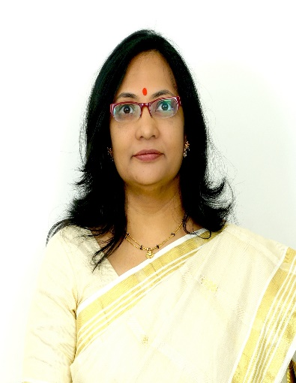

Recent Development In Pediatric Operative Dentistry
Dr Seema Bargale
Professor and Guide

Slide 2
Chemomechanical caries removal
An alternative to the conventional mechanical removal of caries is chemo mechanical method.
The need for local anesthesia is reduced or eliminated as there is little pain during the procedure.
It is an effective alternative for caries removal because it brings together atraumatic characteristics and bactericide / bacteriostatic action.
The chemicals used can be in the form of liquid (caridex) or gel (carisolv).

Slide 3
CARIDEX
Caridex was developed by CM Habib from a formula made of N-mono-chloroglycine and amino butyric acid.
It gained FDA approval in 1984.
It was initially introduced on the US market in 1985.
The system involved the intermittent application of preheated N-monochloro-DL-2-aminobutyric acid to the carious lesion.
The solution was claimed to cause disruption of collagen in the carious dentine, thus facilitating its removal.

Slide 4
The mechanism of softening involved chlorination of remaining partially degraded dentinal collagen and the conversion of hydroxyproline to pyrrole-2-carboxylic acid, which initiated disruption of the altered collagen fibers in the caries.
Disadvantages-
  Expensive
  Large quantity required
  Solution had to be heated
  Short shelf-life
  Hand instruments were not optimum

Slide 5
Carisolv
During the 1980s studies by Malmo, Huddinge at Chalmers Technical University in Goteborg were directed towards a more efficient and effective chemomechanical caries removal system than caridex.
Carisolv key difference to other products already in the market was the use of three amino acids – Lysine, leucine, and glutamic acid – instead of the aminobutyric acid.
These aminoacids counteracted the sodium hypochlorite aggressive behavior at the oral healthy tissues.

Slide 6
Constituents of carisolv:
  Syringe one: sodium hypochlorite (0.5%)
  Syringe two: three amino acids (glutamic acid, leucine, lysine)
  Gel substance: carboxymethlcellulose
  Sodium chloride / sodium hydroxide
  Available as single mix or multi mix syringes.
The amino acids and hypochlorite form high-pH chloramines (pH 12), which react with the denatured collagen in the carious dentin, allowing it to be removedmore easily.
The softened dentin is removed by scraping the surface with special hand instruments.

Slide 7
Advantages of carisolv
Three amino acids are incorporated instead of one, improve the interaction with the degraded collagen within the lesion, thus increasing the efficacy.
Carisolv has a higher viscosity, which allows for the application of higher concentrations of amino acids and sodium hypochlorite.
The solution does not need to be heated, or applied through a pump mechanism.
The increased viscosity of carisolv enhances precision placement.
The overall stability is increased, giving an improved shelf life.

Slide 8
Papain gel
In 2003, a research project in Brazil led to the development of a new formula to universalize the use of chemo-mechanical method for caries removal and promote its use in public health.
The new formula was commercially known as papacarie.
It is basically composed of Papain, chloramines, toluidine blue, salts, thickening vehicle, which together are responsible for the papacarie’s bactericide, bacteriostatic and anti-inflammatory characteristics.
Papain comes from the latex of the leaves and fruits of the green adult papaya.

Slide 9
Papain promotes:
Chemical debridement
Granulation and epithelialization, which hastens the phases of cicatrization
Stimulation of the tensile strength of the scars.
Since Papain can digest only dead cells, it acts breaking the partially degraded collagen molecules, contributing to the degradation and elimination of the fibrin “mantle” formed by the carious process.
Right after the degradation, oxygen is freed, bubbles appear on the surface, and a blearing of the gel is thus noted

Slide 10
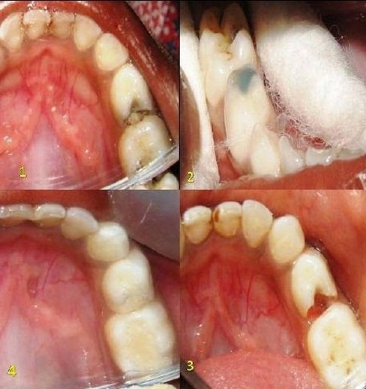
1. Arrow indicating proximocclusal carious lesion
2. Isolation and application of Papain Gel
3. Caries had been removed
4. Arrow showing filled cavity with composite

Slide 11
Caries detecting dyes
In caries removal during cavity preparation, only the soft, heavily infected outer dentin must be removed, whereas the demineralized, uninfected inner dentin should be left.
Caries-detecting dyes (e.g., 1.0% acid red in propylene glycol) have been developed to assist the dentist in distinguishing between the two types of caries (Fusayama 1988).
Caries-detecting dyes have no place in the detection of occlusal fissure caries, primarily because these dyes stain the normal dentin at the enamel dentin junction (Kidd et al.1989).
False-positive diagnoses are also likely because these dyes will stain food debris and other organic material in the fissure.

Slide 12
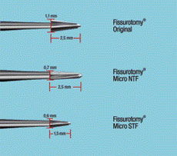
Micro preparation burs
The Fissurotomy Bur is designed to allow exploration of the fissure with minimal removal of enamel.
It is 1.5–2.5mminlength and tapers to a fine carbide tip so that only 1/6th to 1/10th of the intercuspal width is removed.
Other burs such as the Brassler 889M-007 bur allow minimally invasive preparation of the tooth occlusal surface, and where slightly wider preparation is required, the Micro-Diamond 838M-007 can be used.

Slide 13
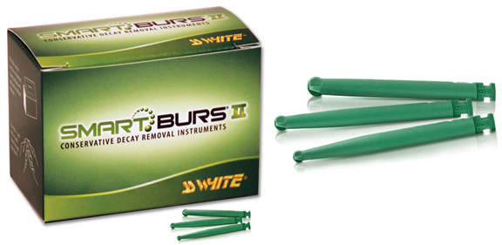
Polymer burs
Boston (2000) has described a polymer bur that only removed softened and infected dentin and not normal dentin.
The cutting elements of the bur were made of a softer polyamide polymer material than the traditional carbide bur.
The bur blades are designed to primarily remove carious dentin by plowing, unlike in the conventional burs the dentin forms chips due to orthogonal cutting

Slide 14
Air abrasion
This technique uses a stream of small aluminum oxide particles, created using pressurized air, that impact the caries and abrade it away.
One of the main advantages of the air abrasion technique is that there is less pain associated with cavity preparation than with conventional bur preparation, perhaps because there is less noise and vibration.
There is little tactile sensation when removing softened carious dentin as the instrument does not touch the tooth, so the indications for use of this instrument tend to be limited to minimal cavity preparation and the removal of surface enamel stain.

Slide 15
Disadvantages:
The abrasive particles tend to remove normal dentin more easily than the softer, carious dentin.
Air abrasion of enamel does not provide enough micromechanical roughening of enamel for the retention of composite resins (Jahn et al. 1999).
It can easily cause iatrogenic damage by removing exposed cementum and root dentin in teeth affected by gingival recession and periodontal disease

Slide 16
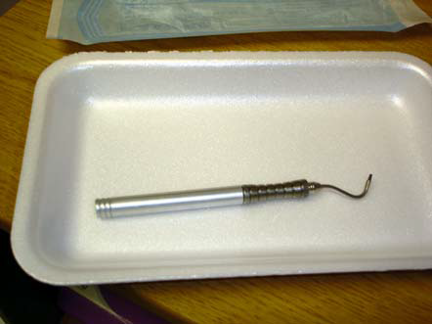
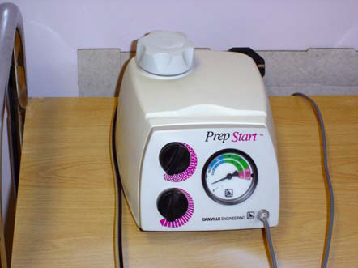
Atkinson et al. (1984) found that their air-powder abrasive system removed a mean depth of 637μm of root structure in 30s of exposure time.
Further research aimed at identifying less abrasive powders is ongoing (Petersilka et al. 2003), because softer particles might be more effective in removing carious dentin more selectively.

Slide 17
Lasers
Early use of infrared lasers, such as carbon dioxide (10.6μmwavelength) and ruby lasers, to remove carious dentin resulted in slow removal of tissue and excessive heat transfer to the dental pulp.
Lasers have achieved success with removal of hyperplastic soft tissue, but sufficient research has now established the use of other laser technologies in restorative dentistry.
The erbium yttrium aluminum garnet (erbium:YAG, 2.94μm wavelength) laser has received much research interest, and in 1997, the FDA approved the erbium:YAG laser for caries removal in the USA.

Slide 18
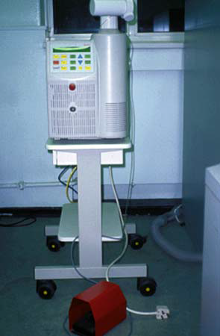
The Fidelis erbium:YAG laser is the commercially available lasers for dental use, but it is a rather large device with settings for varying the cutting speed.
This might be expected to improve the adaptation and retention of adhesively retained resin composites to the tooth.
Erbium:YAG preparation of enamel must be followed by conventional etching with phosphoric acid if adequate adhesion of resin composites to enamel is to be achieved.(Otsuki et al. 2002)

Slide 19
Disadvantages
The erbium:YAG laser energy ablates tissues by being absorbed by water, causing a rapid rise in temperature and pressure, and resulting in a microexplosion of dentin and enamel.
Thus a water mist should be used which prevents a high rise in temperature, washes away ablated tissue, and improves the rate of ablation.
Focusing of the erbium:YAG laser beam is difficult due to pooling of the water spray on the tooth surface, and this defocusing effect results in a marked reduction in ablation efficiency.

Slide 20
The evidence would suggest that the erbium:YAG laser can safely remove dentin and enamel in a cavity preparation provided water cooling and optimal laser parameters are used.
Preparing undercut surfaces is not possible as tissue can only be removed when it is visible in the operator’s line of sight.
Further developments in laser technology are possible with lasers having femtosecond pulse duration (Kohns et al. 1997).

Slide 21
Ozone therapy
Dental caries is caused by bacteria, and as ozone will kill certain bacteria,many studies have investigated whether ozone is effective in arresting the progression of caries.
This treatment modality recommends ozone as a disinfectant gas to eliminate bacteria from occlusal caries (up to 2mm in depth), root carious lesions, and pit and fissure lesions, often with the absence of further operative treatment.
The carious lesion is encouraged to remineralize over 4 weeks using fluoride and mineral mouthwashes, toothpaste, and sprays.
Baysan and Lynch (2004) found that ozone application for 10–20s eliminated most of the microorganisms found in primary root caries lesions.

Slide 22
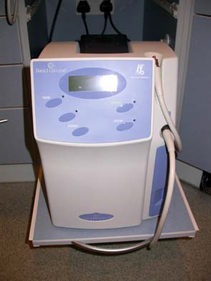
With the Heal Ozone system (KaVo Dental, Biberach, Germany), ozone gas is delivered via a special handpiece that fits over and bathes the tooth.

Slide 23
Bibliography
Hugh Devlin. Operative Dentistry-A Practical Guide to Recent Innovations.1st edition. Springer. Germany:2006.
M. S. Duggal,M. E. J. Curzon,S. A. Fayle, K. J. Toynba. Restorative Techniques in Paediatric Dentistry: An Illustrated Guide to the Restoration of Extensive Carious Primary Teeth.2nd edition. CRC Press:2002.
Edwina A. M. Kidd, Bernard G. N., Smith Timothy F, Watson H. M, Pickard. Pickard’s Manual of Operative Dentistry.8th edition. Oxford: University Press; 2003
M.E.J.Curzon, J.F.Roberts, D.B.Kennedy.Kennedy’s Paediatric Operative Dentistry.4th edition. Reed publishing house;1996.
Paul S. Casamassimo, Henry W. Fields Jr., Dennis J. McTigue, Arthur Nowak. Pediatric Dentistry: Infancy through Adolescence.5th edition. Saunders: Elsevier ; 2013
Nikhil Marwah. Textbook of Pediatric Dentistry.3rd edition. Jaypee Brothers Medical Publishers Private Limited;2014

Slide 24
THANK YOU

