Slide 1

Dr Pratik Kariya
  Associate Professor
  Dept of Pediatric and Preventive Dentistry
  K M Shah Dental College and Hospital, SVDU
  Vadodara, Gujarat
cleft lip and cleft palate

Slide 2

cleft lip and cleft palate
Classifications

Slide 3
Terminologies Regarding cleft lip and palate classification
Cleft: Split or divided; refers to muscle, skin, and bone.
Cleft lip: Congenital deformity of upper lip that varies from a notching to a complete division of the lip; any degree of clefting can exist.
Cleft palate: A congenital split of palate that may extend through the uvula, soft palate, and/or into hard palate; lip may or may not involve.

Slide 4
Classification of cleft lip and palate
Davis and Ritchie’s Classification (1922)
Veau’s Classification (1931)
Kernahan’s and Stark’s Stripped “Y” Classification (1971)

Slide 5
Davis and Ritchie’s Classification
(1922)

Slide 6
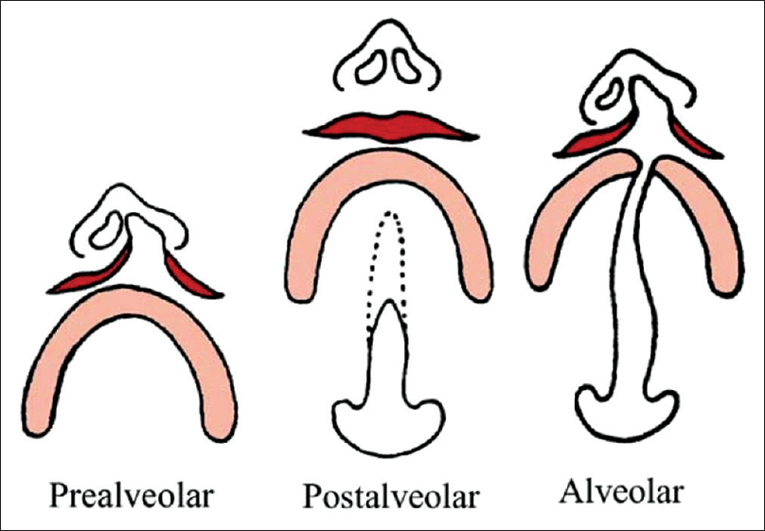
Classification By Davis and Ritchie’s
(1922)
Group 1 | Prealveolar cleft: Lip clefts only with subdivision, unilateral medial, and bilateral.

Slide 7
Classification By Davis and Ritchie’s
(1922)
Group 2 | Postalveolar cleft: Degree of involvement of the soft and hard palate could specified up to the alveolar ridge, submucous clefts also included/

Slide 8
Classification By Davis and Ritchie’s
(1922)
Group 3 | Alveolar cleft: Complete clefts of palate, alveolar ridge, with subdivision of unilateral, medial, and bilateral.

Slide 9
Veau’s Classification
(1931)

Slide 10
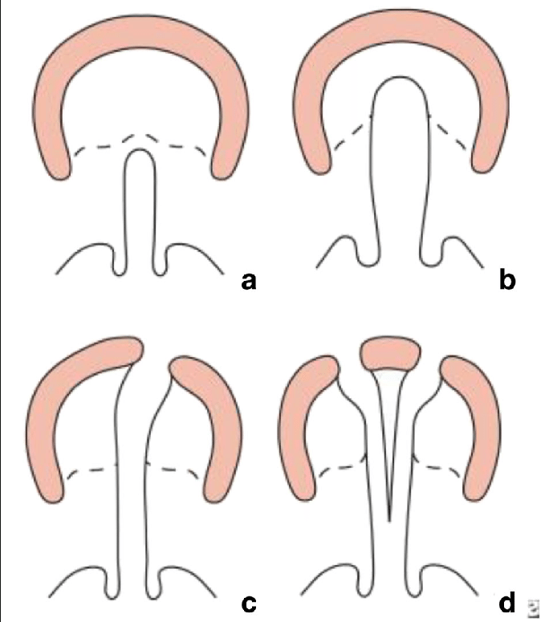
Classification By Veau’s Classification
(1931)
Group 1 | Cleft of soft palate only

Slide 11
Classification By Veau’s Classification
(1931)
Group 2 | Cleft of hard and soft palate to the incisive foramen

Slide 12
Classification By Veau’s Classification
(1931)
Group 3 | Complete unilateral cleft of the soft and hard palate and lip and alveolar ridge on one side.

Slide 13
Classification By Veau’s Classification
(1931)
Group 4 | Complete bilateral cleft of the soft, hard palate and lip and alveolar ridge on both sides.

Slide 14
Kernahan’s and Stark’s Stripped “Y” Classification (1971)

Slide 15
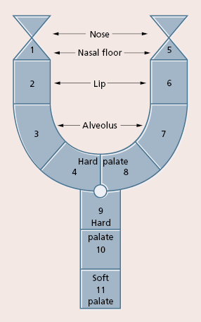
Kernahan’s and Stark’s Stripped “Y” Classification (1971)
Number | Area involved
1 & 5 | Cleft involving Nasal Floor
2 & 6 | Cleft involving Lip
3 & 7 | Cleft involving Alveolus
4 & 8 | Cleft involving Hard Palate anterior to Incisive Foramen
9 & 10 | Cleft involving Hard Palate posterior to Incisive Foramen
11 | Cleft Involving Soft Palate

Slide 16




Thank You

