Slide 1
Chronic inflammatory Demyelinating
Polyradiculoneuropathy
SEMINAR
Faculty : Dr. C. Rathore

Slide 2
SCHEME
  Definition
  Pathogenesis
  Diagnostic criteria
  Treatment
  IVIG
  Steroids
  PLEX
  Other agents

Slide 3
James Austin 1st reported 2 cases of recurrent ACTH responsive polyneuropathy
Brain,1958
Dyck PJ et al coined “CIDP”
Ann Neurol,1982,11:136

Slide 4
DEFINITION
Chronic inflammatory demyelinating polyradiculoneuropathy (CIDP) is an acquired demyelinating disease of the peripheral nervous system (PNS), characterized by relapsing or progressive proximal and distal muscle weakness with possible sensory loss.

Slide 5
PATHOGENESIS
CIDP is an autoimmune disorder → myelin the likely target for the immune response
In fact, CIDP is considered the peripheral counterpart of MS because of similarities between the two diseases
relapsing or progressive disease course
focal demyelination and concomitant axon damage
immune-mediated pathophysiology

Slide 6
The precise mechanisms that lead to demyelination of peripheral nerves in CIDP are not known
Demyelination → mediated by both cellular and humoral immune factors

Slide 7
Experimental autoimmune neuritis (EAN)
Animal model ( rat &mice) for immune mediated neuropathy
EAN can be induced by:-
  active immunization with PNS proteins and glycolipids
  injection of primed autoreactive T cells
  by non-neural antigens (e.g., ovalbumin).
  immunization with myelin proteins such as P2 basic protein, P0 glycoprotein, and peripheral myelin protein 22 (PMP22).

Slide 8
Cellular immune factors
Inflammatory infiltrates on nerve biopsy, consisting primarily of macrophages and T cells
suggest that a T-cell-mediated delayed hypersensitivity reaction directed toward myelin antigens is a probable cause of inflammatory tissue damage in CIDP.

Slide 9
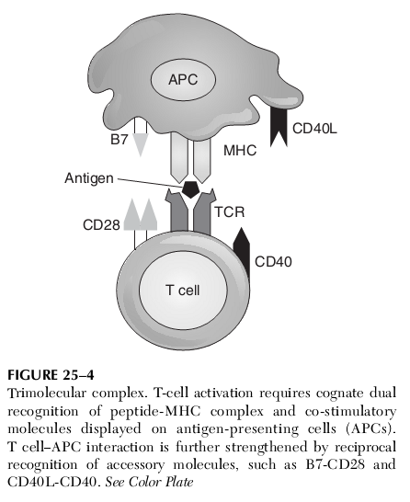
Antigen presentation – First step
T-cell activation and induction require two signals from APC (e.g., macrophages).
  The first signal is binding of the T-cell receptor to its antigen-major histocompatibility complex (MHC) ligand
  the second is simultaneous delivery of a co-stimulatory signal to the APC.

Slide 10
COSTIMULATORY SIGNALS
family of B7 proteins
  B7-1 (CD80)
  B7-2 (CD86)
  their counter-receptors, CD28 and CTLA-4, on T cells
There is evidence of dysfunction in this family of co-stimulatory signals in CIDP.

Slide 11
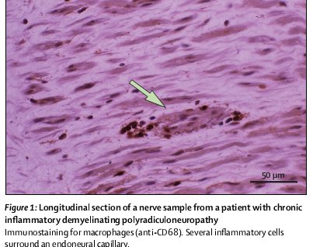
ROLE OF MACROPHAGES
Endoneurial macrophages →identified by their expression of the CD68 molecule

Slide 12
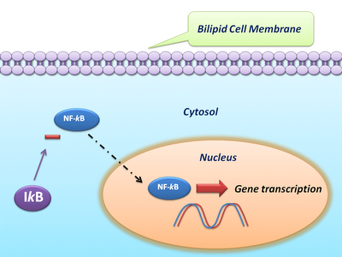
ROLE OF nuclear factor (NF)-kB
Macrophages contain - (NF)-kB →normally sequestered in the cytoplasm
On receptor-mediated activation→ NF-kB translocates to the nucleus and binds to the promoters of genes → in macrophage activation → release of adhesion molecules, proinflammatory cytokines, and reactive oxygen intermediates.

Slide 13
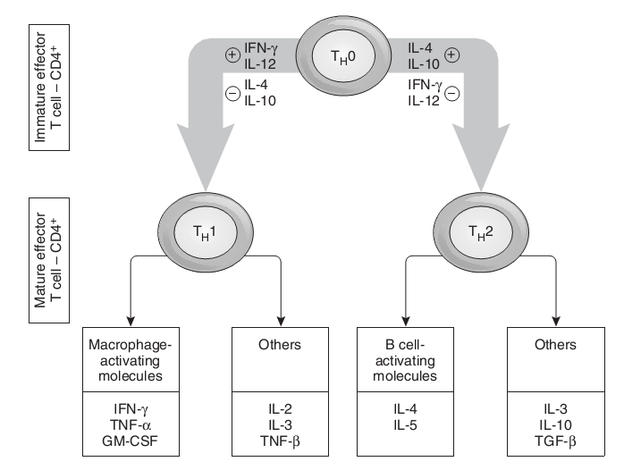
T cells
Pro-inflammatory
anti-inflammatory

Slide 14
T cells….
T cells secrete matrix metalloproteinases especially MMP-2 and MMP-9, which will break down endoneurial proteins
inflammatory T cells are eliminated by apoptosis, either during the natural disease course or after treatment with GCs
suppressor T-cell activity →defective

Slide 15
CHEMICAL MEDIATORS
cytokines, chemokines, and adhesion molecules is postulated to play a role in the breakdown of the blood–nerve barrier
TNF alpha → toxic effects on myelin, Schwann cells and endothelial cells

Slide 16
SCHWANN CELLS
the adhesion molecule CD58 is expressed on Schwann cells
CD58 has been shown to interact with CD2 on T cells and natural killer (NK) cells, and increased expression of this adhesion molecule correlates with increased production of IFNγ, IL-2, and TNFα
Van Rhijn I, Van den Berg LH, Bosboom WMJ, Otten HG, Logtenberg T. Expression of accessory molecules for T-cell activation in peripheral nerve of patients with CIDP and vasculitic neuropathy. Brain 2000;123:2020-2029

Slide 17
HUMORAL IMMUNE FACTORS
Antibodies may bind to macrophages via their Fc portion, activating phagocytosis and release of inflammatory mediators toward the myelin sheath.
Antibodies against PMP22 were detected in 52% of patients with GBS, 35% with CIDP, and 3% with ONP; no antibodies were detected in normal controls.
Gabriel CM, Gregson NA, Hughes RA. Anti-PMP22 antibodies in patients with inflammatory neuropathy. J Neuroimmunol 2000;104:139-146

Slide 18
Human peripheral nerve myelin contains acidic glycosphingolipids such as
  sulfated glucuronyl para-globoside (SGPG) and
  sulfated glucuronyl lactosaminyl paragloboside (SGLPG).
One study found elevated IgM anti-SGPG antibody titers in six of nine patients (67%) with CIDP
Yuki N, Tagawa Y, Handa S. Autoantibodies to peripheral nerve glycosphingolipids SPG, SLPG, and SGPG in Guillain-Barre syndrome andchronic inflammatory demyelinating polyneuropathy. J Neuroimmunol 1996;70:1-6

Slide 19
Hall marks of CIDP- pathology
“onion bulb” formations- excessive proliferation of Schwann cell processes and produced by segmental repetitive demyelination and remyelination.
perivascular inflammatory infiltrates- endoneurium >> perineurium
demyelination

Slide 20
HISTOPATHOLOGY
Marked hypertrophy of spinal roots and nerve trunks sometimes occurs.
This is due to onion bulb formation and the deposition of amorphous material consisting of acid mucopolysaccharides

Slide 21
HPE……
In cases where there is no persistent inflammation- the presumption is that the inflammation had burned out or been suppressed by corticosteroid treatment.
anterior horn cell chromatolysis
degeneration of the dorsal columns, which are sequelae to be expected after spinal root axonal damage

Slide 22
Biopsy studies--Nerve biopsies
active lesions consist of endoneurial infiltrates of lymphocytes and macrophages.
Deposition of immunoglobulin (Ig)M and complement or its membrane attack complex has been reported on the surface of myelin sheaths
As the disease progresses, secondary axon degeneration becomes more established

Slide 23
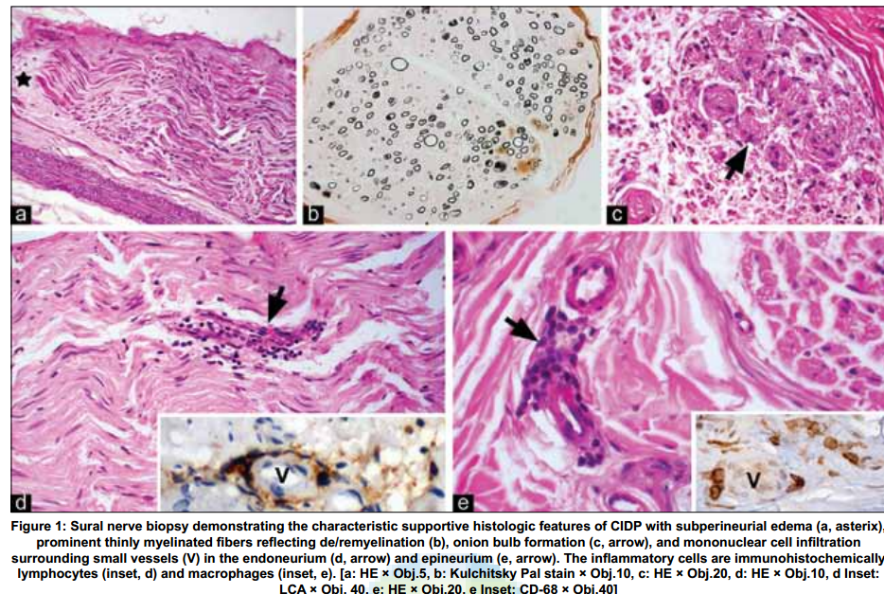

Slide 24
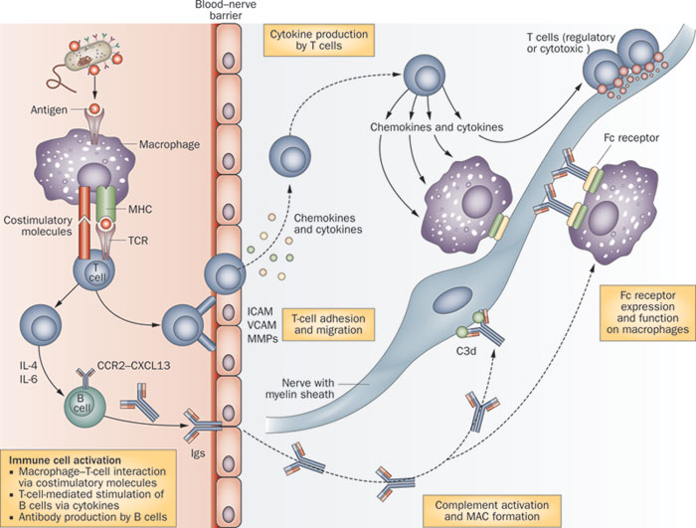
Figure 2 Scheme depicting the main immunopathogenic
network involved in CIDP

Slide 25
Recent advances in pathogenesis
T helper 17 (TH 17) cells are increased in the peripheral blood and CSF of patients with CIDP.
TH 17 →IL­17 is increased in the plasma.
dysfunction of T reg cells (CD4+ CD25highFoxp3+ T cells)

Slide 26
Target antigens
that adhesion molecules in nodal or paranodal regions, such as
  Neurofascins
  gliomedin and
  contactins (namely, contactin­2, CASPR1, connexin, neural cell adhesion molecule, cadherin, ankyrin and others)
  high­titer antibodies to neuro­ fascin were observed in patients with CIDP,
  polymorphisms in the contactin­2 molecule were associated
  with the disease.

Slide 27
Physiology of conduction blocks
Disruption of the nodal or paranodal region regions may result in early conduction block

Slide 28
CLINICAL FEATURES

Slide 29
DEMOGRAPHIC PROFILE
CIDP can occur at any age
it most commonly presents in adults, with a peak incidence at 40 to 60 years of age.
There is a slight male predominance.
Precipitating factors- 30%
URTI, gastroenteritis, surgery, vaccination

Slide 30
Insidious onset > 8 weeks
course may be progressive or relapsing.
Relapsing presentations are more likely to occur in younger individuals
Motor: weakness usually involves both proximal and distal muscles, but can be purely distal.
Atrophy – absent ( sets in late)

Slide 31
Sensory symptoms usually consist of numbness and tingling, but painful paresthesias may be present.
impaired balance --proprioceptive deficits.
Deep tendon reflexes-- absent or depressed.
Facial and neck flexor muscles are often involved.

Slide 32
other features
Cranial nerve involvement: 15% →Extraocular muscle, facial and bulbar
Papilledema – increased CSF protein
Autonomic and respiratory insufficiency can occur- does not require assisted ventillation.
Bladder disturbances- 25% → disturbed bladder sensation and detrusor areflexia

Slide 33
other features
Lumbar canal stenosis
Cauda equina involvement
Extensor plantar
Due to Massive hypertrophy of nerve roots produces crowding and entrapment of the roots in the lumbar thecal sack and the lumbar spinal canal, including the neural foramina.
spinal cord compression from hypertrophied intradural nerve roots in the cervical or thoracic region → extensor plantar responses.
In this circumstance, surgical decompression and a dural plasty may be considered.

Slide 34
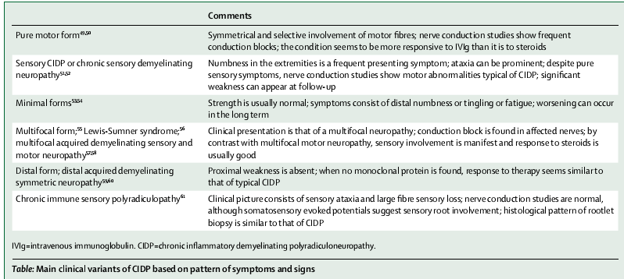
MAIN CLINICAL VARIANTS
Lancet 2010

Slide 35
Chronic acquired demyelinating polyneuropathies - Variants
A. Symmetric proximal and distal motor predominant CIDP
B. Lewis-Sumner syndrome (LSS) (MADSAM)
C. Demyelinating neuropathy with IgG or IgA paraprotein
D. Sensory predominant demyelinating neuropathy
E. CIDP with CNS demyelination
F. Demyelinating neuropathy associated with systemic disorders
G. CIDP in patients who have inherited neuropathy

Slide 36
Demyelinating neuropathy associated with systemic disorders
1. Hepatitis B or C
2. HIV
3. Lymphoma
4. Diabetes mellitus
5. SLE or other collagen vascular disorders
6. Thyrotoxicosis
7. Organ or bone marrow transplants
8. Nephrotic syndrome
9. Inflammatory bowel disease

Slide 37
II. Distinct from CIDP
Multifocal motor neuropathy (MMN)
IgM paraprotein–related neuropathies
1. Distal demyelinating neuropathy
a. With anti–MAGantibodies
b. Without anti-MAG antibodies
2. Chronic ataxic neuropathy ophthalmoplegia M-protein agglutination disialosyl antibodies (CANOMAD)
3. POEMS
Neurology clinics 2007

Slide 38
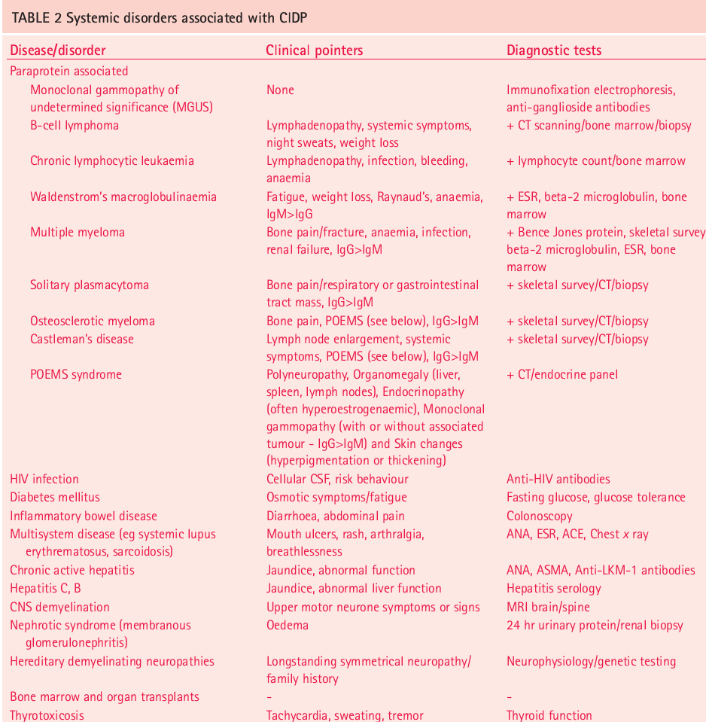

Slide 39
INVESTIGATIONS
The three most important laboratory studies that support the diagnosis of CIDP are the
cerebrospinal fluid (CSF) study
NCS
nerve biopsy.
Of the three sural nerve biopsy is probably the least useful.

Slide 40
CSF examination
A CSF - WBC count of greater than 10 cells/mm should lead to consideration of
  HIV infection
  Lyme disease
  neurosarcoidosis
  lymphomatous or leukemic infiltration of nerve roots
MRI → enlargement of the spinal roots or increased T2 signal and contrast enhancement in roots of the brachial or lumbosacral plexuses

Slide 41
CSF…..
CSF showing albuminocytologic dissociation.
CSF- OCB →65%
elevated CSF protein concentration → > 90% of patients

Slide 42
NERVE BIOPSY -- HPE
Sural nerve biopsy may be helpful in excluding other etiologies, such as
  Amyloidosis
  vasculitis
  hereditary neuropathies.
Demyelination
remyelination
inflammation

Slide 43
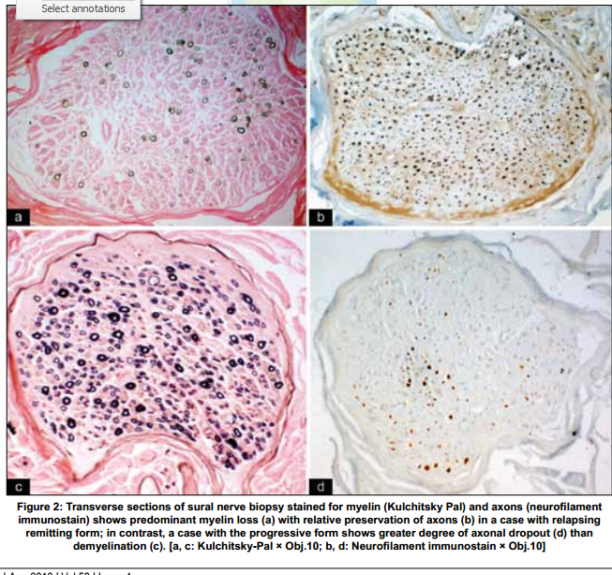

Slide 44
In a series of 60 patients with CIDP
  48% had evidence of demyelination/remyelination
  21% had axon changes
  13% had mixed demyelinating and axonal changes
  18% of biopsies were normal
Barohn RJ, Kissel JT, Warmolts JR, Mendell JR. Chronic inflammatory demyelinating polyradiculoneuropathy. Clinical characteristics, course, and recommendations for diagnostic criteria. Arch Neurol 1989;46:878–884

Slide 45
In most patients with CIDP, a nerve biopsy is not necessary.
However, if the CSF or NCS are not supportive of the diagnosis in a patient who clinically resembles CIDP, a nerve biopsy should be considered.

Slide 46
NERVE CONDUCTION STUDY
Edx→ demyelinating neuropathy
distal motor latency -- prolongation
motor conduction velocity -- slowing
F-waves -- delay or absent
presence of conduction block and/or abnormal temporal dispersion.
There is currently no accepted role for sensory NCS in establishing a diagnosis of a demyelinating polyneuropathy.

Slide 47
DIAGNOSTIC CRITERIA

Slide 48
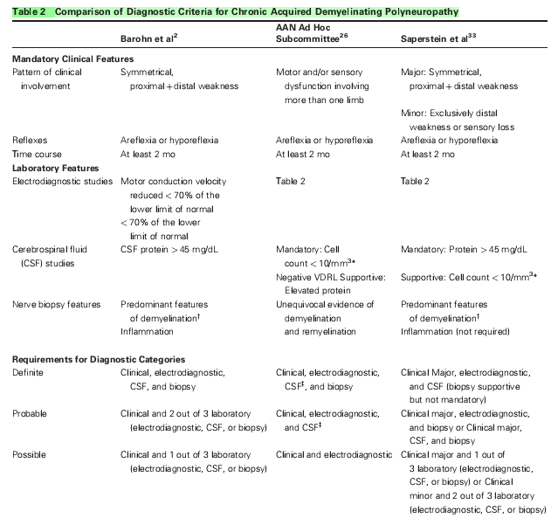
High specificity
Less sensitive
Better clinical applicability
1991

Slide 49
AAN Adhoc criteria
purpose of the AAN criteria was to identify subjects for clinical research studies.
limited sensitivity → missing almost half of patients who may respond to immunomodulatory treatment

Slide 50
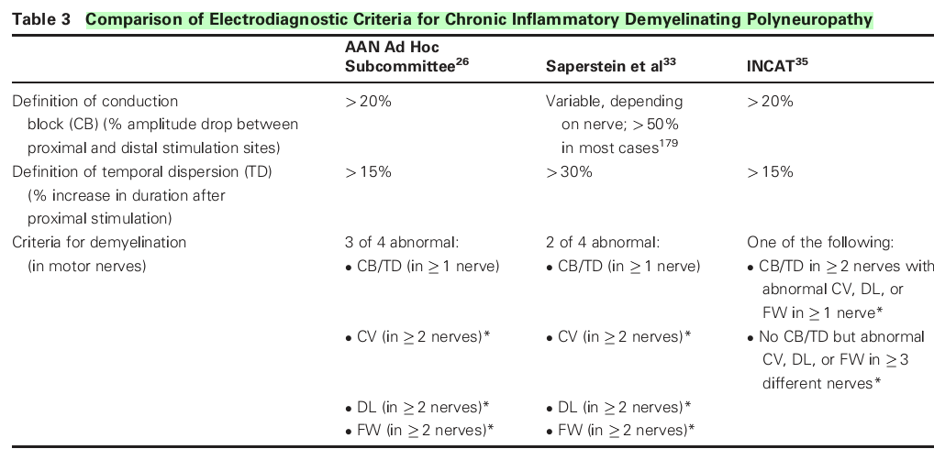
AAEM criteria
Sensitivity- 83%
Sp- 97%
Sensitivity- 90%
Sp- 97%

Slide 51
Criteria for abnormal: NCS
CV:<80% of the LLN if CMAP amplitude>80% of the LLN or<70% of the LLN if CMAP amplitude<80% of the LLN
(2) DL:>125% of the ULN if CMAP amplitude>80% of the LLN or>150% of the ULN if CMAP amplitude<80% of the LLN
(3) FW: minimum F-wave latency>125% of the ULN if CMAP amplitude>80% of the LLN or>150% if CMAP amplitude<80% of the LLN or if F-wave is absent

Slide 52
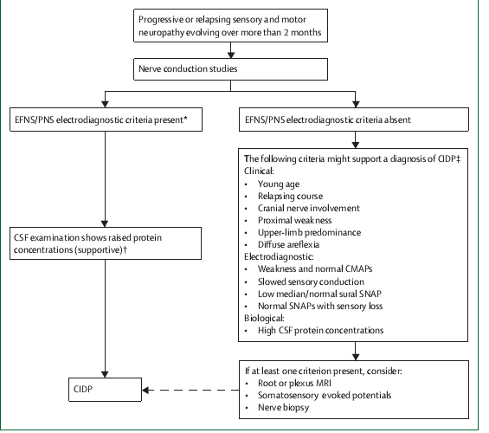
CLINICAL ALGORITHM
Lancet Neurology 2010

Slide 53
TREATMENT

Slide 54
GOALS OF TREATMENT
Control of symptoms (weakness, sensory loss, imbalance, pain)
Improvement of functional ability
Maintenance of long-term remission
Prevent progression

Slide 55
GUIDELINES--- ???
Initial choice of therapy -?
When to initiate treatment ?
Appropriate interval between treatments - ?

Slide 56
FACTORS DETERMINING CHOICE OF THERAPY
Severity of disease
side effects
Risk
Cost

Slide 57
Corticosteroids

Slide 58
Mechanism of action
↓ pro- inflammatory cytokines- IL-1, IL-2, IL-6, TNFα
↑ anti-inflammatory cytokines IL-4, IL-10
Inhibit T-cell proliferation and CMI
Anti-inflammatory & anti-adhesion effects
improves suppressor T cell function

Slide 59
Efficacy
In a RCT by Dyck et al →CIDP patients received either prednisone therapy (N = 14) or no treatment (N = 14)
Prednisone 120 mg A/D- 1st week →Tapered off over 12 weeks
Ann Neurol, 1982, 11:136
Prednisone gp- median improvement in NDS of 10
Controls: median worsening of 1.5 (p = 0.016)
Maximal effect of prednisone typically observed 1 to 6m

Slide 60
Prednisolone Vs IVIg
6-week, randomized, double-blind (n=24)
Oral prednisolone 60 mg OD X 2 wks (tapered down to 10 mg over the course of next month)
or
IVIg 2 g/kg over 1 to 2 days
Hughes et al,Ann Neurol,2001,50:195
Efficacy → steroids= IVIG

Slide 61
Factors predictive of steroid response
Shorter disease duration
Milder neurologic deficit
Smaller decrease in motor NCV
Age <40 years
Female gender
poor response:-
Global distribution of weakness
muscle atrophy
Babinski sign

Slide 62
Tolerability and dosing considerations.
Many complications arise due to long term treatment:
weight gain, insomnia,
hypertrichosis, hyperglycemia
Cushingoid appearance
hyperlipidemia, psychosis
gastric ulcer, osteoporosis
aseptic necrosis of the femoral head
infection

Slide 63
Prednisone Dosage
1–1.5 mg/kg daily
Dose titrated according to clinical response
Alternate-day therapy after 2-3m if favorable response
After stabilization reduce the dosage by 10 mg every month till a maintenance dose of 10-30 mg alt day

Slide 64
IV – METHYL PREDNISOLONE
One gram of IVMP daily for 3 to 5 days, weekly for 4 to 8 weeks, and then monthly based on clinical course.
A favorable response was observed in 13 of 16 patients at 6-month follow-up.
Patients treated with IVMP had less steroid adverse effects
Lopate G, Pestronk A, Al-Lozi M. Treatment of chronic inflammatory demyelinating polyneuropathy with high-dose intermittent intravenous methylprednisolone. Arch Neurol 2005;62:249–254

Slide 65
There is no evidence and no consensus about
whether to use daily or alternate day prednisolone or prednisone
or
high-dose monthly IVMP or oral regimens
Dyck et al. recommends reducing the dosage of prednisone to lowest effective level and use only in patients with moderately severe disease
No established criteria for dose tapering

Slide 66
Adjunctive measures- steroids
low salt, low simple sugar, low-calorie diet to minimize weight gain.
Calcium- 1000 to 1500 mg/d
vitamin D - 400 to 800 IU /day.
Bone densitometry studies are obtained at baseline and repeated at 6 to 12 month intervals.
If there is bone loss meeting criteria for osteopenia or osteoporosis, or there are fractures, start on antiresorptive agent such as alendronate
H2 blockers/PPI

Slide 67
Contraindications
Active peptic ulcer disease
Brittle diabetes
Hypertension
Severe osteoporosis
Systemic fungal infections

Slide 68
IVIG

Slide 69
IVIG- MECHANISM OF ACTION
compete for Fc receptor present on phagocytotic cells, thus reducing damage
accelerate catabolism and elimination of IgG autoantibody
IVIG can bind onto the complement factors
Neutralization of microbial toxins & circulating autoabs

Slide 70
IVIG- MOA….
anti-idiotypic antibodies downregulate B-cell activity.
modulate the immune activity of both CD8+and CD4+ cells.
Inhibit lymphocyte proliferation
Regulation of apoptosis

Slide 71
IVIG- preparation
IVIg prepared from donations of thousands of healthy donors
- contains wide spectrum of natural and induced antibodies
Proportions of various antibodies varies from batch to batch

Slide 72
Efficacy
Many randomized, double-blind, placebo-controlled studies support use of IVIg in CIDP
Cochrane review supportive Van Schaik et al, Lancet Neurol, 2002

Slide 73
Factors associated with improvement
Duration <1 year
Progression of weakness until treatment
Lack of discrepancy in weakness between arms and legs
Areflexia of arms
Slowed NCV in median nerve
Van Doorn, Arch Neurol,1991,36:878. n=52
90% chance of a favorable response to IVIg if all the
above parameters are met.

Slide 74
Meta-analysis of four double blind RCTs with altogether 235 participants showed that IVIg 2.0 g/kg produces significant improvement in disability lasting 2–6 weeks
Eftimov et al., 2009; van Doorn et al., 1990; Vermeulen et al., 1993; Hahn et al., 1996; Mendell et al., 2001; Elovaara et al., 2008
Class I evidence, Recommendation Level A
EFNS/PNS CIDP GUIDELINES European Federation of Neurological Societies/Peripheral Nerve Society 2010

Slide 75
Adverse effects of IVIG
Systemic effects
headache, nausea, fever, chills, myalgias, shortness of breath, and local vein thrombosis
Cardiovascular effects
Hypertension/tachycardia
Cardiac failure
Thromboembolic events, including myocardial infarction
Renal complications
Acute kidney failure
Acute renal tubular necrosis

Slide 76
Neurologic complications
Migraine
Aseptic meningitis
Reversible encephalopathy
Stroke
Hypersensitivity reactions
Anaphylaxis
Changes in serum chemistry
Hyponatremia
Hemolytic anemia, neutropenia, lymphopenia
Immune-complex arthritis
Skin reaction
Pruritus
Petechiae
Elevated ESR (rouleaux formation)
Decreased hemoglobin (dilutional)
Elevated liver enzymes

Slide 77
Precautions
Renal disease, recent DVT- only under careful guidance
Periodic monitoring of renal function tests and urine output advisable in such patients
Patients with symptoms of severe CAD, TIA, recent MI - treat cautiously
Stabilising agent- may be responsible for toxicity

Slide 78
IgA deficiency- anaphylactic reaction
Congenital absence of IgA-very rare
? Need for routine screening with immunoelectrophoresis

Slide 79
DOSAGE
2 g/kg X 2 to 5 days
Every 2 to 8 weeks
0.4–1 g/kg maintenance therapy
May relapse within 1–6 weeks
Subsequent treatment according to the duration of response
Most patients require repeat dosing every 2 to 8 weeks to maintain improvement if no other co-treatment

Slide 80
Rapid Infusion
Young patients
Normal renal and CVS function
2 g/kg of IVIg over 1 to 2 days
Infusion rate not > 200 mL/h

Slide 81
Disadvantage of IVIG
repeated dosing required 2 - 8 weekly in most patients
Cost factors
Side effect profile

Slide 82
Plasma exchange

Slide 83
PE - Mechanism of action
Removal of pathogenic humoral factors including
Antibodies
immune complexes
complement
other inflammatory mediators

Slide 84
Efficacy
RCT -double-blind, sham-controlled study of PE
5 (33%) of 15 pts with CIDP on PE had greater improvements when compared to 14 controls
Dyck et al NEJM,1986,314:461

Slide 85
PE might be considered as an initial treatment as neurological disability may improve rapidly
Class I evidence, Recommendation Level A
EFNS/PNS CIDP GUIDELINES European Federation of Neurological Societies/Peripheral Nerve Society 2010

Slide 86
Tolerability and dosing considerations.
Disadvantages:
- 1/3rd lightheadedness, tiredness
- Anemia (treatable with iron)
- Paresthesias during procedure (helped by addition of calcium)
Complication related to central line

Slide 87
PE
Special centers for PE-- Requires special equipment/ trained personnel
Expensive
Invasive and time-consuming
Repeated venous access may be problematic
Implanted catheters subject to clotting and infection
Relapse < 2–8 weeks

Slide 88
Treatment options -PLEX
Severe disability:
5 exchanges (50 mL/kg )
Over 7–10 days
Followed by same protocol, as needed, to maintain improvement
Allan H. Ropper Neurology 2003;60(Suppl 3):S16–S2

Slide 89
PE
Some patients need only one PE series every 6 months
Others may require monthly treatment
Contraindications
altered coagulation profile
hemodynamic instability
sepsis

Slide 90
IMMUNOSUPPRESSIVE AGENTS

Slide 91
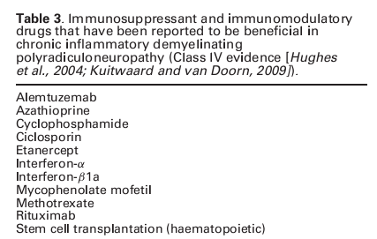
IMMUNOSUPPRESSIVE AGENTS
Randomized controlled trials have been reported
only for azathioprine and methotrexate.

Slide 92
More research is needed before any recommendation can be made.
Immunosuppressant treatment may be considered when the response to corticosteroids, IVIg or PE is inadequate (Good Practice Point)
class IV evidence
EFNS/PNS CIDP GUIDELINES European Federation of Neurological Societies/Peripheral Nerve Society 2010

Slide 93
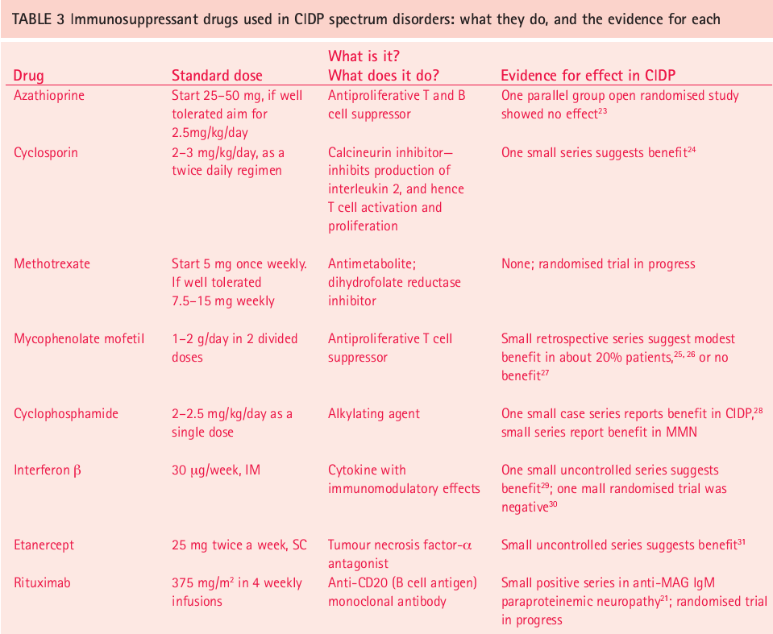
Practical neurology 2006

Slide 94
Interferons
A non-randomized open study of intramuscular interferon-β1a 30 mcg weekly, 7 of 20 patients treated showed clinical improvement, 10 remained stable and three worsened
Vallat et al., 2003 60:S23
In the absence of evidence, interferon treatment may be considered when the response to corticosteroids, IVIg or PE is inadequate
EFNS/PNS CIDP GUIDELINES
(Good Practice Point)

Slide 95
INITIAL MANAGEMENT- CIDP
Patients with mild symptoms → Monitor
Patients with moderate or severe disability - Treatment with
  PE or IVIg (level A recommendation) or
  corticosteroids (level C recommendation) should be offered

Slide 96
GOOD PRACTICE POINTS
IVIg is often the first choice as improvement can be fast.
For pure motor CIDP, IVIg treatment should be the first choice and if corticosteroids are used, patients should be monitored closely for deterioration
EFNS/PNS CIDP GUIDELINES

Slide 97
When to decide on alternate T/t
Therapy →individualized
On corticosteroids→ No response after 12 weeks

Slide 98
Long-term management (Good Practice Points)
No evidence-based guideline
Maintenance
IVIG – Try to reduce the dose & frequency
Steroids
Immunosuppressive medications

Slide 99
Patients who become refractory to IVIg may respond again after a short course of PE
15% of patients fail to respond to any of the proposed treatments.

Slide 100
General measures
Advice about foot care, exercise, diet, driving and life style management should be considered.
Neuropathic pain should be treated accordingly
Depending on the needs of the patient, orthoses, physiotherapy, occupational therapy, psychological support and referral to a rehabilitation specialist should be considered

Slide 101
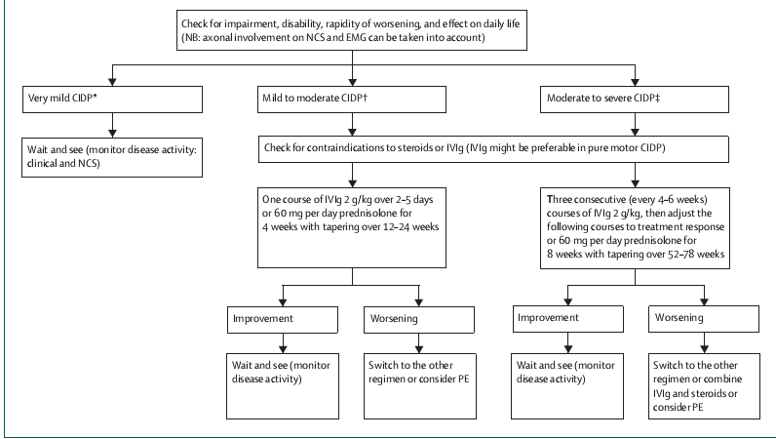
TREATMENT ALGORITHM
Lancet Neurol2010; 9: 402–12

Slide 102
ASSESSMENT
Muscle score - modified MRC
Functional disability -Hughes Functional Disability Scale
Hand grip test
MRS
Forced vital capacity
Motor nerve conduction studies
INCAT scale

Slide 103
UNUSUAL SITUATIONS

Slide 104
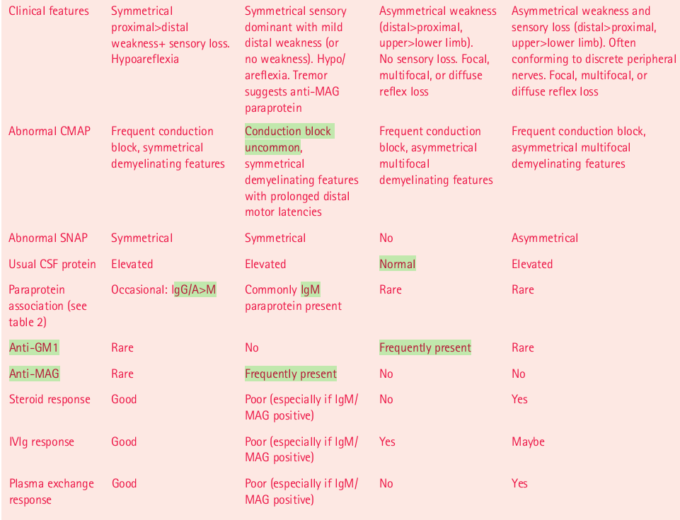
CIDP | DADS | MMN | MADSAM
Practical neurology 2006
Sapperstain etal classification

Slide 105
CIDP and immunisation
Q whether the child with CIDP may safely receive routine immunizations ?
Ans: ??
recent study found the risks of relapse of CIDP to be low with booster injections, unless the disease had been originally triggered by a vaccination.
In susceptible CIDP patients, booster tetanus injections have, on occasion, led to a relapse

Slide 106
CIDP and HIV
occurs - HIV type 1
Observed - during seroconversion or in early stages of the infection
Presentation, course & biopsy - same as CIDP
ODD point - CSF a lymphocytic pleocytosis of 10 to 50 cells/mm

Slide 107
CIDP-MGUS
monoclonal gammopathy involving IgA, IgG or IgM
Patients →tend to be older and more likely male
C/F → predominant and slowly progressive sensory deficits and imbalance.
→ Any motor deficits usually involve distal muscles.
indolent course
responds less well to treatment

Slide 108
CIDP- childhood
Prevalence → 0.48 per 100,000 population
a preceding infection or vaccination → 50%
The initial clinical picture mimicked AIDP
relapsing-remitting course → 80%
Good response → immune-modulating treatments
Good prognosis - often achieve long-term remission.
No controlled comparative studies are available because the number of treated cases is small.

Slide 109
CIDP-CMT
new-onset weakness in proximal leg muscles superimposed on the chronic weakness in peroneal muscles resulting from CMT
EDx→ CB
Biopsy→ may reveal extensive subperineurial edema in addition to perivenular and endoneurial mononuclear cell infiltrates
improve with steroids

Slide 110
CIDP- DM When to suspect CIDP in DM patient ?
if there is recent and subacute development of weakness that is greater proximally than distally and is seen together with sensory loss and ataxia.
Edx → demyelinating neuropathy.
Finding of unequivocal CB in one or more nerves
Such patients tend to respond favorably to the various immune-modulating treatments.

Slide 111
New therapeutic targets
T-cell intracellular signaling pathways
Alemtuzumab- mab against CD52, causes long­lasting lymphocyte depletion via apoptosis.
four out of seven patients with CIDP experienced improvement of symptoms
Targeting Complement
Eculizumab →mab that binds C5
T-cell adhesion and migration
natalizumab and fingolimod.
add­on therapy to IVIg in a CIDP clinical trials.

Slide 112
Key points
■ CIDP is the most common acquired chronic autoimmune neuropathy
■recently revised diagnostic criteria provide an optimal balance between sensitivity and specificity
■ Molecules within the non-compact myelin and points of Schwann cell–axon interaction, rather than within compact myelin, seem to be the putative target antigens
■ Corticosteroids, IVIG and PE provide short-term benefits
■ Potential new therapeutic approaches involve targeting key factors in the immunopathogenesis of CIDP, including T cells, B cells and complement

Slide 113
THANK YOU

Slide 114
References
CIDP Chapter 99; Text book of peripheral neuropathy. Dyck etal; fifth edition
EFNS/PNS CIDP GUIDELINES European Federation of Neurological Societies/Peripheral Nerve Society Guideline on management of chronic inflammatory demyelinating polyradiculoneuropathy: Report of a joint task force of the European Federation of Neurological Societies and the Peripheral Nerve Society – First RevisionJournal of the Peripheral Nervous System 15:1–9 (2010)

Slide 115
3. Chronic inflammatory demyelinating polyradiculoneuropathy: diagnostic and therapeutic challenges for a treatable condition Jean-Michel Vallat, Claudia Sommer, Laurent Magy Lancet Neurol2010; 9: 402–12
4. Chronic Inflammatory Demyelinating Polyneuropathy
Richard A. Lewis, MD Neurol Clin 25 (2007) 71–87
5. Practical Neurology James R Overell and Hugh J Willison
treatment option polyradiculoneuropathy: classification and
Chronic inflammatory demyelinating

Slide 116
6. REVIEW Pathogenesis of chronic inflammatory demyelinatingPolyradiculoneuropathy Richard A. C. Hughes, David Allen, Anna Makowska, and Norman A. Gregson Journal of the Peripheral Nervous System 11:30–46 (2006)
7. The pathogenesis of CIDP Rationale for treatment with immunomodulatory agents Klaus V. Toyka, MD; and Ralf Gold, M NEUROLOGY 2003;60(Suppl 3):S2–S7

Slide 117
MCQ
Which of the statements about MMN is true….
Synonym for Lewis Sumner Syndrome
LL are predominantly affected
Good response to steroids
associated with antiGM1 antibody
Women are commonly affected

Slide 118
The adjuvant in IVIG that is responsible for thrombotic complications
Lactose
Glucose
Sucrose
citrate

Slide 119
Main effector cell in demyelination in CIDP is …
B cells
Plasma cells
Macrophages
T cells
Schwann cells

Slide 120
CLINICAL CLASSIFICATION
Symmetric proximal & distal weakness
Symmetric distal weakness or sensory loss
Asymmetric weakness
Asymmetric weakness & sensory loss
Saperstein et al, M&N, 2001, 24:311

Slide 121
Prognosis
Improvement and stabilization can usually be achieved for 80% of CIDP patients

Slide 122
Prevalence
0.81-1.9 / 1,00,000 population

Slide 123
In recent study of 100 patients
  68% had purely demyelinating findings
  20% had mixed demyelinating and axonal changes
  5 % had purely axonal lesions.
  18% - Inflammatory infiltrates.
Bouchard C, Lacroix C, Plante V, et al. Clinicopathologic findings and prognosis of chronic inflammatory demyelinat-ing polyneuropathy. Neurology 1999;52:498–503

Slide 124
Thus, the main purpose of NCS criteria is to prevent patients without demyelinating neuropathies from being falsely diagnosed with CIDP
Another limitation of all of the NCS criteria is that they cannot reliably distinguish patients with CIDP from those with inherited demyelinating neuropathies.

Slide 125
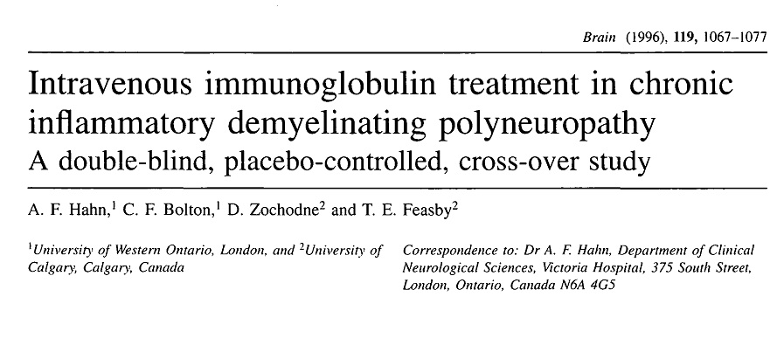
30 patients with CIDP received IVIg 0.4 g/kg or placebo X 5 days
19 (63%) patients on IVIg had short-term benefit
9 (56%) of 16 patients with progressive disease and
10 (71%) of 14 patients with relapsing disease improved
Summed motor NCV
Summed distal motor latencies of median, ulnar, tibial, and peroneal nerves (p < 0.05)

Slide 126
Patients starting on IVIg should be closely monitored to objectify recurrence and duration of response to the first course before embarking on further treatment.
Between 15% and 30% of patients require only a single course of IVIg.

Slide 127
Long-term management (Good Practice Points)
No evidence-based guideline
IVIg given in doses of 1 g/kg over 1–2 days every 3 weeks has been shown to be efficacious over 24 (and possibly 48) weeks with improvement of grip strength, disability and health-related quality of life
Hughes et al., 2008; Merkies et al., 2009

Slide 128
Efficacy assessed using a novel 12-point disability scale:
“Inflammatory Neuropathy Cause and Treatment (INCAT) Disability Scale”
Arm
0 = no upper limb problems
5 = inability to use either arm for any purposeful movement
Leg disability
0 = walking not affected
5 = restricted to wheelchair, unable to stand and walk a few steps with help

