Slide 1
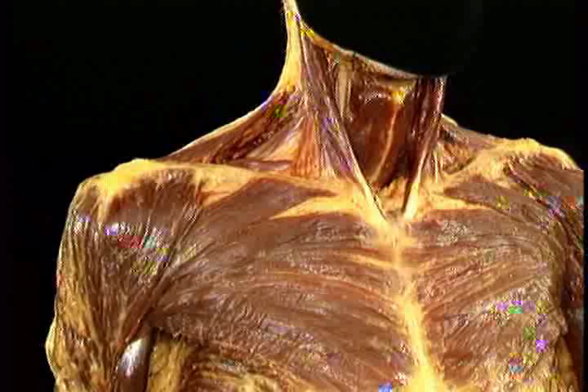
PECTORALIS MAJOR MYOCUTANEOUS FLAP IN HEAD AND NECK RECONSTRUCTION
by- Dr. Piyush Doshi
Associate Professor
Department of Plastic Surgery, SBKSMI & RC

Slide 2
HEADINGS
FLAP → INTRODUCTION, DEFINITION
HISTORY OF FLAP
CLASSIFICATION & TYPES
HISTORY OF PMMC
ANATOMY OF PMMC
PMMC FLAP HARVESTING & MODIFICATIONS
USES & INDICATIONS
CONTRAINDICATIONS & DISADVANTAGES
COMPLICATIONS & MANAGEMENT

Slide 3
I. INTRODUCTION, DEFINITION
A flap is a unit of tissue that is transferred from one site (donor site) to another (recipient site) while maintaining its own blood supply or from a anastomised vessel.
The term "flap" originated in the 16th century from the Dutch word "flappe," meaning something that hung broad and loose, fastened only by one side.
Graft: Movement of tissue usually from a distant site, without an intact vascular network.
Mathes & Nahai ; 1998 Operative plastic surgery

Slide 4
II. HISTORICAL EVOLUTION
Basically divided in 3 phases-
  Before 1900 and early 1900 (from Shushrata to Sir Harrold Gillies)
  1950’s and 1960’s (McGregor, Bakamjian, Millard, Conley)
  1980’s (Aariyan, Mathes, Nahai, Taylor, O’Brien)
Mathes & Nahai ; 1998 Opertaive plastic surgery

Slide 5
HISTORY OF FLAPS
Sushrata –(1000-600 B.C.)-forehead flap
Sir Astley -1817 performed 1st successful human skin graft
Manchot 1889 –introduced concept that arteries have specific vascular territories
Bakamjian’s 1965 – Deltopectoral flap
McGregor 1960’s – basic understanding of flap blood supply; found axial & random pattern flap
Baek, McGregor et al – several flaps into axial & random pattern

Slide 6
III. CLASSIFICATION & TYPES
Ranging into different shapes and forms, from simple advancements of skin to composites of many different types of tissue. These composites need not consist only of soft tissue. They may include skin, muscle, bone, fat, or fascia.

Slide 7
Four basic types
  Based on Location
  Blood supply
  Composition
  Configuration

Slide 8
Principles of flap surgery
PRINCIPLE I: REPLACE LIKE WITH LIKE
Ralph Millard once said, "when a part of one's person is lost, it should be replaced in kind, bone for bone, muscle for muscle, hairless skin for hairless skin, an eye for an eye, a tooth for a tooth."

Slide 9
PRINCIPLE II: THINK OF RECONSTRUCTION IN TERMS OF UNITS
As emphasized by Millard, "The most important aspects of a regional unit are its borders, which are demarcated by creases, margins, angles and hair liners."

Slide 10
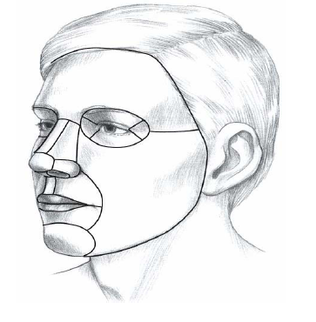
Facial Aesthetic Units
Restoration of the defects should be done as units

Slide 11
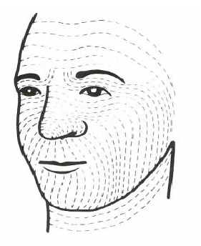
Lines of minimal tension
Lines of minimal tension are adaptation to the function,the skin being constantly pulled and streched by under lying muscle and joint
Scar parallel to lines are not subject to intermittent pull of the subjacent muscles
Relaxed skin tension lines (Borges)

Slide 12
Concept of Angiosome
In 1987, Ian Taylor published his work on the blood supply to the skin and introduced the concept of an angiosome. An angiosome is similar to the dermatome Whereas a single nerve root supplies a dermatome, an angiosome is the three dimensional block of tissue supplied by a single vascular system. If the source artery is blocked, the angiosome can get some blood from neighbouring angiosomes but to get there the blood has to follow narrow calibre tortuous anastomoses.

Slide 13
Appropriately, these channels are known as “choke vessels.” If a flap is raised, therefore, without its source artery, the flap will rely on choke vessels for its survival and may fail. One way around this problem is to use the “delay phenomenon.” The concept is simple: you raise the flap but leave it for one to three weeks allowing the choke vessels to dilate and perfuse the flap.

Slide 14
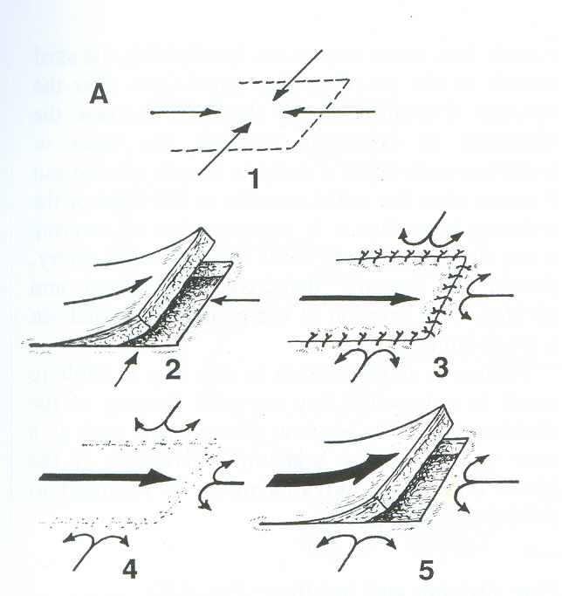
Delay Phenomenon
Incise and undermine
10 to 21 day delay most common
Improved blood supply
conditioning to ischemia
alignment of vessels

Slide 15
PRINCIPLE III: ALWAYS HAVE A PATTERN AND A BACK-UP PLAN

Slide 16
PRINCIPLE IV: STEAL FROM PETER TO PAY PAUL
Apply the "Robin Hood" principal: steal from Peter to pay Paul, but only when Peter can afford it.

Slide 17
PRINCIPLE V: NEVER FORGET THE DONOR AREA

Slide 18
I. Based on Location
Local flaps
    Temporalis
    Sternocleido-mastoid
    Platysma
    Forehead
Regional
    PMMC
    Latissimus dorsi
    Omental
    Trapezius
Free flaps
    Fibula
    Radial forearm
    Deep Circumflex iliac artery flap

Slide 19
Based on Type of Tissue Transfer (COMPOSITION)
Skin (cutaneous)
Fascia
Muscle
Bone
Composite
  Fasciocutaneous (eg, radial forearm flap)
  MYOCUTANEOUS (eg, PMMC)
  Osseocutaneous (eg, fibula flap)
  Tendocutaneous (eg, dorsalis pedis flap)
  Sensory/innervated flaps (eg, dorsalis pedis flap with deep peroneal nerve)

Slide 20
Myocutaneous/ Muscle flap
Myocutaneous flap is a composite soft tissue flap in which skin portion provided wound closure while the muscle mass merely served as a carrier for the essential blood supply
Muscle flap contains only muscle with its blood supply, if required further covered with skin graft

Slide 21
Based on Blood Supply
Random (no named blood vessel)
Axial (named blood vessel)
“Mathes and Nahai Classification”
  TYPE I- One vascular pedicle (eg, tensor fascia lata)
  TYPE II- Dominant pedicle(s) and minor pedicle(s) (eg,SCM, Platysma, Trapezius)
  TYPE III-Two dominant pedicles (eg, Temporalis)
  TYPE IV- Segmental vascular pedicles (eg, sartorius)
  TYPE V-One dominant pedicle and secondary segmental pedicles (eg, PMMC, LD)
Plast Reconstr Surg 1981; 67 (2): 177-187

Slide 22
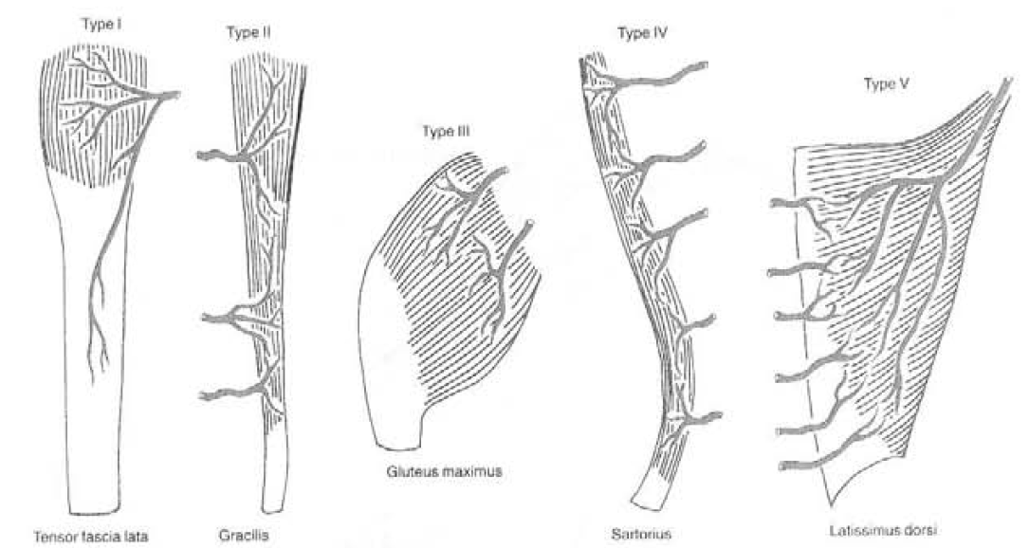
“Mathes and Nahai Classification”
Plast Reconstr Surg 1981; 67 (2): 177-187

Slide 23
FLAP → INTRODUCTION, DEFINITION
HISTORY OF FLAP
CLASSIFICATION & TYPES
HISTORY OF PMMC
ANATOMY OF PMMC
PMMC FLAP HARVESTING & MODIFICATIONS
USES & INDICATIONS
CONTRAINDICATIONS & DISADVANTAGES
COMPLICATIONS & MANAGEMENT

Slide 24
IV. HISTORY OF PMMC
Hueston & McConchie – chest wall defect
Ariyan – 1979 for head & neck reconstruction
Magee et al – Pectoralis “paddle” myocutaneous flaps
Gregor et al – Pectoralis major myocutaneous “island” flap
Maisel et al, Shah et al, Kroll et al – Complications of PMMC flap
Plast Reconstr Surg 1979; 63: 73
Am J Surg 1980; 140: 507
S Afr Med J 1982; 61(21): 788

Slide 25
FLAP → INTRODUCTION, DEFINITION
HISTORY OF FLAP
CLASSIFICATION & TYPES
HISTORY OF PMMC
ANATOMY OF PMMC
PMMC FLAP HARVESTING & MODIFICATIONS
USES & INDICATIONS
CONTRAINDICATIONS & DISADVANTAGES
COMPLICATIONS & MANAGEMENT

Slide 26
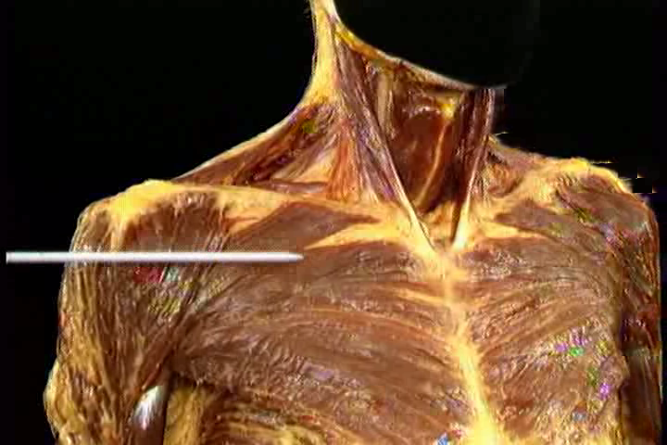
V. ANATOMY OF PMMC
Fan shaped muscle of anterior chest wall

Slide 27
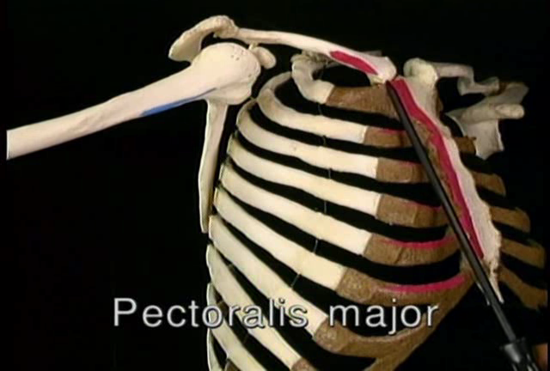
ORIGIN & INSERTION
Intertubercular groove of humerus

Slide 28
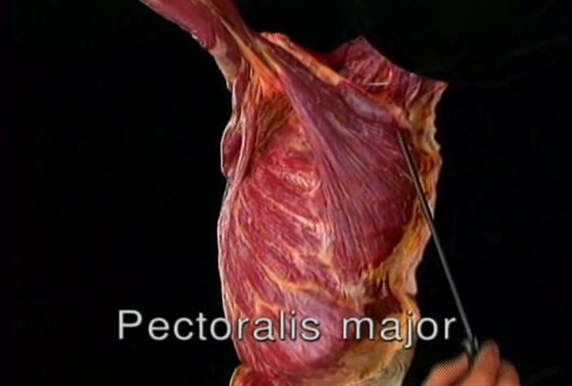
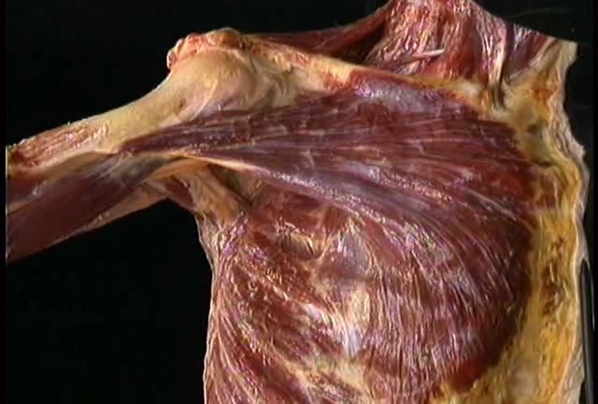

Slide 29
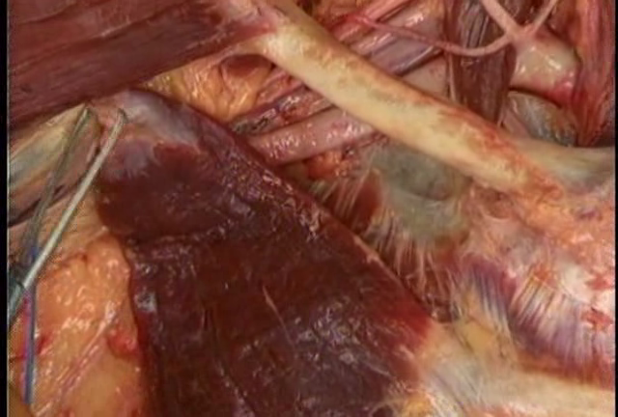
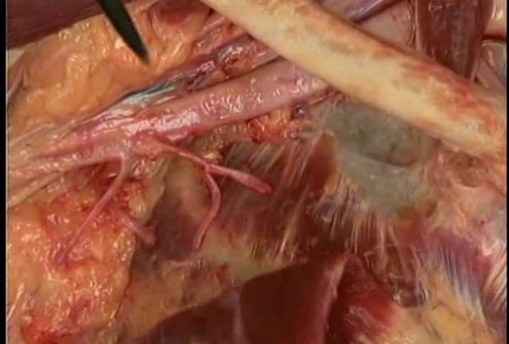

Slide 30
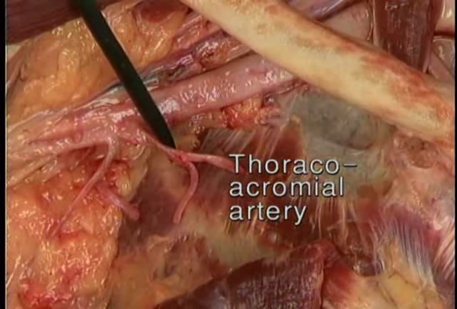
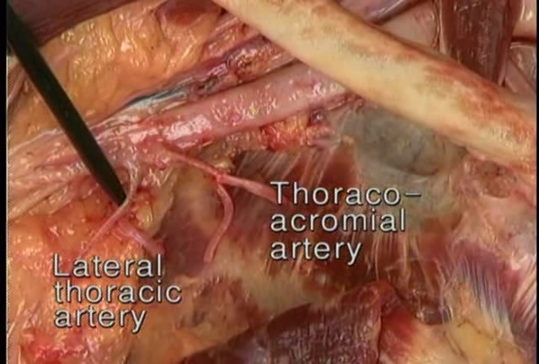
DOMINANT PEDICLE IS PECTORAL BRANCH OF THORACOACROMIAL ARTERY (IST BRANCH OF AXILLARY ARTERY)
MAY BE A MAJOR SOURCE OF BLOOD SUPPLY IN 27 % INDIVIDUALS

Slide 31
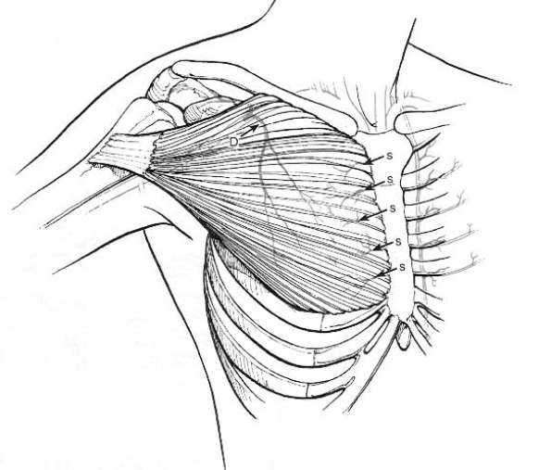
Secondary pedicle: Perforator branches of Internal Mammary Artery
Dominant pedicle: Pectoral Branch of Thoracoacromial artery

Slide 32
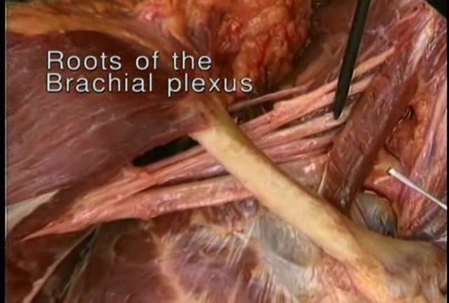
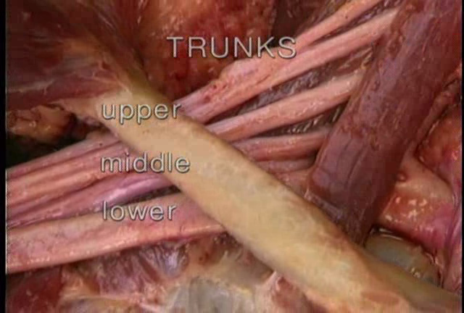

Slide 33
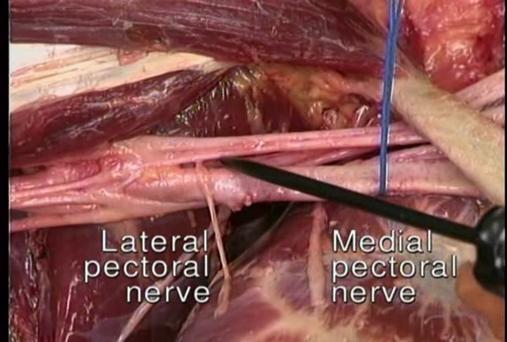
M
O
T
O
R
N
E
R
V
E
S
U
P
P
L
Y
UPPER HALF OF MUSCLE
LOWER HALF OF MUSCLE

Slide 34
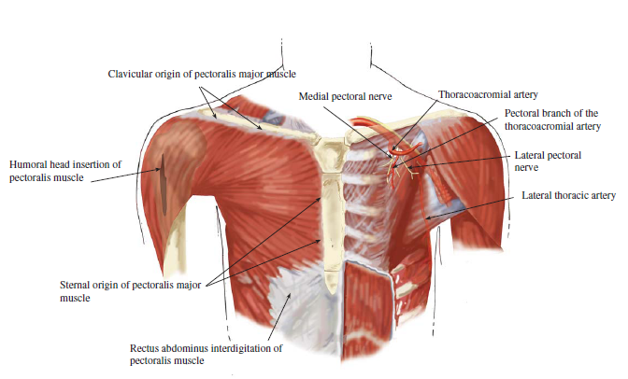

Slide 35
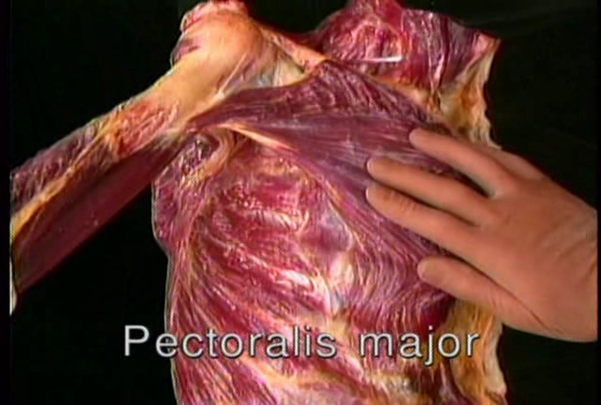
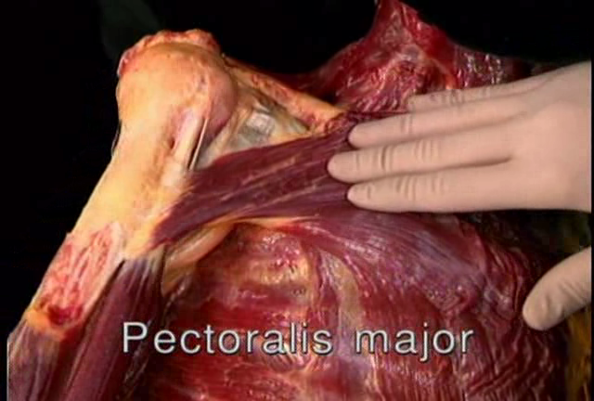
ACTION
MEDIAL ROTATION
ADDUCTION

Slide 36
FLAP → INTRODUCTION, DEFINITION
HISTORY OF FLAP
CLASSIFICATION & TYPES
HISTORY OF PMMC
ANATOMY OF PMMC
PMMC FLAP HARVESTING & MODIFICATIONS
USES & INDICATIONS
CONTRAINDICATIONS & DISADVANTAGES
COMPLICATIONS & MANAGEMENT

Slide 37
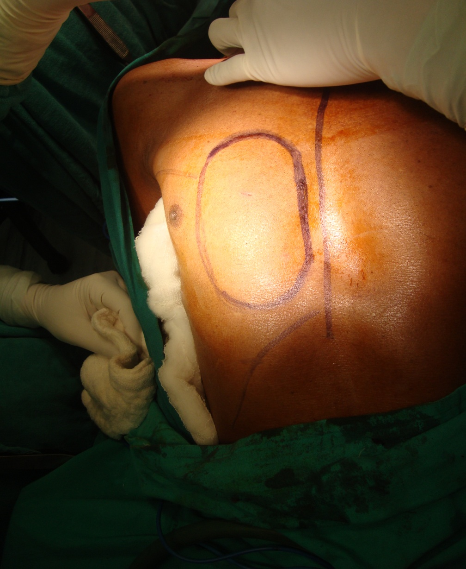
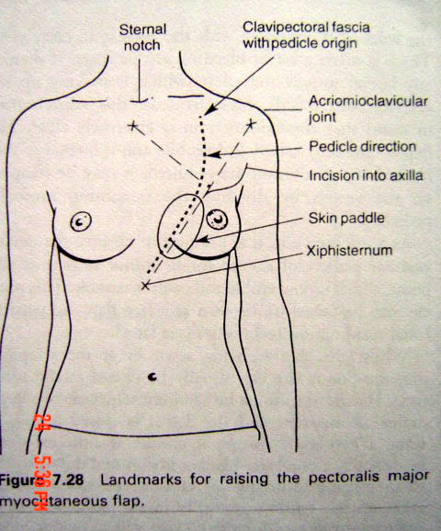
VI. PMMC FLAP HARVESTING

Slide 38
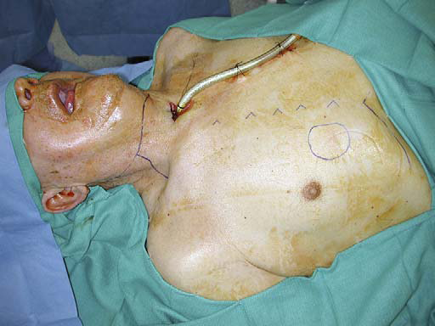
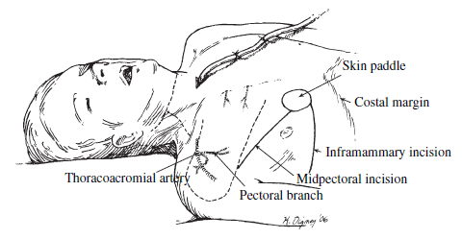

Slide 39
Wide exposure
Markings
Skin paddle drawn(inferomedial quadrant)
Distance measured
Incisions
  Midpectoral
  Inframammary
Cutaneous incision made by 10 # blade
Incision completed
Dissection starts infero laterally

Slide 40
9. Avascular loose areolar plane between Pectoralis minor and major muscles
10. Pectoral branch identified on the undersurface, lies medial to superior aspect of P. minor & Lateral thoracic lies lateral to it.
11. Lateral extension identified and raised upto its insertion
12.Medially minimum of 2 cms muscle attachment is left over body of sternum
13.Superomedially origin is exposed and finally division of medial and lateral pectoral nerve is done.
14. Flap mobilized completely and tunnled which is created by subplatysmal plane of dissection over the clavicle.

Slide 41
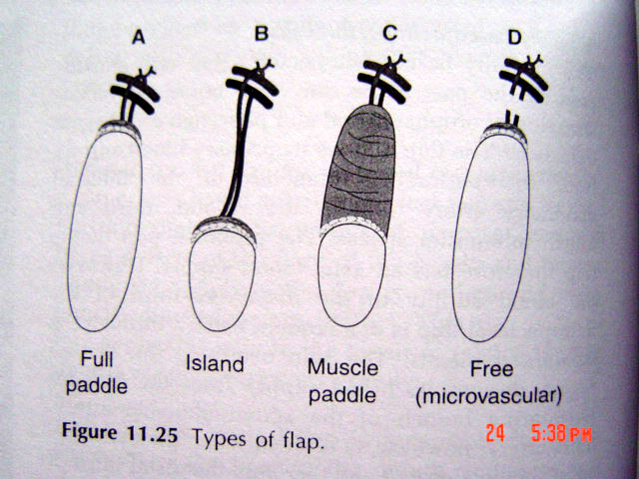
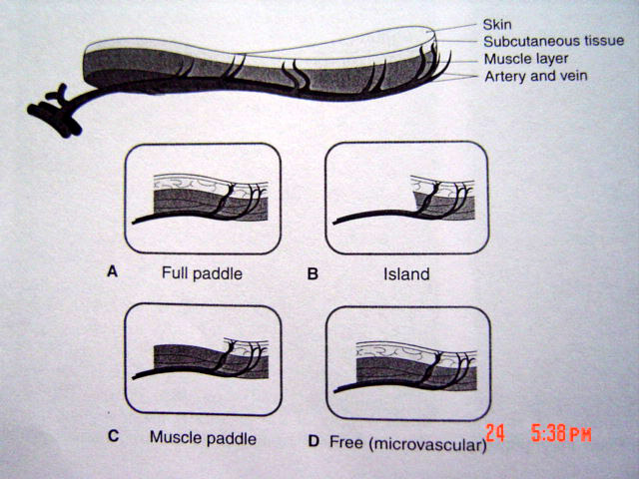
TYPES…PMMCF
A) Full paddle
B) Island
C) Muscle paddle
D) Free
E) Osteomyocutaneous (IV/ V rib)

Slide 43
FLAP → INTRODUCTION, DEFINITION
HISTORY OF FLAP
CLASSIFICATION & TYPES
HISTORY OF PMMC
ANATOMY OF PMMC
PMMC FLAP HARVESTING & MODIFICATIONS
USES & INDICATIONS
CONTRAINDICATIONS & DISADVANTAGES
COMPLICATIONS & MANAGEMENT

Slide 44
VII. INDICATIONS & USES
Ideally used for reconstruction of
  MANDIBLE,
  FLOOR OF MOUTH,
  UPPER NECK, and
  LOWER THIRD OF FACE
The bulk of muscle and subcutaneous tissue is advantageous for large vessel coverage when a neck dissection or large resection is to be performed
Has a special place and are the FLAPS OF CHOICE in cancer patients requiring secondary reconstruction options and under any kind of XRT.

Slide 45
Also used for reconstruction of pharyngoesophageal area, base of the tongue, anterior skull base, midface, total nose and orbital defects.
Ist choice for large mandibular defects as arc of rotation is upto 20 cms from center of clavicles and reaches to most part of mandible
Bulk gives cosmesis, good functional results
Other advantages include 2 team approach without changing patient position

Slide 46
MAJOR ADVANTAGES
Large skin territory
Rich vascular supply, can be transferred without delay
Large arc of rotation
Can be harvested in supine position
Can be used as a muscle only, skin & muscle paddle
Primary donor site is easily achieved
The flap requires no microvascular anastamosis

Slide 47
FLAP → INTRODUCTION, DEFINITION
HISTORY OF FLAP
CLASSIFICATION & TYPES
HISTORY OF PMMC
ANATOMY OF PMMC
PMMC FLAP HARVESTING & MODIFICATIONS
USES & INDICATIONS
CONTRAINDICATIONS & DISADVANTAGES
COMPLICATIONS & MANAGEMENT

Slide 48
VIII. CONTRAINDICATIONS & DISADVANTAGES
A prior history of radical axillary node dissection has been suggested as only true contraindication.
History of breast surgery, augmentation, or reconstruction can limit the quality and quantity of musculocutaneous perforators to the skin paddle or interrupt the dermal plexus.(Relative)
Prior flap reconstruction of the breast can severely limit the arc of rotation and reach of the flap. (Relative)
Morbidly obese or large breasted individuals with excessive adipose or mammary tissue also may have compromised predictable survival of the cutaneous paddle .(Relative)

Slide 49
Smoking, diabetes, peripheral vascular disease, poor nutritional status, hypertension, prior radiation, and scar tissue have been suspected in reduced success of cutaneous tissue survival.
Patients who smoke should be warned that they should quit at least 2 weeks before surgery for improved chances of flap survival.
Disadvantage mainly is related to cosmesis specially in thin patients.
Also debulking may require 2nd surgery

Slide 50
FLAP → INTRODUCTION, DEFINITION
HISTORY OF FLAP
CLASSIFICATION & TYPES
HISTORY OF PMMC
ANATOMY OF PMMC
PMMC FLAP HARVESTING & MODIFICATIONS
USES & INDICATIONS
CONTRAINDICATIONS & DISADVANTAGES
COMPLICATIONS & MANAGEMENT

Slide 51
IX. COMPLICATIONS & MANAGEMENT
Recipient site complications
  Flap necrosis
  Infections
  Fistulization
  Seroma
Donor site complications
  Uncontrolled bleeding,
  Hematoma,
  Dehiscence
  Infection & seroma
Rare – rib osteomyelitis, metastatic spread of tumor to base of the flap

Slide 52
Mehta et al; Plast Recontr Surg 1996; 98: 31 evaluated 220 patients and outlined several risk factors
  Hematoma formation was correlated to advanced tumor stage and subsequently more radical surgeries.
  Infections were increased in patients with hemoglobin levels!10 g/dL, serum albumin3 g/dL, and presence of underlying systemic disease. Infections also significantly increased hospital stay.
  Dehiscence was more common in female patients, patients with serum albumin 3 g/dL, bipedicled flaps, and history of prior chemotherapy
  Fistulas occurred more commonly at the anterior three-point suture between the flap, floor of mouth, and mucoperiosteum at the cut edge of the mandible. Fistula risk also increased with more extensive resection.
  Extensive resection also significantly increasedhospital stay.
  Flap necrosis also seems to be more common in women than men

Slide 53
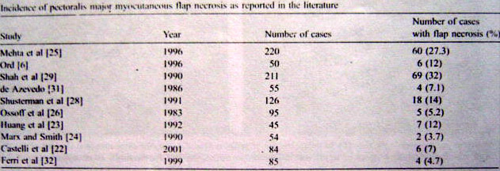
INCIDENCE OF FLAP NECROSIS
Aleksandar et al; J of Cranio-maxillofac Surg; 2006; 34: 340-343 “reports 5oo cases by PMMC of which only 4 % exhibited complete flap necrosis, while repots overall complications upto 32%

Slide 54
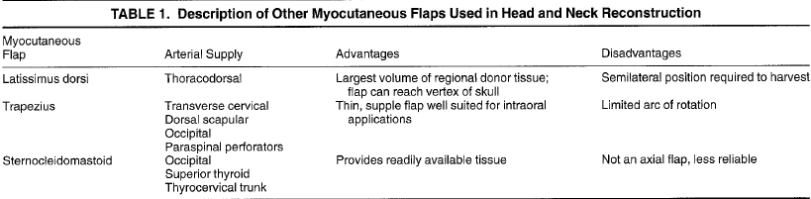

Slide 55
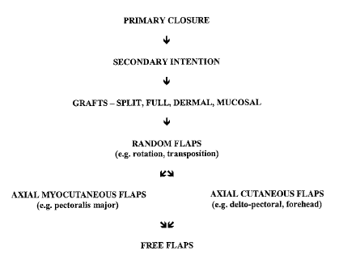

Slide 56
Sometimes purchases in the
bargain basements can serve
as well as those found in the
penthouse suite
Free flaps
Distant
flap
Regional
flap
Local
flap
Skin
grafts
Primary
closure

Slide 57
Decision Making in Oral Cavity Reconstruction
Defect Type
Soft Tissue
Bone
Floor of Mouth
Buccal Mucosa
Tongue
Superficial
Primary Closure
Skin Grafts
Full Thickness
Regional Flaps
Fasciocutaneous Free Flaps
Large Full Thickness
Fasciocutaneous Free Flaps
Pedicled musculocutaneous flaps
Anterior Defect
Lateral Defect
Osseocutaneous free flaps
Regional/Distant Flap
and Mandibular Swing
Reconstruction Plate and
Regional/Distant Flaps
Osseocutaneous Free Flaps
Small
STSG
Moderate
Regional Flaps
Fasciocutaneous Free Flaps
Large
Pedicled Fasciocutaneous flap
Fasciocutaneous free flaps
<50% Loss
Primary Closure
Skin Graft
Combined Defects
Fasciocutaneous free flaps
Total Glossectomy
Myocutaneous free flaps
Pedicled musculocutaneous flaps

Slide 58
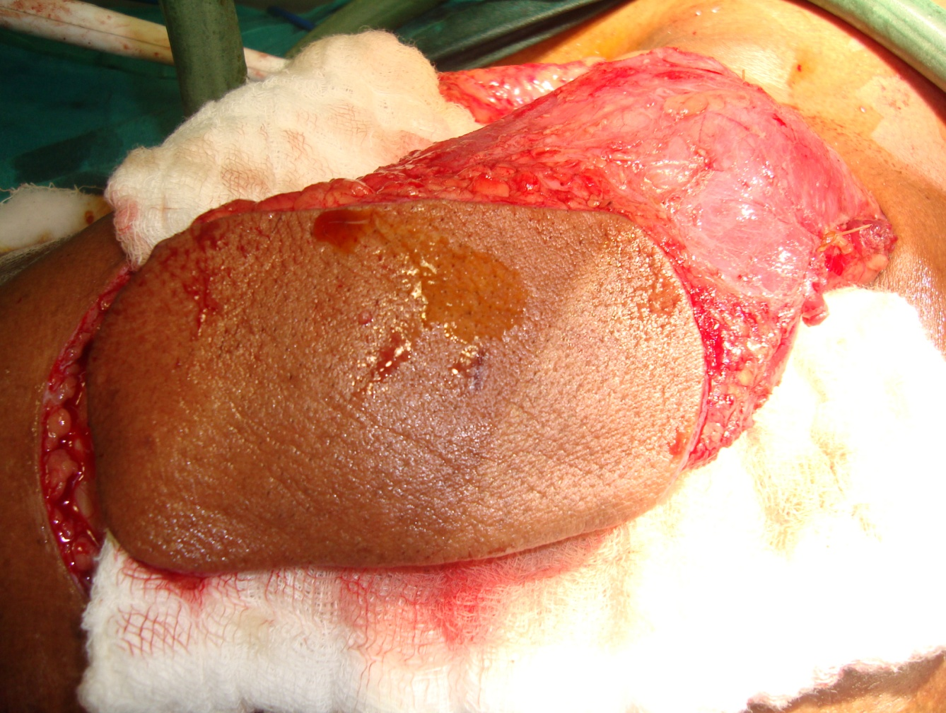
THANK YOU…

