Slide 1
Temporoparietal fascia flap
Dr. Sanjay Vaghani
Assistant Professor
Department of Plastic Surgery, SBKSMI & RC

Slide 2
HISTORY
In 1898 at the end of the nineteenth century, Monks, Golovine, and Brown separately reported cases in which the temporoparietal fascia, based on the superficial temporal vessels, was used to repair eyelid and orbital defects and to perform auricular reconstruction.

Slide 3
Definition
The TPGF is pedicled on the superficial temporal vessels and is a component of the subcutaneous musculoaponeurotic system (SMAS)
The TPGF is the only single layered fascial flap that can be transposed into the craniofacial and head and neck region on its vascular pedicle

Slide 4
The fascial TPGF is an ultrathin (2 to 4 mm), surgically single-layered, fibromuscular sheet with limited bulkiness and unique specific properties of
  high vascularity,
  pliability,
  flexibility,
  versatility.

Slide 5
These unique qualities allow the TPGF to drape around grafts and into problem cavities while maintaining its durability
As vascular liners with extreme pliability, they have the ability to adapt to the needs of hostile recipient sites, such as infected or irradiated nasomaxillary and orbital cavities

Slide 6
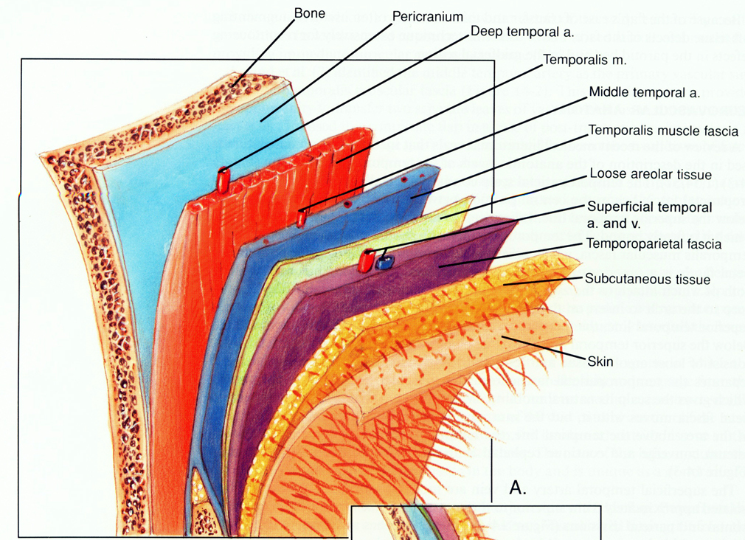


Slide 7

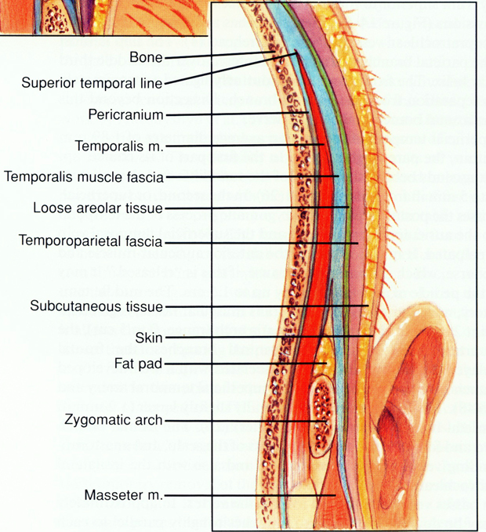

Slide 8
Anatomy
Temporoparietal fascia is extremely vascular and measures 2.5 to 4 mm in thickness in the parietal region. It contains more than 70% of the superficial temporal vessels irrigating the scalp, as well as the temporofrontal branch of the facial nerve and the auriculotemporal nerve

Slide 9
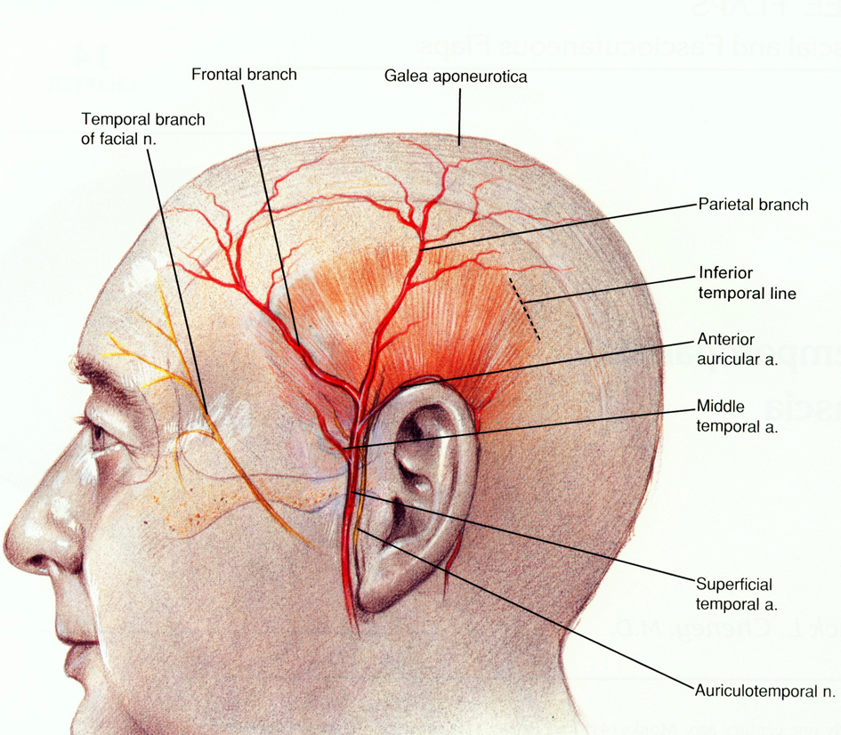
Anatomy

Slide 10
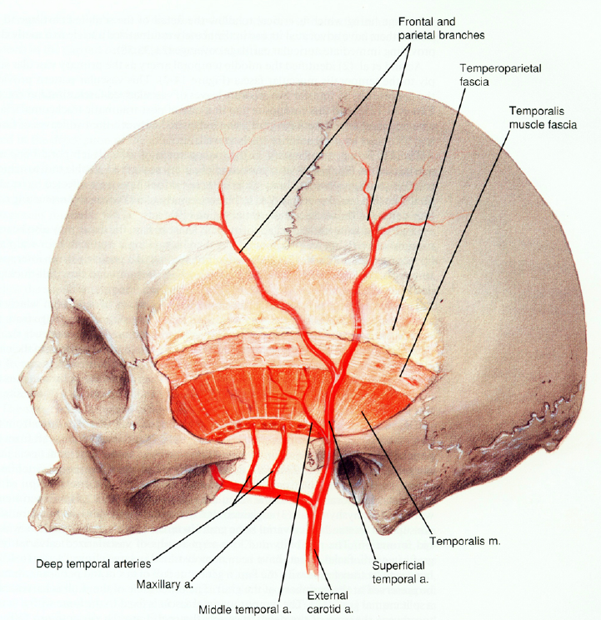

Slide 11
The superficial temporal artery
At the level of the ear, the superficial temporal artery arises from within the parotid gland at the level of the tragus where it perforates into the superficial temporalis fascia 5 mm in front of the tragus.
On the outside of the zygomatic process of the temporal bone, the middle temporal branch that supplies the temporal muscle fascia arises from the proximal superficial temporal artery

Slide 12
At about 2 to 4 cm above the zygomatic arch, it divides into the anterior or frontal and posterior or parietal terminal branches supplying all layers of the scalp
After running in the fascia for 10 cm, the superficial branches of the superficial temporal artery leave the temporoparietal fascia and take a more superficial course passing up into the subdermal plexus. At a level of about 12 cm above the anterosuperior auriculocephalic attachment, a subdermal dissection interrupts the blood supply.

Slide 13
The temporal and zygomatic branches of the facial nerve
This nerve innervates the frontalis muscle
Surgically, the nerve runs anterior from a line from the tragus to a point 3 cm above and 2 cm lateral to the side of the supraorbital rim.
This line represents the anterior safe line of dissection.
To avoid damage to the nerve, one can only dissect in the safe area posterior and superior to this line.

Slide 14
The auriculotemporal nerve, a sensory branch from the trigeminal nerve supplying the regional scalp skin, lies posterior to the superficial temporal artery in the temporoparietal fascia and travels through the temporoparietal fascia to reach the cutaneous level in the superior temporoparietal area.

Slide 15
Flap and its modifications
  Pedicled flap
  Free flap
  Fasciocutaneous flap
  Oseogaleal flap
    Taking parietal bone above the supratemporal line for reconstruction of osteoradionecrotic defects.

Slide 16
Indications
Defect reconstruction following tumor resection
  As a turndown flap, the TPGF resurfaces and creates a watertight seal following resection of the floor of mouth, the tongue, the retromolar area, and the lateral pharynx.

Slide 17
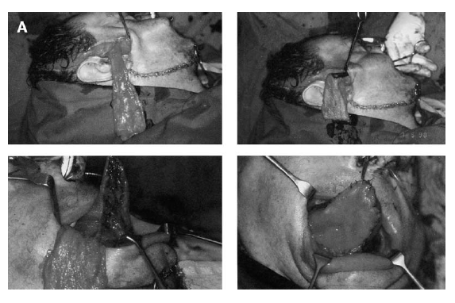
TPGF was easily transferred through a subcutaneous tunnel to cover a large tongue defect following tumor resection

Slide 18
Osseous craniomaxillofacial defects
  In orbitomaxillopalatal reconstruction, the TPGF transfer of vascularized calvarial bone or the combination of fascial cuffed calvarial free bone grafts was always required.
  useful when reconstructing contour defects of the midface and orbital region

Slide 19
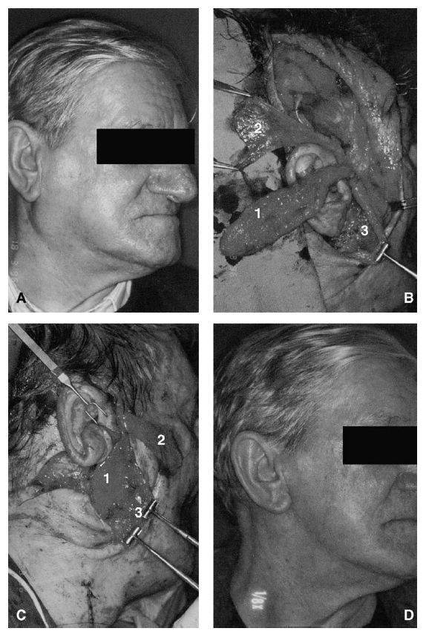
Prevention (therapy) of Frey’s syndrome
TPFF (1),
temporalis muscle fascia flap (2),
and SMAS– platysma flap (3).

Slide 20
Facial cosmetic reconstruction
Jaw, midface, and cheek augmentation secondary posttraumatic and postsurgical periorbital recontouring in conjunction with skin grafts
Because of the connection between the upper and outer layers of the temporoparietal fascia and the SMAS, plication of the temporoparietal fascia increases the tightness of the SMAS and pulls it in a superior direction

Slide 21
Because of the connection with the frontalis and orbicularis oculi muscles, plication of the temporoparietal fascia in the direction of the nasolabial fold provides additional lifting to decrease canthal wrinkles with elevation of the lateral brows

Slide 22
External ear reconstruction
In larger defects of the auricle and in microtia reconstruction, the native auricular cartilage or an autogenous costal cartilage framework was covered by a pedicled) TPGF.

Slide 23
Neurosurgical defect repair
Neurosurgical defect repair at the frontal bone, in the anterior and posterior fossa, and in the clivus region.

Slide 24
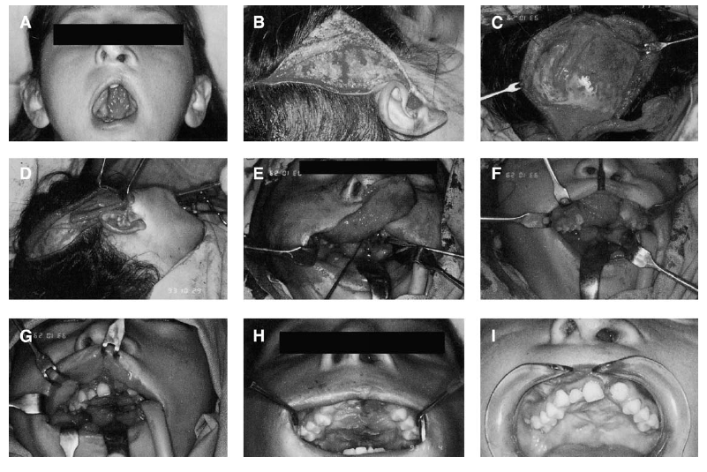
Congenital defect repair in cleft lip and palate

Slide 25
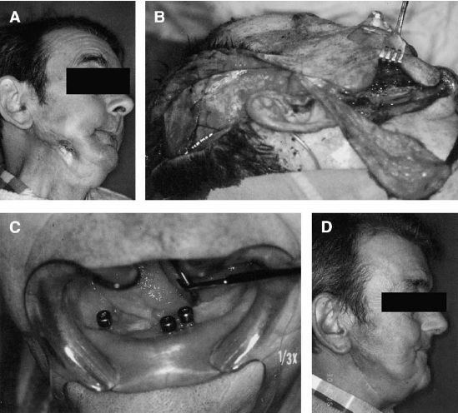
Osteoradionecrotic defect repair

Slide 26
Also used for
Exposed zygoma
Exposed mastoid process
Forehead reconstruction
Eyelid and orbital reconstruction

Slide 27
Relative disadvantages
Transient alopecia is the most common complication
Temporary or permanent paresis of the frontal branch of the facial nerve
Permanent paresthesia of the auriculotemporal nerve is possible

Slide 28
Preoperative assessment
Identification of the pedicle of the superficial temporal artery by palpation or Doppler ultrasonography and evaluation of the contralateral superficial temporal artery and the parietal branch in the absence of scars that could be a limitation of the flap’s volume are the most important preoperative tests to determine the reliability of the flap.
If osteofascial flaps are needed, the cranial bone thickness can be evaluated radiographically.

Slide 29

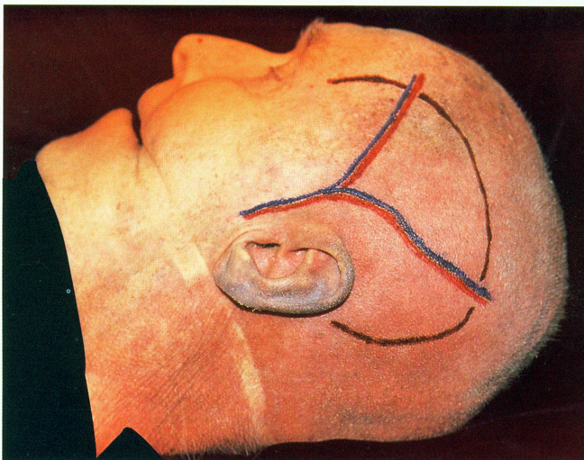

Slide 30
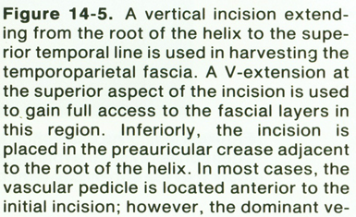
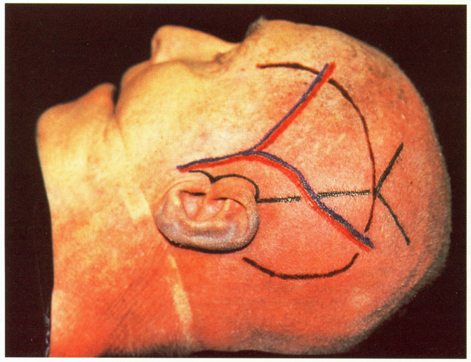

Slide 31
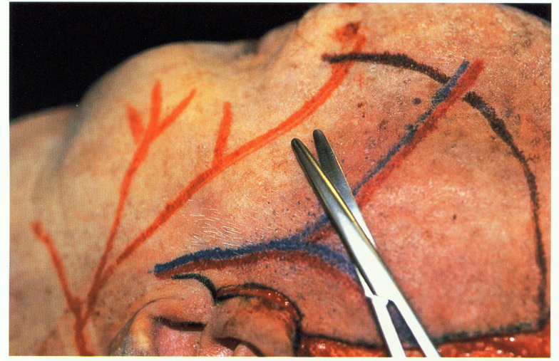


Slide 32
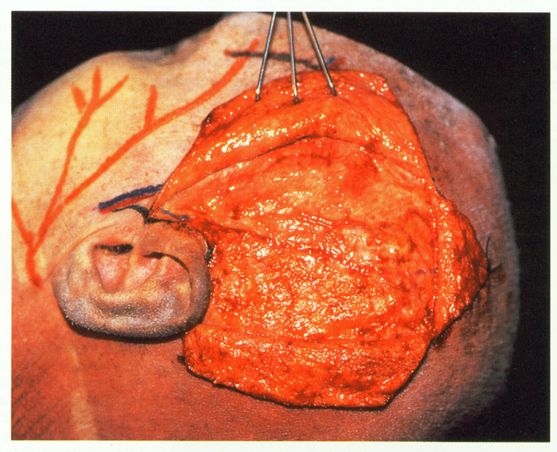


Slide 33
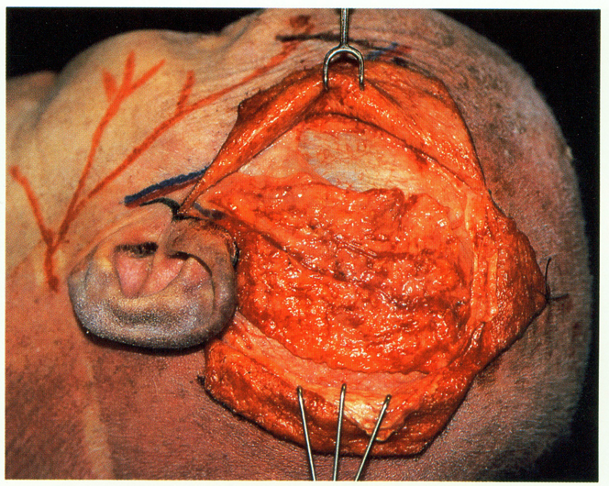
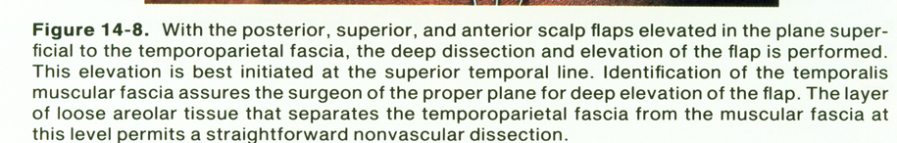

Slide 34
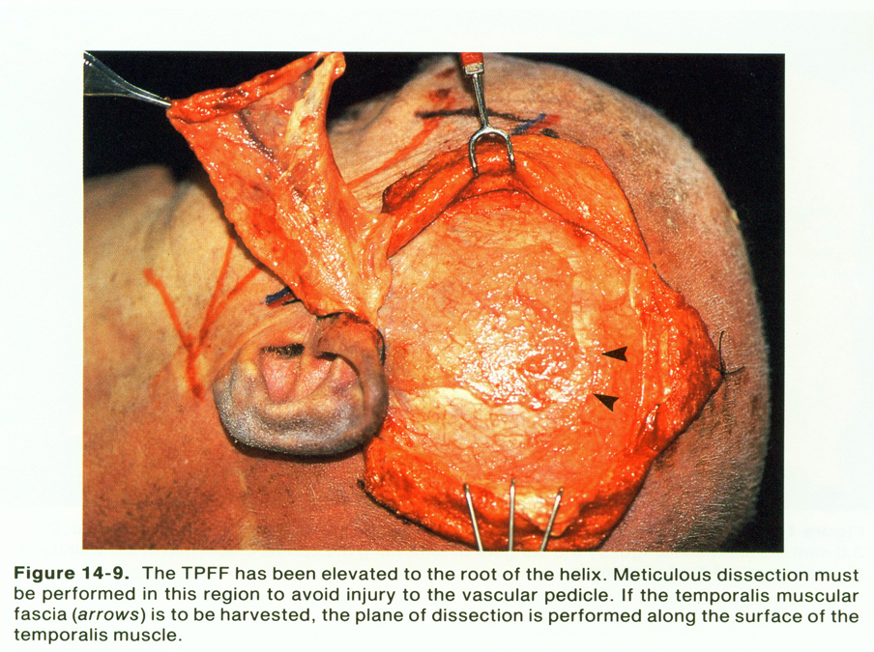

Slide 35
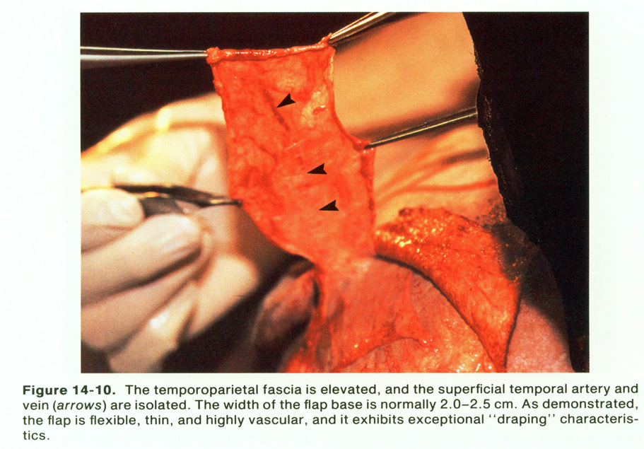

Slide 36
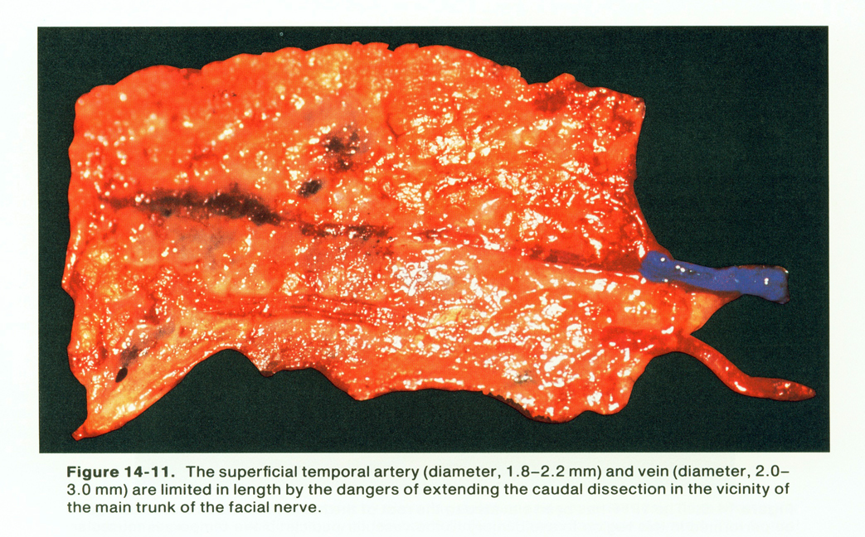

Slide 37
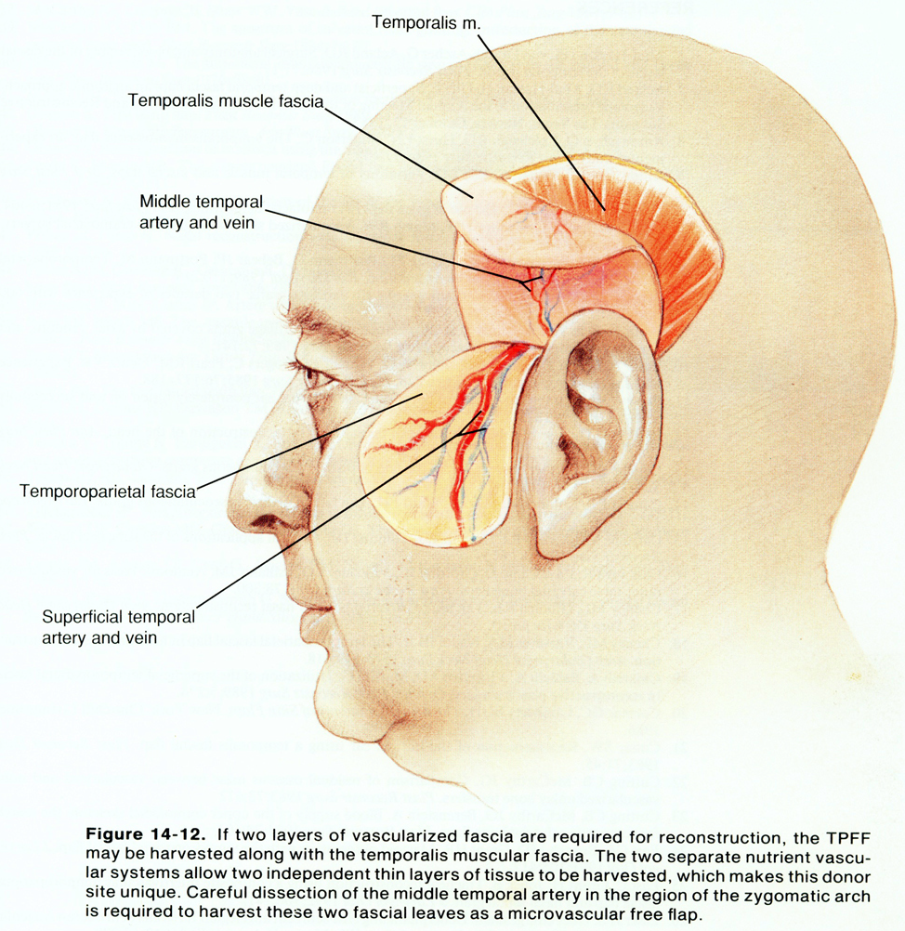

Slide 38
THANK YOU

