Slide 1

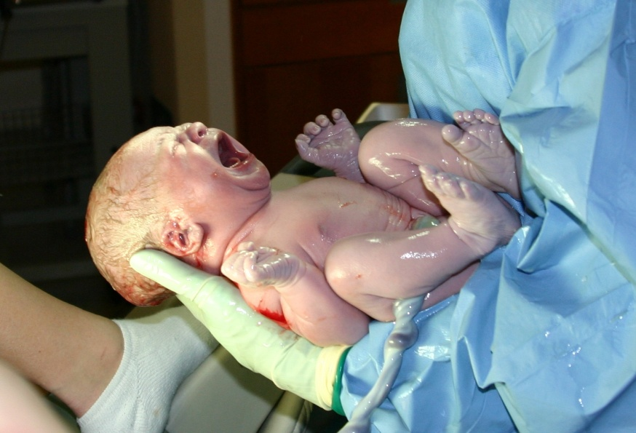
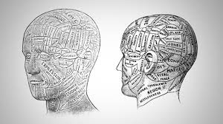



Presented By:
Rachana Joshi
Assistant Professor, Sumandeep Nursing College, SVDU
ORGANISATION OF A SPECIAL CARE NEONATAL UNIT
& NEONATAL TRANSPORT SERVICES

Slide 2
NEONATAL ICU
(NICU)
SOME BABIES NEED SPECIAL CARE
        If a child is premature or has health problems at birth, such as an infection, he may need to spend some time in a special area with facilities for special care….
…………… THE NICU

Slide 3
INTRODUCTION
Organisation of a good quality special care neonatal unit is essential for reducing the neonatal mortality and improving the quality of life among the survivors.
Intensive care of the newborn is highly cost intensive and demands input of staffs, equipment and time.

Slide 4
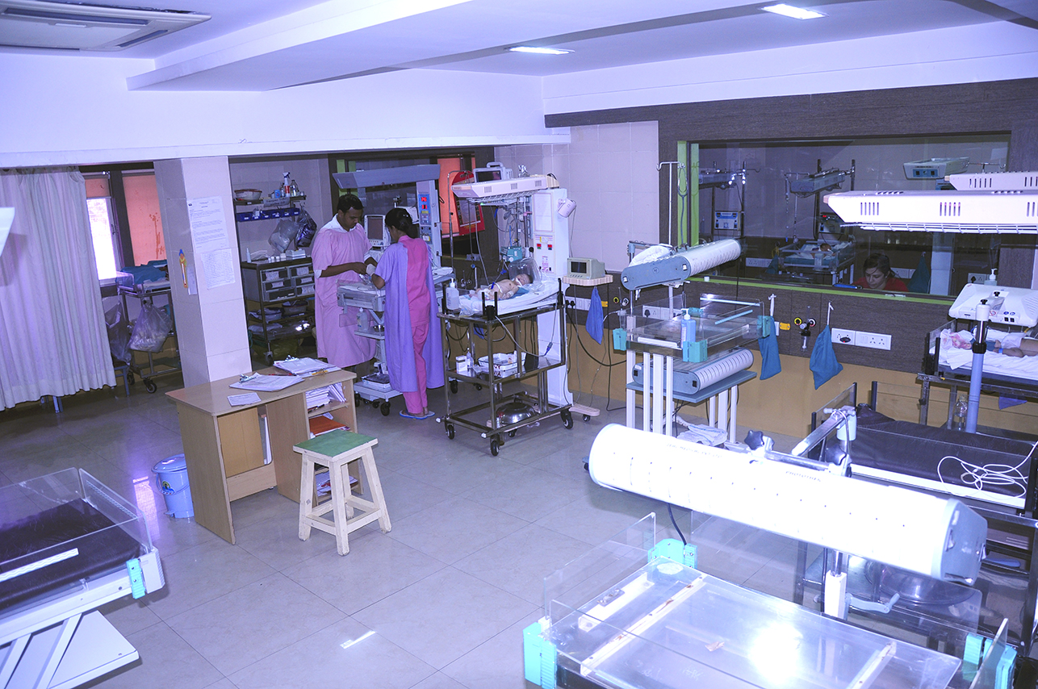
Delivery of Neonatal Care In India

Slide 5

WHY IS A NEED?

Slide 6

WE HAVE TO FOCUS……

Slide 7
LEVELS OF NICU:
LEVEL I (BASIC NEW BORN CARE)
Level III: (TERTIARY LEVEL)
LEVEL II (SPECIALITY NEW BORN CARE)

Slide 8

GOALS OF A NICU:
(a)To improve the clinical 'care of the critically sick neonates,
(b)To reduce the neonatal morbidity and mortality and
(c) Impart continuing in service of training personnel in the care of the newborn.

Slide 9
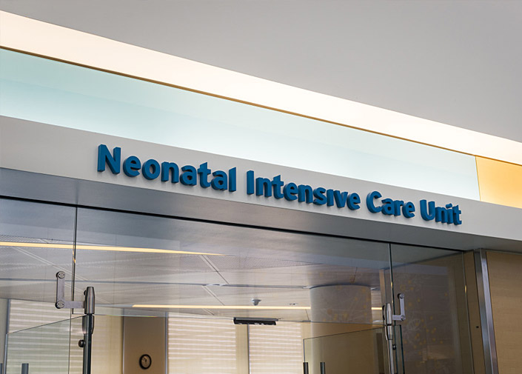
Neonatal intensive care unit :
Physical facilities

Slide 10
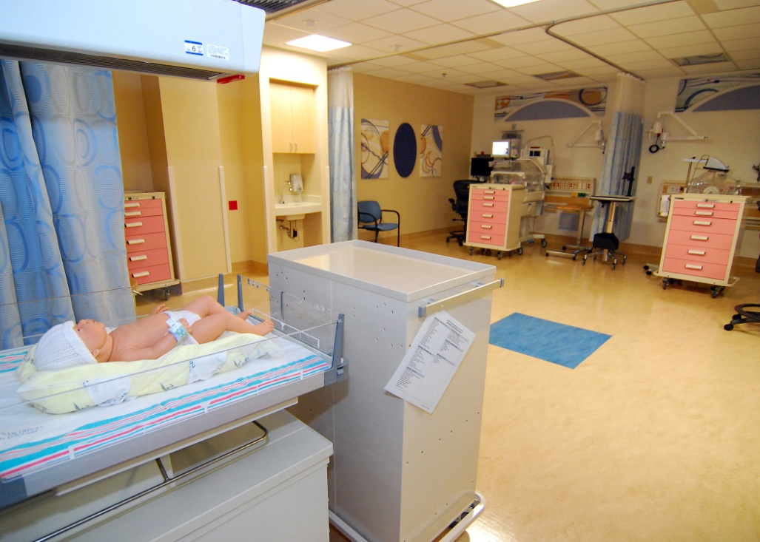
SPACE:

Slide 11
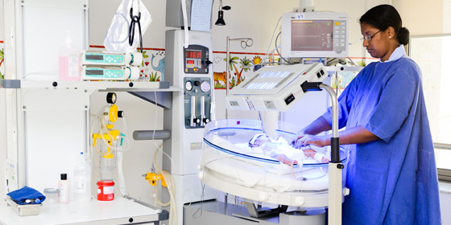

LOCATION:

Slide 12

FLOOR PLAN:

Slide 13
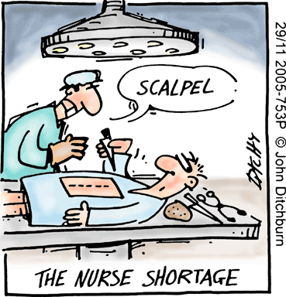
ELECTRICAL,GAS SUPPLY AND MECHANICAL NEEDS:

Slide 14

LIGHTNING:

Slide 15
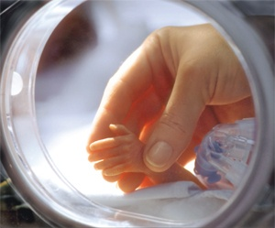
TEMPERATURE AND VENTILATION:

Slide 16
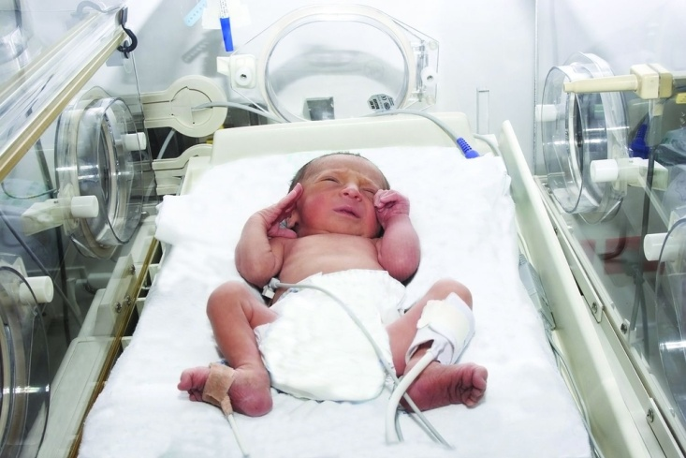
ACOUSTIC:

Slide 17


STAFFING:
Medical
Nurses
OTHER STAFFS:

Slide 18
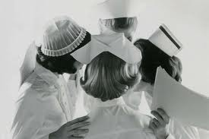
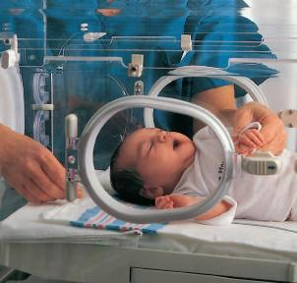

STANDARD OPERATING PROCEDURES (SOP) FOR NICU
INCUBATOR, WARMER & PHOTOTHERAPY CLEANING
AFTER DISCHARGE

Slide 19
ROLE OF NEONATAL NURSES:

Slide 20
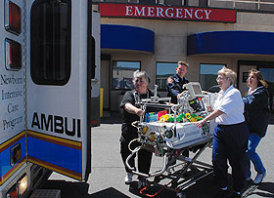
NEONATAL TRANSPORT SERVICES
Maintain good relationship
About 70% of all deliveries in India take place in rural areas and 90-95% of these are homes deliveries. According to an UNICEF report, trained medical personnel conduct only 33% of all births in India. The present system of referral and transport of mother or neonate is far from satisfactory.

Slide 21

Hierarchy of transport:-
Health worker at home visit
P.H.C.
F.R.U.
Medical College
Apex Institutions

Slide 22
ARRANGING TRANSPORT
Patients name and date of birth,
Mothers and fathers names,
Details on prenatal history,
Labour and delivery,
Neonatal resuscitation,
Apgar scores,
Gestational and birth weight,
Vital signs(temperature, heart rate, respiratory rate, and blood pressure)
Oxygen, ventilator support requirement

Slide 23
TRANSPORT TEAM:
Physician trained in neonatology or the neonatologist
neonatal nurse and
Paramedical staff trained in neonatology.
Relative of the baby.

Slide 24
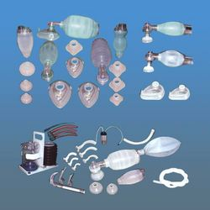
TRANSPORTATION KIT:
INTUBATION KIT:
EMERGENCY DRUGS
FLUIDS:

Slide 25
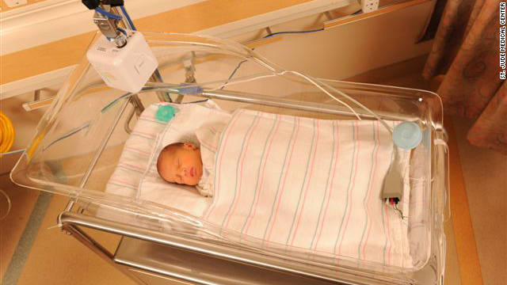
CARE DURING TRANSPORT:
ASSESSMENT
STABILIZATION OF THE NEONATE
WRITE A NOTE
ENCOURAGE MOTHER TO ACCOMPANY
COMMUNICATION
ARRANGE A PROVIDER TO ACCOMPANY

Slide 26
ASSESMENT AND STABILIZATION:
ENSURE WARM TRANSPORT:
make sure that the baby’s feet are warm to touch.
Warm feet means that the baby is neither hypothermic nor in cold stress.
If the baby passes urine or stool, wipe him He should not remain wet, otherwise he will lose heat.

Slide 27
TRANSPORT INCUBATORS:

Slide 28

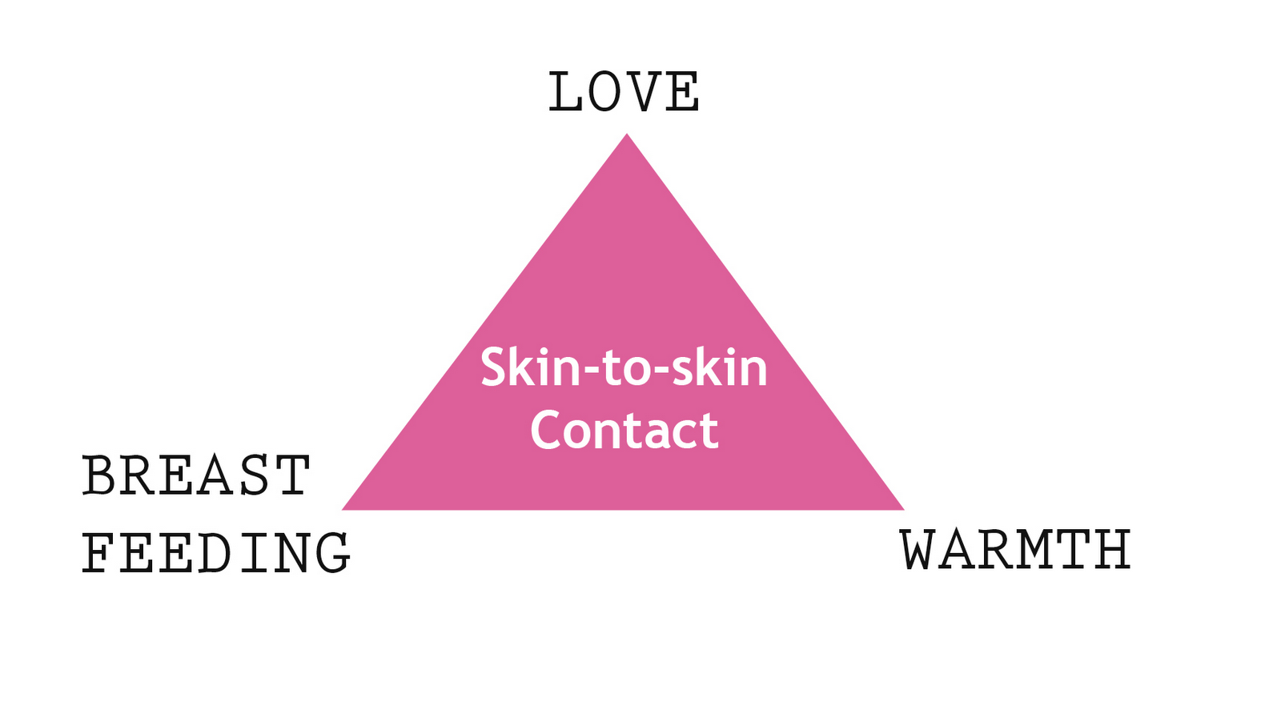

Slide 29
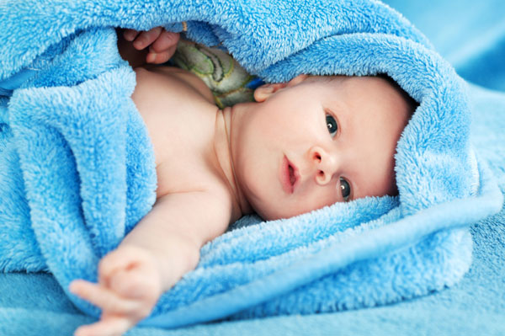
Cover the baby:
Cover the baby fully with clothes (or cotton) including the head and the limbs. Nurse the baby next to the mother or another adult during transport.

Slide 30
THERMOCOL BOX:
Thermocol box with hot water bottles can be used.
PADDED POUCH
BLISTER BUBBLE POLYTHENE SHEETS :
LIQUID PARAFFIN:
Can be applied to the neonates skin to reduce insensible water losses by 40-60
Ensure an open airway:
Check breathing :
Watch baby’s breathing. If the baby stops breathing, provide tactile stimulation to the soles to restore it.
Provide feeds :

Slide 31

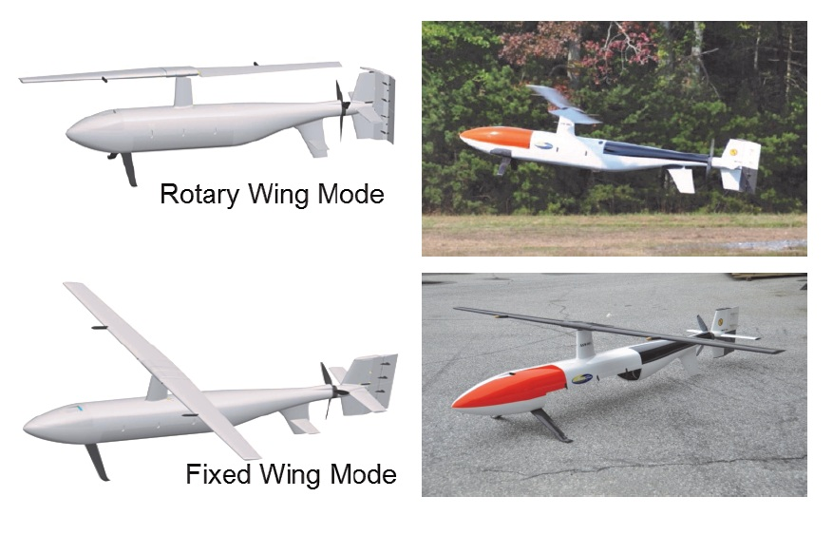
TYPES OF TRANSPORTATION
Ground ambulance :
Rotor-wing aircraft (helicopter) transport
Fixed-wing aircraft (airplane) transport:

Slide 32
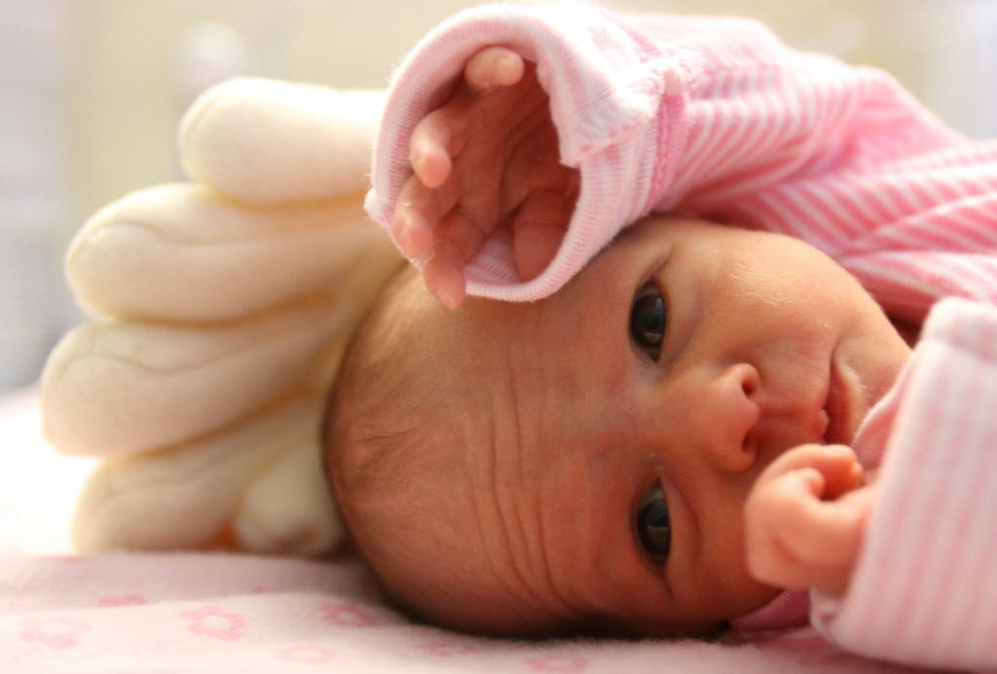
Problems in transporting a neonate:-

Slide 33

ASSIGNMENT
Write the Advantage and Disadvantage of: System of Levels of care and Transportation, in your own words.

Slide 34
Questions:
What you mean by level 3 care in NICU.
State your Roles in Level 3 care..?

Slide 35
Is physical facilities are important in Hospital setting?

Slide 36
How can a Nurse develop a good Transportation services…?

Slide 37
State the Types of Transportation?

Slide 38
Conclusion
A neonate may be transported within the hospital between departments, i.e. Between labour ward and the neonatal icu, between the neonatal icu and any other department within the same hospital or between hospitals for further specialized management. Principles of safe transport are team composition, communication, preparation / planning, stabilization, documentation, prepare for worst case scenario, maintenance of equipment & safe delivery of the patient.

Slide 39




