Slide 1


FETAL ASSESSMENT DURING PREGNANCY
Presented By:
Rachana Joshi,
Assistant Professor, Sumandeep Nursing College, SVDU

Slide 2
INTRODUCTION
Fetal assessment during pregnancy is an essential part of the antenatal period for identifying the markers of the well being of the fetus to rule out any abnormality for the termination of the pregnancy if needed as well as the mother is able to obtain a considerable amount of information about the unborn fetus.

Slide 3
PARAMETERS OF FETAL ASSESSMENT
ULTRASOUND
BIOPHYSICAL PROFILE
CARDIOTOMOGRAPHY
CONTRACTION STRESS TEST
NON-STRESS TEST
AMNIOSCOPY
FETOSCOPY
RADIOLOGICAL EXAMINATION

Slide 4
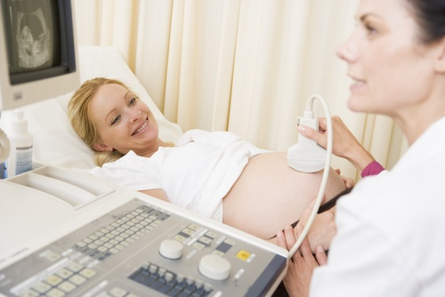
ULTRASOUND
Ultrasound is a technique that involves the use of high-frequency sound waves. Sound waves that are undetectable to human ear.

Slide 5
WHY IS AN ULTRASOUND DONE?
Assess the pregnant client, developing fetus, or both.
Visualize internal maternal and fetal structures.
Guide other diagnostic procedures.

Slide 6
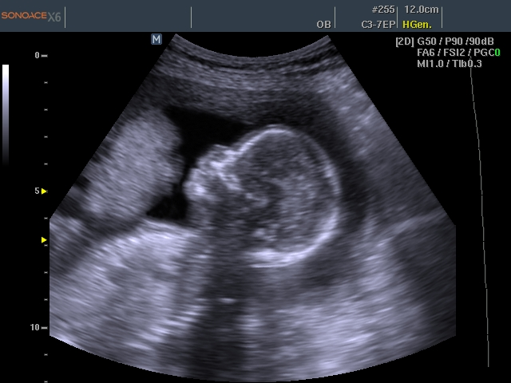
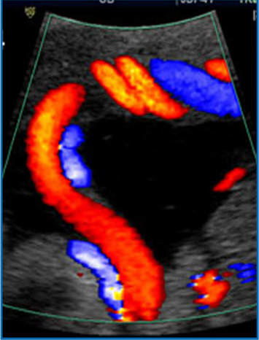
OBSTETRICAL ULTRASOUND
PULSE ECHO IMAGING
Dopper ultrasound

Slide 7
Pulse echo imaging
Pulse echo images give a “still” image in the same way that a photograph freezes a moment in time.
Doppler ultrasound
Doppler ultrasound is a non-invasive test that can be used to measure the blood flow and blood pressure by bouncing high-frequency sound waves off circulating red blood cells.

Slide 8
Uses:
Monitoring the fetal heart rate, which can be picked up as early as 10th week of gestation.
Uterine and fetal blood flow can be assessed.
Fetus at risk of compromise could be diagnosed by noting the absence of hissing sound of blood flow through the veins.

Slide 9
TYPES OF ULTRASOUND
TRANSVAGINAL ULTRASOUND
TRANSRECTAL ULTRASOUND
TRANSESOPHAGEAL ECHOCARDIOGRAM
DOPPLER
BONE SONOGRAPHY
ECHOCARDIOGRAM
3D IMAGES
4D IMAGES

Slide 10
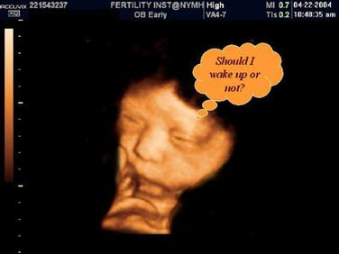
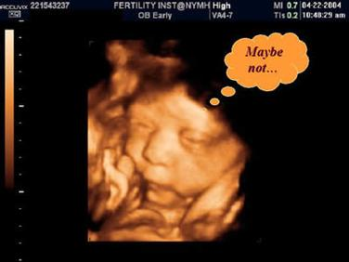
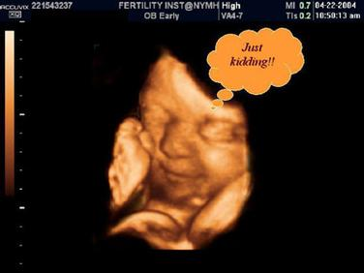
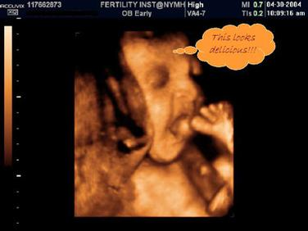
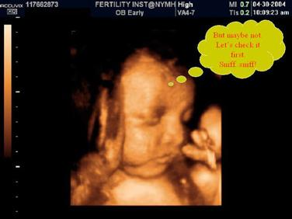
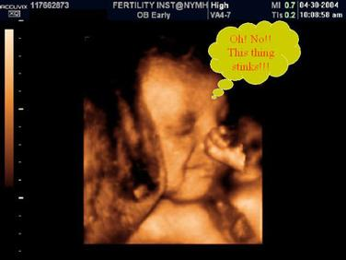
3D AND 4D IMAGES

Slide 11
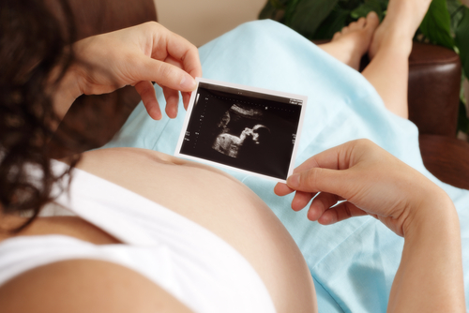
INDICATION OF OBSTETRIC ULTRASOUND

Slide 12
FETAL
Diagnosis of pregnancy.
Assessment of gestational age.
Diagnosis of multiple pregnancy.
Diagnosis of IUFD
Detection of anomaly.
Assessment of growth.
Assessment of well being (biophysical profile).
Diagnosis of presentation (breech).
Diagnosis of ectopic pregnancy.

Slide 13
UTERO PLACENTAL
Localization of placenta.
Diagnosis of abruption placenta.
Diagnosis of molar pregnancy.
Diagnosis of uterine malformation.
Assessment of liquor volume.
Uterine size either > dates or < dates.
Diagnosis of cervical incompetence.

Slide 14
MATERNAL
Pelvic mass diagnosis and follow up.
Amniocentesis
Chorionic villus sampling.
Cordocentesis
Fetoscopy.

Slide 15
FIRST TRIMESTER PREGNANCY SCANS

Slide 16
PREGANACY IS VIABLE & INTRAUTERINE
GESTATIONAL AGE
FETAL NUMBER
DETECTION OF GROSS FETAL ABNORMALITIES, SUCH AS ANENCEPHALY

Slide 17
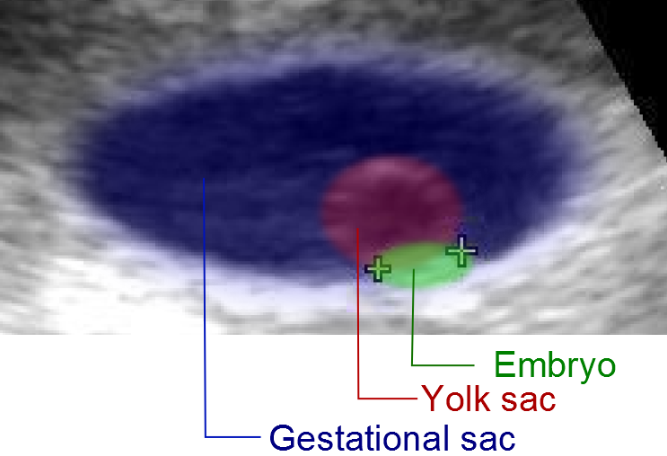
ULTRASOUND OF EMBRYO AT 5 WEEKS

Slide 18
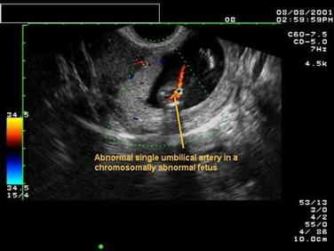
ANOMALY DETECTED

Slide 19
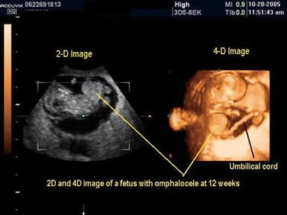
  OMPHALOCELE

Slide 20
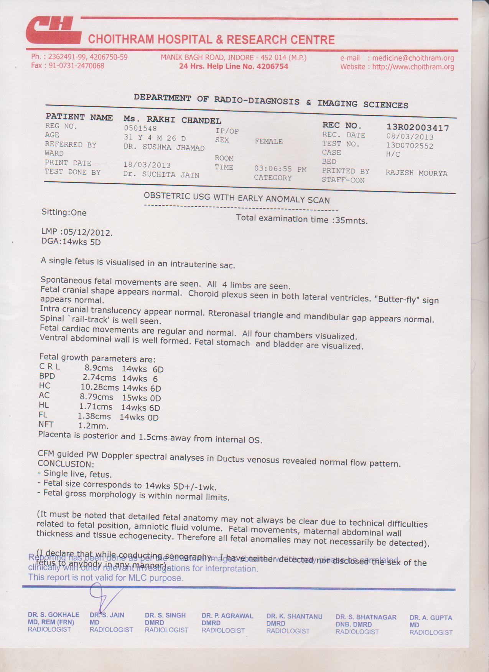

Slide 21
SECOND TRIMESTER ULTRASOUND
targeted fetal scan

Slide 22
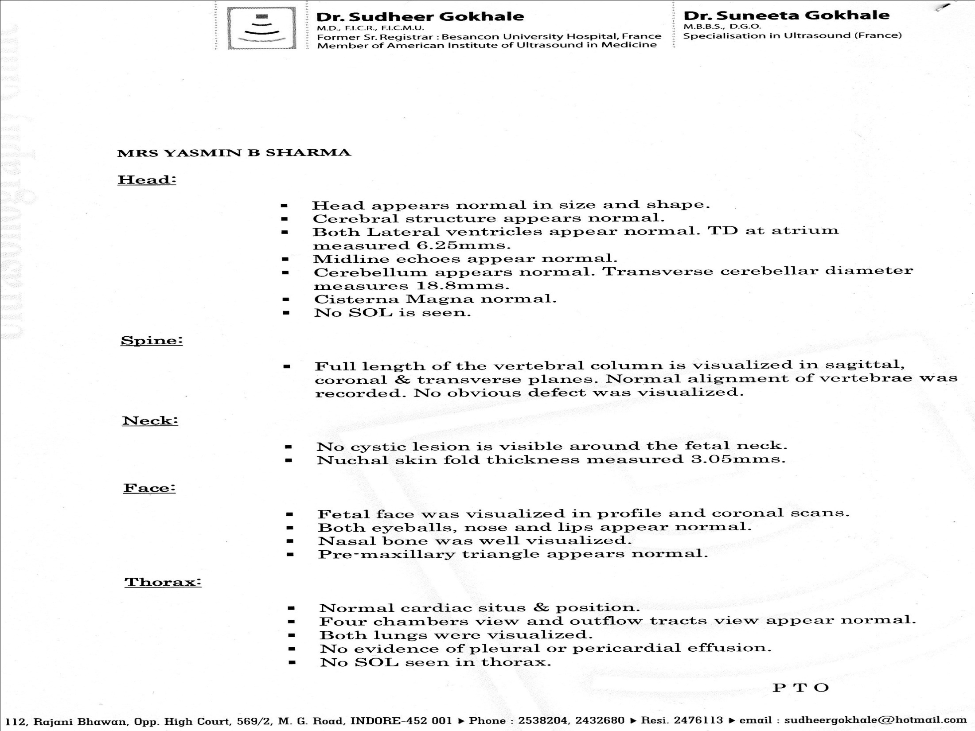

Slide 23


Slide 24
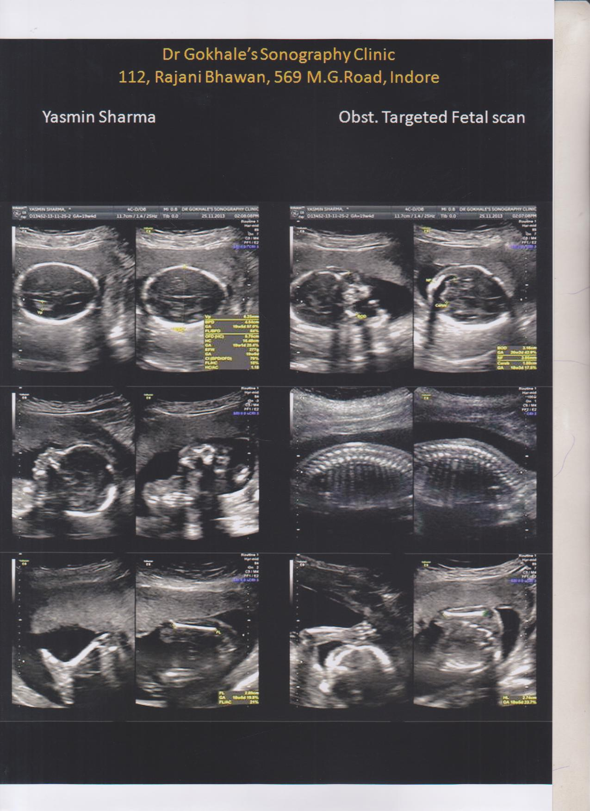

Slide 25
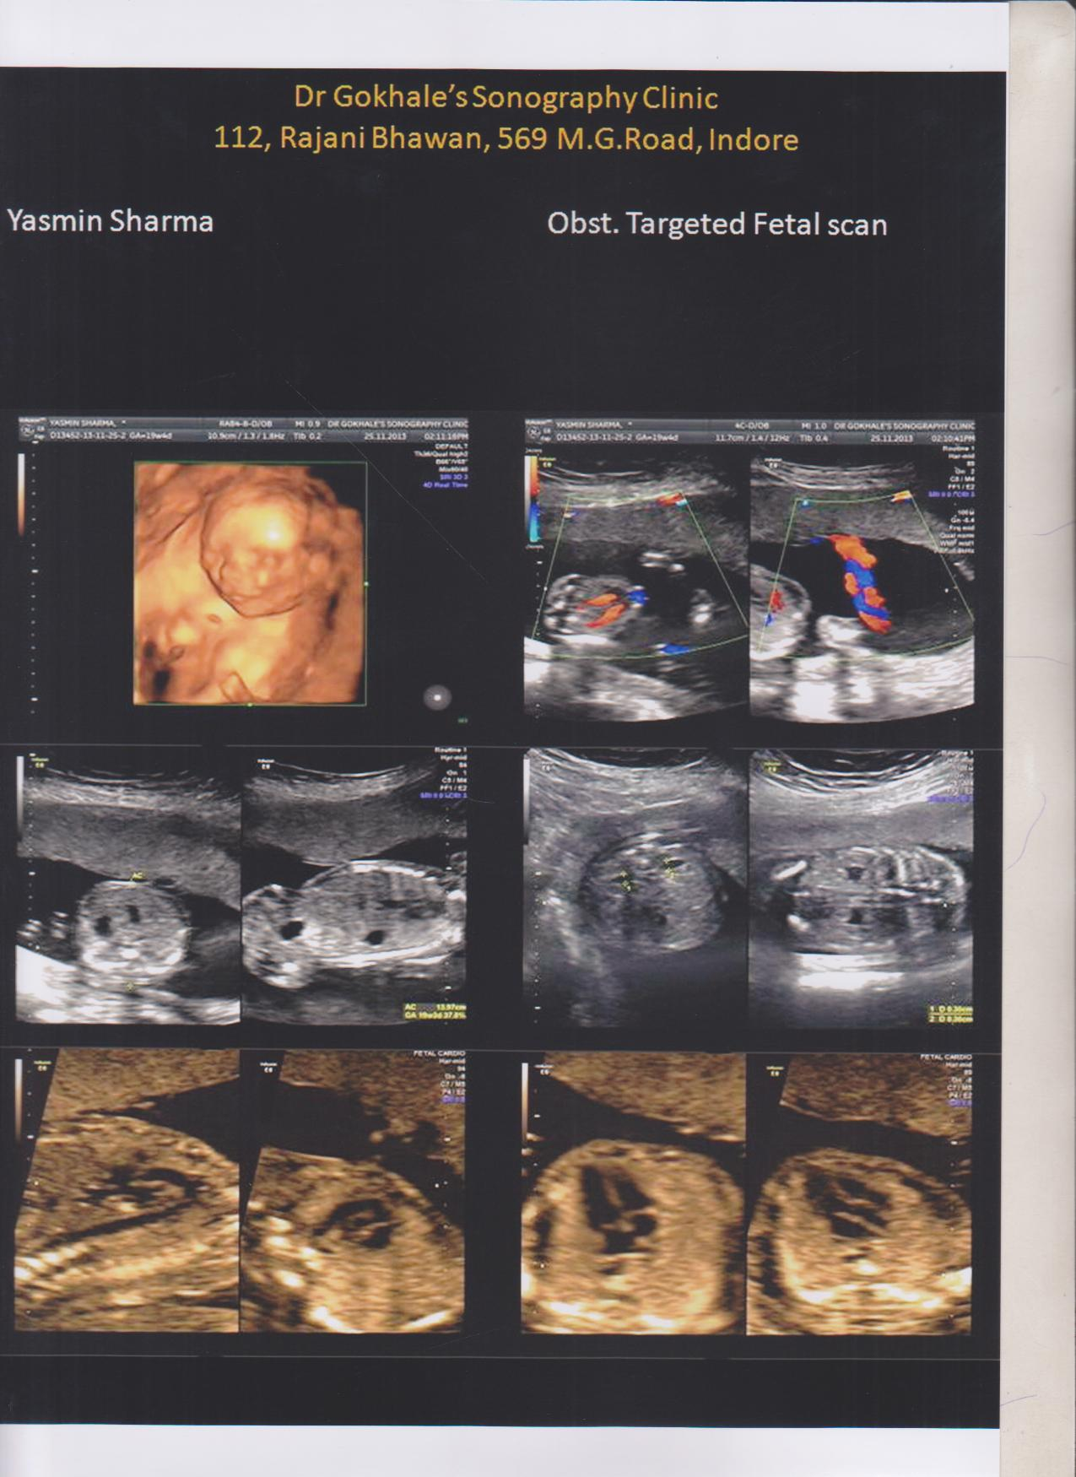

Slide 26
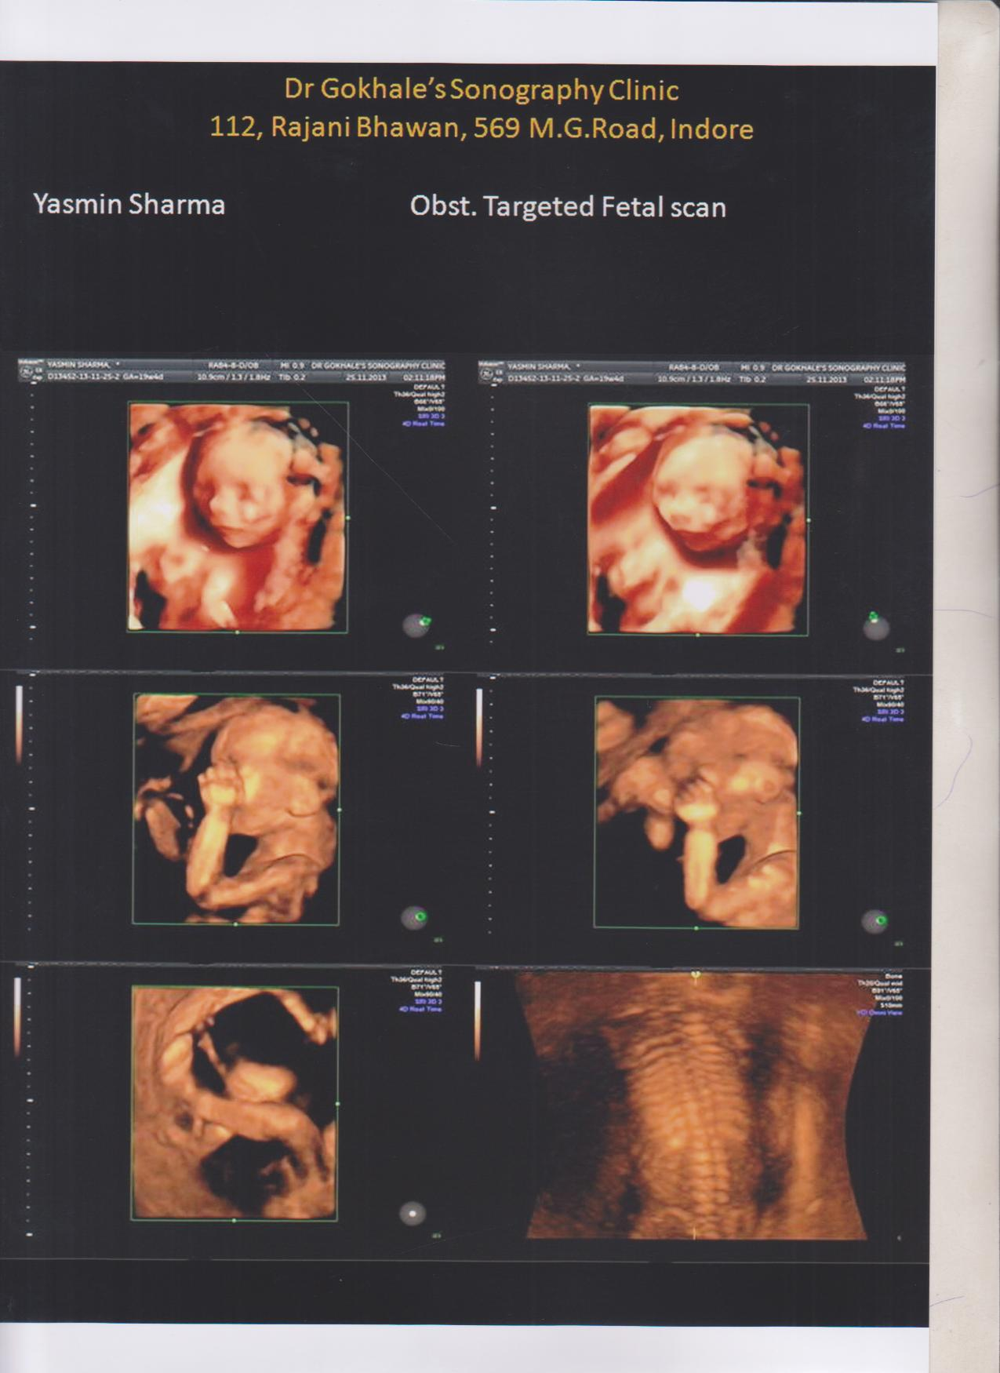

Slide 27
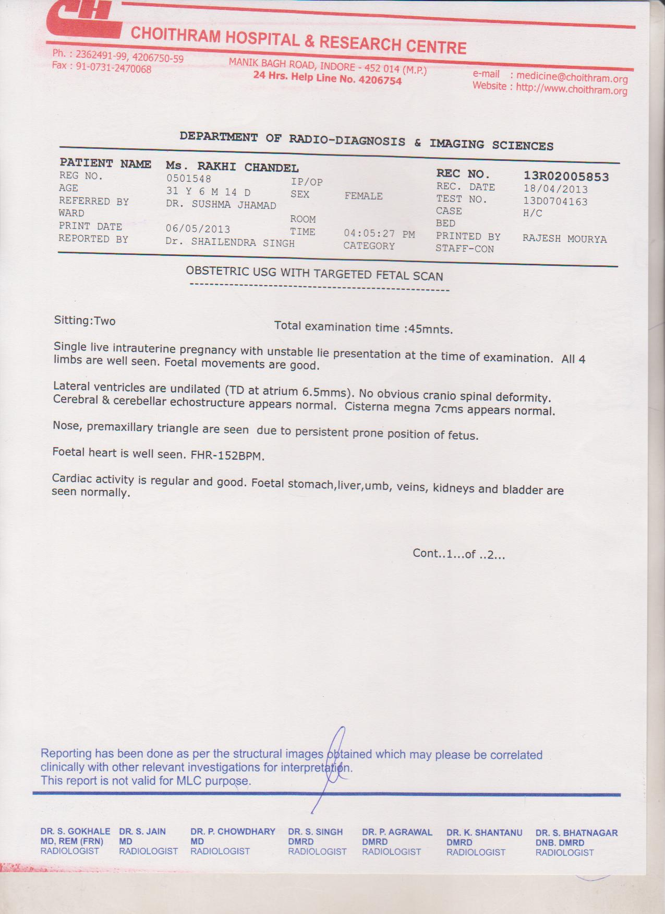

Slide 28
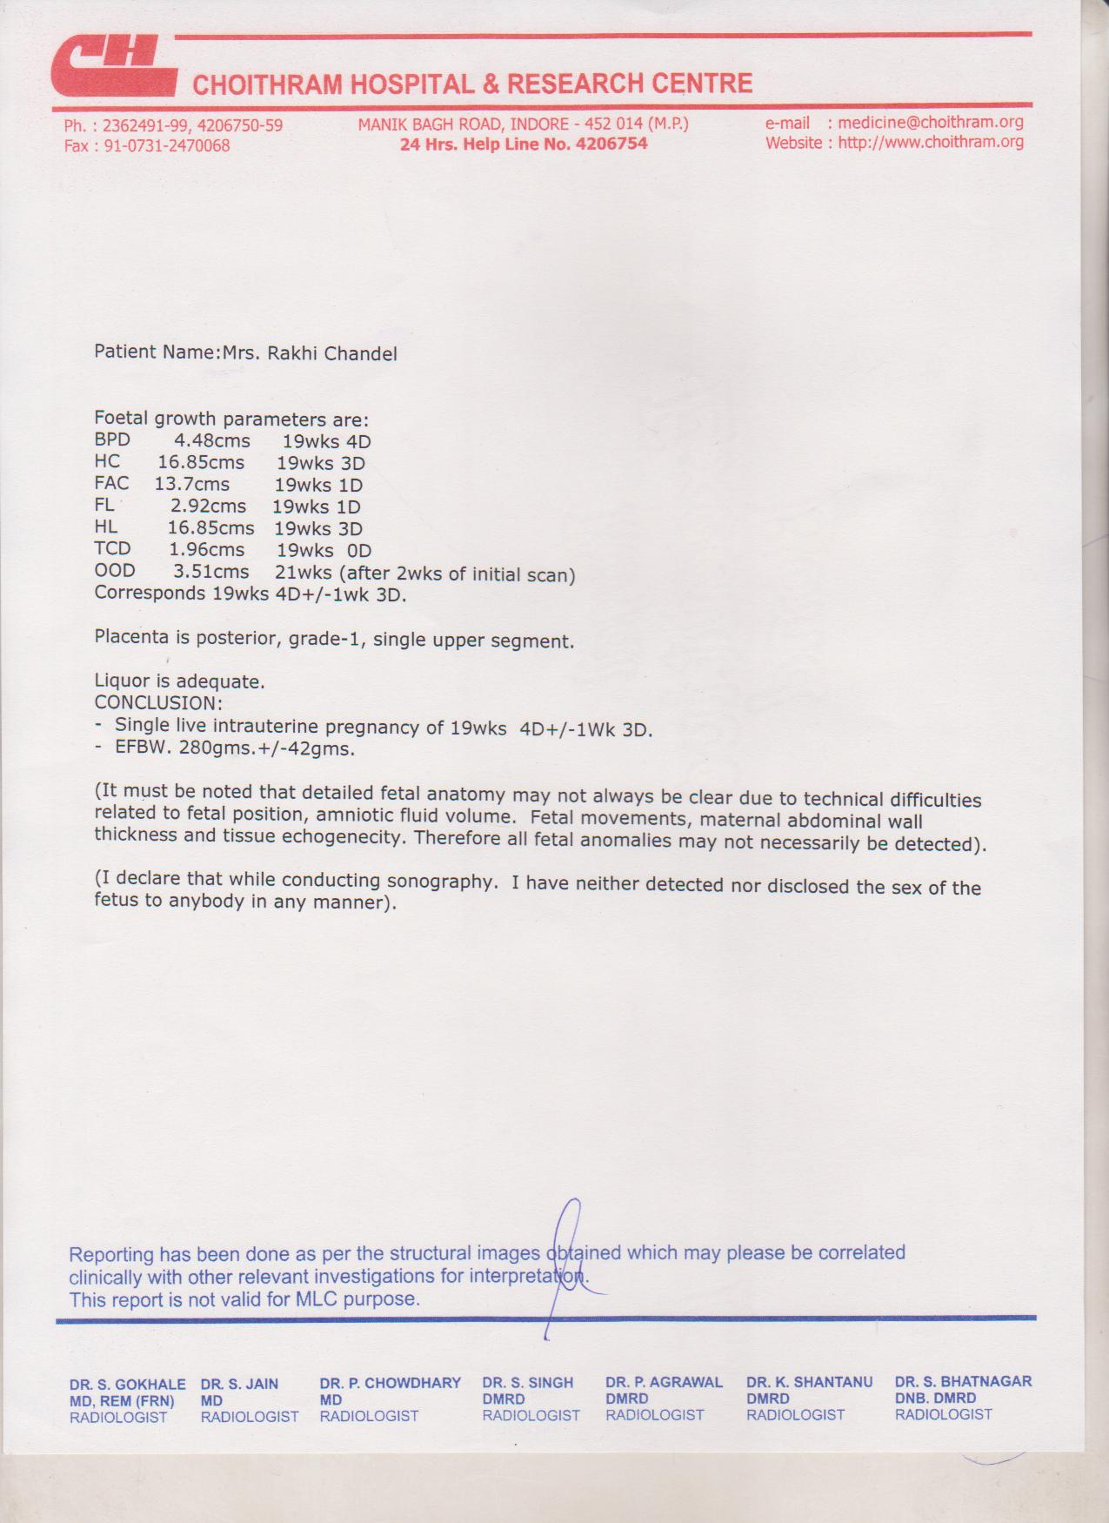

Slide 29
THIRD TRIMESTER ULTRASOUND SCANS

Slide 30
Dwarfism is diagnosed in this trimester.
Estimated fetal weight (EFW)
Fetal growth parameters.
All information of second trimester sonography can be obtained in the third trimester.

Slide 31
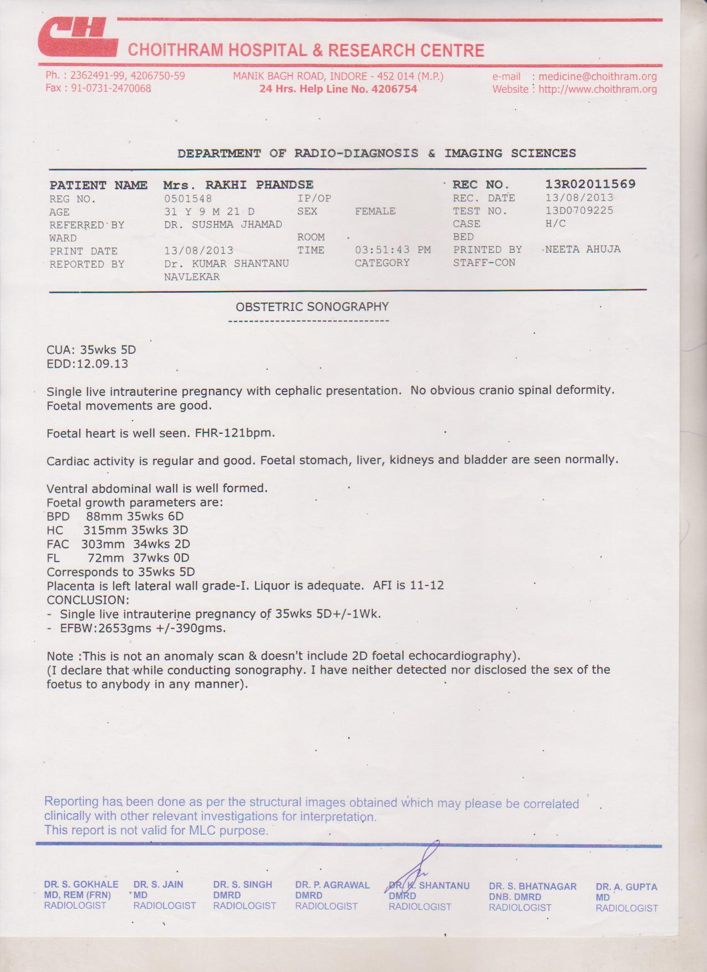

Slide 32


Slide 33
HOW MANY ULTRASOUNDS DOES A ANTENATAL WOMEN REQUIRE?
INITIALLY TO DIAGNOSE A PREGNANCY
FIRST TRIMESTER
SECOND TIMESTER (TARGET SCANNING)
THIRD TRIMESTER

Slide 34


Slide 36
BIO-PHYSICAL PROFILE
Bio-physical profile is a screening test for utero-placental insufficiency. The fetal bio-physical activities are initiated, modulated and regulated through fetal nervous system.

Slide 37
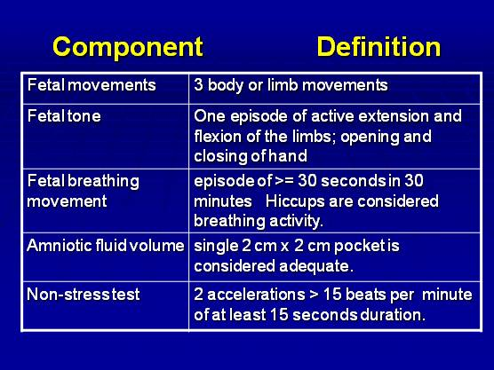

Slide 38
AMNIOTIC FLUID VOLUME
<2CM SUGGEST IUGR
AFI BETWEEN 5 -25 CM IS NORMAL
AFI > 5 INDICATES OLIGOHYDRAMNIOS
AFI < 20-24 CONSIDERED AS POLYHYDRAMNIOS

Slide 39
BPP SCORE
BPP normally is not performed before the 2nd half of a pregnancy, since fetal breathing movements do not occur in the first half.
assessment is graded either 0 or 2 points.
And then added up to yield a number between 0 and 10.
A BPP of 8 or 10 is generally considered reassuring.

Slide 40
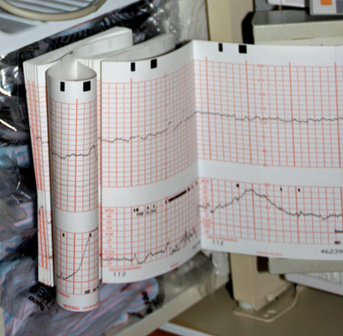
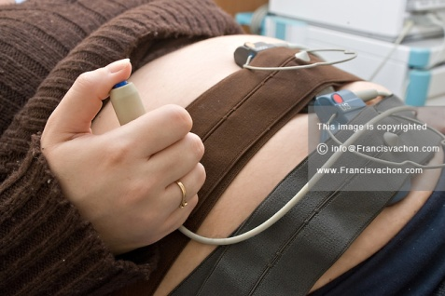
CARDIOTOCOGRAPHY
CTG IS DONE AFTER 32 WEEKS , WHICH SHOWS AN BASE LINE GEART RATE OF 110-115 bpm .

Slide 41
INDICATIONS
To identify the baseline rates.
To identify the baseline variability.
To see the accelerations.
To see the presence or absence of decelerations.
Labour in high risk pregnancy
Labour complications- cord compression or stretching uterine hypertonicity.

Slide 42
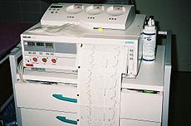
EXTERNAL CARDIOTOCOGRAPHY

Slide 43
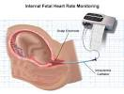
INTERNAL CARDIOTOCOGRAPHY
INTERNAL CTG IS DONE BY PICKING UP THE FETAL HEART RATE FROM AN ECG IS PICKED UP BY CLIPPING AN ELECTRODE ON FETAL PRESENTATION (VERTEX OR BUTTOCKS) BY PLACING INTRA UTERINE CATH IN HINDWATER WHICH REFLECTS INTRAUTERINE PRESSURE CHANGES.

Slide 44
WHEN IS CTG DONE?
ON ADMISSION ASSESSMENT FOR 20 MINUTES
INTERMITTENT ASSESSMENT 4 HOURLY
CONTINEOUS ASSESSMENT TO GET GROSSLY ABNORMAL TRACES FOR IMMEDIATE DELIVERY.

Slide 45
INTERPRETATION
Identify the baseline rates.
Identify the baseline variability.
See the accelerations.
See the presence or absence of decelerations.

Slide 46
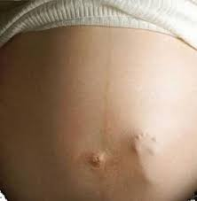
DAILY FETAL MOVEMENT COUNT (DFMC)

Slide 47
CARDIFF COUNTS 10 FORMULA
INSTRUCT THE PATIENT TO COUNT THE FETAL MOVEMENTS FOR 12 HOURS.
SHE SHOULD BE ALERT IF >10 MOVEMENTS OCCUR DURING 12 HOURS ON 2 SUCCESSIVE DAYS.
NO MOVEMENT IS PERCEIVED EVEN AFTER 12 HOURS IN SINGLE DAY.

Slide 48
DAILY FETAL MOVEMENT COUNT
Three counts each of one hour duration are recommended.
The total counts multiplied by four gives daily 12 hour DFMC.
If the number of Kicks to less than 10 in 12 hours (or less than 3 in each hour), it indicates fetal compromise.

Slide 49
INTERPRETATION
Foetal movement ceases at least 12 hours prior to fetal death.
Fetal movements can be either kicks from limb or rolling movement of fetal trunk and limb at intervals.
This is an subjective record, thus its accuracy is variable.

Slide 50
FOETOSCOPY
FOETOSCOPY IS AN ENDOSCOPIC VISUALIZATION OF THE FETUS.
OPTIMUM TIME IS 18-20 WEEKS.

Slide 51
INDICATIONS
Evaluate the fetus for birth defects such as spina bifida as well as other defects.
To collect the samples from the umbilical cord.
Collect samples from the fetus body to test some inherited diseases.

Slide 52

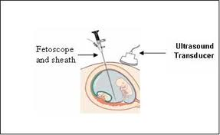
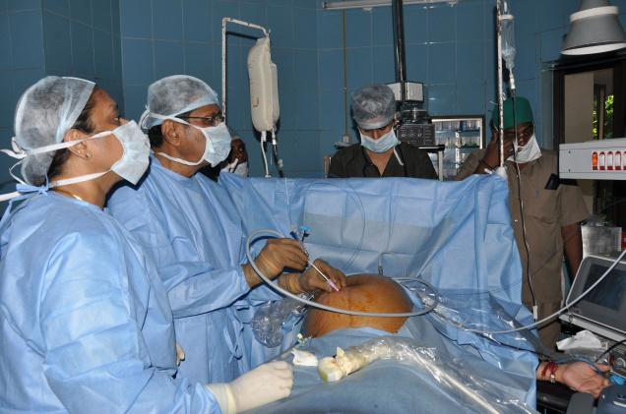
An imaging technique in which a ultrasound-guided, 3 mm in diameter needle with an endoscope is inserted through the abdominal wall into the uterus to view a living fetus, fetoscopy can be performed in the 2nd and 3rd trimesters of pregnancy.

Slide 54
RISK
Misscariage.
Excessive bleeding.
Premature rupture of membrane.
Mixing your blood with the fetus blood.

Slide 55
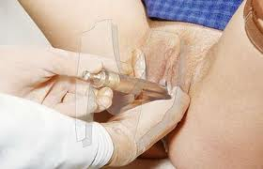
AMNIOSCOPY
Examination of the amniotic cavity and fetus using an optical instrument that is inserted directly into the amniotic cavity.

Slide 56
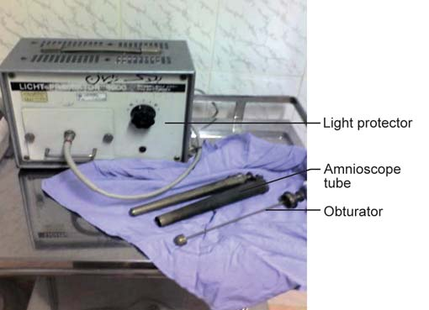
Interpretation
Amnioscopy as a simple method for assessing the colour and volume of the amniotic fluid through the intact fetal membranes.

Slide 57
NON-STRESS TEST
The non stress test monitors the fetal heart rate in response to fetal movement in order to assess fetal well-being.

Slide 58
ADVANTAGES
It has the advantage of involving no external stimulation (e.g., oxytocin stimulation) in the conduct of the test.
It can be done for the women for whom the CST might be contraindicated.
The other advantage is that its simplicity and absence of risk factors allow it to be done in an outpatient setting.

Slide 59
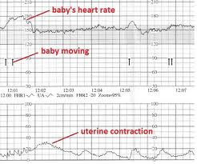

Slide 60
REACTIVE TEST
This is evidenced by fetal heart rate acceleration of 15 beats per minute above the baseline lasting for 15-30 seconds in association with fetal movement. Two or more occurances of this acceleration pattern within a 10-minute period or five or more accelerations within a 20-minnute period are considered normal. A normal fetus near term will also evidence a baseline fetal heart rate between 120 and 160 beats per minute, variability between 10 and 25 beats per minute and no deceleration of any type.

Slide 61
NON-REACTIVE TEST
A non-reactive test is one in which there is a persistent decreased variability with an absence of accelerations in fetal heart rate in response to fetal movement. This is evidenced by fetal heart rate accelerations of less than 15 beats per minute above the baseline or lasting less than 15 seconds in association with fetal movement.

Slide 62
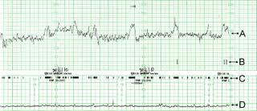
NON-REACTIVE TEST

Slide 63
CONTRACTION STRESS TEST
A contraction stress test (CST) is performed near the end of pregnancy to determine how well the fetus will cope with the contractions of childbirth. The aim is to induce contractions and monitor the FETUS to check for heart rate abnormalities using a CTG.

Slide 64
PROCEDURE
A womens bladder should be empty (to promote comfort and avoid disruption) and she should be in either a semi fowler’s or left lateral position(to avoid supine hypotensive syndrome). Her blood pressure should be checked to obtain a baseline recording.

Slide 65
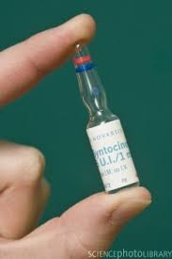
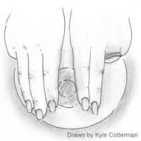
METHODS OF INDUCING CONTRACTION
OXYTOCIN STIMULATION TEST
NIPPLE STIMULATOION TEST

Slide 66
CONDITIONS IN WHICH CST IS FAVOURED
Postmaturity-suspected or actual
Intrauterine growth retardation as suspected by small for gestational age fetus
History of previous still birth
Meconium stained
Hypertension, diabetes,hyperthyroidism
Chronic renal and lung disease.

Slide 67
CONTRAINDICATIONS
Premature birth
Placenta praevia
Cervical incompetence
Multiple gestation
Previous classic caesarian section.

Slide 68
INTERPRETATION
It helps the physician in selecting the optimal time for delivery of a high-risk fetus.

Slide 69

RADIOLOGICAL EXAMINATION

Slide 70
CONCLUSION
The mother is an ideal first line screening test both for high risk and low risk patients. A healthy fetus can be delivered by the proper assessment of its well-being during the early and late antenatal period. Newer technologies and diagnosis of the fetal anomaly can be a very essential for the termination of the pregnancy and avoidance of the early complication. Hence the bio-physical assessment during the antenatal period is a marker of well-being of the fetus.

Slide 71


