Slide 1

EPIDEMIOLOGICAL METHODS
Ms. Ekta M. Patel
Asst. Professor
Sumandeep Nursing College
Sumandeep Vidyapeeth Deemed To Be University
(Accredited ‘A’ Grade By Naac With A Cgpa Of 3.53 Out Of Four Point Scale)
Piparia, Waghodia, Vadodara, Gujarat

Slide 2
How we view the world…..
Pessimist: The glass is half empty.
Optimist: The glass is half full.
Epidemiologist: As compared to what?

Slide 3
EPIDEMIOLOGY
Distribution
Health related events
Specified human population
EPIDEMIOLOGY
Determinants
Control of Health problems

Slide 4
KEY TERMS
Distribution
Determinants
Human population
Health related states
Health related events
Application

Slide 5
Epidemiologic method
It was initially used to investigate, control, and prevent epidemics of infectious disease.
Today, it is also applied to the study of injuries, chronic disease, and social problems.
Study Design is based on
  Objectives of the study
  Resources available
  Ethical considerations

Slide 6
Epidemiological study design
EPIDEMIOLOGIC STUDY
OBSERVATIONAL
EXPERIMENTAL
DESCRIPTIVE
ANALYTICAL
UNCONTROLLED
ECOLOGIC
CONTROLLED
CASE CONTROL
CASE REPORT
CASE SERIES
COHORT
CROSS SECTIONAL
LONGITUDINAL

Slide 7
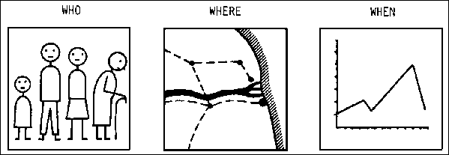
Descriptive Studies
Study of the occurrence and distribution of disease.

Slide 8
Patterns of disease occurrence, in terms of:
  Who gets sick and/or who does not
  Where rates are highest and lowest
  Temporal patterns of disease

Slide 9
The data is collected about :
Personal characteristics
Place distribution
Time distribution/Trends

Slide 10
Descriptive Epidemiology
Study of the occurrence and distribution of disease
Terms:
Time
Place
Person

Slide 11
What are the three categories of descriptive epidemiologic clues?
  □ Person: Who is getting sick?
  □ Place: Where is the sickness occurring?
  □ Time: When is the sickness occurring?
PPT = person, place, time

Slide 12
Time
Secular
Periodic
Seasonal
Epidemic

Slide 13
Secular Trend
The long-time trend of disease occurrence

Slide 14
Tetanus – by year, USA, 1955-2000
During 2000, a total of 35 cases of tetanus were reported. The percentage of cases among persons aged 25-59 years
Has increased in the last decade. Note: A tetanus vaccine was first available in 1933.

Slide 15
Possible Reasons for Changes in Trends
Artifactual
  Errors in numerator due to
  Changes in the recognition of disease.
  Changes in the rules and procedures for classification of causes of death.
  Changes in the classification code of causes of death.
  Changes in accuracy of reporting age at death.
  Errors in the denominator due to error in the enumeration of the population.

Slide 16
Possible Reasons for Changes in Trends (cont.)
Real
  Changes in age distribution of the population.
  Changes in survivorship.
  Changes in incidence of disease resulting from
    Genetic factors
    Environmental factors

Slide 17
Periodic Trend
Temporal interruption of the general trend of secular variation

Slide 18
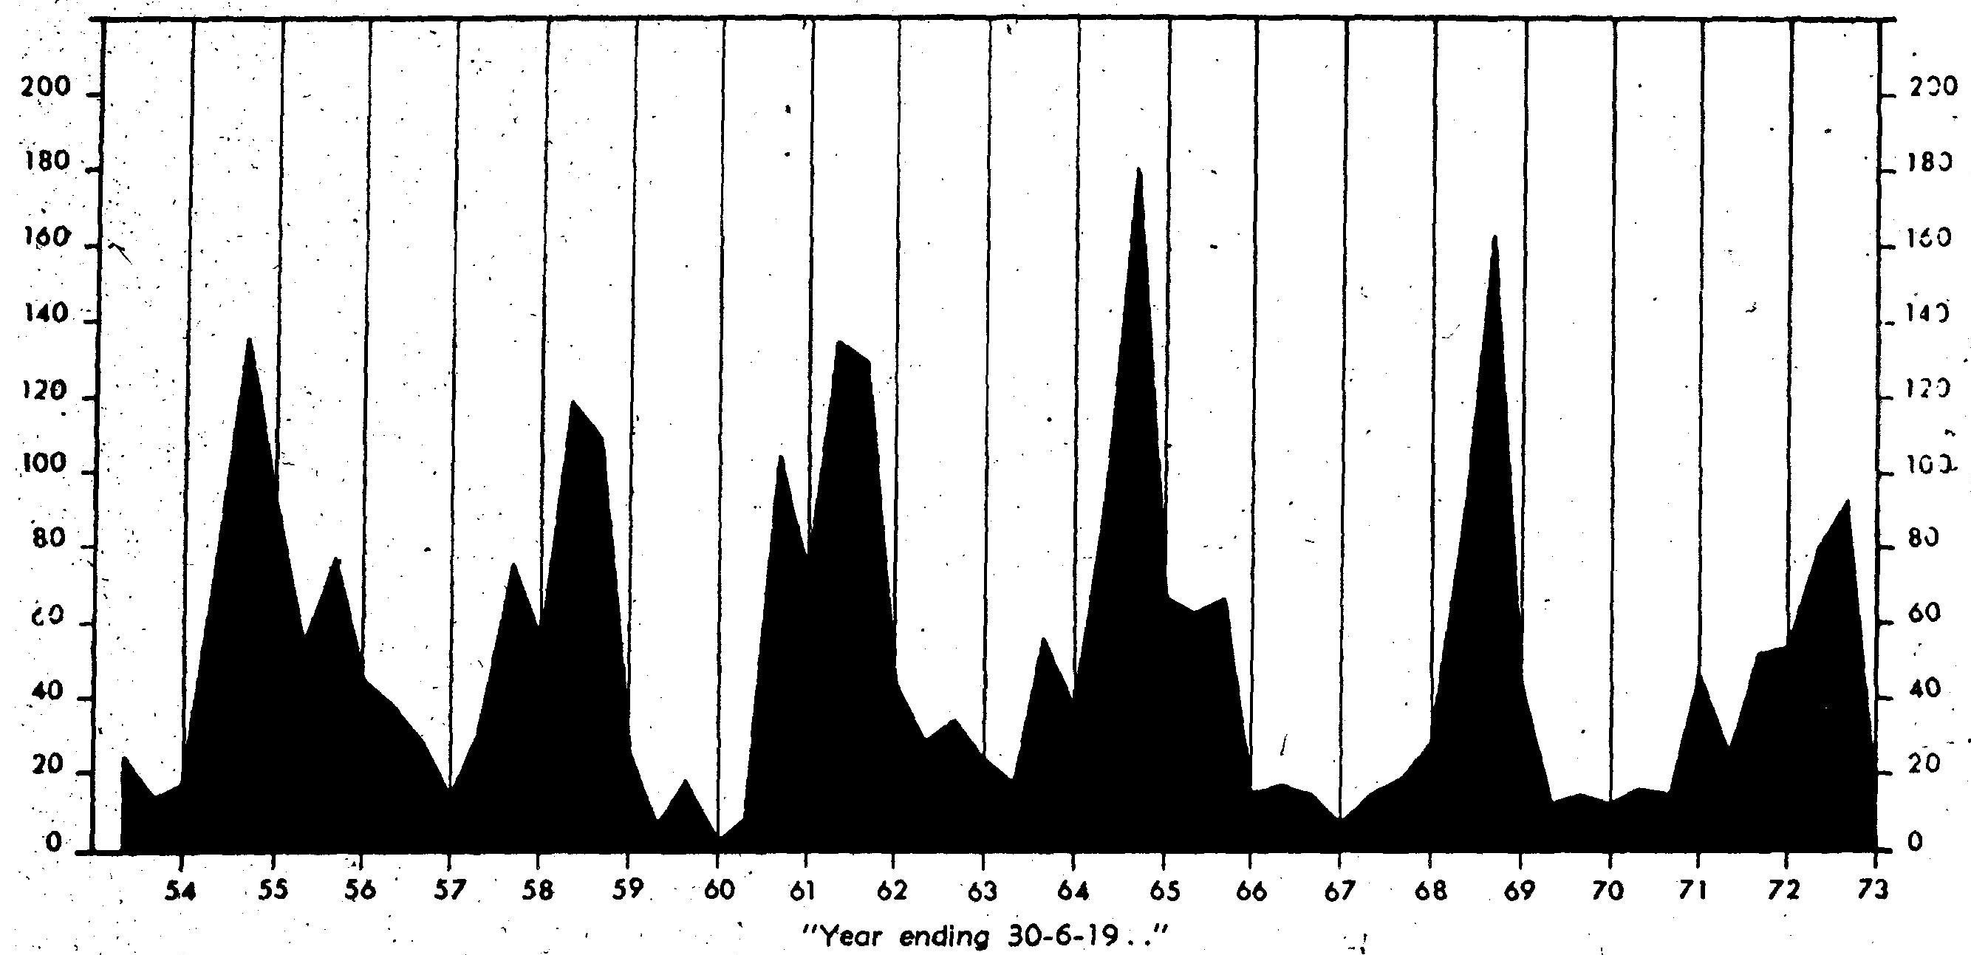
Whooping Cough - Four-monthly admissions, 1954-1973

Slide 19
Seasonal
A cyclic variation in disease frequency by time of year & season.
    Seasonal fluctuations in,
        Environmental factors
        Occupational activities
        Recreational activities

Slide 20
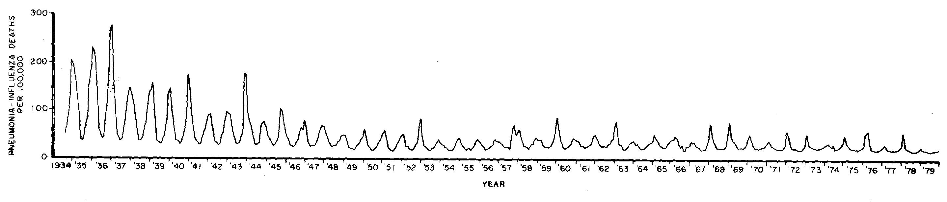
Seasonal Trend
Pneumonia-Influenza Deaths – By year, 1934-1980

Slide 21
Epidemic
An increase in incidence above the expected in a defined geographic area within a defined time period.

Slide 22
Endemic, Epidemic and Pandemic
Endemic - The habitual presence (or usual occurrence) of a disease within a given geographic area
Epidemic - The occurrence of an infectious disease clearly in excess of normal expectancy, and generated from a common or propagated source
Pandemic - A worldwide epidemic affecting an exceptionally high proportion of the global population
Number of Cases
of Disease
Time

Slide 23
Time clustering
Time Place Cluster/disease cluster
A group of cases occur close together & have a well aligned distribution pattern. {in terms of time and place}
Cluster analysis-used for rare or special disease events.

Slide 24
Time/Place clustering analysis using the Poisson model
{Poisson spatial/nearest neighbor distribution}
Poisson probability distribution is an inferential statistics probability measure.
Describes objects/events as they are distributed geographically.
Geographical area divided into a series of equal square areas.
Randomization i.e. each case has equal probability of falling into each square.
If clustering occurs, probability of cause-effect relationship goes up & vice versa.

Slide 25
Place
Geographic Area Example Action Level
Investigation
Control
Prevention
Diagnosis is Made
Contact occurred between agent and host
Source became infected
Home – Patient ill
Restaurant – Food Eaten
Farm – Eggs Infected

Slide 26
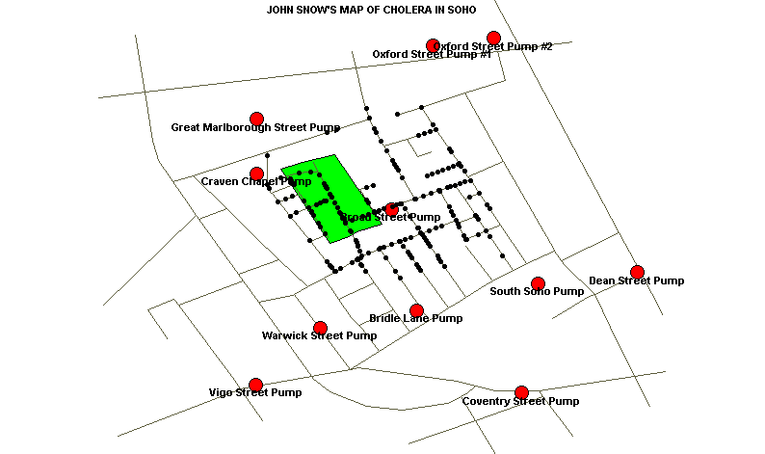

Slide 27
Person
Age Hobbies
Sex Pets
Occupation Travel
Immunization status Personal Habits
Underlying disease Stress
Medication Family unit
Nutritional status School
Socioeconomic factors Genetics
Crowding Religion

Slide 28
Ecological Studies
unit of analysis is a population rather than an individual.
An ecological study is normally regarded as inferior to non-ecological designs such as cohort and case-control studies because it is susceptible to the ecological fallacy.
Ecological studies can be easily confused with cohort studies, especially if different cohorts are located in different places. The difference is that in the case of ecological studies there is no information available about the individual members of the populations compared whereas in a cohort study the data pair exposure/health is known for each individual.

Slide 29
ADVANTAGES
  We can generate hypotheses for case-control studies and environmental studies.
  We can target high-risk populations, time-periods, or geographic regions for future studies

Slide 30
LIMITATIONS
  Because data are for groups, we cannot link disease and exposure in individual.
  We cannot control for potential confounders.
  Data represent average exposures rather than individual exposures, so we cannot determine a dose-response relationship.
  Caution must be taken to avoid drawing inappropriate conclusions, or ecological fallacy.

Slide 31
CASE REPORTS OR CASE SERIES
Case reports:documents unusual medical occurrence and can represent the first clues to the formulation of hypothesis, generally report a new or unique findings and previous undescribed disease.
Case series: collection of individual case reports which may occur within a fairly short time, and experience of a group of patients with similar diagnosis.

Slide 32
Advantages
    Useful for hypothesis generation.
    Informative for very rare disease with few established risk factors.
    Usually of short duration.

Slide 33
Disadvantages
    Cannot study cause and effect relationships.
    Cannot assess disease frequency.

Slide 34
CROSS SECTIONAL STUDY
The data is collected from a cross section of a population at a one point in time. The results of the study are applied on the whole population.
The cross section of the population is sampled carefully so that it is representative of the whole population. Cross section study is like a snapshot and provides information about the prevalence of a disease. It is also called as prevalence study.

Slide 35
Cross Sectional studies are useful :
  detailed community assessment.
  study of morbidity.
  underlying factors especially chronic diseases.

Slide 36
TYPES OF PREVALANCE STUDY
POINT PREVALANCE STUDY
Number of all current (new + old) cases
Exposed population at same point in time
PERIOD PREVALANCE STUDY
Number of all existing (new + old) cases
Estimated mid-interval pop.

Slide 37
Advantage
Best for determining the status (prevalence).
Quick method.
Relatively inexpensive.
Disadvantage
Only a snapshot at a time leading to a misinformation.
Response rate may be low ,with result not representative of the population .

Slide 38
LONGITUDINAL STUDIES
The data is collected from the same population repeatedly over a continuous period of time by follow up of contacts & their examination.
Longitudinal studies are useful for studying the natural history of diseases, finding out incidence rate of diseases & identifying risk factors of diseases. It is more expensive & time consuming studies.

Slide 39
ANALYTICAL METHOD
Analytical Method further studies to determine the validity of a hypothesis concerning the occurrence of disease.

Slide 40
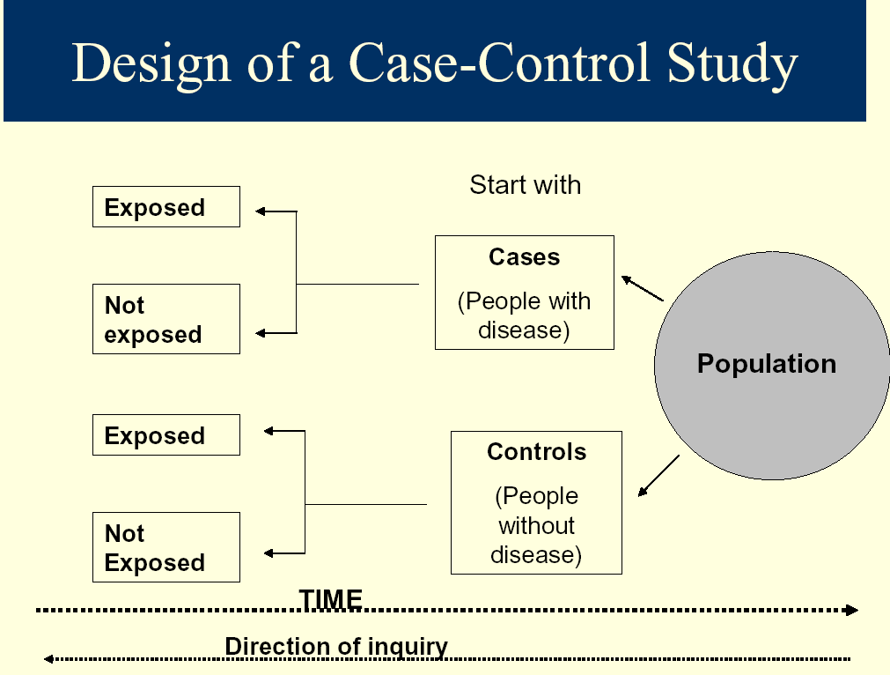
Case Control Study

Slide 41
Advantages of case control
It is relatively easy to carry out because we go back to existing records in the hospital.
It is also rapid and inexpensive.
It requires comparatively few subjects.
It can assist one in studying different etiological factors.
One does not need an ethical clearance.
There is no risk to the subject.

Slide 42
Disadvantages of case control
It introduces bias.
To select an appropriate control could be difficult.
It may be difficult to distinguish between the cause of a disease and an associated factor .

Slide 43
Cohort Study
A cohort is a specific group of people, at a certain time, sharing common characteristics or experience.

Slide 44
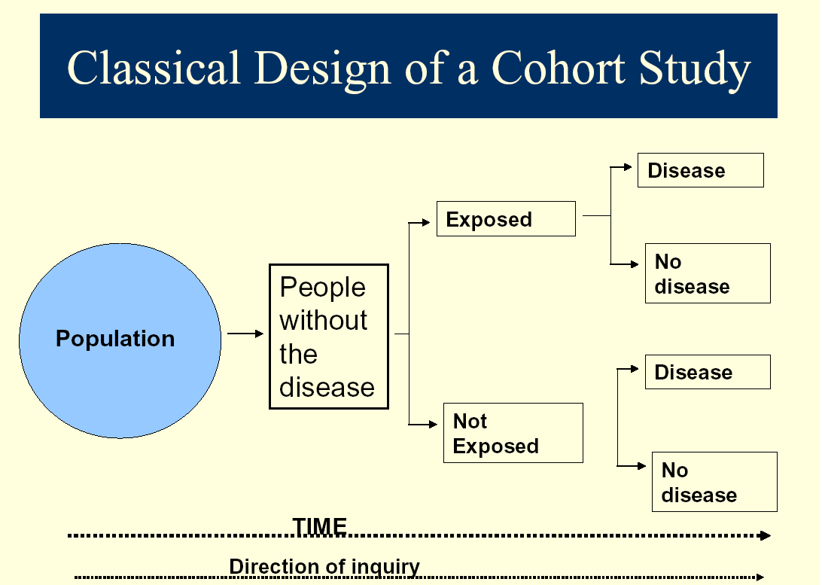

Slide 45
Cohort studies can be designed in three different ways. These are:
Prospective cohort
Retrospective cohort
A combination of both

Slide 46
Experimental Method
Experimental studies are studies in which 1 group is deliberately subjected to an experience compared with a control group with no similar experience
It can be controlled or uncontrolled.

Slide 47
UNCONTROLLED EXPERIMENTAL STUDIES:
  Intervention is not compared with a control.
  The aim is to confirm that the Intervention made a difference.

Slide 48
CONTROLLED EXPERIMENTAL STUDIES
  In this study, a drug or procedure is compared to:
    Another drug
    Procedure
    Placebo
    Previously accepted treatment.
The aim is to prove the difference due to treatment.
STUDY POPULATION
Clinical trials
Field trials
Community trials

Slide 49
Advantages
Best study type
Greatest prove of causality
Gold standard for other design
Least bias
Proves best treatment or procedure efficacy
Disadvantages
Greatest expense.
Long duration.
Unproven facts adopted by community can hinder study acceptance.

Slide 50
SUMMARY

Slide 51


Slide 52


