Slide 1


SCHOOL HEALTH SERVICES
Ms. Ekta M. Patel
Asst. Professor
Sumandeep Nursing College
Sumandeep Vidyapeeth Deemed To Be University
(Accredited ‘A’ Grade By Naac With A Cgpa Of 3.53 Out Of Four Point Scale)
Piparia, Waghodia, Vadodara, Gujarat

Slide 2
INTRODUCTION
Children between the age of 5-17 years are school age children.
• About 30 percent of the population is comprised of this age group.
the health care services to this group will be provided through school system.
this is beacause school system provides exclusive opportunity for influencing knowledge, attitudesband practices of children.

Slide 3
School
School is defined as an educational institution where groups of pupils pursue defined studies at defined levels, receive instructions from one or more teachers, frequently interact with other officers and employees such as principal, various supervisors/ instructors, and maintenance staff etc., usually housed in a single building.

Slide 4

School Health
• School health refers to a state of complete physical, mental, social and spiritual well being and not merely the absence of disease or Infirmity among pupils, teachers and other school personnel .

Slide 5

School Health Services
• Ideally School health services refer to need based comprehensive services rendered to pupils, teachers and other personnel in the school to promote and protect their health, prevent and control diseases and maintain their health. But practically, it refers to providing need based comprehensive services to pupils to promote and protect their health, control diseases and maintain their health.

Slide 6

AIM OF SCHOOL HEALTH SERVICES
The ultimate aim of School Health Services is to promote, protect and maintain health of school children and reduce morbidity and mortality in them.

Slide 7
OBJECTIVES OF SCHOOL HEALTH SERVICES
The promotion of positive health.
2. The prevention of diseases.
3. Early diagnosis, treatment and follow up of defects.
4. Awakening health consciousness in children.
5. The provision of healthful environment

Slide 8
GOALS OF SCHOOL HEALTH SERVICES
1) To prepare the younger generation to adopt measures to remain healthy so as to help them to make the best use of educational facilities, to utilize leisure in productive and constructive manner, to enjoy recreation and to develop concern for others.
2) To help the younger generation become healthy and useful citizens who will be able to perform their role effectively for the welfare of themselves, their families, and the community at large and country as a whole.

Slide 9
NEED FOR SCHOOL HEALTH SERVICES
School children constitute a vital and substantial segment of population.
2. School children are vulnerable section of population by virtue of their physical, mental, emotional and social growth and development during this period.
3. School children are exposed to various stressful situations.

Slide 10
cont........
children coming to school belong to different socio economic and cultural background which affect their health and nutritional status.
Children in school age are prone to get specific health problems like,
    Dental Problem
    Nutritional Problem(Mal nutrition)
    Gastro intestinal problem.
    Skin problem
    Eye disease
    Respiratory problem
    Behavioural problem

Slide 11
PHILOSOPHY OF SCHOOL HEALTH SERVICES
A healthy child is mentally alert, receptive, will not miss school due to minor sickness and will have better performance in his/her studies.
Health is not just freedom from sickness or infirmity but the realization of the full potential of the child which has physical, mental, social and spiritual components.

Slide 12
Cont...
3. Prevention is better than cure; interventions when health breaks down are costly and time consuming.
4. School health services will help identify any deviations from normal growth and development, any health problem so that timely, therapeutic, corrective and rehabilitative actions can be taken to im-prove and maintain health and continue studies.
5. While early diagnosis and prompt and adequate treatment is of great importance, follow up care is equally important for effective school health services.
6. Rehabilitation of physically and mentally handicapped children can be done and must receive ad-equate attention.
7. Health knowledge and skills learnt not only will benefit the child but also it will benefit the school, the parents, family and community

Slide 13
PRINCIPLES OF SCHOOL HEALTH SERVICES
1. Be based on health needs of school children.
2. Be planned in coordination with school, health personnel, parents and community people.
3. Be part of community health services.
4. Emphasize on promotive and preventive aspects.
5. Emphasize on health education to promote, protect, improve and maintain health of children and Staff.
6. Emphasize on learning through active and desirable participation.
7. Be ongoing and continuous programme.
8. Have an effective system of record keeping and reporting.

Slide 14
COMPONENTS OF SCHOOL HEALTH SERVICES
I) Health Promotive and Protective Services
1. Wholesome school environment
2. Maintenance of personal hygiene.
3. Nutritional services
4. Physical & recreational activities
5. Promotion of Mental health
6. Health Education
7. Immunization
II) Therapeutic Services
1. Health appraisal
2. Treatment and follow up
3. First aid and emergency care
4. Specialized health services
III) Rehabilitative Services
1. Care of the handicapped
IV) School Health Records

Slide 15
1. SCHOOL ENVIRONMENT:
Value of Sanitary Environment:
  Basic preventive measure of communicable diseases.
  Contributes to health promotion .
  Provides feeling of comfort, and enhances educational achievement.
  Draws good example of clean environment.

Slide 16
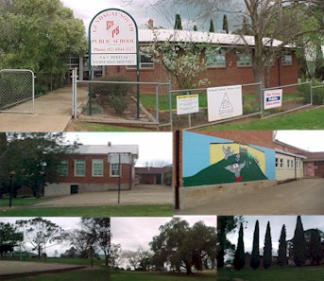

Slide 17
Components of school Environment:
1. Site and area:
- Away from noise, traffic and dust.
- easily reached.
- Located in quite area.
- 10 – 15 square m. / scholars
2. School building:
- Damp, fire, heat and rat proof.
- Cross ventation.
- 10sq Feet space per student.
- 2 – 3 floors
- > 1 stair case.
- Governmental design( E, T, L types ).
3. Class rooms:
- Rectangular 6x8 = 48 m2
- 1-1.5m2 of floor area for primary students,
- 1.5-2m2 for intermed. & high school students.
- Windows location on left side.
- Allow best illumination.
- Natural & white ceiling.

Slide 18
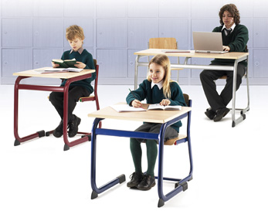
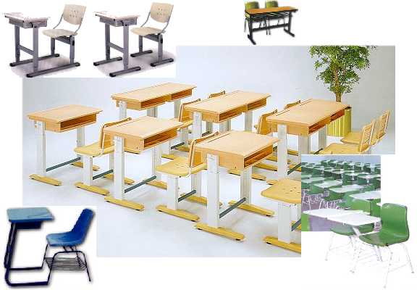
4. School furniture:
- Single desk with chair
- Chair with proper backrest
- Desk should be “minus” type
- Suitably suspended writing board,
- Height & slope of desks
(15 degree angle ),
- Size of seats in relation to students age & built,
- Distance between columns of desks ( 60 cm).

Slide 19
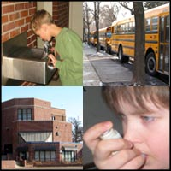
5. Kitchen and Dining:
- Proper illumination & ventilation,
- Rat & insect proof,
- Washable walls & floors,
- Cold & hot water taps,
- Refrigerators ,
- Sanitary refuse baskets ,
- > one door ,
- Proper control of food handlers.
6. Water, Sewage and refuse disposal:
- Drinking fountains,
- one tap / 40 students,
- one toilette / 30 students,
- Soap & Paper towels

Slide 20
2. Maintenance of personal hygiene
It is very essential for promotion of health of children.
The teacher can play important role by becoming role model by following good personal hygine, educate and encourage children to follow good personal hygine, daily inspection of children for their personal hygine.

Slide 21
3. Good Nutrition
Good nutrition is very essential not only for optimal health, growth and development of school children but also for his/her educational achivement.
A nutritious mid-day mill for children in the school is considered a practical solution to combat mal nutrition.

Slide 22
4. Physical and recreational activity
It promote musculo skeletal development, develop team spirit and health to release physical and mental stress.

Slide 23
5. Promotional of mental health
It is very essential to make sound adjustment with the overall environment of the school.
Mal adjustment may lead to various mental and psychological disturbances in children.
There is need to have counscling facility for the student.

Slide 24
6. Health Education
Health education create awareness, give knowledge regarding health matter, develop motivation and promote change in health behaviour and attitued of student.

Slide 25
7. Immunization
It is necessary to give specific protection against communicable diseases. These diseases include diptheria tetanus, measles and polio.

Slide 26
2. THERAPEUTIC SERVICES
HEALTH APPRAISAL
  MEDICAL EXAMINATION
Objectives medical examination:
  Case-finding, specially of unapparent
disease ,
  Assessment of health status of school
children,
( planning and evaluation of school health services.)
-- Primary examination at school entry
( baseline for follow-up of health status ),
-- Health education and guidance of students,

Slide 27

Medical Care :
1. Health Appraisal
includes:-
- comprehensive medical examination,
- screening tests,
- clinical (curative) service, and
- survey studies.

Slide 28
Screening Tests:
They are simple tests which can be carried out frequently to:
-To screen for certain pathological conditions or diseases.
-To screen suspected cases of disease, who need further investigation for final diagnosis.
Examples of screening tests include:
- weight and height,
- visual acuity,
- acuity of hearing,
- IQ testing, and
- dental examination.

Slide 29
3- Rehabilitative Service:
May be congenital or acquired.
Children with minor or mild cases of disability can attend regular schools,
Severe forms (e.g. the deaf, blind, or mentally retarded) can attend special institutes.

Slide 30
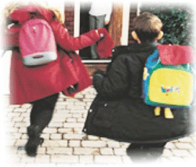
Some forms of handicapping conditions in regular school:
  Heart disease:
  Rheumatic valvular disease is the most important.
  Musculoskeletal deformities:
  mild paralytic poliomyelitis, and healed rickets.
  Impaired vision:
  mainly due to errors of refraction, and may be corneal opacity.
  Impaired hearing:
  neglected chronic otitis media, ear injury by foreign body, and occasionally ototoxic drugs and complicated meningitis.

Slide 31
4. School Health Record:
Each school child should have his own health record, for registration of events and activities related to health.
Contents of Record:
- Personal and social data.
- Results of health appraisal.
- Immunizations /date/age.
- Any morbidity, and management record.

Slide 32
Value of Health Record:
-For reference whenever registered health data
are needed;
e.g. past medical history to assist diagnosis of existing disease.
-Allows follow-up of chronic
disease.
-Collecting statistical data and indices of school children,
( for future planning and
evaluation of health services).

Slide 33
Role of teacher in school health services
1. Daily inspection of children for personal hygiene and cleanliness.
2. Daily observation of children for detecting any evidence of any deviation from normal health, behavior, any communicable disease, malnutrition etc
3. Help in control of communicable diseases.
4. Referral of child having any problem to school health clinic for further action.
5. Informing the parents and maintaining follow up;
6. Maintaining record of anthropometric measurements and other health record of children;
7. Help in providing safe environmental sanitation;
8. Giving First Aid and Emergency care to children;
9. Imparting of health education on healthful living habits and behavior etc;
10.Participate in investigation of epidemic or any communicable disease etc.

Slide 34
Role of parents in school health services
1. They can help in correction of defects if any and follow up of children found sick.
2. They can help in formation of good healthful living habits and behaviour.
3. Through "Parents- Teachers Association" the parents can be involved in planning, organizing and implementation of school health programme,

Slide 35
Role of community in school health services
1. Providing suitable land for school building;
2. Providing funds and labour in building proper school;
3. Participation in school health committees or councils and contribute in formulation of school health policies and plan;
4. Participation in implementation of programme activities.
5. Motivating parents to send their children to school and take care of their health etc.

Slide 36
Role of students
1. Learn values of medical and health examinations, personal hygiene, good nutrition, environmental sanitation etc.;
2. Co-operate in various aspects of school health programme;
3. Develop positive habits and healthful living activities as educated upon;
4. Extend this knowledge to other members of the family, neighborhood etc

Slide 37
ROLE OF NURSE IN SCHOOLHEALTH SERVICES:1
I . HEALTHAPPRAISAL
2. Remedial measures and follow-up
3 .Prevention of communicable diseases
4. Healthful school environment
5. Nutritional services
6. First-aid and emergency care
7. Mental health
8. Dental health
9. Eye health services
10. Health education
11. Education of handicapped children
12.School Health Records

Slide 38
PICO ANALYSIS

Slide 39
PROBLEM | INTERVENTION | CONTROL | OUTPUT
School health programme practices among private secondary school administrators in an urban local government area in Lagos state, Nigeria | descriptive cross-sectional study which was carried out among private secondary school managers in Ikeja Local Government Area of Lagos State. | No Control Group. | There was a high level of awareness about School Health Programme among the respondents in this study. This is probably because most of the respondents (92.9%) were trained professionally in education. However, knowledge of the activities under School Health Programme among majority of the principals/administrators of these private secondary schools was fair or poor (58.9% and 33.9% respectively) which might be an indication of some deficiencies in the training of teachers, especially with regards to School health Programme.

Slide 40
THANK YOU

