Slide 1



Professional standards in
Nursing
Mr. Swamy PGN.
Assistant Professor
SNC

Slide 2
STANDARD
The standard of care is a constant
The same standard of care is expected from a generalist and a specialist
But what amounts to reasonable care with regard to the specialist differs from what amount of reasonable care is standard for the generalist.

Slide 3

Standards - definition
■ Predetermined levels of excellence that serves as a guide for practice

Slide 4

Nursing standards
Are needed to practice safely.
They reflect a desired and achievable level of performance against which actual performance can be compared. Their main purpose is to promote, guide and direct professional nursing practice.

Slide 5

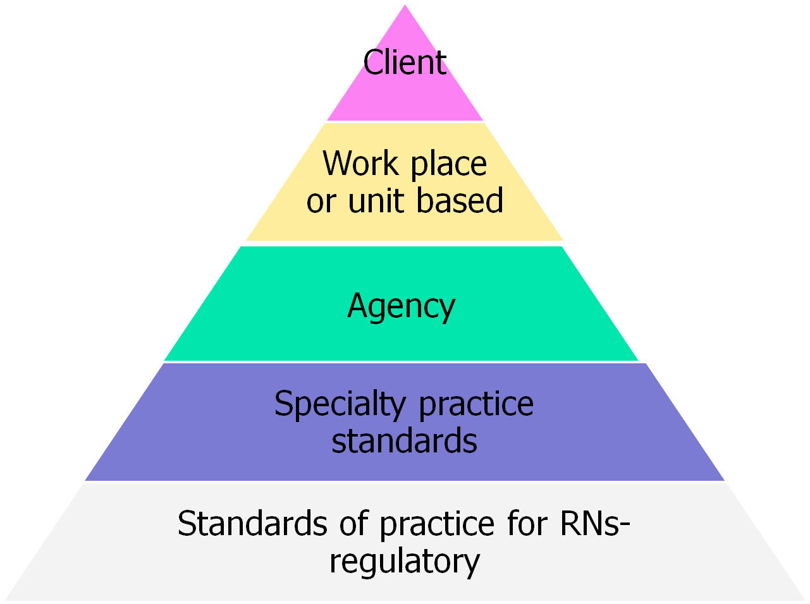





Slide 6

Purposes of standards

Slide 7
Structural standards Things we use
Process standards Things we do
Outcome standards The result

Slide 8
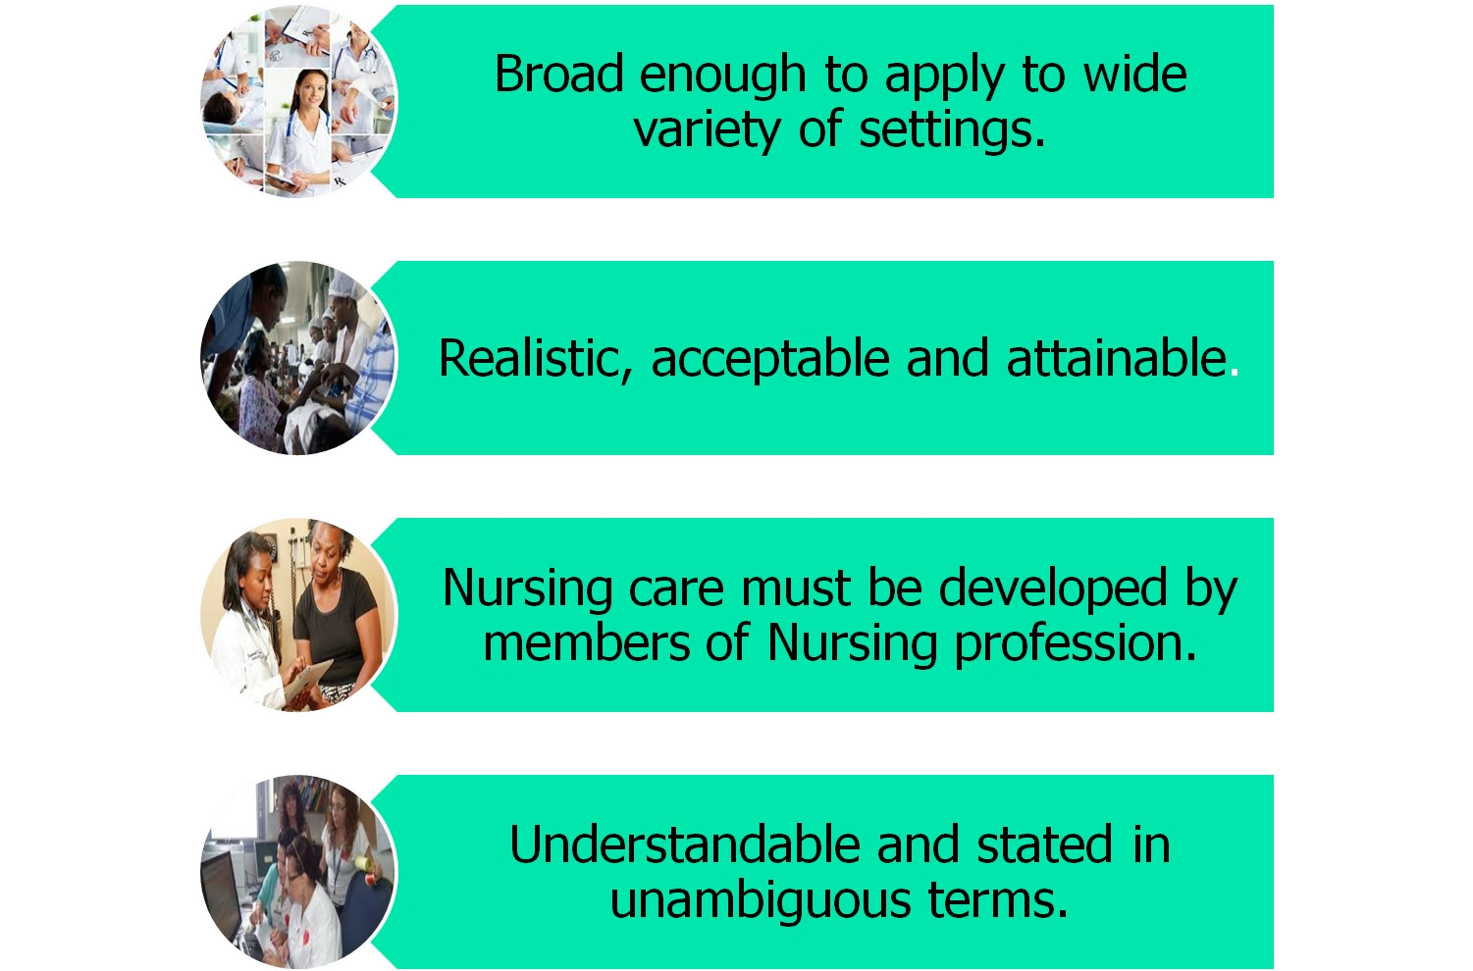
Characteristics of Standards

Slide 9



Characteristics of Standards
contd
Based on current knowledge and scientific practice.
Must be reviewed and revised periodically.
Directed towards optimal standard.

Slide 10
Sources of Nursing care
standards
TNAI
Licensing bodies like INC, MCI etc
Departments of the institution
Patient care unit
Government at national, state and local levels
Individual personal standard

Slide 11




Slide 12
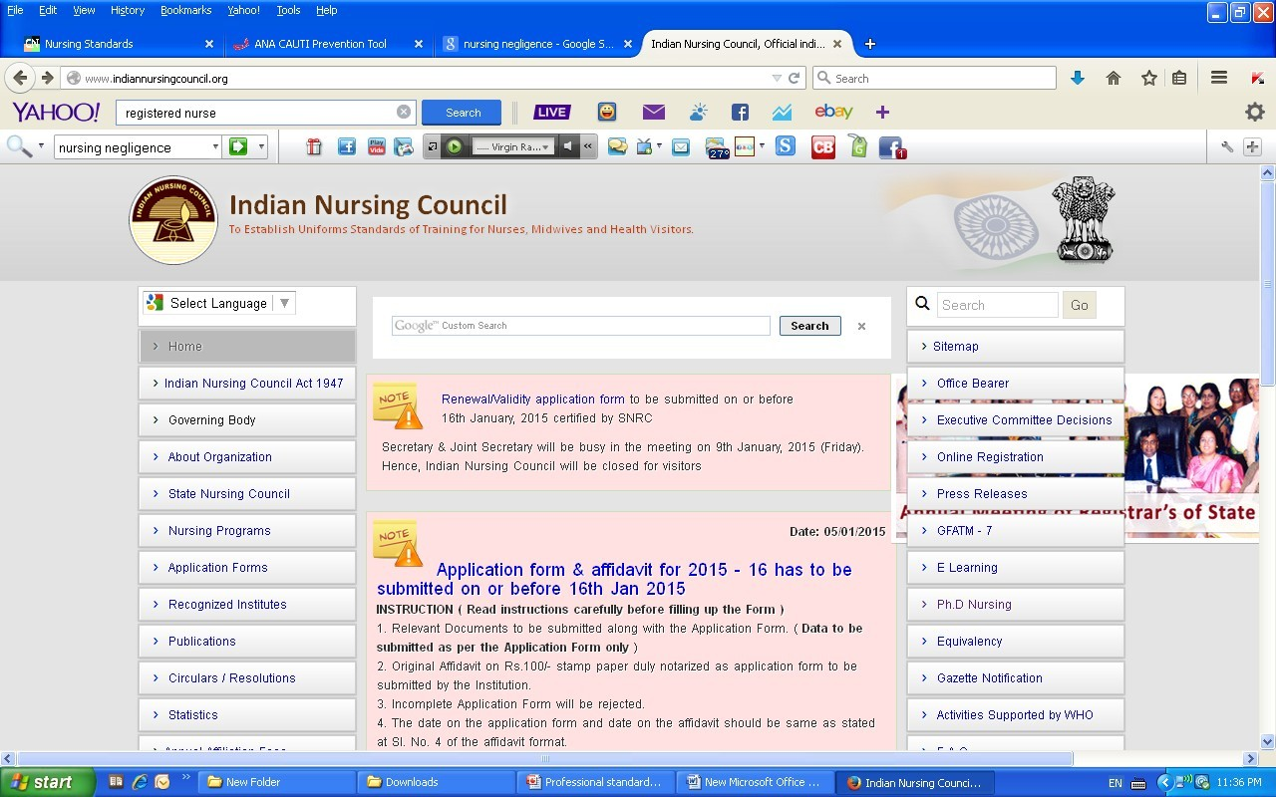

Slide 13


Slide 14


