Slide 1


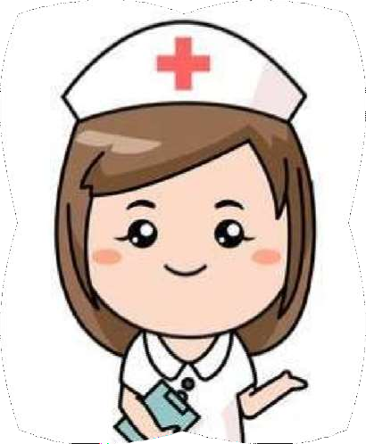



Functions & Qualities of Professional Nurse
Mr. Swamy PGN
Assistant Professor
SNC

Slide 2
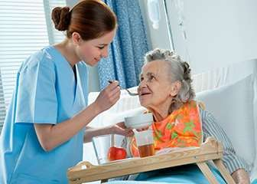



FUNCTIONS OF A NURSE
Caregiver
The caregiver role has traditionally included those activities that assist the client physically and psychologically while preserving the client’s dignity. Caregiving encompasses the physical, psychosocial, developmental, cultural and spiritual levels.

Slide 3

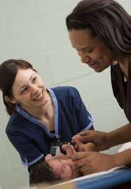

Communicator
Communication is an integral to all nursing roles. Nurses communicate with the client, support persons, other health professionals, and people in the community. In the role of communicator, nurses identify client problems and then communicate these verbally or in writing to other members of the health team. The quality of a nurse’s communication is an important factor in nursing care.

Slide 4


Teacher :
As a teacher, the nurse helps clients learn about their health and the health care procedures they need to perform to restore or maintain their health. The nurse assesses the
client’s learning needs and readiness to learn, sets specific learning goals in conjunction with the client, enacts teaching strategies and measures learning.

Slide 5


Client advocate
Client advocate acts to protect the client. In this role the nurse may represent the client’s needs and wishes to other health professionals, such as relaying the client’s wishes for information to the physician. They also assist clients in exercising their rights and help them speak up for themselves.

Slide 6

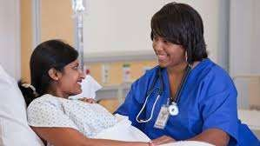
Counselor
Counseling is a process of helping a client to recognize and cope with stressful psychologic or
social problems, to developed improved interpersonal relationships, and to promote personal growth. It involves providing emotional, intellectual, and psychologic support.

Slide 7
Change agent
The nurse acts as a change agent when assisting others, that is, clients, to make modifications in their own behavior. Nurses also often act to make changes in a system such as clinical care, if it is not helping a client return to health.

Slide 8
Leader
A leader influences others to work together to accomplish a specific goal. The leader role can be employed at different levels; individual client, family, groups of clients, colleagues, or the community. Effective leadership is a learned process requiring an understanding of the needs and goals that motivate people, the knowledge to apply the leadership skills, and the interpersonal skills to influence others.

Slide 9

Manager
The nurse manages the nursing care of individuals, families, and communities. The nurse-manager also delegates nursing activities to ancillary workers and other nurses, and supervises and evaluates their performance.
Case manager
Nurse case managers work with the multidisciplinary health care team to measure the effectiveness of the case management plan and to monitor outcomes.

Slide 10

Qualities of a nurse :
Caring nature:
  Nurses deal with the sick and injured and their families on a daily basis, and must be able to show that they truly care about the situation.
Empathic attitude
  Nurses must be able to put themselves in their patients’ shoes to provide the quality care needed.
Detail oriented
  Nurses must remember to make entries on patients’ charts and to bring medications at the correct times.

Slide 11
Emotionally stable
  Nurses feel the joy of seeing a new baby born as well as the pain of losing a long-term patient. Emotional stability is crucial to deal with the wide range of emotions nurses must endure.
Adaptable
  People are unpredictable at the best of times, but become even more so under stress, so a nurse’s typical workday will require flexibility and adaptability.

Slide 12

Hardworking :Nursing is a never ending job. It is unusual for a hospital or medical center to be overstaffed, which of course means more workload on each nurse in the unit.
Quick thinker :
When a nurse notices something is not right with a patient, they must be able to make decisions quickly and put their plans into action instantly, because a fraction of a second can mean the difference between life and death.

Slide 13
Physical endurance
  Nurses are on their feet all day, sometimes 12 or more hours at a time, and are often required to assist patients with activities that require physical strength.
Good judgment
  A nurse must be able to look at a patient’s current state and accurately assess what is needed, especially during emergencies.

Slide 14
Good communication skills
  Nurses must communicate with other nurses, doctors, patients, and patients’ families clearly.
Responsible
  Good nurses know how to perform all of their responsibilities with the utmost accuracy and detail. They play a major role in assessing and treating patients’ , and when dealing with the health of another human being, so nurses must responsibly carry out their duties at all times.

Slide 15

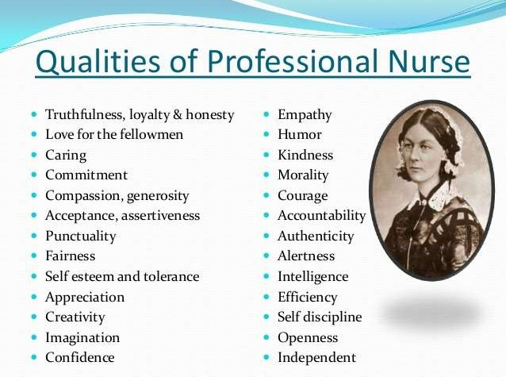

Slide 16
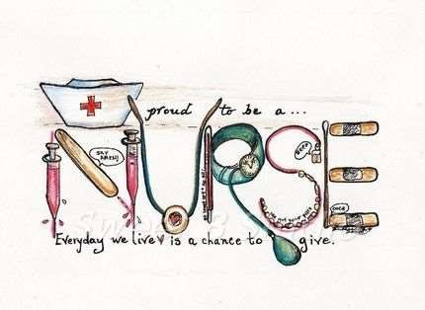
N – Nobility, Knowledge
U – Usefulness, Understanding
R - Righteousness, Responsibility
S – Simplicity, Sympathy
E – Efficiency , Equanimity

Slide 17
Thank you … ☺

