Slide 1

DISASTER MANAGEMENT
Ms. Varsha Hun
ASST.PROFESSOR
SNC

Slide 2
INTRODUCTION
Presently at the global level, there has been considerable concern over natural disasters. Even as substantial scientific and material progress is made, the loss of lives and property due to disasters has not decreased. In fact, the human toll and economic losses have mounted.
There has been an increase in the number of natural disasters over the past years and with it, increasing losses on account of urbanization and population growth, as a result of which the impact of natural disasters is now felt to a larger extent.

Slide 3
According to the United Nations, in 2001 alone, natural disasters of medium to high range caused at least 25,000 deaths around the world, more than double the previous year and economic losses of around US $36 billion.

Slide 4
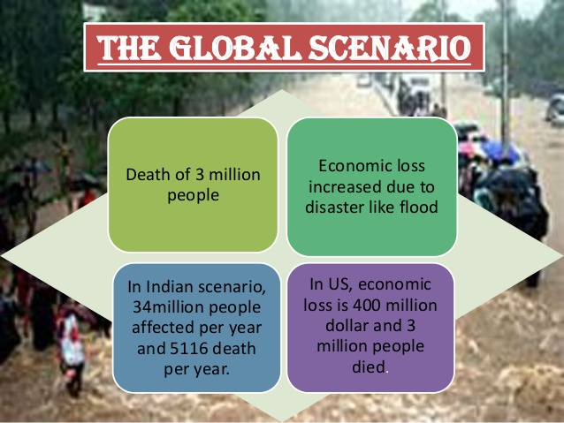

Slide 5
MEANING
Disaster means that any occurrence that causes damage, ecological disruption, loss of human life or deterioration of health and health services on a scale sufficient to warrant and extraordinary response from outside the affected community or area.
(WHO 1995)

Slide 6
“DISASTER” alphabetically means:
D
Destructions
I
S
Sufferings
S
T
E
R
Incidents
A
Administrative, Financial failures
Sentiments
Tragedies
Eruption of communicable diseases
Research program and its implementation

Slide 7
Definition of Disaster Nursing
Disaster Nursing can be defined as the adaptation of professional nursing skills in recognizing and meeting the nursing physical and emotional needs resulting from a disaster. The overall goal of disaster nursing is to achieve the best possible level of health for the people and the community involved in the disaster.

Slide 8
PRINCIPLES OF DISASTER MANAGEMENT
Prevent the occurrence of the disaster whenever possible.
Minimize the number of casualties if the disaster cannot be prevented.
Prevent further casualties from occurring after the initial impact of the disaster.
Rescue the victims.
Provide first aid to the injured.
Evacuate the injured to medical facilities.
Provide definitive medical care.
Promote reconstruction of lives.

Slide 9
Types of Disaster
NATURAL DISASTERS
Droughts
Earthquakes
MAN-MADE DISASTERS
Hazardous Substance Accidents
E.g., Chemicals, Toxic Gases
Radiologic Accidents
Tsunamis
Forest Fires
Landslides & Mudslides
Blizzards
Hurricanes
Tornadoes
Floods & Volcanic Disruption
Resource Shortage
E.g., Food, Electricity, & Water
Structural Fire & Domestic Disturbances
E.g., Terrorism, bombing, & Riots
Toxic materials, Pollution, Civil Unrest(E.g., Riots, Demonstration)

Slide 10

Droughts: Very long period of abnormally low rainfall.

Slide 11
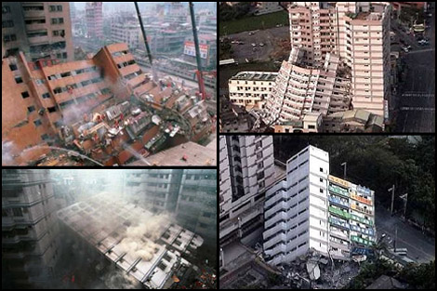
Earthquakes: Sudden violent shaking of the ground caused by movements within the earth’s crust.

Slide 12
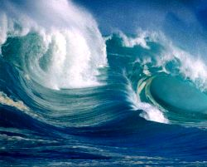
Tsunamis: Tidal wave caused by an underwater earthquake or disturbance.

Slide 13
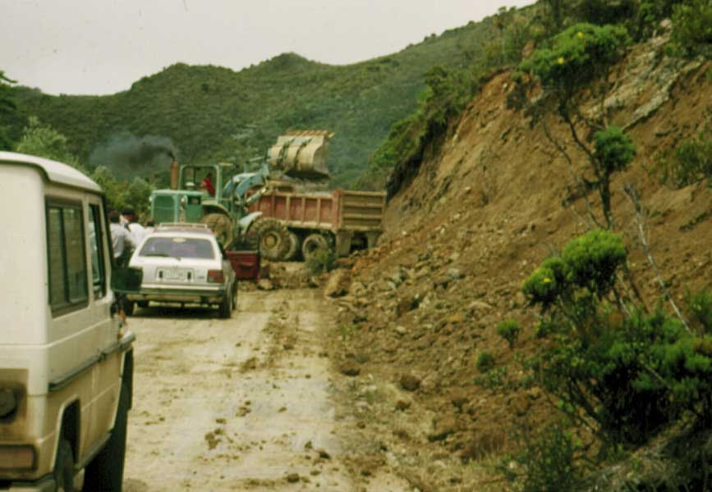
Landslides: A mass of earth or rock that slides down a mountain or cliff.

Slide 14
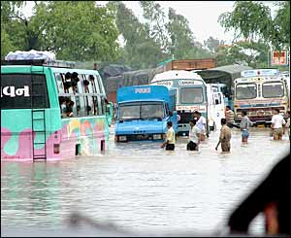
Floods: An overflow of large amount of water over dry land.

Slide 15
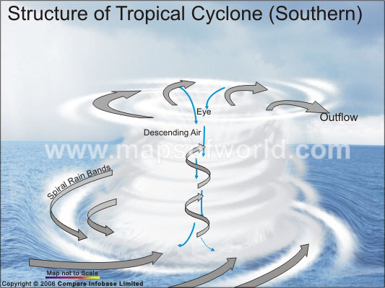
TROPICAL CYCLONESL: When the cyclone strikes land, high winds, exceptional rainfall and storm surges cause damage with secondary flooding and landslides.

Slide 16
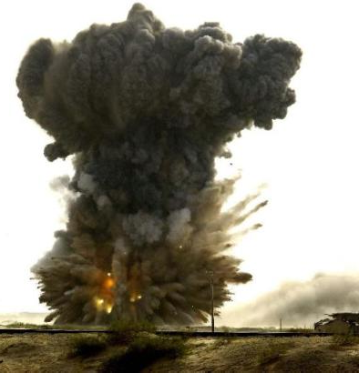
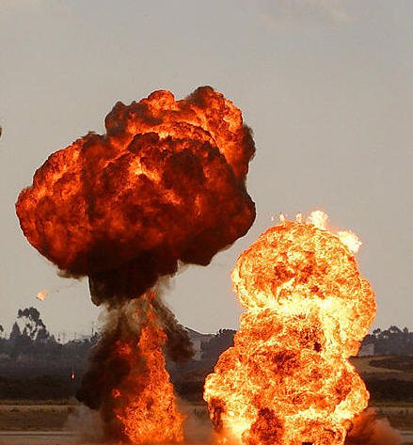
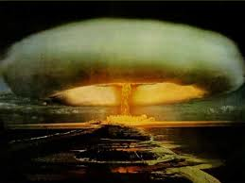
EXPLOSIONS:

Slide 17
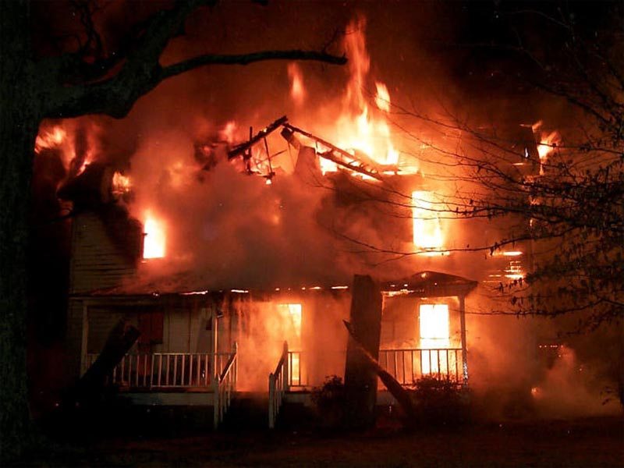
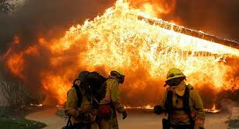
Structural fire:

Slide 18

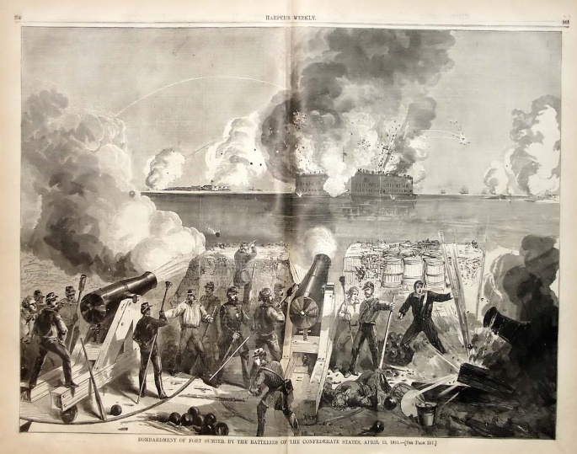
WARS AND CIVIL STRIFE:

Slide 19

CHEMICAL AND INDUSTRIAL ACCIDENTS:

Slide 20
Disaster Agent:
The Agent is the Physical item that actually causes the injury or destruction.
Primary agents include falling buildings, heat, wind, rising water and smoke.
Secondary agents include bacteria and viruses that produce contamination or infection after the primary agent has caused injury or destruction.

Slide 21
Conti…..
Host :
The Host is Human kind.
Host Factors includes Age, immunization status, Pre- existing health status, Degree of mobility & Emotional stability.

Slide 22
Environment: Environmental Factors that affect the outcome of a disaster include….
Physical Factors
Chemical Factors
Biological Factors
Social Factors
Psychological Factors

Slide 23
PHASES OF A DISASTER:
Pre-impact Phase
Impact Phase
Post Impact Phase

Slide 24
Conti……
Pre-Impact Phase
It is the initial phase of the disaster, warning is given prior to the actual occurrence, Emergency centers are opened, Communication, radio and television, community must be educated.
Impact Phase
This occurs at the time of disaster, The impact phase continues until the threat of further destructions has passed and the emergency plan is in effect. If there has been no warning, this is

Slide 25
Conti……
the time when the Emergency Operation Center (EOC) is established and put in operation.
Post impact Phase:
Recovery beings during the emergency phase and end with the return of normal community order and functioning. For persons in then impact area this phase may last a lifetime (e.g., victims of the atomic bombing of Hiroshima).

Slide 26
Victims Of Disaster Go Through Four Stages Of Emotional Response:
Denial
Strong Emotional Response
Acceptance
Recover

Slide 27
DIMENSIONS OF A DISASTER
Dimensions
Predictability
Controllability
Time
Scope & Intensity
frequency

Slide 28
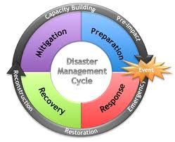
Disaster management cycle

Slide 29
DISASTER MANAGEMENT CYCLE:
1) MITIGATION:
Activities that prevent a disaster, reduce the chance of a disaster happening, or reduce the damaging effects of unavoidable disasters.
Effective Mitigation includes recognizing and preventing potential technologic disasters and being adequately prepared.

Slide 30
Conti….
To Plan effectively for disaster prevention the nurse needs to have community assessment information, including knowledge of community resources , community health personnel.
The goal is to prevent or minimize death, disability, suffering and loss on the part of disaster victims.

Slide 31
2) PREPAREDNESS
Personal Preparedness:
Great stress is placed on the nurse with client responsibilities who also becomes a disaster victim.
Conflict arise between family & work-related responsibilities.
Personal preparedness can help case some of the conflict that will arise & allows to nurses to attend to client needs sooner that one may anticipate.

Slide 32
Conti…
Professional Preparedness:
It requires that nurses become aware of and understand the disaster plans at their workplace and community.
The more adequately prepared nurses are, the more they will be able to function in a leadership capacity.
A Copy of their professional licence.
Personal equipment, such as stethoscope, a flashlight& extra batteries, warmclothing, record-keeping materials, etc.

Slide 33
Conti….
Community preparedness:
The level of community preparedness for a disaster is only as good as the people & organization in the community make it.
ROLE OF NURSE IN PREPAREDNESS
To facilitate preparation within the community and place of employment.
Within the employing organization, nurse can help initiate or update the disaster plan, provide educational program & material regarding disaster.
The CHN is to provide an update record of vunrable population in community.

Slide 34
Conti…
Community nurse as a advocate, the CHN should always seek to keep a safe environment
The nurse in the community has an obligation to assess for and report environmental health hazards.
The CHN should also have an understanding of what community resources will be available after a disaster strikes and most important, how the community will work together.
The CHN who seeks greater involvement or a more in-depth understanding of disaster management can become involved in any number of community organization that are part of the official response team.

Slide 35
3) RESPONSE:
It includes community assessment, case finding and referring, prevention, health education, surveillance, and working with aggregates.
Triage is the process of separating causalities and allocating treatment based on the victim’s potential for survival.

Slide 36
Triage: During the emergency response in which triage may be necessary to best determine the needs of injured victims.
RED - Most Urgent, First Priority
YELLOW- Urgent, Second Priority
GREEN – Third Priority
BLACK - Dying Or Dead

Slide 37
Conti…
SHELTER MANAGEMENT
Responsibility of the local Red Cross, building of “tent cities”
Assessing and referring, ensuring medical needs, providing first aid, serving meals, keeping patient records, ensuring emergency communications and transportation, and providing a safe environment.

Slide 38
INTERNATIONAL RELIEF EFFORTS:
Federation of Red Cross and Red Crescent Societies and the International Committee of Red Cross or as health representatives from the WHO.
PSYCHOLOGICAL STRESS OF DISASTER WORKERS: The degree of worker stress depends "on the nature of the disaster, role in the disaster, individual stamina, and other environmental factors.

Slide 39
4) RECOVERY
Flexibility
Community cleanup efforts
Release of continuing threat
teaching proper hygiene
short-term psychological support
alert for environmental health hazards
Home visits

Slide 40
THE NURSING ROLE IN DISASTERS
Psychological care,
Emotional support services,
Treatment for victims and their families.
Assess The Community
Community Disaster Planning
Implement Disaster Plan

Slide 41
The evaluation of research methods during disaster exercises: applicability for improving disaster health management.

Slide 42
Abstract
INTRODUCTION:
The objective of this study was to investigate whether disaster exercises can be used as a proxy environment to evaluate potential research instruments designed to study the application of medical care management resources during a disaster.
METHODS:
During an 06 April 2005 Ministerial-level exercise in the Netherlands, three functional areas of patient contact were assessed: (1) Command and Control, through the application of an existing incident management system questionnaire; (2) patient flow and quality of patient distribution, through registration of data from prehospital casualty collection points, ambulances, and participating trauma centers (with inclusion of data in a flow chart); and (3) hospital coping capacity, through timed registration reports from participating trauma centers

Slide 43
RESULTS:
The existing incident management system questionnaire used for evaluating Command and Control during a disaster exercise would benefit from minor adaptations and validation that could not be anticipated in the exercise planning stage. Patient flow and the quality of patient distribution could not be studied during the exercise because of inconsistencies among data, and lack of data from various collection points. Coping capacity was better measured by using 10-minute rather than one hour time intervals, but provided little information regarding bottlenecks in surge capacity.
CONCLUSION:
Research instruments can be evaluated and improved when tested during a disaster exercise. Lack of data recovery hampers disaster research even in the artificial setting of a national disaster exercise. Providers at every level must be aware that proper data collection is essential to improve the quality of health care during a disaster, and that predisaster cooperation is crucial to validate patient outcomes. These problems must be addressed pre-exercise by stakeholders and decision-makers during planning, education, and training. If not, disaster exercises will not meet their full potential.

Slide 44
POPUTALTION | INTERVENTION | CONTROL | OUTCOME
study was to investigate whether disaster exercises can be used as a proxy environment to evaluate potential research instruments designed to study the application of medical care management resources during a disaster | patient contact were assessed: (1) Command and Control, through the application of an existing incident management system questionnaire; (2) patient flow and quality of patient distribution, through registration of data from prehospital casualty collection points, ambulances, and participating trauma centers (with inclusion of data in a flow chart); and (3) hospital coping capacity, through timed registration reports from participating trauma centers. |  | . Patient flow and the quality of patient distribution could not be studied during the exercise because of inconsistencies among data, and lack of data from various collection points. Coping capacity was better measured by using 10-minute rather than one hour time intervals, but provided little information regarding bottlenecks in surge capacity
Level of Evidence: v

Slide 45

THANK YOU

