Slide 1
RESEARCH DESIGNS
Mr. Suresh V.
Associate Professor In Mental Health Nursing
Sumandeep Nursing college
Sumandeep Vidyapeeth Deemed to be University

Slide 2



Research
A detailed study of a subject, especially in order to discover (new) information or reach a (New) understanding.
We all do research at different level.

Slide 3

Choose what suits you

Slide 4
Research design
A research design is the set of methods and procedures used in collecting and analyzing the variables specified in the research problem.

Slide 5


Slide 6
Hierarchy of study types (Primary research)
Analytic
Observational
Cross sectional
Case-control
Cohort studies
Ecological
Descriptive
Case Study
Case series
Survey
Semi-experimental (e.g. Quasi Experimental)
Experimental
Randomized
controlled trials

Slide 7
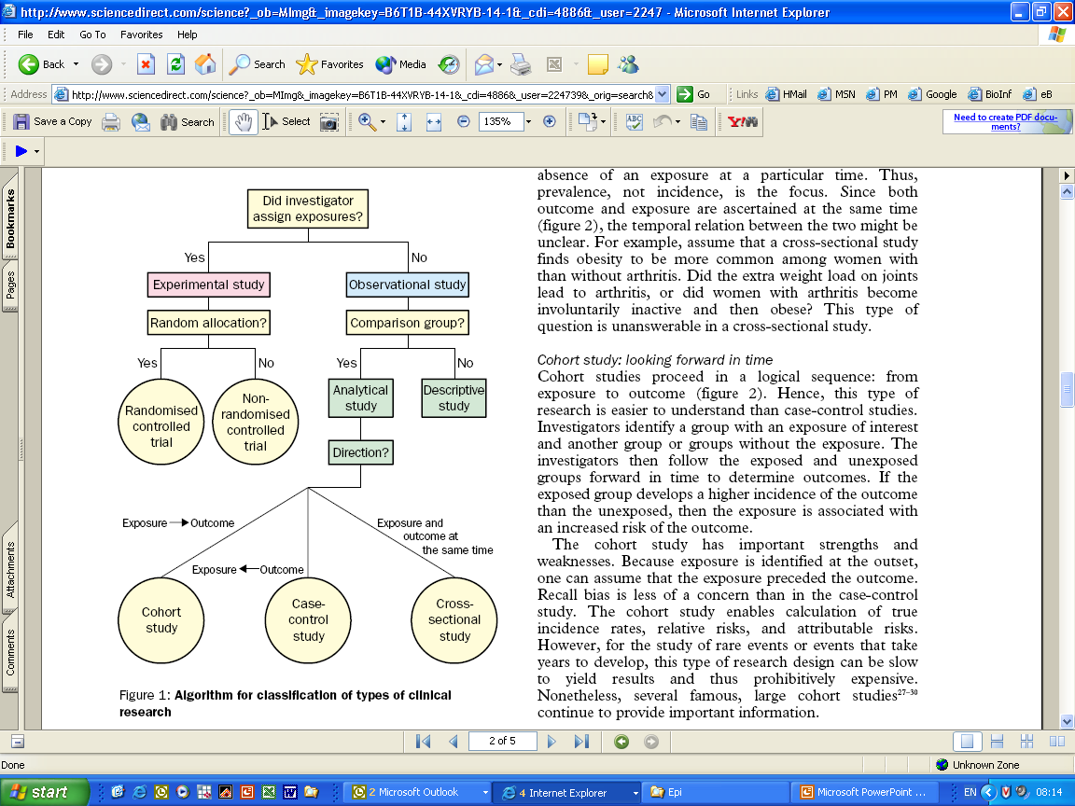
How to identify the type of research?

Slide 8
Hierarchy of study types (Secondary research)
Review
Review (Systematic Review)
Meta-analytic (Meta Analysis)

Slide 9
Descriptive
(Descriptive research is used to describe characteristics of a population)
Case report/ Case study:
  Case study is a research method involving an in-depth, and detailed examination of a subject of study.
  Example: Alzheimer's disease is a chronic neurodegenerative disease that usually starts slowly and gets worse over time. As the disease advances, symptoms can include problems with language, disorientation, mood swings, loss of motivation, not managing self care, and behavioural issues. The disease process is associated with plaques and tangles in the brain.

Slide 10
Case series
Is a type of medical research study that tracks subjects with a known exposure, such as patients who have received a similar treatment.
Eg: Exposure to hospital and developing nosocomial infection.)

Slide 11
Survey
An investigation of the opinions or experience of a group of people, based on a series of questions.
Eg: Finding out the prevalence of disease. (Number of postnatal depression cases in waghodia)

Slide 12
Analytical Study Design
Comparative studies in populations used to study prognosis, risk and causation.
Investigators observe events in specified population and come to conclusions.

Slide 13
Types
Cross sectional Study
Case control study
Cohort study
Ecological study

Slide 14
Cross sectional Study
  A one time measurement conducted on a sample derived from a population.
  Cross sectional research design would have comparative group.
  Usually done to estimate prevalence and to describe disease spectrum.
Eg: Measures individuals of various ages at one point in time to provide information about the age differences.

Slide 15
Case control study
A study in which subjects are observed in order to determine both their exposure and their outcome status. (odd ratio)
  Group of patients with Lung Cancer (cases)
  ask for exposure to Smoking
  Group of persons without Lung Cancer (controls)
  ask for exposure to Smoking
  Compare the two groups.

Slide 16
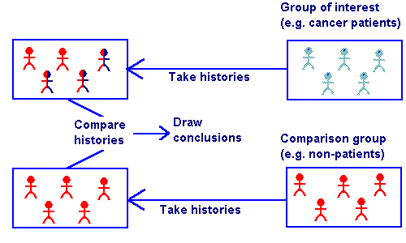
Case Control Studies

Slide 17
Cohort Studies
Cohort studies typically observe large groups of individuals, recording their exposure to certain risk factors to find out the possible causes of disease.

Slide 18
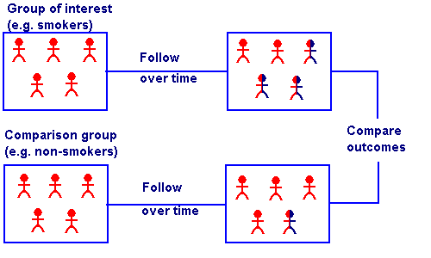
Cohort Studies

Slide 19
Ecological Study
A study in which at least one variable is measured at the group (not individual) people.
Examples: How the environmental factors affecting people. Cholera

Slide 20
Experimental research
Experimental research is an attempt by the researcher to maintain control over all factors that may affect the result of an experiment.
Eg: Randomized controlled trials (Gold standards for deriving conclusions in medical research)

Slide 21
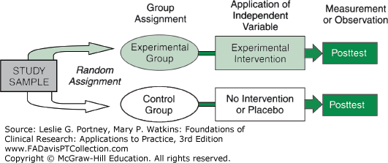
True experimental research design/ Randomized Control trial
Post test only control design: A true experimental design where test units are randomly allocated to an experimental group and a control group.
The experimental group is exposed to a treatment and both groups are measured afterwards.

Slide 22
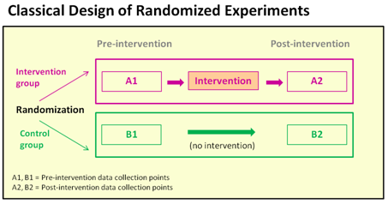
Pretest posttest control design: Subjects are randomly assigned to either the experimental or the control group. Observation of dependent variables in both group takes place before the treatment.
The treatment is carried out on experimental group only, and after treatment observation of dependent variable is made on both groups to examine the effect of manipulation.

Slide 23
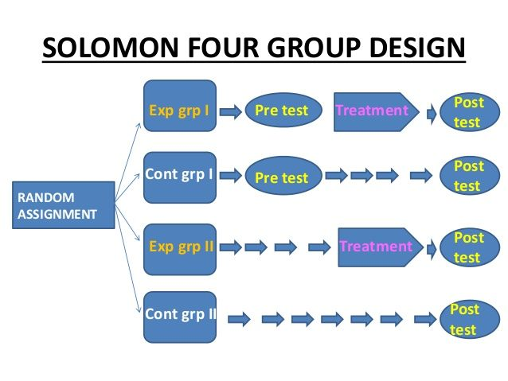
Solomon four group design: There are two experimental group and two control group. Initially, the investigator randomly assigns subjects to the four groups. (Control the confounding variables and Minimize the threat to internal and external validity.)

Slide 24
Factorial design
In factorial research design, researcher manipulates two or more independent variables simultaneously to observe their effects on the independent variable.
For example: Observe the effects of two different protocols of mouth care on prevention of VAP when performed at different frequencies in a day.
Frequency of Mouth Care | Protocols of Mouth Care
 | Hexidine (α1) | Saline (α2)
4 Hourly (β1) | α1, β1 | α2, β1
6 Hourly(β2) | α1, β2 | α2, β2
8 Hourly (β3) | α1, β3 | α2, β3

Slide 25
Crossover design
Subjects are exposed to more than one treatment, where the subjects are randomly assigned to different orders of treatment.
Crossover design is considered as extremely powerful design sometimes it is not effective because the subjects are exposed to two different conditions, their responses of the second condition may be influenced by their first condition.
Group | Protocols of Mouth care
Group-I | Hexidine α1 | Saline α2
Group-II | Saline α2 | Hexidine α1

Slide 26
Completely Randomized design
A researcher want to conduct an experiment to determine which environment is best suitable for studying. 1) A library, 2) In one’s own room 3) Outside.
A total of 30 university students participate in the experiment.
30 University Students
Randomly Assigned
Group-I
Library
Compare the results
Group-II
Own Room
Group-III
Outside

Slide 27
Randomized Block design
With the same example now the researcher believes that gender has an effect on the result. (when there are large number of experimental comparison the randomized block design used to bring the homogeneity among selected different group.
Blocking variable: Gender.

Slide 28
Randomized Block design
Female (18)
Randomly Assigned
Group-I (6)
Library
Compare the results
Group-II (6)
Own Room
30 University Students
Group-III (6)
Outside
Male (12)
Randomly Assigned
Group-I (4)
Library
Compare the results
Group-II (4)
Own Room
Group-III (4)
Outside

Slide 29
Comparison in pairs
A researcher is trying to determine whether or not sleep deprivation has an effect on test scores. (Lets see how a comparison pairs would be used)
Sleep Deprivation
Test Score
Normal sleep

Slide 30
Continue …
Grade them according to their performance.
Poor | Average | Good
1 (Slp Deprivation) 1 (Normal Slp) | 1 (Slp Deprivation) 1 (Normal Slp) | 1 (Slp Deprivation) 1 (Normal Slp)
Comparison | Comparison | Comparison

Slide 31
Latin Square Design
Latin square design is a method of placing treatments so that they appear in a balanced fashion within a square block or field. Treatments appear once in each row and column.
The Latin square design is used where the researcher desires to control the variation in an experiment that is related to rows and columns in the field.
A | B | C | D
B | C | D | A
C | D | A | B
D | A | B | C

Slide 32
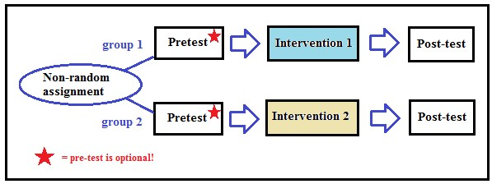
Quasi Experimental Research Design
Quasi-experimental research also similar to randomized controlled trial, but it specifically lacks the element of random assignment to treatment or control.

Slide 33
Systematic Review
A systematic review summarizes the results of available carefully designed healthcare studies (controlled trials) and provides a high level of evidence on the effectiveness of healthcare interventions.

Slide 34
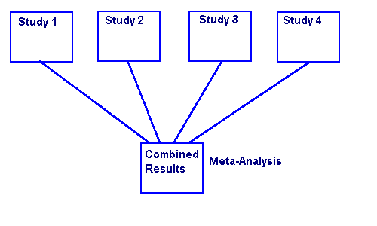
Meta- analysis
A meta-analysis is the use of statistical methods to summarize the results of these studies.

Slide 35
Internal Validity
Extend to which the (Confounding Variables) effect detected in a study reflect rather than result from the effects of extraneous variables.

Slide 36
External Validity
The extend to which the study finding can be generalized beyond the sample used in the study.

Slide 37
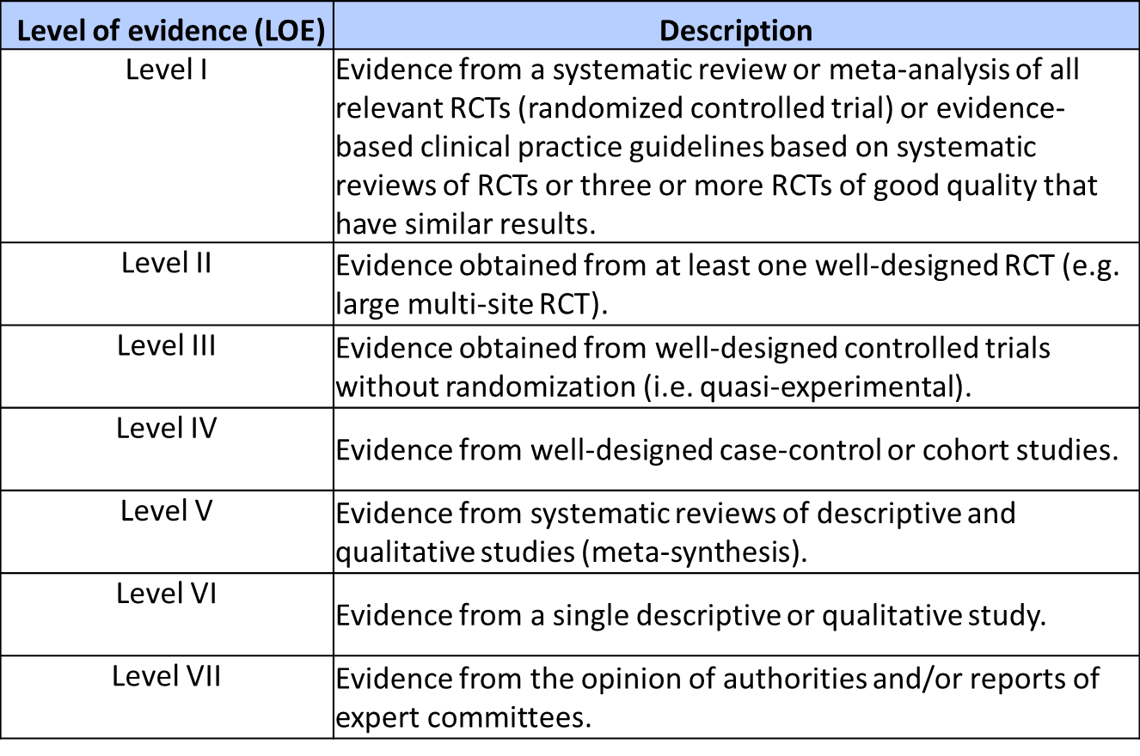
Levels of evidence in EBP

Slide 38

Thank you

