Slide 1


Biomedical Waste Management
Mr. Suresh V.
Associate Professor In Mental Health Nursing
Sumandeep Nursing college
Sumandeep Vidyapeeth Deemed to be University

Slide 2
BIO-MEDICAL WASTE
BMW Waste generated in the diagnosis, treatment or immunization of human beings or animals, in research or in the production or testing of biological products. It also includes waste coming out of medical treatment given at home.
HAZARDOUS WASTE : Any waste with a potential threat to human health & life

Slide 3
CLASSIFICATION OF BMW
NON-HAZARDOUS ( 80% )
HAZARDOUS ( 20% )
  INFECTIOUS ( 15% ) Non sharp, Sharp, Plastic Disposal, Liquid
  OTHER HAZARDOUS (5%) Radioactive, Broken Glassware, Chemical, cytotoxic.

Slide 4
BIO HAZARDOUS WASTE
Infectious waste – 10% (sharp, non sharp, plastics, disposables, liquid waste)
Non infectious waste – 5% (radioactive waste, discarded glass, chemical waste, incinerated waste)
WHO has estimated that 16 billion injection are administered every year. Not all needles & syringes are disposed properly. Despite this progress, In the year 2010, unsafe injection were still responsible for as many as 33,800 new HIV infections, 1.7 million hepatitis B infections & 3,15,000 hepatitis C infections.
Any infectious or non infectious Bio hazardous waste mixed with general waste renders the whole bio hazardous waste .

Slide 5
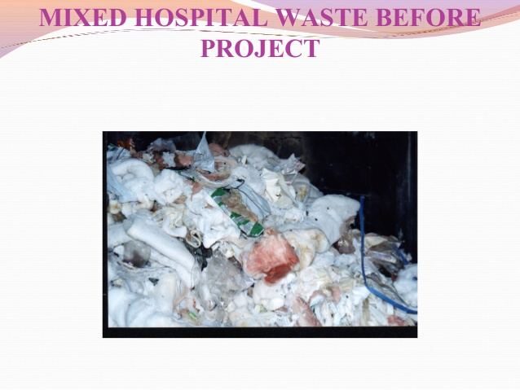
Mixed Hospital waste before project

Slide 6
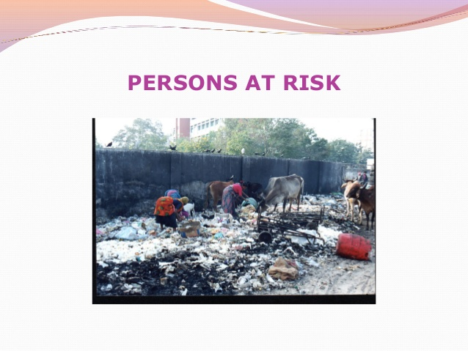
Persons at Risk

Slide 7
RULES FOR BMW
Government of India, first enacted an environment (Protection) act in 1986 notified the rules for the management & handling of bio-medical waste in July, 1998.
Subsequently revised in 2011 & now the “bio medical waste management rules in 2016” Gov. of India.
As per these rules it is duty of hospital, Nursing home, clinic, dispensary, Veterinary institute, animal house, blood bank & pathological laboratory to take all steps to ensure that BMW is handled without adverse effect to human health & environment

Slide 8
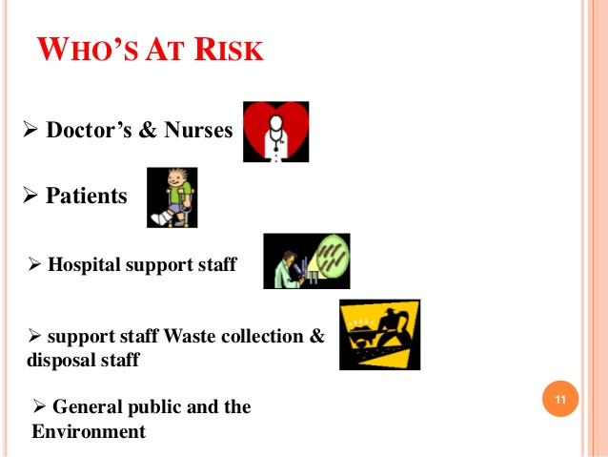
WHO’S AT RISK

Slide 9
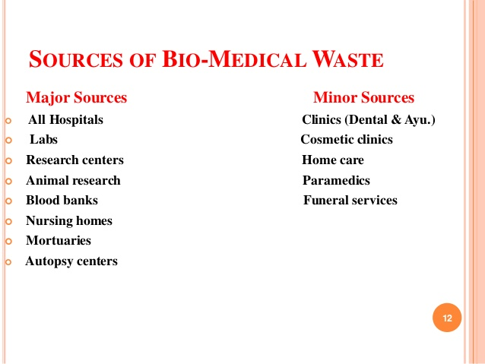

Slide 10
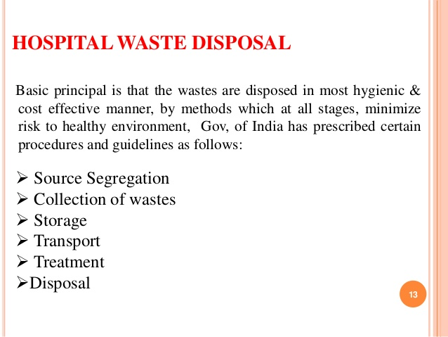

Slide 11
AS PER NOTIFIED RULES
BMW is not to be mixed with other wastes.
BMW should be segregated in specified Container / bag at the site of generation.
Each container has to be specifically labeled.
Transportation of such waste has to be done in specified vehicle only .
Untreated BMW is not to be stored beyond a period of 48 hours.

Slide 12
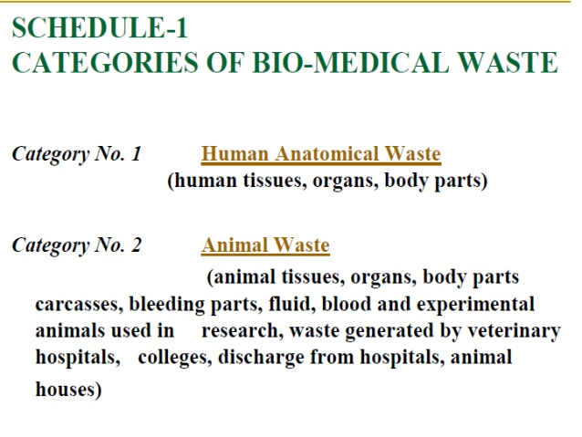

Slide 13
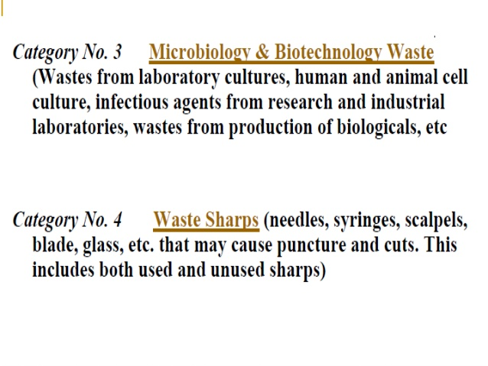

Slide 14
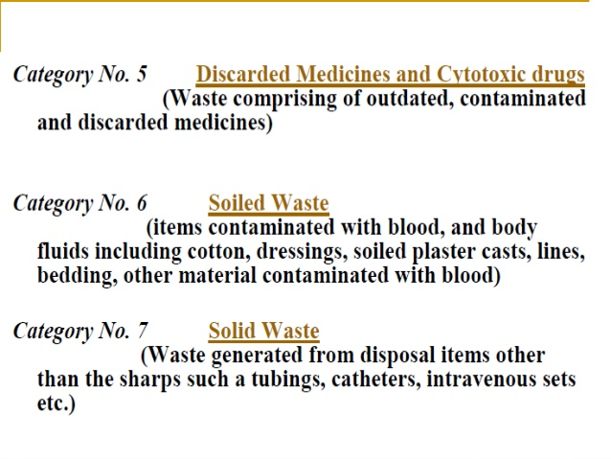

Slide 15
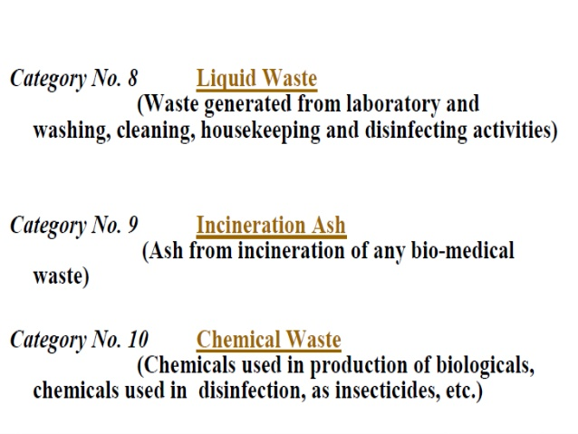

Slide 16
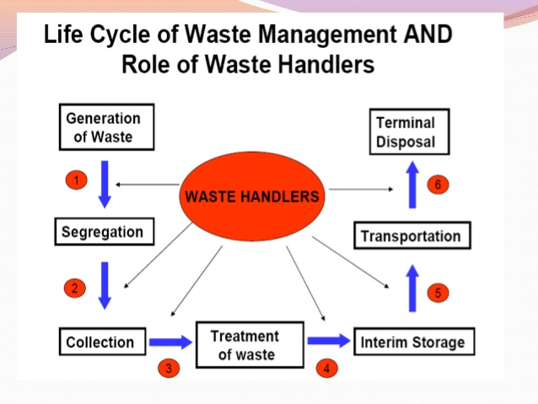

Slide 17
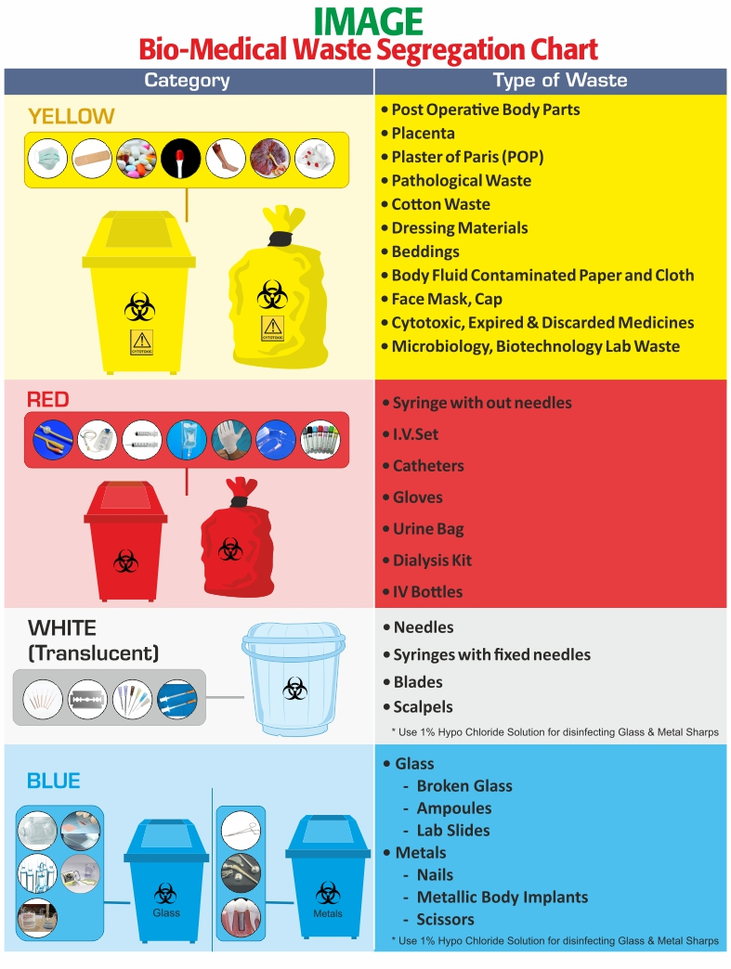

Slide 18
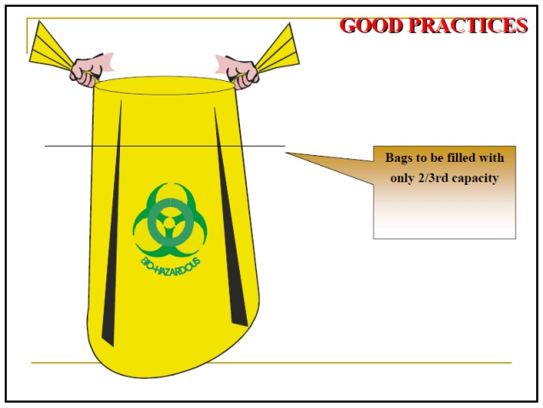

Slide 19
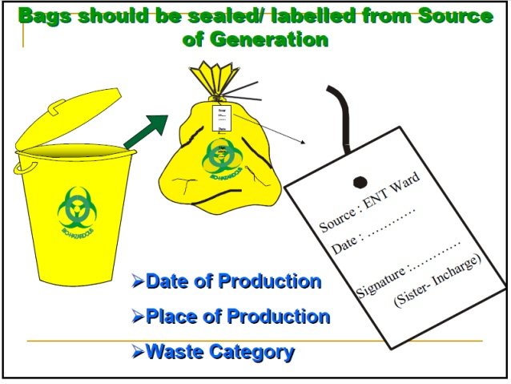

Slide 20
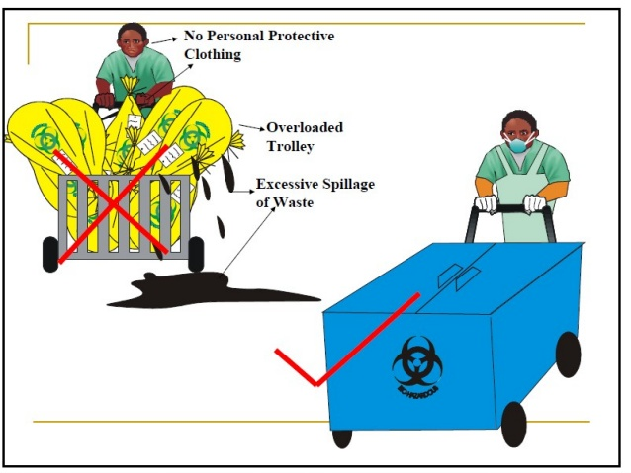

Slide 21
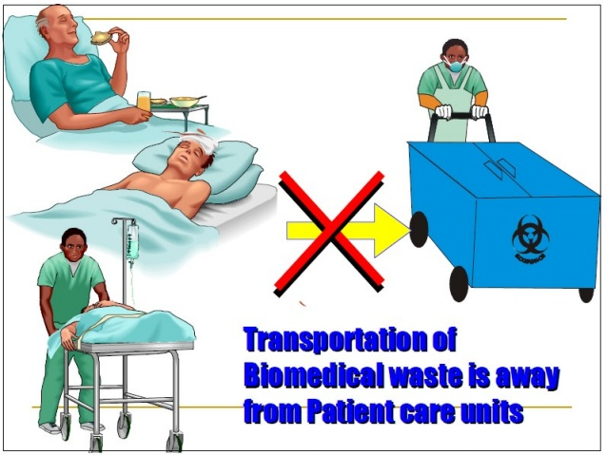

Slide 22
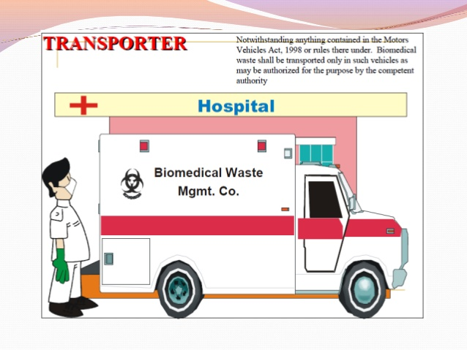

Slide 23
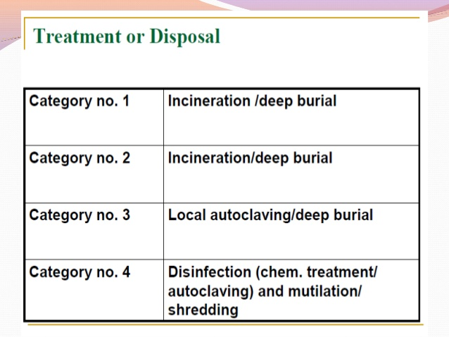

Slide 24
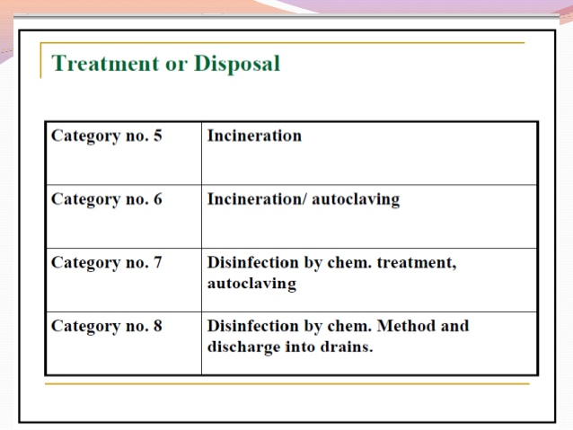

Slide 25
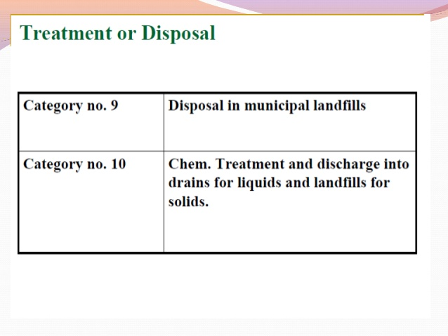

Slide 26
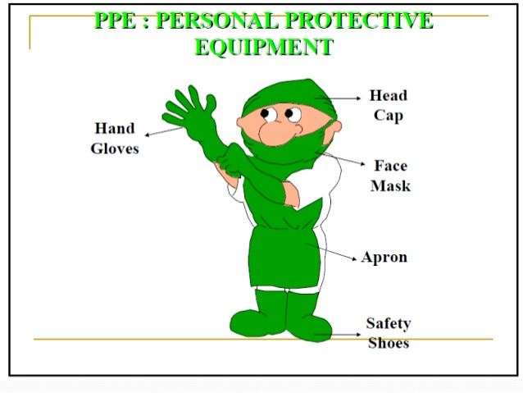

Slide 27
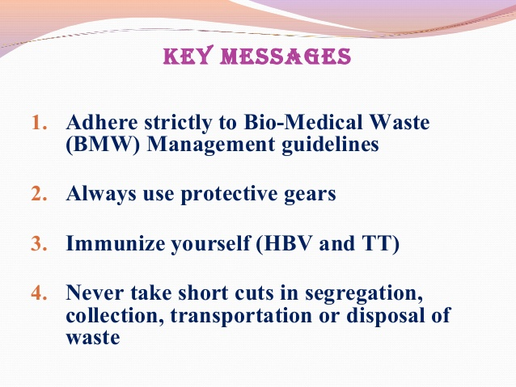

Slide 28


Thank you

