Slide 1
Promotion of mental health and Suicide Prevention
Mr. Suresh V.
Associate Professor In Mental Health Nursing
Sumandeep Nursing college

Slide 2
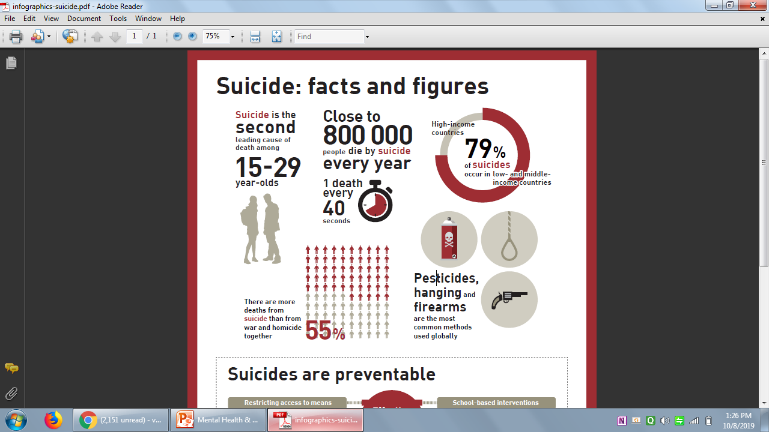
Bitter Truth (WHO-High Priority to Suicide)

Slide 3
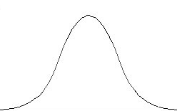
Mental Health & Illness
When a person could able to overcome the situation
Mental Health Mental illness

Slide 4
Who have “No Problem” in life…
Married or Unmarried
Men or Women
Indian or American
Hindu, Muslim or Christian
Believer of god or
Atheist

Slide 5
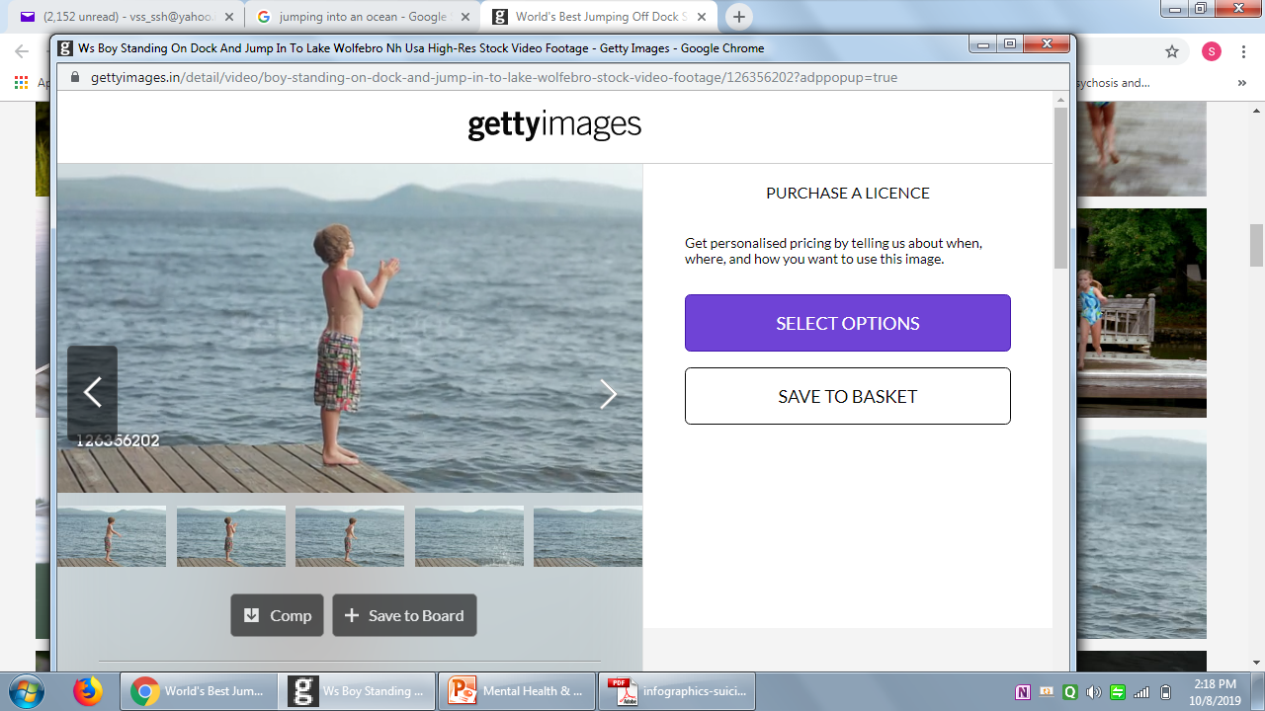
There is nobody in the world without facing problem in their life (Problems are integral part of our life)

Slide 6
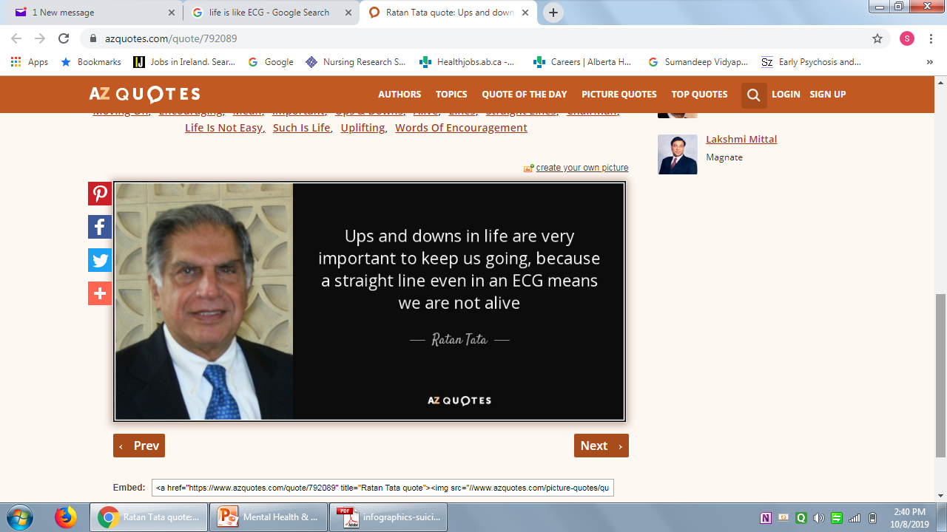
Intensity and Magnitude of problem may differ but problem remain constant

Slide 7
Causes of Suicide
Academic Problem
Health problem (Old Age)
Relationship Problem or breakdown
Opportunity problem
Work pressure, deadlines, Work place politics
Financial problem

Slide 8
Tips to Overcome
Low level hopelessness & Boost up Coping
Kill the shame and prevent suicide.
Ventilate your feelings
Invest in relationship is Greatest asset for mental health.
Encourage the children to share bad news early then good news.
Parents have to come down to share their feelings (That promote the child to share feelings)
Teacher has to interact with students regarding breakup and other problem… (Group Therapy)
Announce the breakup rather announcing love.

Slide 9
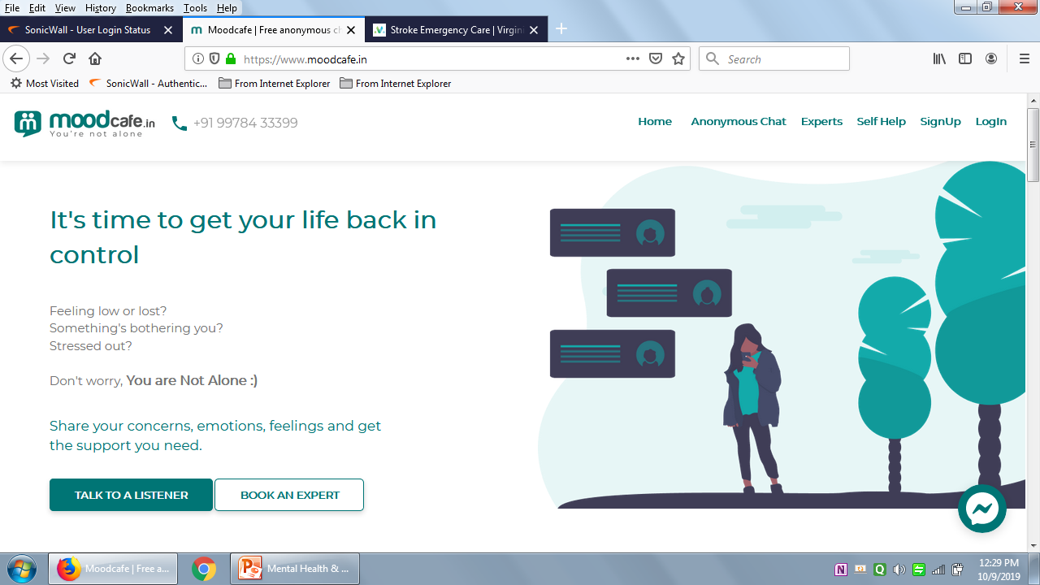
Step for boosting up coping mechanism inner challenges (Mr.Mikul Patel- Mood Café)

Slide 10
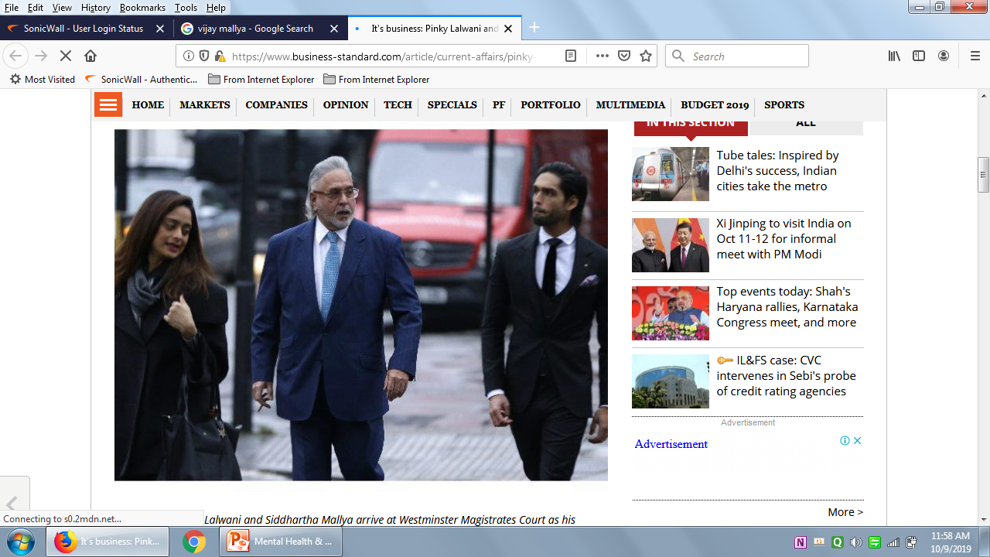
Fiscal hygiene (Self-esteem)

Slide 11
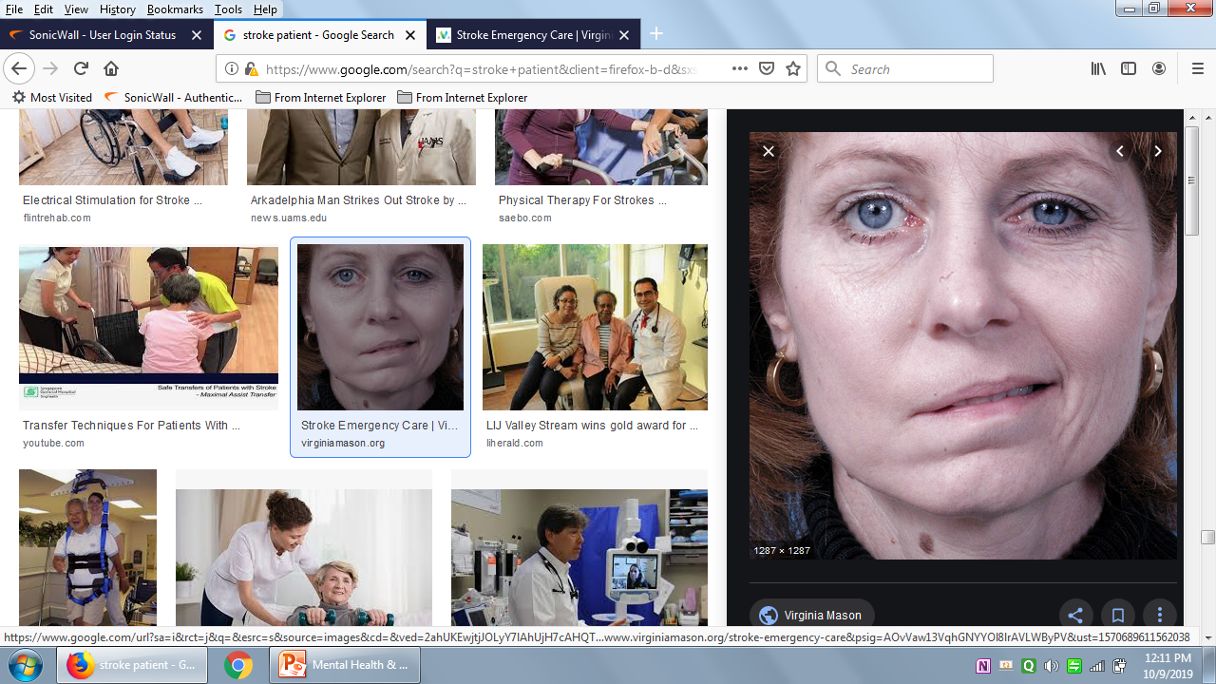
Chronic illness (person has stroke but also suffers with depression)
No human contact

Slide 12
Sleep Deprivation
Don’t keep your mobile beside of your bed keep it invisible
Sleep Deprivation is brittle mind
Re connect the emotion.

Slide 13

Thank you

