Slide 1
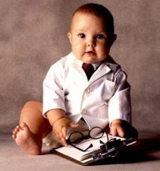

STRESS…
Ms. Bhoomika N. Patel
Assistant professor

Slide 2


Slide 3
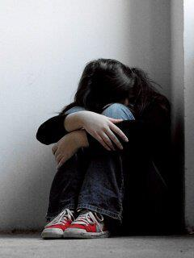
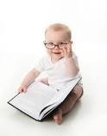
INTRODUCTION
Stress may be viewed as an individual’s reaction to any changes that required an adjustment or response, which can be physical, emotional or mental.

Slide 4
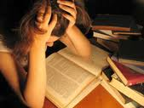
DEFINITION
“Stress is the arousal of mind and body in response to demand made upon them.”
“The response to events that are threatening or challenging.”
“The nonspecific response of the body to any demand for change”
Hans Selye
Acute ,Chronic,
Eustress, Distress

Slide 5
STRESSORS
It is any person or situation that produces anxiety response.
  The environmental stressors:
    Noise, pollution, traffic and crowding etc..
  The physiological stressors:
    illness, injuries, hormonal fluctuation, inadequate sleep or nutrition etc..
  Social stressors:
    Financial problems, work demands, social events, losing a loved ones etc…
  Thought (psychological):
    Negative self talk, catastrophising and perfectionism.

Slide 6
STRESSOR AT DIFFERENT STAGE
DEVELOPMENTAL STAGE | STRESSOR
CHILDHOOD | Conflict between parents, abuse, neglect, family expectorations, financial situation, law academic performance, chronic illness
ADOLESCENCE | Academic pressure, peer pressure, increased conflict with parents, accepting physical changes, relationship with opposite sex, leaving home for higher studies, substance abuse
EARLY ADULTHOOD | Starting a carrier, marriage, adjusting with in-laws, parenting ,work pressures, financial pressures
MIDDLE ADULTHOOD | Coping with health problems, dealing with teenage children, marriage and carrier of children, taking care of old parents, job burnout
OLD AGE | Failing health and stamina, living alone, death of spouse, living with reduced income, adjusting to retirement and loneliness.

Slide 7
Stress cycle
Stress reactions
Wear and tear of body
Reduced optimal health
Increased sensitivity
Stressor

Slide 8
FACTORS WHICH INDUCE STRESS
Change of any kind can induce stress:
  Fear of new, the unknown.
  Feeling of personal insecurity.
  Fear of rejection
  Need of approval
  Fear of conflict
  Fear of taking risk
  Fear of inability to cope with changes

Slide 9
Individuals personalities that can induce stress:
  Low self –esteem
  Feeling over responsible
  Fear of loss of control
  Failure fear, error, mistakes
  Chronic striving to be perfect
  Chronic guilt, anger and depression.

Slide 10
Interpersonal issues that can induce stress:
  Lack of adequate support with in a relationship.
  Lack of healthy communication with in relations.
  Sense of competitiveness between the people.
  Threat of rejection/ disapproval between people.
  Struggle for power and control in the relationship.
  Poor intimacy with in the relationship.
  Over dependency of one person on another.

Slide 11
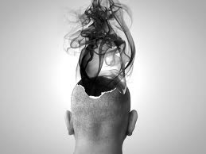
Systems (Family, job, School. Club, Organization) issues that can induce stress.
  Lack of leadership
  Competitive atmosphere
  Lack of team work
  Confused communication.

Slide 12
STRESS AND PHYSICAL HEALTH
The body reacts to stressors by initiating a complex sequence of response attempts to adapt to the continued presence of a stressor may deplete the body’s resources and make it vulnerable to illness.
The wear and tear on the body that result from chronic activity of the physiological response to stress.

Slide 13
ILLNESS
Circulatory system
Persistent stressor
Release of stress hormone
Immune suppression
Unhealthy behavior
Digestive system

Slide 14
Chronic stress can leads to physiological disorders such as Ulcers, high blood pressure, and cardiovascular disease like heart attack, migraines, head ache, asthma etc are some other disorders can result due to stress. It may impair the immune system, decreasing the body’s ability to fight invading viruses and bacteria by inhibiting the release of WBC.
Continuous stress produce catecholamine hormone in the body which put pressure on heart.

Slide 15
People who engage in a healthy lifestyle- eating a low fat diet, getting enough sleep and exercising regularly often report that stressful events seem more manageable and that they full more in control of their lives.
Thus engaging in healthy behaviors can help reduce the stressfulness of life as well as reducing the risk or progression of a number of serious diseases.

Slide 16
SYMPTOMS OF STRESS
Physical symptoms:
  Muscle tension
  Cold/ illness
  High blood pressure
  Rapid breathing
  Indigestion
  Ulcers
  Difficulty in sleeping
  Fatigue
  Head ache/ Back, neck problems/ Back ache
  Increased smoking/ alcohol
  Being more prone to accidents.

Slide 17
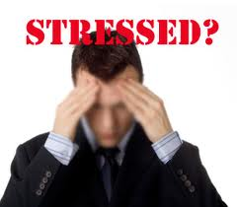
Cognitive symptoms:
  Forgetfulness
  Unwanted repetitive thought
  Difficulty in concentration
  Fear of failure
  Self criticism
Emotional symptoms:
  Irritability
  Depression
  Anger
  Fear/ Anxiety
  Feeling over whelmed
  Mood swings.

Slide 18
PSYCHOSOMATIC DISORDER
7 classical psychosomatic illness…
CARDIO-VASCULAR:
Hypertention
Coronary Artery Disease
Migraine
Mitral Valve Prolapse Syndrome

Slide 19
ENDOCRINE DISORDER:
Diabetes Mellitus
Hyperthyroidism
Cushing Syndrome
Premenopausal Syndrome
Amenorrhoea
Menorrhagia

Slide 20
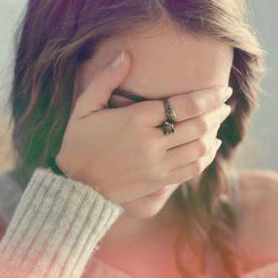
GASTRO-INTESTINAL DISODER:
Esophageal Reflux
Peptic Ulcer
Ulcerative Collitis
Crohn’s Disease

Slide 21
IMMUNE DISORDER:
Auto immune disorders.
Example: Systemic Lupus Erythematous
Allergic Disorder- Bronchial Asthma
Viral Infection
MUSCULO-SKELETAL DISORDERS:
Rheumatoid Arthritis

Slide 22

RESPIRATORY DISORDER:
Bronchial Asthma
Rhinitis
SKIN DISORDER:
Psoriasis
Acne Vulgaris
Warts

Slide 23
MODELS OF STRESS
Models of stress assist nurses to identify the stressors in a particular situation. There are 3 Models, they are as follows:
Stimulus Based Model
Response Based Model
Transaction Based Model

Slide 24
STIMULUS BASED MODEL
Stress is a stimulus that arouse physiological & psychological reaction that may increase the individual vulnerability to illness.
Holmes & Rahe developed rating scale that is “SOCIAL READJUSTMENT RATING SCALE”.
It has 43 Events of questions, in which both positive & negative considered as a stressful.

Slide 25
The more stressors an individual experience, the more likely to develop Physical Illness and Mental Disorders.

Slide 26
RESPONSE-BASED MODEL
It is physiological response or a general adaptation syndrome.
The syndrome of symptoms has come to be known as the “FLIGHT OR FIGHT SYNDROME”
There are 3 Stages of reaction, they are:
Alarm Reaction Stage
Stage Of Resistance
Stage Of Exhaustion

Slide 27
Alarm Reaction Stage: During this stage the physiological response of the “FLIGHT OR FIGHT” Syndrome is initiated.

Slide 28
Stressors
Hypothalamus
Sympathetic Nervous System
Adrenal medulla, Eye, Lacrimal gland, Respiratory system, cardiovascular system, G.I System, Liver, Urinary System, Sweat Glands, Fat Cells.

Slide 29
STAGE OF RESISTANCE
The individual uses the physiological responses as a defence in attempt to adopt the stressors.

Slide 30
Stressor
Stimulates
Hypothalamus
Releases
CRH
GHRH
TRH
Stimulates
Anterior Pituitary
Releases
ACTH
HGH
TSH
Stimulates
Stimulates
Stimulates
Adrenal Cortex
Liver
Thyroid gland
Releases
Supplies energy through Glyconeogenesis and increased breakdown of fats
Supplies energy through increased breakdown of Carbohydrates
Adrenal Hormones
(Glucocorticoids & Mineralocorticoids)

Slide 31
STAGE OF EXHAUSATION
This stage occurs when there is a prolonged exposure of stressors, at this stage, the cell started to die & the organs weakens
A long term resistances reaction put heavy demand on the body

Slide 32
TRANSACTION-BASED MODEL
It is also called as as Lazarus Model.
It is emphasized that certain environmental demands & pressure producing stress in number of people.
The people differ from sensitivity, perception & reaction.
In terms of illness-1st id denial another is anxiety & still another one is depression it happens based on the perception.

Slide 33
COPING
Coping refers to the conscious effort to solve problems and to master, minimize and tolerate stress
Coping strategies
Appraisal focused strategies (modify thinking)
Problem focused strategies (task oriented,: attack, withdrawal and compromise)
Emotion focused strategies

Slide 34
DEFENCE MECHANISM
Sigmund Freud used the term defense mechanism.
It refers to unconscious process that will protect the person from anxiety and helping for the adjustment.
Repression:
  It means pushing of unacceptable impulses back into the unconscious. (Forgetting)
  Eg: Excluding painful thoughts from consciousness (or) Forgetting some bitter experiences.

Slide 35
Denial:
  It is refusal to face painful thoughts/ feelings
  Example: Not accepting the illness
Displacement:
  Its an unaccepted feeling about a person/situation which is transferred from its true target to another
  Example:A frustrated officer may take out his aggression on his wife or child.
Reaction formation:
It consist of replacing unacceptable feeling with their exact opposites.

Slide 36
Example: A jealous boy who hates his elder brother may show him exaggerated respect & affection.
Rationalization:
It is a process in which an individual justifies his failure by giving socially approved reasons.
Example: A student who fails in examination;complaints the faculty’s are not good in the institution.

Slide 37
Sublimation:
It is transformation of repressed motives/feelings into a more socially acceptable form (similar to displacement).
Example:Agression might be transferred into business or sports.
Compensation:
  Attempting to overcome feeling of inferiority / make up for the deficiency
  Example: Poor academic student showing their talent in the sports & become champion.

Slide 38
Projection:
  A person blames another for his own mistake.
  Example: A mistake committed by the doctor ,but blames on nurse.
Intellectualization:
  It is an attempt to gain detachment from an emotionally threatening situation.
  Example: Students take leave on examination dates

Slide 39
Undoing:
  It is an action that is desired to prevent some unacceptable thoughts.
  Example: Listening music's, performing dance involving in jogging / exercise etc..
Regression:
  Returning to earlier, safer stages of our lives
  There may be regression to the stage where there was previous fixation
  Example: An adult (shows) throws a temper tantrum when he does not get his own way.

Slide 40
Identification :An attempt to increase self worth by acquiring certain attribute and characteristics of an individual one admires.
Fantasy : withdrawing to make believe world through day dreaming
Negativism : becoming uncooperative and doing the opposite of what should be done
Undoing:Trying to reverse or "undo" a thought or feeling by performing an action that signifies an opposite feeling than your original thought or feeling. Ex.: You have feelings of dislike for someone so you buy them a gift
Introjection : integrating the beliefs and values of another individual into one’s own ego structure.

Slide 41
STRESS MANAGEMENT STRATEGIES
Take a deep breath: When a feel of “UP-TIGHT” exists, take a minute to slow down & breath deeply through nose & exhale out through mouth.
Practice Specific Relaxation Techniques: Relaxation techniques like- meditation,hypnosis & deep muscle relaxation etc is helpful
In this state both body & mind are at rest & outside world is screened out for a period of time.

Slide 42
Manage Time: One of the greatest source of stress is poor time management
Do not over work yourself, schedule time for both work & for self.
Connect with others: A good way to compensate sadness, boredom & loneliness is to set out activities involving others.
Talk It Out: When you feel something,try to express it out by sharing feelings," BOTTLED UP" emotions increase frustrations & stress, talking with someone else can help to clear your mind’s confusion which help in problem solving.

Slide 43
Take A “Minute” Vacation: Imagine a Quite country scene can take you out of the Turmoil of a stressful situation.
When you have an opportunity, take a moment to close your eyes & imagine a place where you feel relaxed & comfortable, notice all the details of your chosen place, including pleasant sounds, smells & temperature etc.
Monitor Your Physical Comfort: wear comfortable clothes, do not wait till your discomfort turns into a real problem.

Slide 44
Get Physical: When you feel nervous, angry or upset, release the pressure through exercise or physical activity, such as-running, walking, listening music, dancing etc.
Working In garden, playing with baby’s or children can relieve that “Up Tight” feeling, & often will actually energies you,& makes your mind & body work together.
Laugh: Maintain your sense of humor.

Slide 45
Take Care Of Your Body: Healthy eating & adequate sleep frees your mind as well as your body.
Avoid consuming too much amount of caffeine & sugar
Take time for personal interests & hobbies, listen to one’s own body.
If you are irritable & tense from lack of sleep & anorexia, you will be less able to “Go The Distance In Dealing With Stressful Situations”

Slide 46
Know Your Limits: There may be many circumstances in life beyond our control, consider the fact that we live in a imperfect world.
If the problem is beyond your control & can’t be changed at the moment, don't fight the situation.
Learn to accept What Is For Now until the time when you can change things.
Think Positively: Reforces the negative to be positive, make an effort to stop negative thoughts.

Slide 47
Compromise: A little give & take on both sides may reduce the strain (in relationship &work place) & help you feel more comfortable & peaceful
Have A Good Cry: A good cry during period of stress can be a healthy way to bring relief to your anxiety.
It might prevent a head ache or other physical consequences of “Bottling Things Up” .

Slide 48
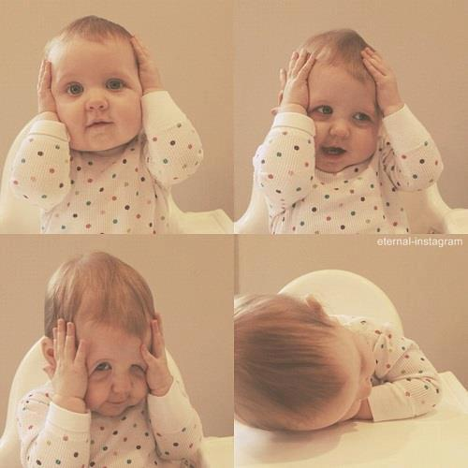

Slide 49
NURSING MANAGEMENT
NURSING ASSESSMENT:
Assessment Of Individual:-Nurse should collect patient’s perceived stressors/stressful incidents, manifestation of stress, past & present coping strategies.
Assessment Of Family:-Assess the family perception of the problem
Assessment Of Environment:-Occupation with a high degree of stress ;adverse environment influences like too much of lighting, temperature etc.

Slide 50
NURSING GOALS:
Decrease /Resolve Anxiety
Increase Ability To Manage
Cope With Stressful Events
Improve Role Performance
NURSING INTERVENTION:
Minimizing Anxiety
Minimizing Stress

Slide 51
STRESS IN NURSES
Working in the caring professions continually exposed to human suffering are arguable at greater risk for stress related problems
Nurses experience stress because in their work importance iss attached to success & failure is clearly visible
So its necessary for a nurse to remember some strategies to reduce her stress on job without disturbing her working skills and efficiency..

Slide 52
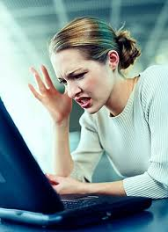
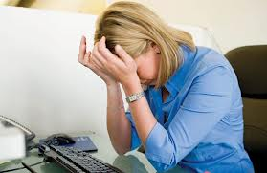

Slide 53
Points to be kept in mind:
Avoid unnecessary arguments with others.
Take proper rest
Always take care of food & health.
Should learn some yoga/exercise to relax.
Can listen music/T.V. programs to entertain & relax.
Avoid noisy condition as far as possible.
Compromise with the hectic condition of nursing profession.

Slide 54
STRESS AMONG NURSING STUDENTS
Nursing education programs can generate a considerable amount of stress & anxiety among the students.
There are numerous stressors associated with nursing education as students develop critical thinking & complex psychomotor skill & progress through a competitive.
Several potentially stressful time are during the process of acquiring & demonstrating skill competence & passing writing examination with the application of critical thinking skill.

Slide 55
Nursing students are under more stress than registered practioners due to the demand of studying & placement, combined with financial hardships.
Stress management strategies are more important to the nursing students so that the students will be empowered to use strategies that help in reduction of stress, facilitate self-control & enhanced concentration.

Slide 56

STRESS IN NURSES

Slide 57
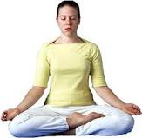
TREATMENT
Relaxation Techniques
Yoga
Hypnosis
Meditation
Biofeedback
Behavioral Modification technique
Individual Therapy
Group Therapy

Slide 58
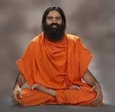
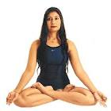
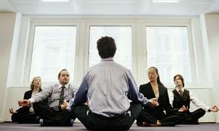

Slide 59


THANK YOU!!!

