Slide 1
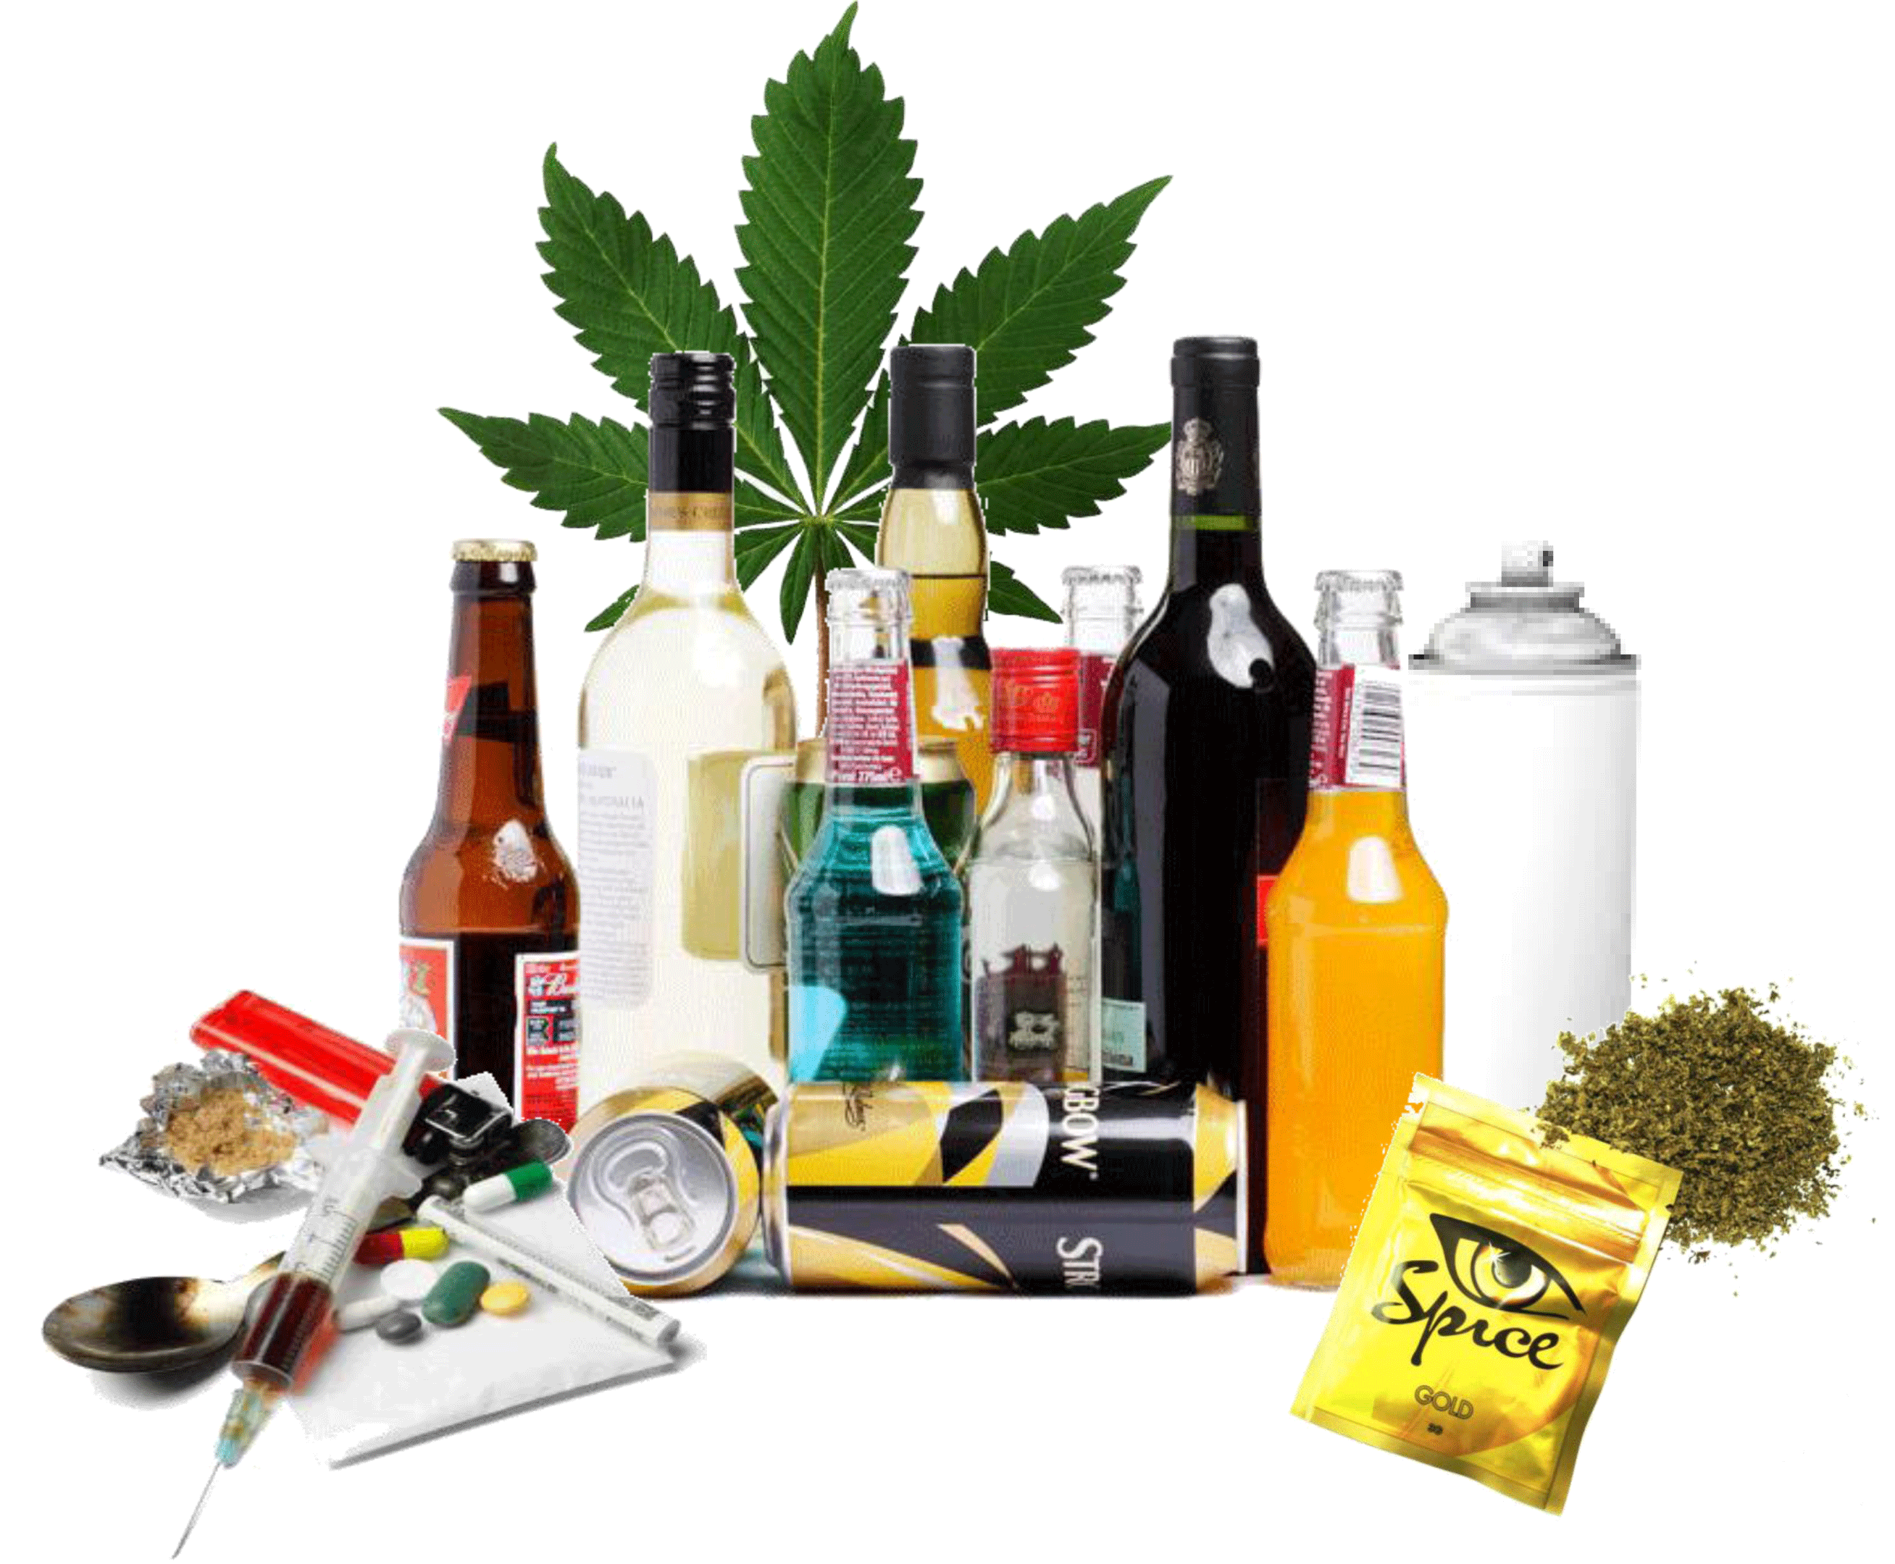

Slide 2

SUBSTANCE USE DISORDER
BHAVISHA PATEL
ASSISTANT PROFESSOR
SNC

Slide 3

TERMINOLOGY
Substance: Any physical matter
Abuse: Wrong or harmful use
Dependence: a compulsive or chronic requirement
Addiction: uncontrolled and compulsive use
Psychoactive substance: one that is capable of altering the mental functions

Slide 4
DEFINITIONS
SUBSTANCE ABUSE:
Any use of substances that poses significant hazards to health.
SUBSTANCE DEPENDENCE:
A cluster of cognitive, behavioral and physiological symptoms indicating that the individual continues use of the substance despite substance related problems (APA)

Slide 5
DEFINITION
SUBSTANCE USE DISORDER:
A disorder in which the use of one or more substances leads to a clinically significant impairment or distress

Slide 6
PSYCHOACTIVE SUBSTANCES
Alcohol
Opioids (opium, heroin)
Cannabinoids (cannabis)
Cocaine
Amphetamines and other sympathomimetics
Hallucinogens (LSD, phencyclidine)
Sedatives and hypnotics (barbiturates)
Inhalants (volatile solvents)
Nicotine
Other stimulants (caffeine)

Slide 7
ETIOLOGY
BIOLOGICAL FACTORS:
  Family history
  Co morbid psychiatric disorders
  Co morbid medical disorders
  Reinforcing effects of drug use
  Withdrawal effects of drug use
  Biochemical factors

Slide 8
PSYCHOLOGICAL FACTORS:
  Curiosity
  Early initiation of alcohol or tobacco
  Poor impulse control
  Low self esteem
  Poor stress management skills
  Childhood trauma or loss
  Relief from boredom/ fatigue
  Escape from reality
  Psychological stress
  Lack of goals

Slide 9
SOCIAL FACTORS:
  Peer pressure
  Modeling
  Ease of availability of alcohol or drugs
  Intrafamilial conflicts
  Religious reasons
  Poor social/ familial support
  Perceived distance within the family
  Rapid urbanization

Slide 10
SUBSTANCE ABUSE
ADDICTION
DEPENDENCY
TOLERANCE
WITHDRAWAL

Slide 11
ALCOHOL DEPENDENCE SYNDROM
Alcohol dependence is a previous psychiatric diagnosis in which an individual is physically or psychologically dependent upon drinking alcohol.
In 2013 it was reclassified as alcohol use disorder.

Slide 12
PROPERTIES OF ALCOHOL
Alcohol is a clear colored liquid with a strong burning taste. The rate of alcohol into the blood stream is more rapid than its elimination.
Absorption of alcohol into the bloodstream is slower when food is present in the stomach. A small amount is excreted through urine and a small amount is exhaled.

Slide 13
A concentration of 80-100 mg of alcohol per 100ml of blood is considered intoxication.
A person with 200-250 mg will be toxic, sleepy, confused and his thought process will be altered.
If blood level is 300mg/100ml of blood the person may lose consciousness.
A concentration of 500 mg/ 100ml is fatal. All the symptoms change according to tolerance.

Slide 14
EPIDEMIOLOGY
The incidence of alcohol dependence is 2% in india.
While 20-40% of subjects aged above 15 years are current users of alcohol, and nearly 10% of them are regular or excessive users.
Nearly, 15-30% of patients are developing alcohol-related problems and seeking admission in psychiatric hospitals.

Slide 15
SIGNS AND SYMPTOMS
Malaise
Dyspepsia
Mood swings or depression
Increased incidence of infection
Poor Personal hygiene
Untreated injury
Unusually high tolerance for sedatives
Nutritional deficiency
Secretive behaviour
Consumption of alcohol-contain product
Denial of problem
Tendency to blame others
Rationalize problems

Slide 16

PSYCHIATRIC DISORDERS DUE TO ALCOHOL DEPENDENCE
Acute intoxication
Withdrawal syndrome
Alcohol-induced amnestic disorder
Alcohol-induced psychiatric disorder

Slide 17
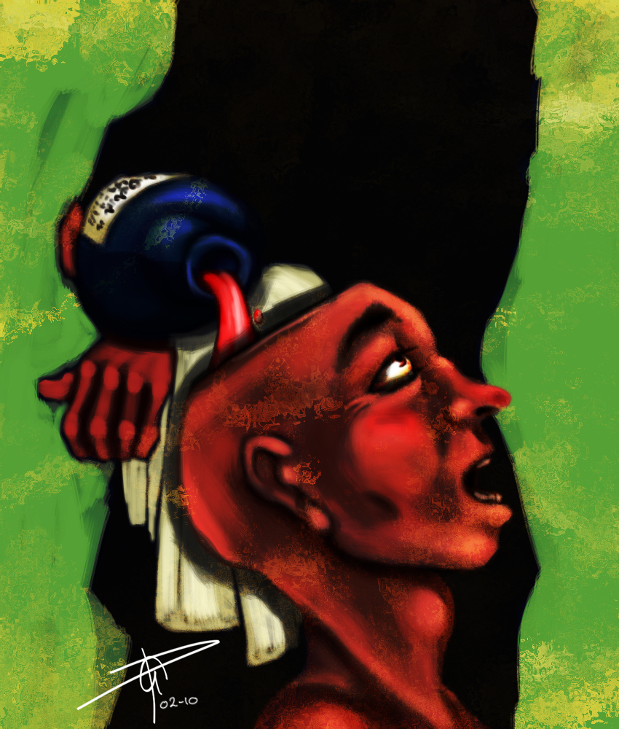
1. ACUTE INTOXICATION
Alcohol intoxication is the result of alcohol entering the bloodstream faster than it can be metabolized by the liver, which breaks down the ethanol into non-intoxicating by products.

Slide 18
Some effects of alcohol intoxication (such as euphoria and lowered social inhibitions) are central to alcohol's desirability as a beverage and its history as one of the world's most widespread recreational drugs.
Despite this widespread use and alcohol's legality in most countries, many medical sources tend to describe any level of alcohol intoxication as a form of poisoning due to ethanol's damaging effects on the body in large doses.

Slide 19
2. WITHDRAWAL SYNDROME
Alcohol withdrawal syndrome, symptoms seen when an individual reduces or stops alcohol consumption after periods of excessive alcohol intake.
These are:
1. simple withdrawal syndrome
2. delirium tremens

Slide 20
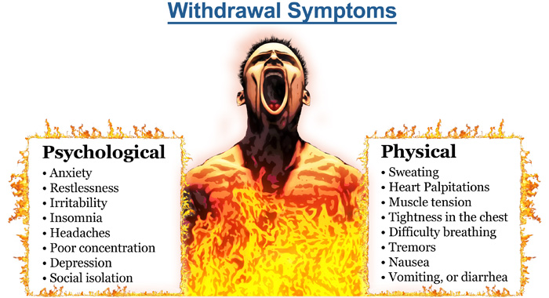

Slide 21
Delirium tremens
It occurs usually within 2-4 days of complete or significant abstinence from heavy alcohol drinking. The course is short, with recovery occurring within 3-7 days.
Simple withdrawal syndrome
It is characterized by mild tremors, nausea, vomiting, weakness, irritability, insomnia and anxiety

Slide 22
3. ALCOHOL-INDUCED AMNESTIC DISORDERS
Chronic alcohol abuse associated with thiamine deficiency is the most frequent cause of amnestic disorders.
This condition is devided into:
Wernicke’s syndrome:
- This is characterised by prominent cerebellar ataxia, palsy of the 6th cranial nerve, peripheral neuropathy and mental confusion.

Slide 23
Korsakoff’s syndrome: The prominent syndrome in korsafoff’s syndrome is gross memory disturbance. Other symptoms include:
Disorientation
Confusion
Confabulation
Poor attention span and distractibility
Impairment of insight

Slide 24
4. ALCOHOL-INDUCED PSYCHIATRIC DISORDERS
Alcohol induced dementia:
it is a long-term complication of alcohol abuse, characterised by global decrease in cognitive functioning.
b. Alcohol-induced mood disorder:
- excess drinking may induced persistent depression or anxiety.

Slide 25
c. Suicidal behaviour: suicidal rate are higher in alcoholics when compared to nonalcoholics of the same age.
d. Alcohol-induced anxiety disorders: alcoholics reports panic attacks during acute withdrawal, similarly during the first 4-6 weeks of abstinence.
e. Pathological jealousy: excessive drinkers may develop an overvalued idea or delusion that the partner is being unfaithful.

Slide 26
f. Alcoholic seizures:
generalised tonic clonic seizures occur usually within 12-18 hours after a heavy bout of drinking.
g. Alcoholic hallucination:
- this is characterised by presence of hallucination during abstinence following regular alcohol intake.

Slide 27
COMPLICATIONS 0F ALCOHOL ABUSE
Alcohol damages body tissues by irritating them directly, through changes that occur during its metabolism by interacting with other drugs, by aggravation existing disease, or through accidents brought on by intoxication.
Tissue damage can lead to a host of complication.

Slide 28
DIAGNOSIS
Blood alcohol level to indicate intoxication
Urine toxicology to reveal use of other drugs
Serum electrolyte analysis
Liver function studies
Hematologic workup possibility revealing anemia, thrombocytopenia
Echocardiography and ECG
Based on ICD10

Slide 29

TREATMENT FOR WITHDRAWAL SYMPTOMS
Detoxification: detoxification is the treatment for alcohol withdrawal symptoms.
The drugs of choice are benzodiazepines. The most commonly drugs from this class are clorodizepoxide 80-200 mg/day and diazepam 40-80 mg/day, in devided doses

Slide 30
Others:
For vitamin B deficiency a preparation of vitamin B containing 100 mg of thiamine should be administered parenterally , twice daily for 3-5 days . this should be followed by oral administration of vitamin B for at least 6 months.
Administration of anticonvulsants is necessary maintaining fluid and electrolyte balance, strict monitoring of vitals, level of consciousness and orientation. Close observation is essential especially during the 1st five days.

Slide 31
DISULFIRAM
It is used to ensure abstinence in the treatment of alcohol dependence.
Its main effect is to produce a rapid and violently unpleasant reaction in a person who ingest a small amount of alcohol while talking disulfiram.

Slide 32
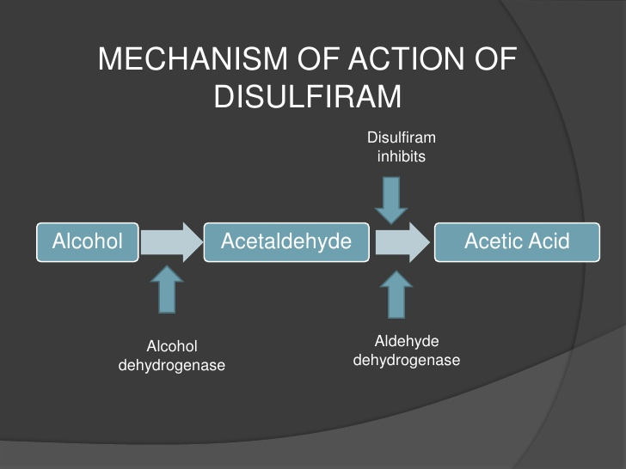

Slide 33
Side effect
Fatigue Hepatic damage
Dermatitis Respiratory depression
Impotence Convulsions
Optic neuritis Cardiovascular collaps
Mental changes MI
Acute polyneuropathy Death

Slide 34
Contraindications:
Pulmonary and cardiovascular disease.
Nephritis
Brain damage
Hypothyroidism
Diabetes
Hepatic disease
Seizures
Poly-drug dependence
Alcohol ingestion

Slide 35
Dosage
250-500 mg 0rally
The usual initial dose is 500 mg/day oralllyfor the first 2 weeks, followed by a maintenance dosage of 250mg/day.
The dosage should not exceed 500mg/day.

Slide 36

Nurses role
an informed concern should be taken before starting treatment.
Ensure that at least 12 hours have elapsed since the ingestion of alcohol before administering the drug.
Patient must be instructed that ingestion of even the smallest amount of alcohol brings on a disulfiram-ethanol reaction with all its unpleasant effects; he should therefore be strictly warned not to take any alcohol whatever.

Slide 37
The patient should also be warned against ingestion of any alcohol-containing preparations such as cough syrups, drops of any kind, and alcohol-containing foods and sauces.
Advice against use of alcohol based aftershave lotions and inhalation of paints, warnishes, etc. containing alcohol. Any topical applications containing alcohol should also be avoided.
Caution patient against taking CNS depressants or any OTC medications during disulfiram therapy.
Instruct the patient to avoid driving or oter activities requiring alertness until response to drug is known.

Slide 38

NURSING MANAGEMENT
Nursing assessment:
Recognition of alcohol abuse: the CAGE questionnaire may be adopted for this purpose:
C: have you ever felt you ought to CUT down
on your drinking?
A: have people ANNOYED you by critizing
your drinking?
G: have you ever felt GUILTY about your
Drinking?
E: have you ever had a drink first thing in the
Morning to steady your nerves or get rid of
a hangover?

Slide 39
Be suspicious about at risk factors: problems in the marriage and family, at work, with finances or with the law; at risk occupations; withdrawal symptoms after admission; alcohol-related physical disorders; repeated accidents; deliberate self harm.
If at risk factors raise suspicion, the next step is to ask tactful but persistent questions to confirm the diagnosis.

Slide 40
Nursing diagnosis 1
Risk for injury related to hallucinosis, acute intoxication evidenced by confusion, disorientation, inability to identify potentially harmful situations.
Nursing diagnosis 2
Altered health maintenance related to inability to identify, manage or seek out help to maintain health, evidenced by various physical symptoms, exhaustion, sleep disturbances. Etc

Slide 41
Nursing diagnosis 3
Ineffective denial related to weak, underdeveloped ego, evidenced by lack of insight, rationalization of problems, blaming others, failure to accept responsibility for his behaviour.
Nursing diagnosis 4
Ineffective individual coping related to impairment of adaptive behaviour and problem solving abilities, evidenced by use of substances as coping mechanisms.

Slide 42
Evaluation:
The following question s can be useful in evaluating the nursing care:
Has detoxification occurred without complications?
Has a correlation been made between personal problems and the use of substances?
Does he accept responsibility for own behaviour?

Slide 43

M.C.Q.
A concentration of 80-100 mg of alcohol per 100ml of blood is considered as …….
Confused
Unconsciousness
Fatal
Intoxication
In which condition gross memory disturbance is occur?
Wernick’s syndrome
Korsakoff’s syndrome
Delirium tremens
Withdrawal symptoms

Slide 44
Which drug is used for withdrawal symptoms?
Disulfiram
Antause
Benzodizepines
Aniemetics
The usual initial dose of disulfiram is…..
250 mg/day
500 mg/day
250-500 mg/day
200 mg/day

Slide 45
5. Which are the alcohol-induced amnestic disorders?
Wernicke’s syndrome
Korsakoff’s syndrome
Alcohol induced dementia
Both a and b

Slide 46


Slide 47


