Slide 1

BEHAVIOURAL THERAPY
BHAVISHA PATEL
ASSISTANT PROFESSOR
SNC

Slide 2

INTRODUCTION
Behavioural therapy, also called behavioural modification, uses psychological counselling to change activity that is undesirable or potentially harmful.
Treatment most often is directed toward changing harmful habits, such as discontinuing cigarette smoking, dieting to lose weight, controlling alcohol abuse, or managing stress more effectively.

Slide 3

DEFINITION
“It is the systematic application of learning a form of psychotherapy, aims at changing mal-adaptive behaviour by substituting it with adaptive behaviour.”
“Behaviour therapy, the application of experimentally derived principles of learning to the treatment of psychological disorders.”

Slide 4

PURPOSE
Permanent change in behavior occurs as a result of practice or experience
Correction of the abnormal psycho-dynamics which are contributing to the illness.
Helpful even in those conditions which are refractory to other forms of the behavioural therapy.

Slide 5
Based on the principles and procedures of the scientific method.
Active behaviour change
Emphasizes self-management Strategies.
Focus is on assessing behavior directly, identifying the problem, and evaluating change.
Teaching clients skills to use in everyday life
Deals with current problems and factors influencing them

Slide 6

CHART

Slide 7

CONTRAINDICATIONS
The disease in which symptomatology is acute pervasive of non-circumscribed and in which triggering environmental event or external reinforcement are not obvious.

Slide 8

ASPECTS
CLASSICAL CONDITIONING
OPERANT CONDITIONING
SOCIAL LEARNING APPROACH
COGNITIVE BEHAVIOUR THERAPY

Slide 9

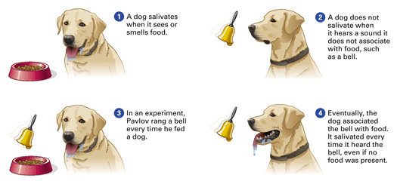
1. CLASSICAL CONDITIONING

Slide 10
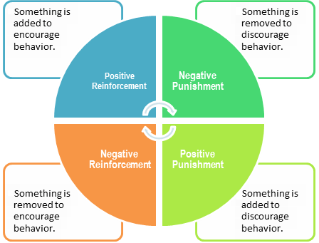
2. OPERANT CONDITIONING

Slide 11
3. SOCIAL LEARNING APPROACH
Behavior is influenced by triadic reciprocal interaction among …
- environment
- personal factors (beliefs, preferences, etc.)
- individual behavior
-Capable of self-directed behavior change
-Self-efficacy refers to the individual’s belief that they can change.

Slide 12
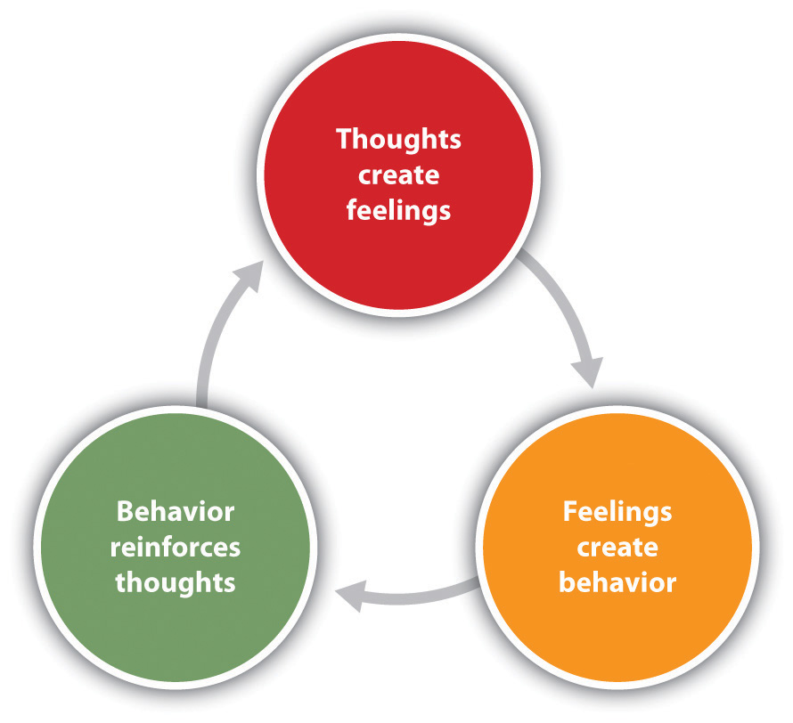
4. COGNITIVE BEHAVIOUR THERAPY

Slide 13
BEHAVIOUR TECHNIQUES
Systematic desensitization
Flooding
Aversion therapy
Operant conditioning procedures for increasing adaptive behavior
Operant conditioning procedures to teach new behavior
Operant conditioning procedures for decreasing maladaptive behavior
Assertiveness and social skill training

Slide 14

A. SYSTEMATIC DESENSITIZATION
It was developed by Joseph Wolpe, based on the behavioural principle of counter conditioning, in this patient attains a state of complete relaxation and is then exposed to the stimulus that elicits the anxiety response.
The negative reaction of anxiety is inhibited by the relaxed state, a process called reciprocal inhibition

Slide 15
It consists of three main steps:
Relaxation training
Hierarchy construction
Desensitization of the stimulus

Slide 16
Indication:
Phobias
Obsessions
Compulsions
Certain sexual disorders

Slide 17
B. FLOODING
The technique, sometimes called implosive therapy, is also used to desensitize individuals to phobic stimuli.
It differs from systematic desensitization in that, instead of working up in a hierarchy of anxiety producing stimuli, the individual is ‘flooded’ with a continuous presentation (through mental imagery) of the phobic stimulus until it no longer elicits anxiety.

Slide 18
Flooding is believed to produce results faster than systematic desensitization; however, some therapists report more lasting behavioural changes with systematic desensitization.
Flooding is contraindicated with clients for whom intense anxiety would Be hazardous (e.g. individuals with heart disease or fragile psychological adaptation)

Slide 19

C. Aversion therapy:
Pairing of pleasant stimulus with an unpleasant response, so that even in the absence of the unpleasant response the pleasant stimulus becomes unpleasant by association.
Indication:
Alcohol abuse
Paraphilias
Homosexuality
Transvestism

Slide 20
Overt sensitization
It is a type of aversion therapy that produces unpleasant consequences for undesirable behavior. For an example, disufiram (Antabuse) is a drug that is given to individual who wish to stop drinking alcohol. If an individual consumes alcohol while on Antabuse therapy, symptoms of severe nausea and vomiting, dyspnea, palpitation, and headache will occur.

Slide 21
Instead of the euphoric feeling normally experienced from the alcohol (the positive reinforcement for drinking), the individual receives a severe punishment that is intended to extinguish the unacceptable behavior (drinking alcohol).

Slide 22
Covert Sensitization
Covert sensitization relies on the individual’s imagination to produce unpleasant symptoms rather than on medication.

Slide 23
D) Operant conditioning procedures for increasing adaptive behavior
Positive reinforcement:
when a behavioral response is followed by a generally rewarding event such as as food, praise or gifts, it tends to strengthened and occurs more frequently than before the reward. This technique is used to increase desire behavior.

Slide 24
2)Token economy
This programme involves giving token rewards for appropriate or desired target behavior performs by the patient. The token can later be exchanged for other rewards.
For example: on inpatient hospital wards patient receives a reward for performing desired behavior such as tokens which they may use to buy snacks or to visit coffee shop or library etc.

Slide 25
3) Premack principle:
This technique, named for its originator, states that a frequently occurring response (R1) can serve as a positive reinforcement for a response (R2) that occurs less frequently (Premack, 1959).

Slide 26

E) Operant conditioning procedures to teach new behavior
Modeling:
Modeling refers to learning new behavior by imitating behavior in others.
Modeling is the method of teaching by demonstration, wherein the therapist shows how a specific behavior is to be performed.

Slide 27
2) Shaping:
In shaping the component of particular skill, the behavior is reinforcing step by step.
The therapist starts shaping by reinforcing the existing behavior.
Once it is established he reinforces the responses which are closest to desire behavior and ignores the other responses.

Slide 28
3) Chaining:
Chaining is used when a person fails to perform a complex task.
The complex task is broken into a number of small steps and each step is taught to the patient. In forward chaining one starts with the first step, goes on to the second step, then to the third and so on.
In backward chaining, one starts with the last step and goes on to the next step in a backward fashion. Backward chaining is found to be effective in training the mentally disabled.

Slide 29
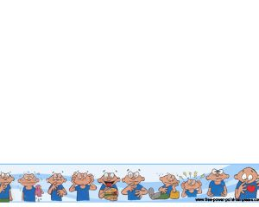
F) Operant conditioning procedures for decreasing maladaptive behavior
Extinction:
Extinction means removal of attention rewards permanently, following a problem behavior. This includes actions like not looking at the patient, not talking to the patient, or having no physical contact with the patient etc, following the problem behavior this is commonly used when patient exhibits all behavior.

Slide 30
2. Time out:
Time out method includes removing the patient from the reward or the reward from the patient for a particular period of time following a problem behavior. This is often used in treatment of childhood disorders. For example, the child is not allowed to go out of the ward to play if he fails to complete the given work.

Slide 31
3. Punishment:
Aversive stimulus (punishment) is presented contingent upon the undesirable response. The punishment procedure should be administered immediately and consistently following the undesirable behavior with clear explanation. Differential reinforcement of an adaptive or desirable behavior should be added when a punishment is being used for decreasing an undesired behavior.

Slide 32
4. Restitution (over-correction):
Restitution means restoring the disturbed situation to a state that is much better than what it was before the occurrence of the problem behavior.
For example, if a patient passes urine in the ward, he would be required to not only clean the dirty area but also mop the entire/larger area of the floor in the ward.

Slide 33
5. Response cost:
This procedure is used with individuals who are on token program for teaching adaptive behavior. When undesirable behavior occurs, a fixed number of tokens or points are deducted from what the individual has already earned.

Slide 34

F) Assertiveness and social skill training
Assertive training is a behaviour therapy technique in which the patient is given training to bring about change in emotional and other behavioural pattern by being assertive. Client is encouraged not to be afraid of showing an appropriate response, negative or positive, to an idea or suggestion.

Slide 35
Assertive behaviour training is given by the therapist, first by role play and then by practice in real life situations. Attention is focused on more effective interpersonal skills. Social skill training helps to improve social manners like encouraging eye contact, speaking appropriately, observing simple etiquette and relating to people.

Slide 36
Role of nurse in behavior therapy:
The continual direct contact with client and due to therapeutic nurse client relationship the nurses are the ideal practitioner to deliver continuous behavioral therapy.
Nursing process and behavior therapy have a lot in common both are client centered and strongly emphasize mutuality.
Be active and directive
Be a consultant
Be a problem solver
Role modeling (observing others’ behavior)
Conduct a thorough functional assessment, formulate initial treatment goals, use strategies for behavior change, evaluate the success of the change, and conduct a follow-up assessment

Slide 37

M.C.Q.
Which are the aspects of behaviour therapy?
Classical Conditioning
Operant Conditioning
Social Learning Approach
Cognitive Behaviour Therapy
All of above
2. Disulfiram drugs used for….
Stop alcohol
Delirium
Schizophrenia
BMD

Slide 38
3. Extinction means….
removing the patient from the reward or the reward
removal of attention rewards permanently
Both
None of above
4. Restitution means….
restoring the disturbed situation to a state that is much better than what it was before the occurrence of the problem behavior.
removing the patient from the reward or the reward
removal of attention rewards permanently
none

Slide 39


