Slide 1

A Seminar on
WOMEN & MENTAL HEALTH
Prepared By:
Patel Bhavisha
Assistant Professor
SNC

Slide 2
Introduction
Every year, about 10 million women endure life-threatening complications during pregnancy and childbirth, sometimes leading to long term disability
Early and unwanted childbearing, HIV and other sexually transmitted infections, and pregnancy-related illnesses and deaths account for a significant proportion of the burden of illness experienced by women especially in low-income countries
Maternal conditions are leading causes of death and disability among women. More than 99 percent of the estimated 536,000 maternal deaths each year occur in the developing world.
1

Slide 3
CONCEPTION
“Conception is the process of fusion of the spermatozoon with mature ovum.” It begins with sperm egg collision and ends with production of a mononucleated single cell called the zygote.
Its objective are:-
To initiate the embryonic development and
To restore the chromosome number of the species
Almost always fertilization occur in the ampullary part of the fallopian tube
2

Slide 4
NORMAL REACTIONS OF WOMEN TOWARDS CONCEPTION
Fear
Anxiety
Worry
3

Slide 5

PREGNANCY
“Pregnancy is defined as the period from conception to the onset of the labor usually it is of 37 weeks.”
4

Slide 6
NORMAL REACTION TO PREGNANCY
1. FIRST TRIMESTER OF PREGNANCY
A. Displays a sense of ambivalence to the pregnancy
B. fantasize about the pregnancy
C. role playing
D. increased concern for financial and social problems
E. decreased interest in sex due to bodily changes
5

Slide 7
2.SECOND TRIMESTER OF PREGNANCY
• The patient develops a sense of well-being
• "Quickening" is experienced
• Changes in sexuality

Slide 8
3.THIRD TRIMASTER OF PREGNANCY
A. Altered self-image
B. Fear
C. aggravation
D. fatigue
E. obsession
F. wondering

Slide 9
MENTAL HEALTH PROBLEMS DURING PREGNANCY
Eating disorders
• Anorexia nervosa
• Bulimia nervosa
• Binge eating disorder
Anxiety
Bipolar disorder
Depression
Mania (or manic episode)
Obsessive–compulsive disorder (OCD)
Panic disorder
Post-traumatic stress disorder (PTSD)
Psychosis and schizophrenia
6

Slide 10


Anorexia nervosa

Slide 11


Bulimia nervosa

Slide 12

Binge eating disorder

Slide 13
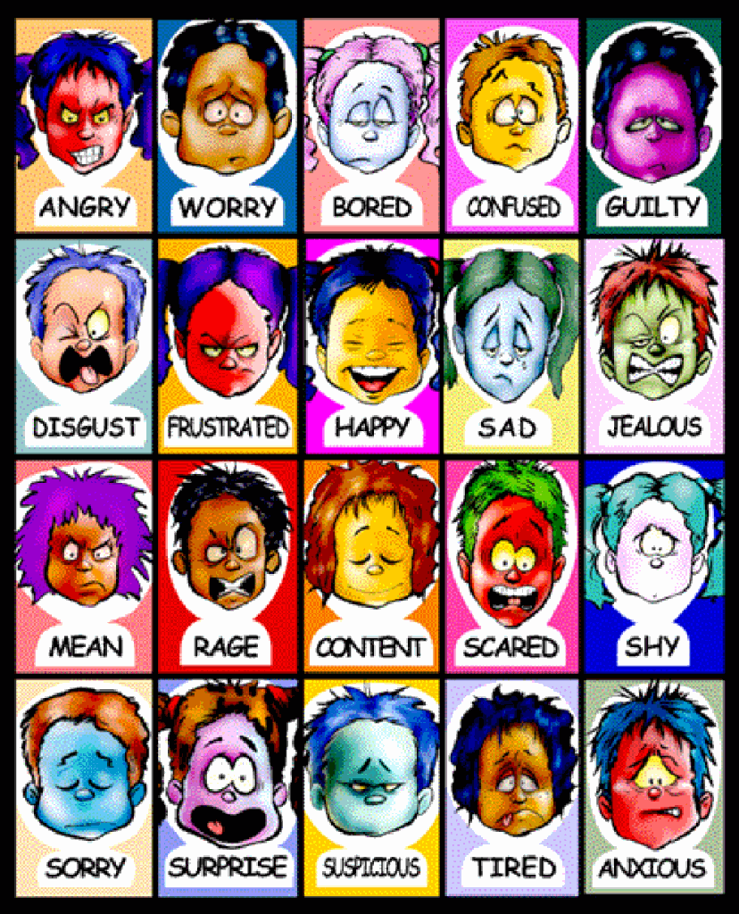

Slide 14

Depression

Slide 15
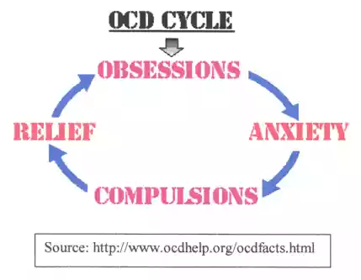
Obsessive compulsive disorder

Slide 16

Post-traumatic stress disorders

Slide 17

Psychosis

Slide 18

Electroconvulsive therapy

Slide 19
TREATMENT OF PSYCHIATRIC DISORDERS DURING PREGNANCY
Specific concerns
Psychotropic medications readily cross the placenta. The following factors must be considered before starting psychotropic medications
1. Teratogenesis
2. Toxicity to the neonate
3. Neurobehavioral sequelae
4. Risk of no treatment
5. Risk of medication discontinuation
7

Slide 20
PHARMACOTHERAPEUTIC AGENTS DURING PREGNANCY
Major depression
Bipolar disorder
Anxiety disorders
Psychotic disorders
Electro-convulsive therapy (ECT)
8

Slide 21
PUERPERIUM
Puerperium is the period following childbirth during which the body tissues, specially the pelvic organs revert back approximately to the pre pregnant state both anatomically and physiologically. The woman is termed as a puerperal.
9

Slide 22
PSYCHIATRIC DISORDERS DURING PUERPERIUM
Postpartum blues
Postpartum depression
Postpartum psychosis (schizophrenia)
10

Slide 23

COUNCELLING
Premarital councelling
Marital councelling
Genetics councelling
11

Slide 24

Premarital councelling

Slide 25
PREMARITAL COUNCELING
Pre-marital counseling, like any couples counseling, is usually facilitated by a skilled family therapist, (and sometimes members of the clergy). The function of pre-marital counseling is two-fold:
1. To assist couples in developing skills to navigate their way through marriage successfully
2. To identify (and if possible resolve) areas of difference between couples that may become a source of conflict later.

Slide 26
Many professionals performing pre-marital counseling will use assessment tools to help identify these potential difficulties.
Perhaps the most commonly used instrument is the Pre Marital Inventory (PMI) available to clinicians and clergy through Intercommunications Publishing.
The PMI addresses the following areas, all common discussion grounds in pre-marital counseling.

Slide 27
Role Expectations
• Personal Adjustment
• Interpersonal Communication
• Religion and Philosophy
• Marriage Expectations
• Family Issues
• Finances
• Children (and Parenting)
• Sexuality

Slide 28
When Should a Couple Seek Pre-Marital Counseling?
When you are young and have never been married
When one partner is “commitment-phobic”
When a couple cannot resolve significant issues (if a couple has disagreements regarding money, parenting, household responsibility, work, sex, etc. the time to resolve them is before marriage)
When one or both partners have a previously failed marriage and want to avoid repeating the same mistakes

Slide 29
Additional reasons to enter pre-marital counseling may include
• Difficulty handling conflict: No marriage tool box is complete (nor can any marriage survive) without strong conflict resolution skills.
• History of childhood abuse or domestic violence: Abuse, unfortunately, has been correlated with higher rates of divorce.

Slide 30
Other Considerations in Preparing for Marriage
Other Considerations in Preparing for Marriage
Educate yourself on marriage in general. Browse the internet or your local bookstore for information on marriage and relationships.
If blending families, couples may want to prepare for the transition by following the Help for Blended Families Steps to Success as well as developing a Parenting Plan.

Slide 31
Marriage, and family, can be among life's greatest assets. If we strive to protect assets that mean less to us than our loved ones, why not explore the issues ahead of time to "damage-proof" the precious gift of marriage

Slide 32
MARITAL COUNCELLING
Marriage counseling, also called couples therapy, is a type of psychotherapy.
Marriage counseling helps couples of all types recognize and resolve conflicts and improve their relationships.
Through marriage counseling, you can make thoughtful decisions about rebuilding your relationship or going your separate ways.
Marriage counseling is often provided by licensed therapists known as marriage and family therapists.
These therapists have graduate or postgraduate degrees — and many choose to become credentialed by the American Association for Marriage and Family Therapy (AAMFT).

Slide 33
WHY IT'S DONE
Marriage counseling can help couples in all types of intimate relationships — heterosexual or homosexual, married or not.
Some couples seek marriage counseling to strengthen their bonds and gain a better understanding of each other.
Marriage counseling can also help couples who plan to get married. This pre-marriage counseling can help couples achieve a deeper understanding of each other and iron out differences before marriage.

Slide 34
In other cases, couples seek marriage counseling to improve a troubled relationship. You can use marriage counseling to address many specific issues, including:
* Communication problems
* Sexual difficulties
* Conflicts about child rearing or blended families
* Substance abuse
* Financial problems
* Anger
* Divorce

Slide 35
Relationship counselor or couple's therapist
The basic principles for a counselor include:
• Provide a confidential dialogue, which normalizes feelings
• To enable each person to be heard and to hear themselves
• Provide a mirror with expertise to reflect the relationship's difficulties and the potential and direction for change
• Empower the relationship to take control of its own destiny and make vital decisions
• Deliver relevant and appropriate information
• To foster a secure attachment between partners.

Slide 36
Common core principles of relationship counseling and couple's therapy are:
Respect
Empathy
Tact
Consent
Confidentiality
Accountability
Expertise
Evidence based
Certification, ongoing training and supervision

Slide 37
In both methods, the practitioner evaluates the couple's personal and relationship story as it is narrated, interrupts wisely, facilitates both de-escalation of unhelpful conflict and the development of realistic, practical solutions.
The practitioner may meet each person individually at first but only if this is beneficial to both, is consensual and is unlikely to cause harm.
Individualistic approaches to couple problems can cause harm.
The counselor or therapist encourages the participants to give their best efforts to reorienting their relationship with each other.
One of the challenges here is for each person to change their own responses to their partner's behavior.

Slide 38

Genetic councelling

Slide 39
Genetic counselors
A genetic counselor is a medical genetics expert with a Master of Science degree.
Genetic counselors are expert educators, skilled in translating the complex language of genomic medicine into terms that are easy to understand.
Genetic counselors work as members of a health care team and act as a patient advocate as well as a genetic resource to physicians.
Genetic counselors provide information and support to families who have members with birth defects or genetic disorders, and to families who may be at risk for a variety of inherited conditions.

Slide 40
Conti…..
They identify families at risk, investigate the problems present in the family, interpret information about the disorder, analyze inheritance patterns and risks of recurrence, and review available genetic testing options with the family.
Genetic counselors are present at high risk or specialty prenatal clinics that offer prenatal diagnosis, pediatric care centers, and adult genetic centers.
Genetic counseling can occur before conception through to adulthood .

Slide 41
Patients
Any person may seek out genetic counseling for a condition they may have inherited from their biological parents.
A woman may be referred for genetic counseling if pregnant and undergoing prenatal testing or screening.
Genetic counselors educate the patient about their testing options and inform them of their results.
If a prenatal screening or test is abnormal, the genetic counselor evaluates the risk of an affected pregnancy, educates the patient about these risks and informs the patient of their options.

Slide 42
A person may also undergo genetic counseling after the birth of a child with a genetic condition.
In these instances, the genetic counselor explains the condition to the patient along with recurrence risks in future children.
In all cases of a positive family history for a condition, the genetic counselor can evaluate risks, recurrence and explain the condition itself.

Slide 43
Amniocentesis
Amniocentesis, first performed in 1967, is a procedure which is performed by obstetricians to help identify chromosomal and genetic abnormalities which may be present in fetuses.

Slide 44
MCQ:
1. The process of fusion of the spermatozoon with mature ovum is called as….
Pregnancy
Conception
Puerperium
None of above
2. Why women may have fear toward conception?
women is unmarried
painful experience and complicated process
Economical conditions
unknown sex of the baby that it may be boy or girl
All of above

Slide 45
3. In which trimester of pregnancy mother is fantasized about pregnancy?
First trimester
Second trimester
Third trimester
None
4. What do you mean by obsession?
Becomes tired easily
Concerned with delivery
Patient wonders what kind of parent she will be
None of above

Slide 46
5. An illness in which a person keeps their body weight very low by dieting, vomiting or exercising excessively is called as….
Anorexia nervosa
Bulimia nervosa
Binge eating disorders
None of above
6. In which conditions women having visual flashbacks, nightmares, frightening memories?
Psychosis
PTSD
Depression
anxiety

Slide 47
7. In which condition women is having thoughts of harming their infants rarely?
Panic disorder
Obsession
Mania
Depression
8. Feelings of panic or anxiety is called as…..
PTSD
Depression
Agoraphobia
Mania

Slide 48
9. Clinical manifestation of postpartum blues?
Negative feelings
Insomnia
Anxiety
All of above
10. How many women are suffers from postpartum blues?
40%
20%
50%
70%

Slide 49
11. Clinical manifestation of postpartum depression?
Social withdrawl
Irritability
Suicidal attitude
All of above
12. Postpartum depression observed in?
5-10%
10-20%
20-25%
15-20%

Slide 50
13. Clinical manifestation of postpartum psychosis?
Fear
Restless
Confusion
All of above
14. Assist couples in developing skills to navigate their way through marriage successfully is the counseling of…….
Genetic counselling
Marital counselling
Premarital counselling
None

Slide 51
15. AAMFT stands for
Assisted American for marriage and family therapy
Associated American for marriage and family therapy
American associated for marriage and family therapy
American associated for music and family therapy

Slide 52
Thank u……….!
24

