Slide 1
DELIRIUM, DEMENTIA AND AMNESTIC DISORDER
PREPARED BY:-
Sweety raval

Slide 2
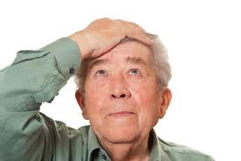
INTRODUCTION:
Cognitive disorders include those in which a clinically significant deficit in cognition or memory exists, representing a significant change from a previous level of functioning.

Slide 3
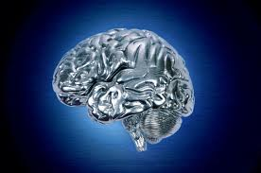
DELIRIUM
DEFINITION:
Delirium is a mental state characterized by a disturbance of cognition, which is manifested by confusion, excitement, disorientation, and clouding of consciousness.
Hallucinations and illusions are common.

Slide 4
PREDISPOSING FACTORS:
1. Delirium due to a general medical condition
2. Substance-induced delirium
3. Substance-intoxication delirium
4. Substance-withdrawal delirium
5. Delirium due to multiple etiologies

Slide 5

Delirium Due to a General
Medical Condition
systemic infections
metabolic disorders
fluid or electrolyte imbalances
hepatic or renal disease
thiamine deficiency
postoperative states
hypertensive encephalopathy
postictal states
head trauma

Slide 6
Substance-Induced Delirium
This disorder is characterized by the symptoms of delirium that are attributed to medication side effects or exposure to a toxin.
anaesthetics, analgesics, antiasthmatic agents, anticonvulsants, antihypertensive and cardiovascular medications, antimicrobials, antiparkinsonian drugs, corticosteroids, lithium, muscle relaxants, and psychotropic medications with anticholinergic side effects.
volatile substances such as fuel or organic solvents.

Slide 7
Substance-Intoxication Delirium
With this disorder, the symptoms of delirium may arise within minutes to hours after taking relatively high doses of certain drugs such as cannabis, cocaine, and hallucinogens. It may take longer periods of sustained intoxication to produce delirium symptoms with alcohol, anxiolytics, or narcotics (APA, 2000).

Slide 8
Substance-Withdrawal Delirium
Withdrawal delirium symptoms develop after reduction or termination of sustained, usually high-dose use of certain substances, such as alcohol, sedatives, hypnotics, or anxiolytics (APA, 2000).
The duration of the delirium is directly related to the half-life of the substance involved and may last from a few hours to 2 to 4 weeks.

Slide 9
Delirium Due to Multiple Etiologies
This diagnosis is used when the symptoms of delirium are brought on by more than one cause.
For example, the delirium may be related to more than one general medical condition or it may be a result of the combined effects of a general medical condition and substance use (APA, 2000).

Slide 10
CLINICAL FINDINGS:
Disturbance of consciousness
Inability to maintain attention
Disorganized thinking
Slurred speech
Reduced reasoning ability and goal oriented activity
Disorientation
Autonomic manifestations
Sleep disturbances
Fluctuating Psychomotor Activity
Emotional instability

Slide 11

MEDICAL TREATMENT MODALITIES
The first step in the treatment of delirium should be the determination and correction of the underlying causes.
Additional attention must be given to fluid and electrolyte status, hypoxia, anoxia, and diabetic problems.
Staff members should remain with the client at all times to monitor behaviour and provide reorientation and assurance.

Slide 12
CONT…
The room should maintain a low level of stimuli. Safe environment should be provided.
Decreasing patients fear and anxiety.
Meeting physical need.
Low-dose neuroleptics are the pharmacological treatment of choice in most cases. A benzodiazepine (e.g., lorazepam) is commonly used when the etiology is substance withdrawal.

Slide 13

AMNESTIC DISORDERS

Slide 14
Definition:
Amnesia
The inability to retain or recall past experiences. The condition may be temporary or permanent, depending on etiology.

Slide 15
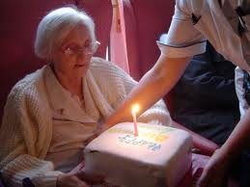
CLINICAL FINDINGS:
An inability to learn new information (short-term memory deficit) despite normal attention.
An inability to recall previously learned information (long-term memory deficit).
Events from the remote past often are recalled more easily than recently occurring ones.
The syndrome differs from dementia in that there is no impairment in abstract thinking or judgment, no other disturbances of higher cortical function, and no personality change.

Slide 16
Cont.…
Profound amnesia may result in disorientation to place and time, but rarely to self. The individual may engage in confabulation—the creation of imaginary events to fill in memory gaps.
Apathy, lack of initiative, and emotional bland- ness are common.
The person may appear friendly and agreeable, but the emotionality is superficial.

Slide 17
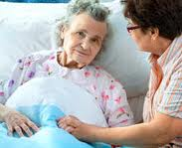
PREDISPOSING FACTORS
1. Amnestic disorder due to a general medical condition
2. Substance-induced persisting amnestic disorder

Slide 18
General medical conditions that may be associated with amnestic disorder include:
head trauma
cerebrovascular disease
cerebral neoplastic disease
cerebral anoxia
herpes simplex encephalitis
poorly controlled insulin- dependent diabetes
surgical intervention to the brain

Slide 19
SUBSTANCE-INDUCED PERSISTING AMNESTIC DISORDER
In this disorder, evidence must exist from the history, physical examination, or laboratory findings that the memory impairment is related to the persisting effects of substance use (e.g., a drug of abuse, a medication, or toxin exposure; APA, 2000).
The term persisting is used to indicate that the symptoms exist long after the effects of substance intoxication or withdrawal have subsided.

Slide 20
DEMENTIA:

Slide 21
DEFINITION:
Dementia is defined by a loss of previous levels of cognitive, executive, and memory function in a state of full alertness.

Slide 22
EPIDEMIOLOGY:
This disorder constitutes a large and growing public health problem.
Scientists estimate that 4.5 million people currently have Alzheimer’s disease (AD),
one in ten people age 65 and older, one in five ages 75 to 85, and one in two age 85 and older.
After heart disease and cancer, AD is the third most costly disease to society

Slide 23
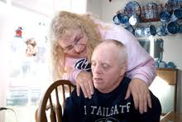
CLASSIFICATION:
Primary dementias are those, such as AD, in which the dementia itself is the major sign of some organic brain disease not directly related to any other organic illness.
Secondary dementias are caused by or related to another disease or condition, such as human immunodeficiency virus (HIV) disease or a cerebral trauma.

Slide 24
CLINICAL FINDINGS
Impairment is evident in abstract thinking, judgment, and impulse control.
The conventional rules of social conduct are often disregarded.
Behaviour may be uninhibited and inappropriate.
Personal appearance and hygiene are often neglected.
Language may or may not be affected.

Slide 25
In severe forms of dementia, the individual may not speak at all.
The client may know his or her needs but may not know how to communicate those needs to a caregiver.
Personality change is common in dementia and may Be manifested by either an alteration of premorbid characteristics.

Slide 26
Stages of Dementia
Stage 1: Early Stage (2-4 Years)
Forgetfulness
Declining interest in environment
Hesitancy in initiating actions
Poor performance at work
Stage 2: Middle Stage (2-12 Years)
Progressive memory loss
Hesitates in response to question
Has difficulty in following simple instructions
Irritable, Wandering, Neglects personal hygiene and Social Isolation

Slide 27
Stage 3: Early Stage (Up to a Year)
Marked weight loss due to inadequate intake of food
Unable to communicate
Does not recognize family
Incontinence of urine and feces
Looses ability to stand and walk
Death due to aspiration pneumonia

Slide 28
PREDISPOSING FACTORS
1. Dementia of the Alzheimer’s type
2. Vascular dementia
3. Dementia due to HIV disease
4. Dementia due to head trauma
5. Dementia due to Lewy body disease
6. Dementia due to Parkinson’s disease
7. Dementia due to Huntington’s disease
8. Dementia due to Pick’s disease
9. Dementia due to Creutzfeldt–Jakob disease
10. Dementia due to other general medical conditions
11. Substance-induced persisting dementia
12. Dementia due to multiple etiologies

Slide 29
DEMENTIA OF THE ALZHEIMER’S TYPE
The onset of symptoms is slow and insidious, and the course of the disorder is generally progressive and deteriorating.
The categorizes this disorder as
early onset (first symptoms occurring at age 65 or younger)
late onset (first symptoms occurring after age 65)

Slide 30
Examination by CT scan and MRI
It reveals a degenerative pathology of the brain that includes atrophy, widened cortical sulci, and enlarged cerebral ventricles

Slide 31
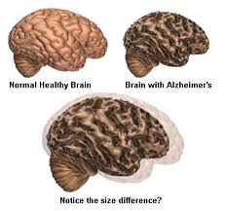

Slide 32
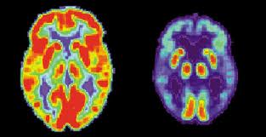
Etiology
Exact cause is unknown but some hypotheses have been supported by varying amounts and quality of data

Slide 33
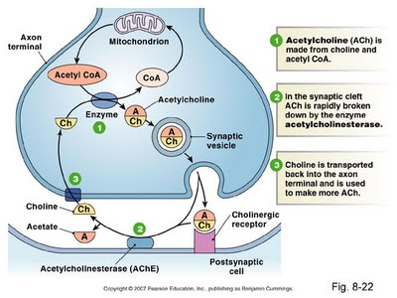
Acetylcholine alteration

Slide 34
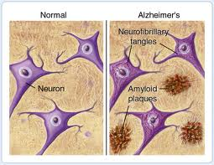
Plaques and tangles

Slide 35
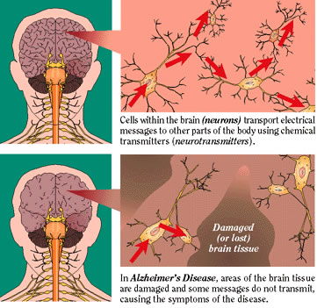
Head trauma

Slide 36
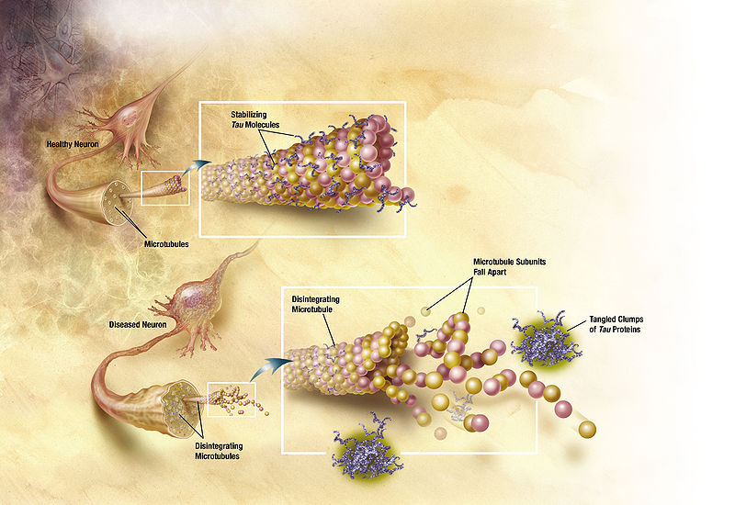
Genetic factors

Slide 37
VASCULAR DEMENTIA
In vascular dementia, the clinical syndrome of dementia is due to significant cerebrovascular disease. The blood vessels of the brain are affected, and progressive intellectual deterioration occurs. Vascular dementia is the second most common form of dementia, ranking after AD.
Vascular dementia differs from AD in that it has a more abrupt onset and runs a highly variable course.

Slide 38
Clinical findings
Progression of the symptoms occurs in “steps”
At times the dementia seems to clear up and the individual exhibits fairly lucid thinking.
Memory may seem better
Client may become optimistic that improvement is occurring, only to experience further decline of functioning in a fluctuating pattern of progression.
This irregular pattern of decline appears to be an intense source of anxiety for the client with this disorder.

Slide 39
DEMENTIA DUE TO HIV
Infection with the HIV-1 produces a dementing illness called HIV- 1–associated cognitive/motor complex (also called HIV Associated Dementia [HAD]).
The immune dysfunction associated with HIV disease can lead to brain infections by other organisms, and the HIV-1 also appears to cause dementia directly.
In the early stages, neuropsychiatric symptoms may be manifested by barely perceptible changes in a person’s normal psychological presentation.

Slide 40
Severe cognitive changes, particularly confusion, changes in behaviour, and sometimes psychoses, are not uncommon in the later stages.

Slide 41
DEMENTIA DUE TO HEAD TRAUMA
Serious head trauma can result in symptoms associated with the syndrome of dementia.
Amnesia is the most common neurobehavioral symptom following head trauma, and a degree of permanent disturbance may persist.
Repeated head trauma, such as the type experienced by boxers, can result in dementia pugilistica, a syndrome characterized by emotional lability, Dysarthria, ataxia, and impulsivity.

Slide 42
DEMENTIA DUE TO LEWY BODY DISEASE
Clinically, Lewy body disease is fairly similar to AD; however, it tends to progress more rapidly, and there is an earlier appearance of visual hallucinations and parkinsonian features.
This disorder is distinctive by the presence of Lewy bodies—eosinophilic inclusion bodies—seen in the cerebral cortex and brainstem.
These patients are Highly sensitive to extrapyramidal effects of antipsychotic medications.
The disease is progressive and irreversible, and may account for as many as 25 percent of all dementia cases.

Slide 43
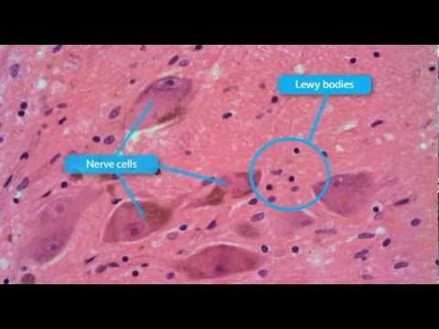

Slide 44
DEMENTIA DUE TO PARKINSON’S DISEASE
Dementia is observed in as many as 60 percent of clients with Parkinson’s disease.
In this disease, there is a loss of nerve cells located in the substantia nigra, and dopamine activity is diminished, resulting in involuntary muscle movements, slowness, and rigidity.
Tremor in the upper extremities is characteristic.
In some instances, the cerebral changes that occur in dementia of Parkinson’s disease closely resemble those of AD.

Slide 45
DEMENTIA DUE TO HUNTINGTON’S DISEASE
Huntington’s disease is transmitted as a Mendelian dominant gene. Damage is seen in the areas of the basal ganglia and the cerebral cortex.
The onset of symptoms (i.e., involuntary twitching of the limbs or facial muscles; mild cognitive changes; depression and apathy) is usually between age 30 and 50 years.
The client usually declines into a profound state of dementia and ataxia.

Slide 46
DEMENTIA DUE TO PICK’S DISEASE
The cause of Pick’s disease is unknown, but a genetic factor appears to be involved.
The clinical picture is strikingly similar to that of AD.
One major difference is that the initial symptom in Pick’s disease is usually personality change, whereas the initial symptom in AD is memory impairment.
Studies reveal that pathology of Pick’s disease results from atrophy in the frontal and temporal lobes of the brain, in contrast to AD, which is more widely distributed.

Slide 47
DEMENTIA DUE TO CREUTZFELDT–JAKOB DISEASE
Creutzfeldt–Jakob disease is an uncommon neurodegenerative disease caused by a transmissible agent known as a “slow virus” or prion.
Five to 15 percent of cases have a genetic component.
The clinical presentation is typical of the syndrome of dementia, along with involuntary movements, muscle rigidity, and ataxia.
Symptoms may develop at any age in adults, but typically occur between ages 40 and 60 years.
The clinical course is extremely rapid, with progressive deterioration and death within 1 year.

Slide 48
DEMENTIA DUE TO OTHER MEDICAL CONDITIONS:
It include endocrine conditions (e.g., hypoglycaemia, hypothyroidism), pulmonary disease, hepatic or renal failure, cardiopulmonary insufficiency, fluid and electrolyte imbalances, nutritional deficiencies, frontal or temporal lobe lesions, central nervous system (CNS) or systemic infections, uncontrolled epilepsy, and other neurological conditions such as multiple sclerosis.

Slide 49
SUBSTANCE-INDUCED PERSISTING DEMENTIA
1. Alcohol
2. Inhalants
3. Sedatives, hypnotics, and anxiolytics
4. Medications: Anticonvulsants, Intrathecal methotrexate
5. Toxins: Lead, Mercury, Carbon monoxide, Organophosphate insecticides, Industrial solvents

Slide 50
Medical management
Tacrin hydrochloride
Donepezil hydrochloride
Antipsychotics – Risperidone and Haloperidol
Benzodiazepines
Antidepressants
Anticonvulsants

Slide 51
Nursing Diagnosis
Risk for trauma
Disturbed thought process
Disturbed sensory perception
Risk for other-directed violence
Impaired verbal communication
Self care deficit
Situational low self -esteem

Slide 52
THANK YOU

