Slide 1
Schizophrenia –treatment modalities
Raval Sweety

Slide 2
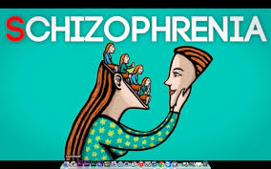
It is a psychotic
condition characterized by disturbance in thinking, emotions, volitions in the presence of clear consciousness which usually leads to social withdrawal.

Slide 3
Treatment Modalities :
Category | Trade Name | Daily Dosage
Typical antipsychotic agent | Chlorpromazine | 40-400
 | Fluphenazine | 2.5-10
 | Haloperidol | 1-100
 | Loxapine | 20-250
 | Perphenazine | 12-64
 | Pimozide | 1-10
 | Prochloperazine | 15-150
 | Thioridazine | 150-800
 | Thiothixene | 6-30
 | Trifluoperazine | 4-40
Pharmacotherapy:

Slide 4
Atypical antipsychotic agent | Aripiprazole | 10-30
 | Asenapine | 10-20
 | Clozapine | 300-900
 | Iloperidone | 12-24
 | Lurasidone | 40-80
 | Olanzapine | 5-20
 | Paliperidone | 6-12
 | Quetiapine | 300-400
 | Risperidone | 4-8
 | Ziprasidone | 40-160

Slide 5
Mechanism of action
Antipsychotic drugs block D2 receptors in the mesolimbic and mesofrontal systems concerned with emotional reactions.
Typical antipsychotics work by blocking postsynaptic dopamine receptors in the basal ganglia, hypothalamus, limbic system, brainstem, and medulla.

Slide 6
Atypical antipsychotic are weaker dopamine receptor antagonists than the conventional antipsychotics
but are more potent antagonists of the serotonin receptors.
They also exhibit antagonism
for
cholinergic , histamine and adrenergic receptors.

Slide 7

Pharmacokinetics
Antipsychotic when administered orally are absorbed variably from the gastrointestinal tract, with uneven blood levels.
They are metabolized in the liver, and excreted through kidneys.

Slide 8
CONTRAINDICATION

Slide 9

Severely depressed patient

Slide 10


Slide 11
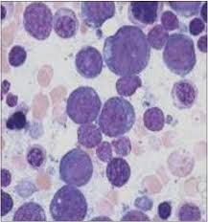
agranulocytosis

Slide 12

cardiac arrhythmia

Slide 13
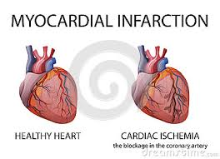

Slide 14

Autonomic side effect
Dry mouth

Slide 15
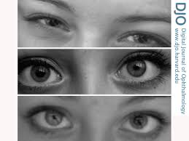
Mydriasis

Slide 16
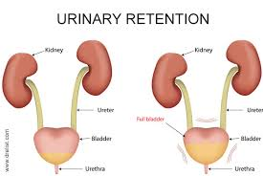
Urinary retention

Slide 17
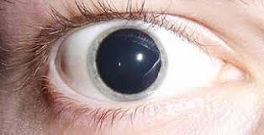
cycloplegia

Slide 18
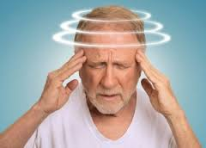
Orthostatic hypotension

Slide 19
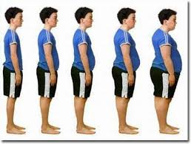
Weight gain

Slide 20
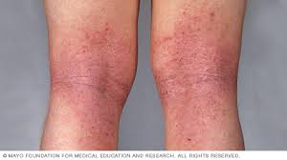
Dermatological effects

Slide 21
Impotence and impaired ejaculation
Constipation
Lactation

Slide 22
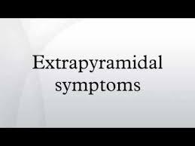
Adverse Effect of antipsychotic drugs
Extra pyramidal symptoms :
These are serious neurologic symptoms and major side effects of antipsychotic drugs.
Blockade of D2 receptors in the midbrain region of the brainstem is responsible for development of EPS.

Slide 23

Conventional antipsychotics drugs cause a greater incidence of EPS than do atypical antipsychotic drugs

Slide 24
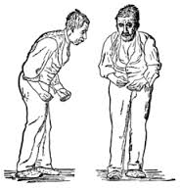
Neuroleptic –induced parkinsonism : Symptoms include
rigidity,
tremors, bradykinesia, stooped posture, drooling, akinesia, ataxia etc.
The disorder can be treated with anticholinergic agents.

Slide 25
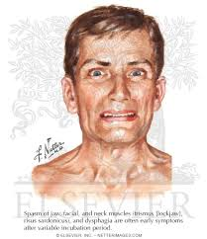
Acute dystonia :
It leads to involuntary movement.
Dystonia can involve the neck, jaw, tongue and the entire body.
There is also involvement of eyes leading to upward lateral movement of the eyes known as oculogyric crisis.

Slide 26
Dystonia can be prevented by
anticholinergics
antihistamines
dopamine agonists
beta-adrenergic antagonists
benzodiazepine etc.

Slide 27

Akathisia:
It is a subjective feeling of muscular discomfort that can cause patients to be agitated, restless and feel generally dysphoric.
It can be treated with propranol, benzodiazepine and clonidine.

Slide 28
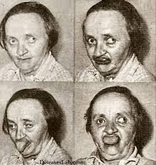
Tardive dyskinesia:
It is a delayed adverse effect of antipsychotics.
It consists abnormal, irreregular choreoathoid
movements of the muscles of the head, limbs and trunk.
It is characterized by chewing, sucking, grimacing and perioral movements.

Slide 29
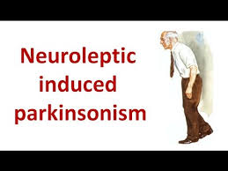
Neuroleptic malignant syndrome : This is a rare but serious disorder which includes
severe motor
mental and autonomic side effects.
Creatinine level may be increased & WBC also increased.

Slide 30
Other features may include
pneumonia,
thromboembolism,

Slide 31
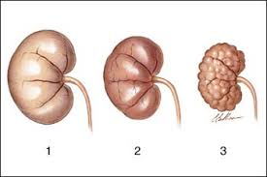
renal failure

Slide 32
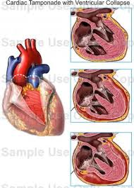
cardiovascular collapse

Slide 33

Stiffness
akinetic mutism
stupor or impaired consciousness.
Hyperpraxia includes unstable blood pressure

Slide 34
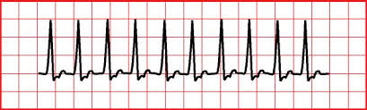
Tachycardia,
Excessive sweating,
Salivation
Urinary incontinence.

Slide 35

Psychological Treatment
Individual Psychotherapy
These include
Problem solving
Reality testing
Psychoeducation
Supportive and
cognitive-behavioral techniques

Slide 36
Successful intervention may be achieved with honesty
simple directness
respects client’s privacy and human dignity.
Exaggerated warmth and professions of friendship are likely to be met with confusion and suspicion.

Slide 37
Therapeutic interpersonal relationship
has been established - reality orientation is maintained.
Education is provided to help the client identify sources of real or perceived danger and ways of reacting appropriately.

Slide 38

Group therapy
It is effective, particularly with outpatients and when combined with drug treatment.
It focuses on real-life plans, problems, and relationships.
It is effective in
reducing social isolation

Slide 39
Increasing the sense of cohesiveness
improving reality testing for patients with schizophrenia.
Group therapy in inpatient settings is less productive.

Slide 40
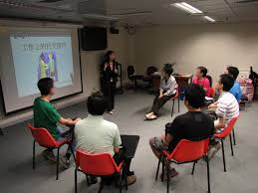
Inpatient treatment usually occurs when symptomatology and social disorganization are at their most intense.
It has been most useful over the long-term course of the illness.

Slide 41
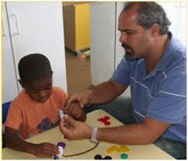
Behaviour Therapy
Behaviour modification has a history of qualified success in
Reducing the frequency of bizarre, disturbing, and deviant behaviours and increasing appropriate behaviours.

Slide 42

It includes :
Clearly defining goals and how they will be measured.
Attaching
positive, negative
Aversive reinforcements to adaptive and maladaptive behaviour.

Slide 43
Using simple, concrete instructions
prompts to elicit the desired behaviour.
Behaviour therapy can be a powerful treatment tool for helping clients change undesirable behaviours.

Slide 44
In the treatment setting
The healthcare provider can use praise and other positive reinforcements to help the client with schizophrenia reduce the frequency of maladaptive or deviant behaviours.

Slide 45

Social Skills Training
Social dysfunction is a hallmark of schizophrenia
It leads to enhancement of social skills in clients.
The educational procedure in social skills training focuses on role-play.

Slide 46
A series of brief scenarios are selected.
typical of situations clients experience in their daily lives graduated in terms of level of difficulty.
Immediate feedback is provided regarding the client’s presentation.
Progress is geared toward the client’s needs and limitations.

Slide 47
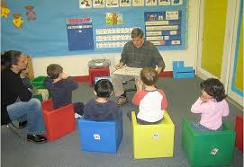
The focus is on small units of behavior, and the training proceeds very gradually.
Highly threatening issues are avoided and emphasis
is placed on functional skills that are relevant to activities of daily living.

Slide 48

Social Treatment
Milieu Therapy
Most milieu therapy programs emphasize
group and social interaction
rules and expectations are mediated by peer pressure for normalization of adaptation

Slide 49
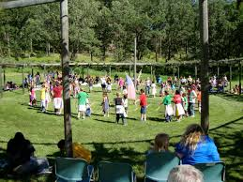
Milieu therapy includes
a patient’s rights to goals and to have freedom of movement and informal relationship with staff
It also emphasizes interdisciplinary participation and goal-oriented, clear communication.

Slide 50
Individuals with schizophrenia who are treated with milieu therapy alone require longer hospital stays than do those treated with drugs and psychosocial therapy.

Slide 51
Limitation of high staff-to-client ratio, in addition to the longer admission, limit the use of milieu therapy
The milieu environment can be successfully employed in
outpatient settings, however, such as day and partial hospitalization programs.

Slide 52

Family Therapy
If the families appear to cope well, then
It is a notable impact on the mental health status of relatives when a family member has the illness.
The importance of the expanded role of family in the aftercare of relatives with schizophrenia has been recognized.

Slide 53
Thereby stimulating interest in family intervention programs
Designed to support the family system, prevent or delay relapse, and help to maintain the client in the community.
These psychoeducational programs treat the family as a resource rather than a stressor, with the focus on concrete problem solving and specific helping behaviors for coping with stress.

Slide 54

Family therapy typically consists of a brief program of family education about schizophrenia
a more extended program of family contact designed to reduce overt manifestations of conflict and to alter patterns of family communication and problem solving.

Slide 55
Assertive Community Treatment
Assertive Community Treatment (ACT) is a program of case management
Team approach in providing comprehensive, community-based psychiatric treatment, rehabilitation
Support to persons with serious and persistent mental illness such as schizophrenia.

Slide 56

Assertive programs of treatment are individually tailored for each client and include the
Teaching of basic living skills
Helping clients work with community agencies
assisting clients in developing a social support network

Slide 57
There is emphasis on vocational expectations, and supported work settings (i.e., sheltered workshops) are an important part of it.
Other services include substance abuse treatment, psychoeducational programs, family support and education, mobile crisis intervention, and attention to healthcare needs

Slide 58
Responsibilities are shared by
multiple team members, including psychiatrists, nurses, social workers, vocational rehabilitation therapists, and substance abuse counselors.
Services are provided in the person’s home; within the neighborhood; and in local restaurants, parks, stores, or wherever assistance by the client is required.
These services are available to the client 24 hours a day, 365 days a year.

Slide 59
The National Alliance for the Mentally Ill (NAMI; 2007) lists the primary goals of ACT as follows:
To meet basic needs and enhance quality of life
To improve functioning in adult social and employment roles
To enhance an individual’s ability to live independently in his or her own community

Slide 60
To lessen the family’s burden of providing care
To lessen or eliminate the debilitating symptoms of mental illness
To minimize or prevent recurrent acute episodes of the illness
It has been shown to reduce the number of hospitalizations and decrease costs of care for these clients

Slide 61

Nursing Management / Roll of Nurse
Nurse’s Responsibility for a patient receiving antipsychotics
To relieve dryness of mouth
Take sips of water frequently

Slide 62

High fibre diet
increased fluid intake and laxatives if needed, help to reduce constipation
Applying glycerine on lips

Slide 63


Frequent mouth wash Use of chewing gum

Slide 64

Advise the patient to get up from the bed or chair very slowly.
Patient should sit on the edge of the bed for one full minute dangling his feet, before standing up.
Check BP before and after medication given.

Slide 65
Important measure to prevent falls
other complications resulting from orthostatic hypotension.
Change of drug - side-effects are severe.
Administer antiparkinsonian drugs as prescribed
Observe the patients regularly for abnormal movements.
Take all seizure precautions.

Slide 66
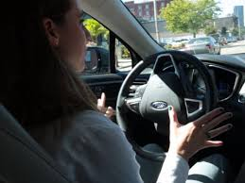
Patient should be warned about driving a car or operating machinery when first treated with antipsychotics
Giving the entire dose at bedtime usually eliminates any problem from sedation.

Slide 67

Advise the patient to use sunscreen measures.
Teach the importance of drug compliance side-effects of drugs and reporting if too severe, regular follow-ups.

Slide 68
Monitor TC,DC, Stop the drug if the WBC count drops to less than 3000/mm3 of blood. The patient should also be told to report if sore throat or fever develop, which might indicate infection.
Seizure precaution should also be taken as clozapine reduces seizures threshold. The dose should be regulated carefully

Slide 69
Give reassurance and reduce unfounded fears and anxieties.
A patient receiving clozapine is at risk for developing agranulocytosis.
The patient may also be put on anticonvulsants such as eptoin.

Slide 70

NURSING PRIORITIES
It includes :
1. Promote appropriate interaction (reality orientation) between client and environment.
2. Enhance physiologic stability /health maintenance medication compliance.

Slide 71

3. Provide protection ensure safety needs. (Anosonasia (lack of insight) is a persistent, negative symptom.)
4. Encourage family/ significant other to become involved in activities to promote independent, satisfying lives.

Slide 72
Nursing diagnosis
Disturbed thought process, related to inability to trust, panic anxiety, possible hereditary or biochemical factors evidenced by delusional thinking, extreme suspiciousness of others.

Slide 73
Ineffective health maintenance related to inability to trust, extreme suspiciousness evidenced by poor diet intake, inadequate food and fluid intake, difficulty in falling asleep.

Slide 74
Self-care deficit related to withdrawal, regression, panic anxiety, cognitive impairment, inability to trust, evidenced by difficulty in carrying out tasks associated with hygiene, dressing, grooming, eating, sleeping and toileting.

Slide 75
Potential for violence, self-directed or at others related to command hallucinations evidenced by physical violence, destruction of objects in the environment or self-destructive behaviour.
Risk for self-inflicted or life-threatening injury related to command hallucinations evidenced by suicidal ideas, plans or attemps.

Slide 76
Disturbed sensory-perception related to panic anxiety, possible hereditary or biochemical factors evidenced by inappropriate responses, disordered thought sequencing, poor concentration, disorientation, withdrawn behaviour.

Slide 77
Social isolation related to inability to trust, panic anxiety, delusional thinking, evidenced by withdrawl,sad, dull affect, preoccupation with own thoughts, expression of feelings of rejection of aloneness imposed by others.
Impaired verbal communication related to panic anxiety, disordered, unrealistic thinking, evidenced by loosening of associations, echolalia, verbalizations that reflect concrete thinking and poor eye contact.

Slide 78
Ineffective family coping related to highly ambivalent family relationship, impaired family communication, evidenced by neglectful care of patient, extreme denial or prolonged over-concerned regarding his illness.

Slide 79


