Slide 1
Community mental health nursing
BY – BELA PATEL
CLINICAL INSTRUCTOR
SUMANDEEP NURSING COLLEGE

Slide 2

INTRODUCTION
application of specialized knowledge to populations and communities to promote and maintain mental health, and to rehabilitate populations at risk that continue to have residual effects of mental illness.

Slide 3
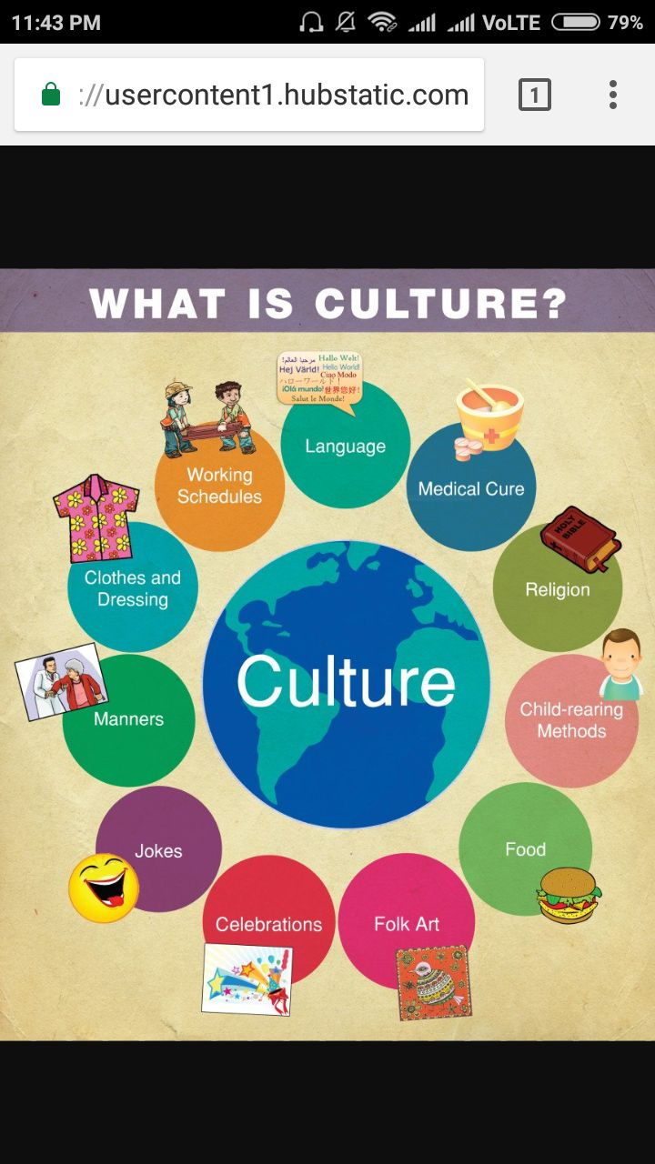
Community Mental Health Nurse Attributes
Awareness of self, personal and cultural values
Non-judgmental attitude
Flexibility
Problem solving skills
Ability to cross service systems
Knowledge of community resources
Willingness to work with family
Understanding of the social, cultural and political issues that affect mental health and illness
Knowledge of political activism

Slide 4


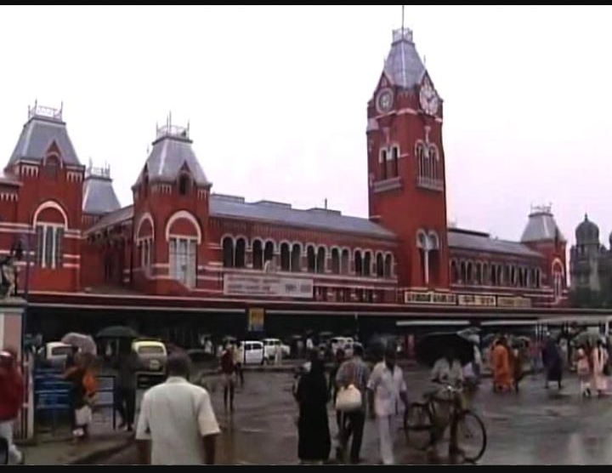
DEVELOPMENT OF COMMUNITY MENTAL HEALTH IN INDIA
institutional treatment and the use of allopathic medicine were introduced by the European rulers.
PHASE 1
colonial period prior to independence.
mental asylum established
1^{Sst} - Bombay (1745)
2nd - Calcutta (1781)
3rd - madras
4th - Bihar.
bihar
madras

Slide 5
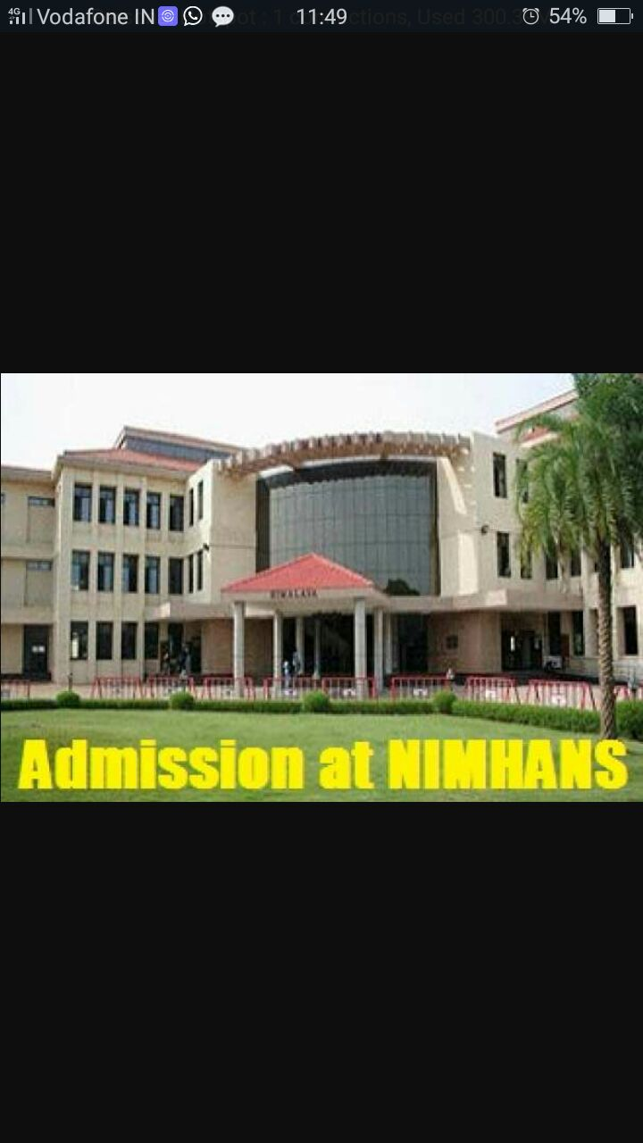
2nd phase
Developed when break in delivery of mental care
1954 NIMHANS – Bangalore
This phase referred to as era of mental hospital as mental health care services centered around the mental hospital.

Slide 6
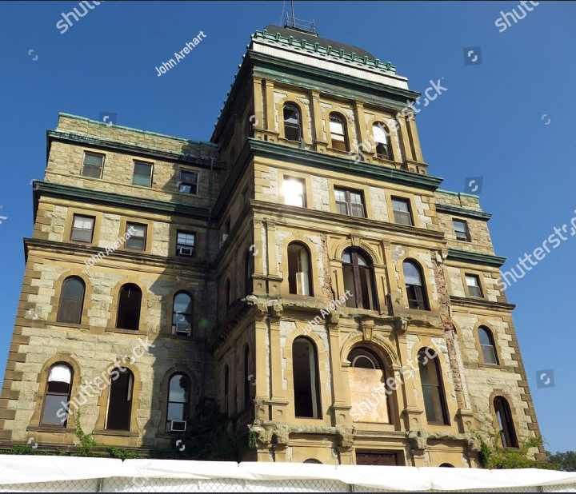
3rd Phase
began in the mid 1960s
establishment of general hospital psychiatric units
1st - Bombay and culcutta in 1933

Slide 7
4th phase
Development of psychiatric services from mental hospital and general hospital to the primary health centers and the community
Adopt NMHP in 1982

Slide 8
5th phase
voluntary and non-governmental organization talking an active interest in various aspect of mental health
increasing number of persons with various minor mental disorders are beginning to seek mental health care services

Slide 9
Goals Of Community Mental Health Nursing
Identify factors that affect interation with their environmentt
Provide prevention activities
Develop innovative approach
Provide intervention earlier
Develop sense of self-worth & independence
Education about mental health

Slide 10
COMMUNITY MENTAL HEALTH NURSING PROCESS
Assessment
Intervention

Slide 11
roles for nurses working in community mental health services:
Consultative role
Clinician role
Therapeutic role
researcher role
Educator

Slide 12
Trainer
Manager
Domiciliary careh (Home care )
Liaison role(beneficial relationships)
Preventive roles

Slide 13
Psychiatric rehabilitation
Rehabilitation is the process of enabling the individual to return to his highest possible level of functioning.
It is an important component of the community mental health program, and is undertaken at the level of tertiary prevention.

Slide 14




Disorders that indicated commonly for rehabilitation
Organic mental disorder
Alcohol dependence
Mental retardation

Slide 15
Principles of Rehabilitation
Increasing independence
Improvement of capabilities and competence of clients with psychiatric problems.
Maximum use must be made of residual capacities.
Patient's active participation is very essential.
Skill development, therapeutic environment are fundamental interventions for a successful rehabilitation process.

Slide 16
Psychiatric Rehabilitation Approaches
Psycho education
Working with families
Group therapy
Social skills training

Slide 17

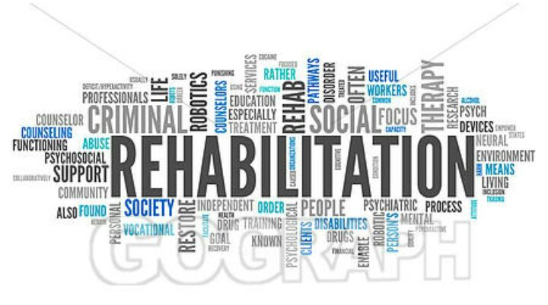


recreational therapist
Psy. Social worker
Occupational therapist
counsellor
Team

Slide 18
Steps in Psychiatric Rehabilitation
Reduction of impairments
Remediation of disabilities through skill training
Remediating disabilities through supportive interventions
Remediation of handicaps

Slide 19
Role of a Nurse in Psychiatric Rehabilitation
assessment
planning
Intervention
evaluation

Slide 20

VOCATIONAL REHABILITATION
continuous and coordinated process of rehabilitation which involves the provision of those vocational services designed to enable a disabled person secure and retain suitable employment.

Slide 21
Phases in Vocational Rehabilitation
Vocational
assessment
Vocational counseling
Vocational training
Job exploration
Jobplacement
Follow-up

Slide 22
MENTAL HEALTH SERVICIES
Primary level
Psychiatric Hospitals/ Nursing Homes
Sub
centers
Primary Health Centers
Community Mental Health Centers

Slide 23
2. Secondary Level
General hospital Psychiatric Unit
Govt and private psychiatric Hospitals
Voluntary Organization

Slide 24
Tertiary Level
Rehabilitation Centers
Voluntary Organization
Non-governmental mental health organization

Slide 25
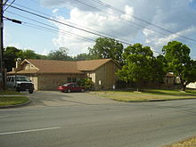
MENTAL HEALTH SERVICIES AVAILABLE FOR PSYCHIATRIC PATIENT
Partial hospitalization:

Slide 26
Main day care centres in India
Sanjivini, New Delhi
• SCARF (Schizophrenia Research Foundation), Chennai, has started a day care center called "BAVISHYA"in 1985
• Association of the Friends of Mentally Ill, Mumbai
• Institute of Mental Health, Ahmedabad
• Psychiatric Center, Kolkata
• NIMHANS, Bangalore
• Krupamayie Institute of Mental Health, Miraj
• Anugraha Day Care Center, Chennai
• The Richmond Fellowship Society,Bangalore

Slide 27
Quarter way homes

Slide 28
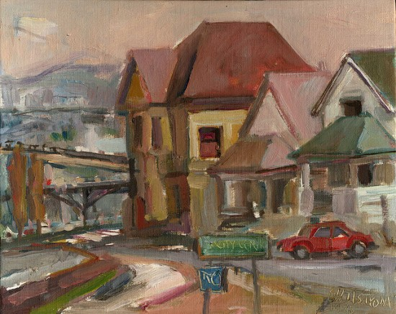
Halfway home
It is a Transitory residential center for mentally ill patients who no longer need the full services of a hospital, but are not yet ready for a completely independent living.
major role in the rehabilitation of the mentally ill individual.
Objectives
To ensure a smooth transition from the hospital to the family.
To integrate the individual into the mainstream of life.
Activities
in monitoring the progress of discharged patients

Slide 29

Some of the halfway homes available in India include:
Medico-Pastoral Association, Bangalore
• Atmashakti Vidyalaya, Bangalore
• Richmond Fellowship, Bangalore
• Puraskara Aftercare Home, Bangalore
• Cadabam's Home for the Mentally Disabled, Bangalore
• Family Fellowship Society for Psychosocial Rehabilitation, Bangalore
• Raju Rehabilitation Foundation, Bangalore
• YWCA Halfway Home for Mentally Ill, Chennai
• Dr. Boaz's Rehabilitation Center, Chennai
• Dr. Dhairyan's Psychotherapy and Rehabilitation Center, Chennai
• Sowkya Halfway Home at Madurai
• Delhi Psychosocial Rehabilitation Society
• Paripurnata Halfway Home, West Bengal
• Societyfor Mental Health, Kerala

Slide 30
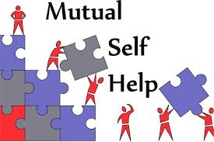
SELF-HELP GROUPS
People who are trying to cope with a specific problem or life crisis, and have improved the emotional health and well being of many people. Usually organized with a particular task in mind, such groups do not attempt to explore individual psychodynamics in great depth or to change personality functioning significantly.

Slide 31


Suicide prevention centres
Helping Hands in Bangalore
Sneha in Chennai
Sahara in Mumbai
Sanjivini and Sumaitri in New Delhi

Slide 32

INTERNATIONAL MENTAL HEALTH AGENCIES
World Health Organization(WHO)
WHO defines mental health as not simply absence of disease but a positive state of physical, mental health concerns to prevent and control mental disorders.
One of the important recommendations of WHO has been to develop community based mental health care program.

Slide 33
2. The United Nations Educational Scientific and Cultural Organization(UNESCO)
Arranged the use of satellites for educational and mental health purposes.
It helps in the training of scientists as in the development of scientific research in developing countries.

Slide 34
The world federation for mental Health(WFMH)
It was established in 1948 as an organization and individuals concerned with mental health.
Its purpose is to promote co-operation at the international level between governmental, non-governmental mental health agencies and its membership has now extended to more than 50 countries.
.
The goals of WFMH are as follows:
To promote mental health and optimal functioning.
To prevent mental, neurological and psychosocial disorders.
To heighten public awareness about the importance of mental health.
To improve the care and treatment of those with mental, neurological and psychosocial disorders.

Slide 35
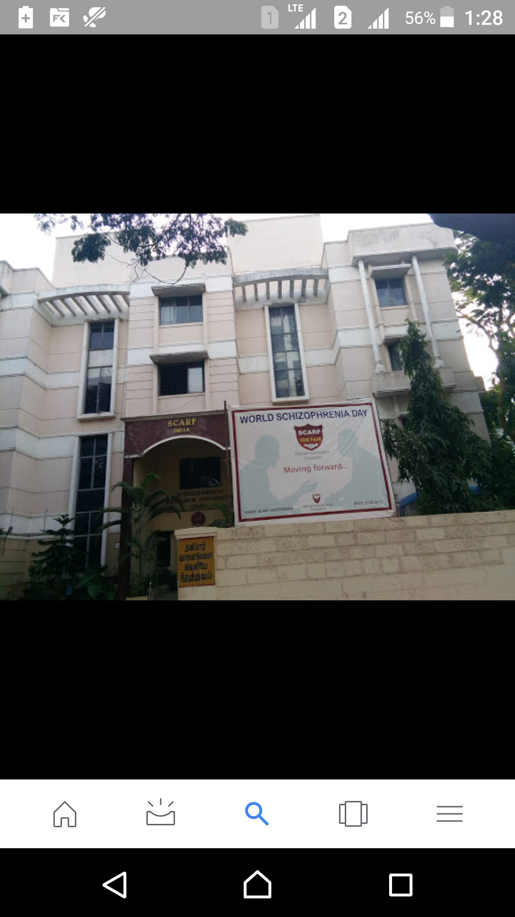
The internal society for mental health online(ISMO)
It is a non-profit organization formed in 1997 to promote the understanding, use and development of online communication information and technology for the international mental health community.
The archive serves as a valuable resources for researchers, clinicians and ordinary people interested in the topic of online mental health.

Slide 36
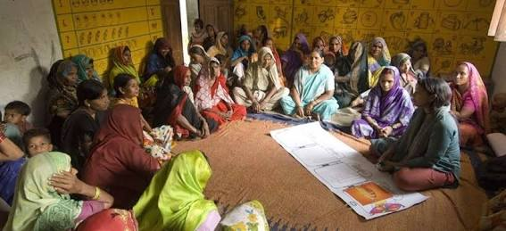
National alliances for the mentally ill(NAMI)
It is a non profit self-help, support and advocacy organization of consumers, families and friends of people with severe mental illness.

Slide 37
Thank you

