Slide 1
Eating Disorders
BY- BELA PATEL
CLINICAL INSTRUCTOR
SUMANDEEP NURSING COLLEGE

Slide 2
INTRODUCTION
Eating disorders are complex conditions that arise from a combination of long-standing behavioral, emotional, psychological, interpersonal, and social factors.

Slide 3
What are they?
People with eating disorders often use food and the control of food in an attempt to compensate for feelings and emotions that may otherwise seem over-whelming.
For some, dieting, bingeing, and purging may begin as a way to cope with painful emotions and to feel in control of one’s life, but ultimately, these behaviors will damage a person’s physical and emotional health, self-esteem, and sense of competence and control.

Slide 4
Disorders
Anorexia Nervosa
Bulimia
Binge Eating Disorder

Slide 5
Anorexia Nervosa
Women suffering from anorexia nervosa have an irrational fear of becoming obese, a preoccupation or with their weight and food, a distorted body-image, persistently starve themselves and deny their appetites.

Slide 6
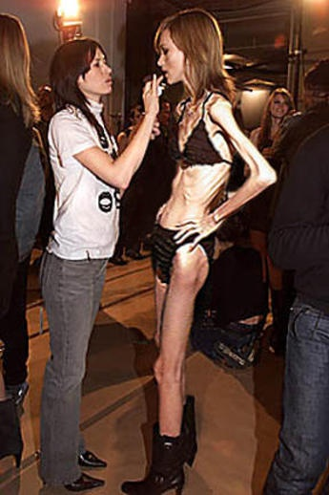

Slide 7
Anorexia Nervosa: Those with anorexia nervosa (often just referred to as anorexia) have a distorted body image causing them to see themselves as overweight even when they're dangerously thin. They refuse to eat, exercise compulsively, and develop unusual eating habits such as refusing to eat in front of others; they lose large amounts of weight and may even starve to death.

Slide 8
Definition
Anorexia nervosa is characterized by highly specific behavior and psychological symptoms and significant somatic signs.

Slide 9
Etiology
Genetic:
  Among female siblings of patients established anorexia nervosa 6-10% people.
Disturbance in the hypothalamic function
Social factors:
  High in the female students and in the occupational groups, influence of mass media and beauty contests.

Slide 10
Individual psychological factors:
  Disturbance in the body image.
  Low self-esteem
  Perfectionism.
Cause with in the family:
  Disturbance in the family relationship
  Over-protection.

Slide 11
Clinical manifestations
Intense fear of become obese.
Body wt is 15% below the standard Weight.
Body image disturbances ( The person unable to perceive the body image accurately)
Patient eat little and set their calories themselves.
Signs related to starvation (Cold, constipation, low blood pressure, hypothermia amenorrhea)

Slide 12
Vomiting and abuse of laxatives may leads to electrolyte imbalance and hypokalemia.
Hormonal abnormality.
Psychological findings (Preoccupation with body size and description of themselves as fat.)

Slide 13
Complication
Malnutrition .
Dehydration and electrolyte imbalance.
Increased chance of infection.
Hypoalbuminemia.
Chronic inflammatory bowel disease.
Esophageal erosion and ulcer.
Amenorrhea.
Cardiovascular complication.

Slide 14
Diagnostic evaluation
Physical examination
CBC (Hemoglobin levels, platelet count, Cholesterol level, protein, calcium, sodium and potassium.
ECG
Rule out substance abuse and anxiety disorder.

Slide 15
TREATMENT
The treatment is in two phases which merge into each other.
short term treatment to ensure weight gain and correct nutritional deficiencies if any .
long term treatment aimed at maintaining the near normal weight achieved in short term treatment and preventing relapses.

Slide 16
DRUGS
  Neuroleptic
  Appetite stimulants
  Antidepressant
BEHAVOIUR THERAPY
This is based on providing positive reinforcements contingent on weight gain by the patient. The gain in weight should not exceed 1.5 kg-2 kg in a fortnight . occasionally forceful ryle’s tube feeling may be needed initially in resistant patients.
INDIVIDUAL PSYCHOTHERAPY
It is often successful.

Slide 17
GROUP THERAPY AND FAMILY THERAPY
These methods are used to educate the patient and her family about anorexia nervosa and its treatment.

Slide 18
Nursing interventions
Maintain I/O chart.
Monitor status of skin and mucous membranes.
Encourage the patient to ventilate the feelings.
Encourage the family participation.
Avoid discussing food and weight.
Hospitalization.

Slide 19
Eating must be supervised by the nurse.
Advise for early treatment.
Monitor the weight and serum electrolyte level regularly.
Control vomiting by making bathroom in accessible for 2 hours after food.
Gavage feeding.

Slide 20
Bulimia nervosa
Bulimia nervosa is characterized by episodes of Binge-eating followed by feeling of guilt and depressed.
Frequent binging (Consuming abnormally large portion of food within the specific period)
Involving recurrent use of compensatory measures to (Such as self induced vomiting, Diuretics or laxative use, dieting, and fasting).

Slide 21
etiology
Common in first degree of biological relatives.
Altered Serotonin level.
Society emphasis on appearance and thinness.
Family disturbances or conflict.
Sexual abuse
Learned maladaptive behavior.
Struggle for control and self identity.

Slide 22
Clinical manifestation
Persistent sore throat, heart burn.
Callused or scarring on back of hands and knuckles.
Tooth staining or discoloration and loss of dental enamel.
History of eating amount of food larger than the regular food.
During Binge-eating episodes, sense of lack of control.
Thin, normal and slightly overweight.

Slide 23
Abdominal and epigastric pain
Amenorrhea
Fluid and electrolyte imbalance.
Perfectionism
Distorted body image.
Exaggerated sense of guilt.
Feeling of alienation.
Poor impulse control.

Slide 24
complication
Gastric rupture during the period of binge eating.
Dental caries, erosion of tooth enamel and gum infection.
Dehydration and electrolyte imbalance.
Irregular bowel movements and constipation from laxative use.
Increased risk of suicide and psychoactive substances.

Slide 25
diagnosis
Rule out the upper gastrointestinal disorder
Depression inventory
History
Serum electrolytes and ECG

Slide 26
treatment
Psychotherapy
TCAs and SSRIs
Self help group
And hospitalization.

Slide 27
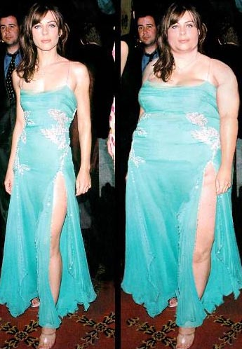
Binge Eating Disorder
Characterized primarily by periods of uncontrolled, impulsive, or continuous eating beyond the point of feeling comfortably full.
While there is no purging, repetitive diets and often feelings of shame.
People who overeat compulsively may struggle with anxiety, depression, and loneliness, which can contribute to their unhealthy episodes of binge eating.
Body weight may vary from normal to mild, moderate, or severe obesity.

Slide 28
NURSING DIAGNOSIS
The following are the nursing diagnosis is encountered in the care of patients with eating disorders.
Imbalanced nutrition less than body requirements related to excessive intake of calories as evidenced by being 40% above idea body weight sleep apnea and difficulty with mobility.

Slide 29
Body image disturbance related to fear of weight gain as evidence by verbalization of being fat while actually being 30% below ideal body weight
Fluid volume deficit related to purging as evidenced by weakness ,hypokalemia and hypotension .
Anxiety related to fear of weight gain as evidenced by rituals associated with food preparation and eating .
Ineffective individual coping related to rumination , fear of intensity of feelings , guilt .
Powerlessness related to percieved lack of control over eating behaviors as evidenced by inability to stop binge eating and avoidance of food related setting .

Slide 30
Self esteem disturbance related to feelings of low self worth as evidence by verbalization of sole standard of success being related to physical attraction .
Risk for self – mutilation related to feelings of inadequacy as evidenced by injuries caused by excessive exercise .

Slide 31
Thank you

